Slide 1
Atomic-absorption spectroscopy
Lab no. 3
Done by : Iman Al Ajeyan

Slide 2
Introduction
In analytical chemistry, Atomic absorption spectroscopy (AAS) is a technique for determining the concentration of a particular metal element (e.g.Fe, Cu, Al, Pb, Ca, Zn)in a sample ( water, medicine, food) . Atomic absorption spectroscopy can be used to analyze the concentration of over 62 different metals in a solution.

Slide 3
Technique
Atomic-absorption (AA) spectroscopy uses the absorption of light to measure the concentration of gas-phase atoms. Since samples are usually liquids or solids, the analyte atoms must be vaporized or atomized in a flame or graphite furnace.

Slide 4
Steps
The steps are involved in turning a liquid sample into an atomic gas:
Desolvation – the liquid solvent is evaporated, and the dry sample remains.
Vaporisation– the solid sample vaporises to a gas.
Volatilization: The compounds making up the sample are broken into free atoms.

Slide 5
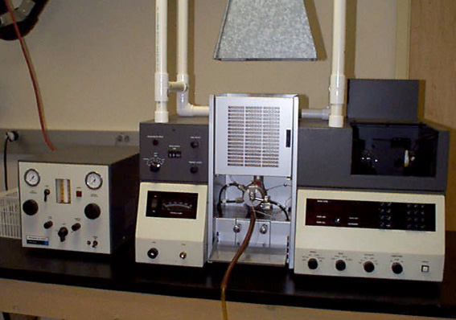
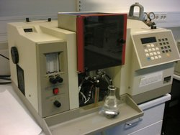
Instrumentation

Slide 6
Light Source: Hollow Cathode Lamp
The light that is focused into the flame is produced by a hollow cathode lamp. Inside the lamp is a cylindrical metal cathode containing the metal for excitation, an anode and inert gas. When a high voltage is applied across the anode and cathode, the metal atoms in the cathode are excited into producing light with a certain emission spectrum.

Slide 7
The type of hollow cathode tube depends on the metal being analyzed. For analyzing the concentration of copper, a copper cathode tube would be used, and likewise for any other metal being analyzed.

Slide 8
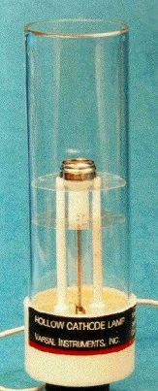

Slide 9
Atomizer
AA spectroscopy requires that the analyte atoms be in the gas phase. Ions or atoms in a sample must undergo desolvation and vaporization in a high-temperature source such as a flame or graphite furnace.
Flame AA can only analyze solutions, while graphite furnace AA can accept solutions, slurries, or solid samples.

Slide 10
Flame AA uses a slot type burner to increase the path length, and therefore to increase the total absorbance (see Beer-Lambert law). Sample solutions are usually aspirated with the gas flow into a nebulizing/mixing chamber to form small droplets before entering the flame.

Slide 11
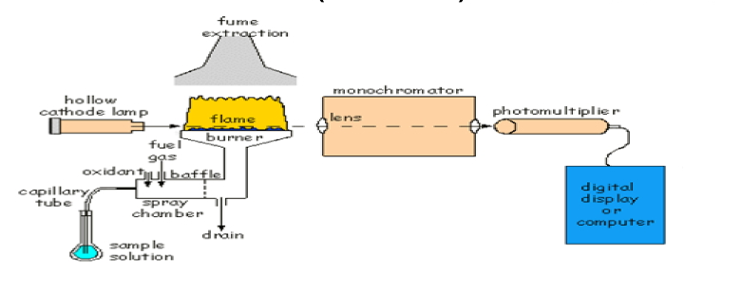

Slide 12
Flame
Different temperatures required for different elements
Air-Acetylene flame
Preferred flame for 35 elements
Temperature of 2300 C
Nitrous Oxide-Acetylene flame
Temperature of 2900 C

Slide 13
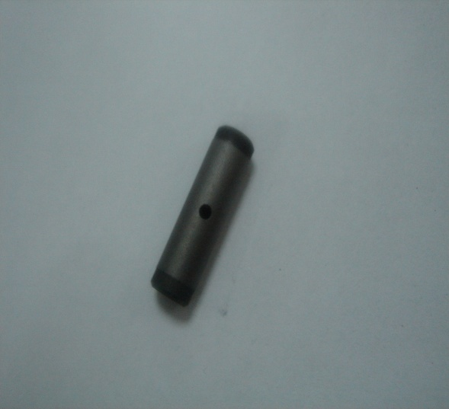
The graphite furnace has several
advantages over a flame. It is a much
more efficient atomizer than a flame
and it can directly accept very small
absolute quantities of sample.
Samples are placed directly in the graphite furnace and the furnace is electrically heated in several steps to dry the sample, ash organic matter, and vaporize the analyte atoms.

Slide 14
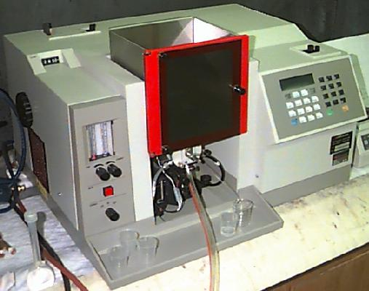
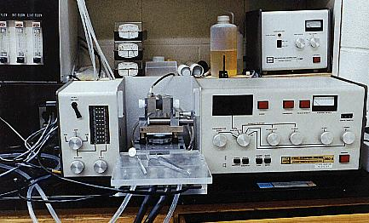
a flame atomic-absorption spectrometer
a graphite-furnace atomic-absorption spectrometer:

Slide 15
Monochromator
Which is set to isolate the radiation at the specified wavelength and travels into the detector.

Slide 16
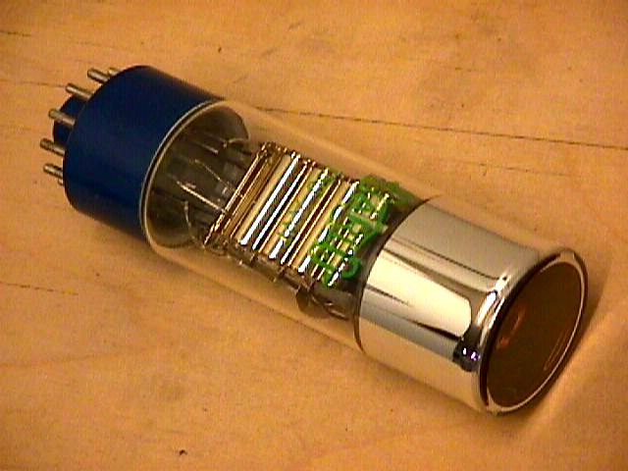
Detector
Photo multiplier tube
Extremely sensitive
Can detect single photons
Measures the intensity of the beam of light. When some of the light is absorbed by metal, the beam's intensity is reduced. The detector records that reduction as absorption. That absorption is shown on output device by the data system

Slide 17
Schematic of an atomic-absorption experiment

Slide 18
We can find the concentrations of a sample running a series of calibration standards through the instrument. By plotting the absorption versus the concentrations of the standards, a calibration curve can be plotted. We can then look at the absorption for a sample solution and use the calibration curves to determine the concentration of a sample.

