Slide 1
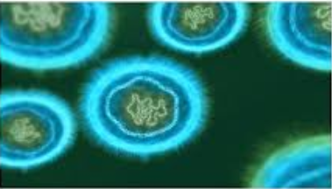
CLS 311 Basic Microbiology Lect 9: Bacterial Genatics

Slide 2
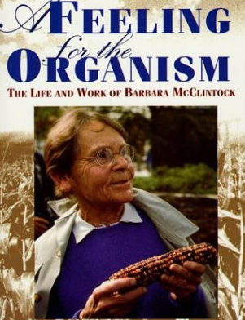
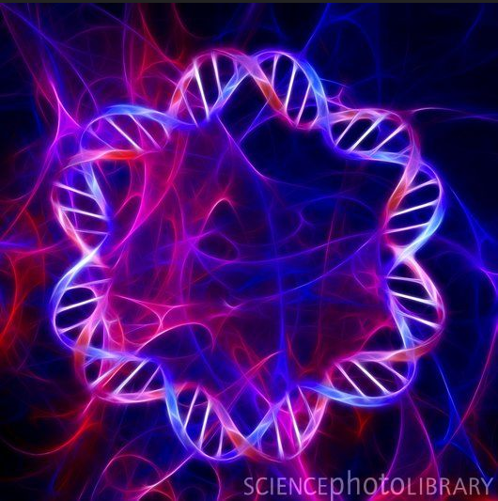
History
Barbara McClintock (1902-1992).
In 1983, at age of 81, McClintock received the Nobel Prize in Medicine or Physiology largely for her discovery 40 years earlier of transposable elements, or transposons, popularly called “jumping genes”

Slide 3
Facts
In 1970 the usual treatment for Stpahylococcusaureus infections in penicillin-like antibiotics.
In 2003 over 60% of S.aureus strains isolated in hospitals ere resistant to this antibiotics.
In 2002 the situations became more worrisome, when a S.aureus isolated from foot ulcers on a diabetes patient in Detroit was vancomycin-resistant.

Slide 4

The Question
How do multiple resistant strains arise and evolve??
How are these resistance traits transferred so readily to other bacteria.

Slide 5
DIFINITIONS
GENOTYPE:
The sequence of nucleotides in the DNA of an organism.
PHENOTYPE:
Observable characteristics of a cell resulting from expression of the genotype. (also influenced by environmental conditions)
HAPLOID:
Containing only a single set of genes. (there is no “backup copy” of the gene.

Slide 6
Genetic Change Occur by 2 Mechanisms:
MUTATION (vertical gene transfer):
Change in the existing nucleotide sequence of a cell’s DNA which is then passed on to daughter cells.
GENE TRANSFER (horizontal gene transfer):
The acquisition of genes from another organism.
(the cell acquires DNA from different source)

Slide 7
In both mutation and gene transfer the changes in DNA are passed to the progeny of the altered organism.

Slide 8
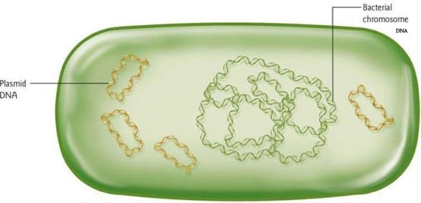
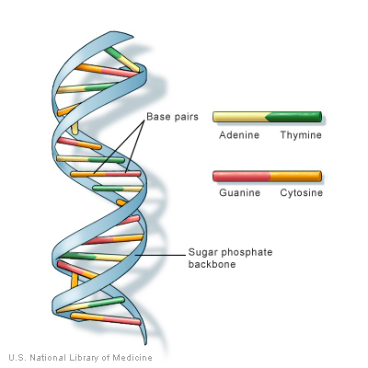
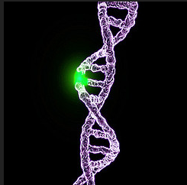

Slide 9
MUTATION
To understand mutation we will discuss the following:
Spontaneous mutations:
Induced mutations:
Repair of damaged DNA
Mutant selection.

Slide 10
Spontaneous Mutations
They occur in the cell’s natural environment.
They occur randomly.
Each gene will mutate spontaneously and infrequently at a characteristic rate.
The chance that two given mutations will occur within the same cell is very low.
Mutations are stable so that the progeny of a mutant will retain the genotype.

Slide 11
Spontaneous Mutations
Because of mutations, the concept that all cells arising form a single cell are identical is not strictly true, since every large population contains mutants.
Even in a single colony that contains about 1 million cells, all cells are not completely identical because of spontaneous random mutations.
This is called natural selection, the environment dose not cause the mutation but rather selects those cells that can grow under its conditions.

Slide 12
Mutants in nature are important because they are the raw material on which natural selection operates.

Slide 13
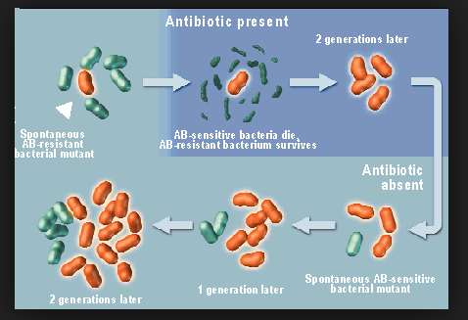
Spontaneous Mutations

Slide 14
Spontaneous Mutations
It can happen by:
Base Substitution.
It is the most common type of mutation , it occurs during DNA synthesis, when an incorrect base is incorporated into DNA.

Slide 15
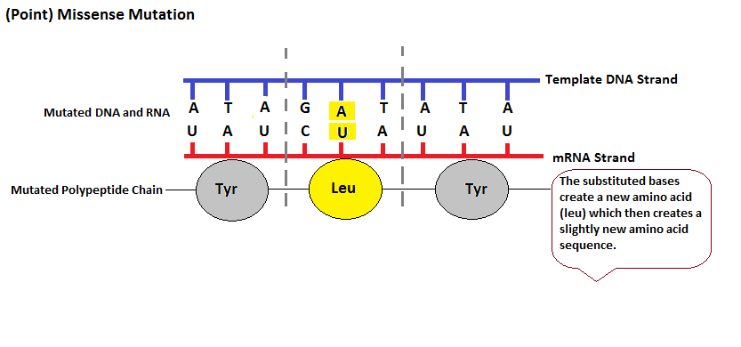
Base Substitution.

Slide 16
Base Substitution.
Three outcomes are possible:
Silent mutation: the nucleotide change generates a codon that still specifies the same amino acid.
Missense mutation: the new codon specifies a different amino acid. the effect of this type will depend on the position of the change and the difference between the original and the new a.a.
Nonsense mutation: the new codon is a stop codon and in most cases the protien is non-functional

Slide 17
Spontaneous Mutations
Removal or Addition of Nucleotides.
The consequence of this depends on how many nucleotides are deleted or added.
E.g. if 3 nucleotides are deleted or added → one codon is removed or (added) in the DNA → one a.a. is added or removed from a protein.
How serous this change is; depends on the location of the change in the encoded protein.

Slide 18
Removal or Addition of Nucleotides
Adding or subtracting 1 or 2 nucleotides is more significant than adding or subtracting 3 because it cause frameshift mutations.
This change the reading frame, so that an entirely different set of codons is used.
And frequently one of the resulting codons will be a stop codon and the result will be non-functional protein.

Slide 19
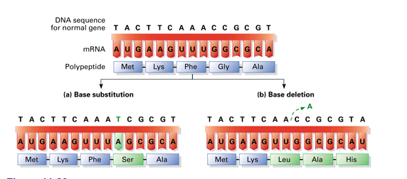

Slide 20
Spontaneous Mutations
Transposable Elements (Jumping Genes = transposons):
Inside a single cell, a transposon can “jump” to a different location within the chromosome, or to a plasmid, or vice versa.
Most transposons contain transcriptional terminators that stop mRNA synthesis.

Slide 21
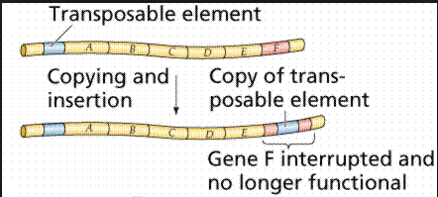
Transposable Elements (Jumping Genes = transposons):

Slide 22
Why do we study genetics in bacteria???
They grow rapidly, especially E.coli.
It is cheap.
Thus rare mutations will be represented in a small volume of medium.
Bacteria are haploid thus it is easy to spot the mutation.

Slide 23
Induced Mutations
Because the frequency of spontaneous mutations is so low.
Thus to study mutation investigators use mutagens that can increase the frequency of mutations at least, 1000 fold.
Such mutations are called induced mutations.

Slide 24
Induced Mutations
MUTAGENS:
Chemicals mutagens.
Transposition.
Radiation

Slide 25
Induced Mutations
Chemical mutagens:
Alkylating agents:
Chemicals that add alkyl groups onto purines and pyrimidines their by altering their hydrogen-bonding properties.
Base analogs:
They are compounds that structurally resemble purine or pyrimidine bases that they can be mistakenly incorporated in place of the natural bases. Usually the analog will bind with the wrong base as the complementary strand is being synthesized.

Slide 26
Induced Mutations
Chemical mutagens:
Intercalating agents:
They increase the frequency of frame shift mutations. They insert, or intercalate, between adjacent base pairs. This pushes the nucleotides apart, producing enough space between bases that errors are made during replication.
Example of such chemcials
Ethidium bromide → DNA stain
Chloroquine→ drug to treat malaria

Slide 27
Induced Mutations
MUTAGENS:
Chemicals mutagens.
Transposition.
Radiation

Slide 28
Induced Mutations
Transposition:
To introduce a transposon into a cell.
The gene into witch the transposon has inserted will usually be inactivated.
Radiation:
They cause several types of damage to the DNA. The radiation used are Ultraviolet light and X ray.

Slide 29
Repair of Damaged DNA
The amount of spontaneous and mutagen-induced damage to DNA in cells is enormous.
This damage if not repaired can lead to cell death and , in animals lead to cancer.
Usually any alteration in DAN are repaired shortly after they occur and before they can be passed on to progeny.
Thus both prokaryotic and eukaryotic organisms have developed several different mechanisms for repairing any damage that occur in their DNA

Slide 30
FACTS
Every 24 hours , the DNA in every cell in the human body is damaged spontaneously more than 10,000 times.

Slide 31
Repair of Damaged DNA
The cells can produce different enzymes to repair any damage of DNA.

Slide 32
The Challange
Even though mutagens are used to induce mutations the major challenge to the investigator is how to isolate the desired mutant.
How to find and identify the rare cells containing the desired mutation.

Slide 33
Mutant Selection
Direct Selection:
We inoculate cells onto a medium on which the mutant, but not the parent , can grow.
To select mutants that are resistant to certain antibiotic.

Slide 34
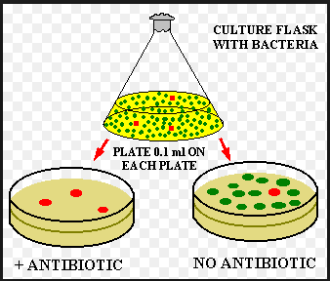
Direct Selection:

Slide 35
Mutant Selection
Indirect Selection:
Is required when no medium supports the growth of only the desired mutant.
We use the Replica plating , which involves the simultaneous transfer of all colonies on one plate to two other plates and the comparison of the growth of individual colonies on both plates.

Slide 36
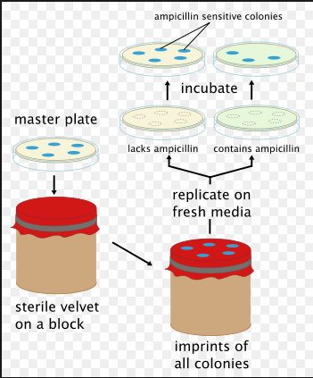
Replica Plating

Slide 37
Testing for Chemicals for their Cancer-Causing Ability
Ames Test:
Developed by Bruce Ames in the 1970s,
used to test for carcinogens.

Slide 38
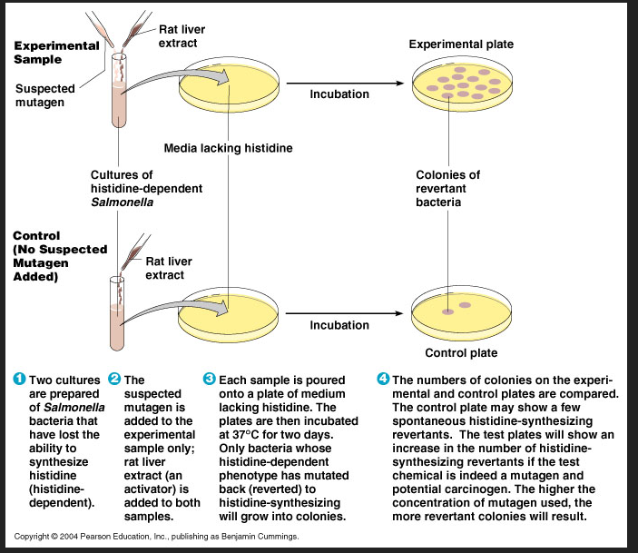

Slide 39
Genetic Exchange
The sharing of genetic information within and between related species occur by:
Transformation.
Transduction.
Conjugation.
All three processes involve a one-way transfer of DNA from a donor cell to a recipient cell.
The molecule of DNA introduced into the recipient is called the exogenoteand the cell’s own original chromosome, called the endogenote.

Slide 40
Transformation
Involves the release of DNA into the environment by the lyses of some cells, followed by the direct uptake of that DNA by the recipient cells.

Slide 41
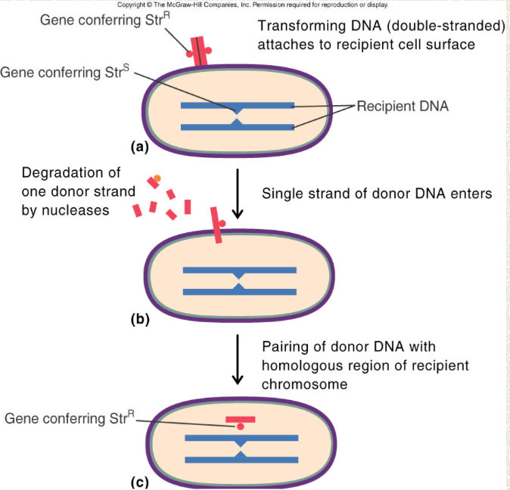

Slide 42
Transduction
The DNA is introduced into the recipient cell by a non lethal virus that has grown on the donor cell.

Slide 43
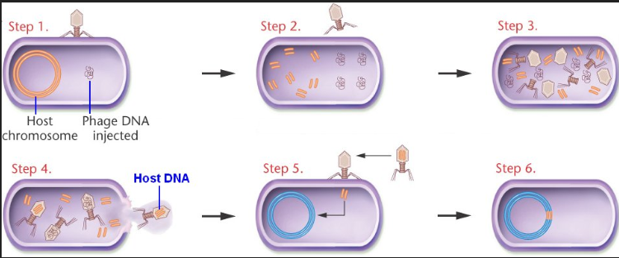
Transduction

Slide 44
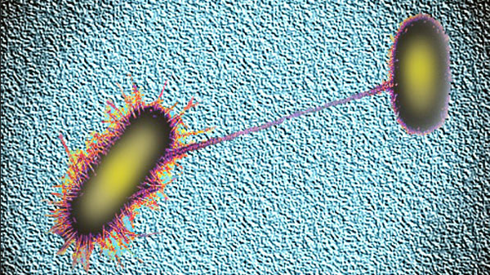
Conjugation
This involves actual contact between donor and recipient cell during which DNA is transferred as part of a plasmid.
In conjugation ,donor and recipient cells are referred to as F⁺and F⁻cells, respectively.

Slide 45
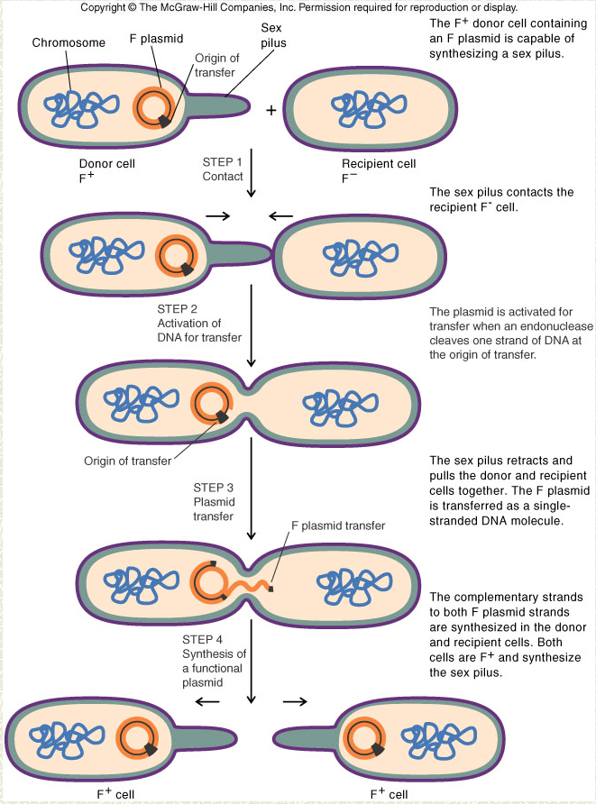

Slide 46
