Slide 1
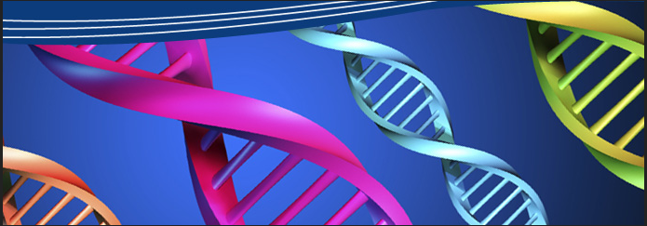
Genetic Engineering

Slide 2
BIOTECHNOLOGY & RECOMBINANT DNA TECHNIQUE
It is the methods scientist use to study and manipulate DNA.
It made it possible for researchers to genetically alter organisms to give them more useful traits.

Slide 3
BIOTECHNOLOGY & RECOMBINANT DNA TECHNIQUE
Researchers isolate genes from one organism, manipulate the purified DNA in vitro, and then transfer the genes into another organism.

Slide 4
Tools Used in Biotechnology
Restriction Enzymes (scissors):
Are naturally occurring enzymes that cut DNA into fragments in a predictable and controllable manner creating sticky ends.
Ligase Enzymes (glue):
These fragments of DNA can then be easily joined to fragments from an entirely different DNA using DNA ligase Enzymes.

Slide 5
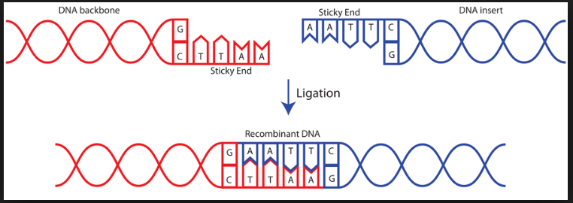
The combined actions of restriction enzymes, and DNA ligase enable researchers to join fragments of DNA from diverse sources, creating recombinant DNA molecules:

Slide 6
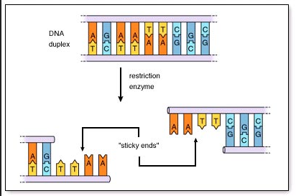

Slide 7
Gel Electrophoresis:
This is used to separate DNA fragments according to size.
Usually agarose or polyacrylamide gel is used.
Then the gel is stained by ethidium bromide that binds to DNA and flouresces when viewed with UV light.

Slide 8
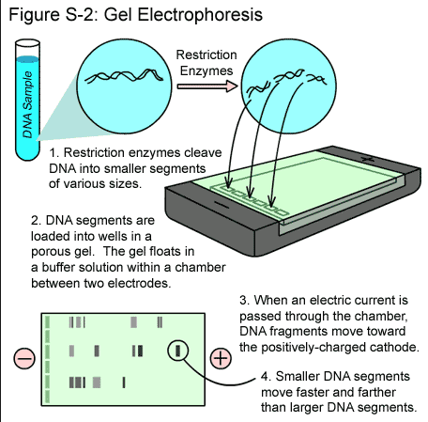

Slide 9
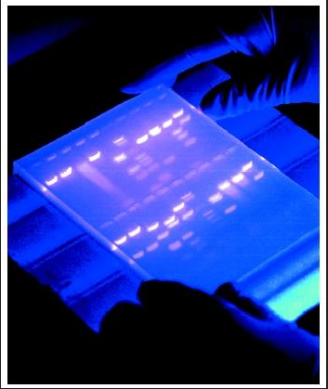

Slide 10
Techniques Used in Genetic Engineering
Obtaining DNA:
To isolate DNA , cells are lysed by adding a detergent. The relatively DNA is sheared into many pieces of varying lengths.
DNA ligase:
The DNA ligase enzyme is used to join the vector (plasmid or a bacteriophage) and the insert (the DNA of interest that need to be coloned) .

Slide 11
Techniques Used in Genetic Engineering
Introducing the recombinant DNA into a new host:
The recombinant molecule is introduced into the new host, usually E.coli, using transformation.
Then this new DNA molecule is allowed to replicate with the host.

Slide 12
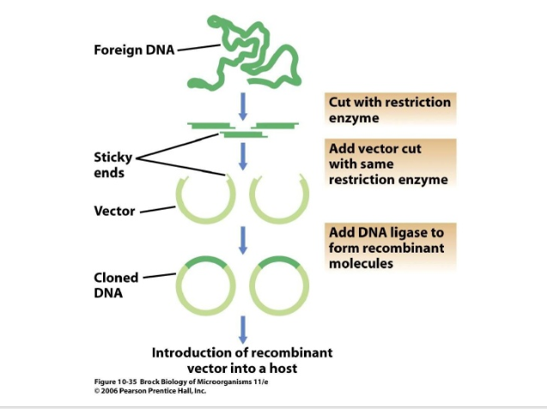

Slide 13
DNA SEQUENCING
The most widely used technique is the dideoxy chain termination method.
A key ingredient in a sequencing reaction is a dideoxynucleotide, a nuclotide that lacks the 3’OH and therefore functions as a chain terminator.
The flourescent marker used on the ddNTPs indicates which nucleotide was incorporated at the terminating position.

Slide 14
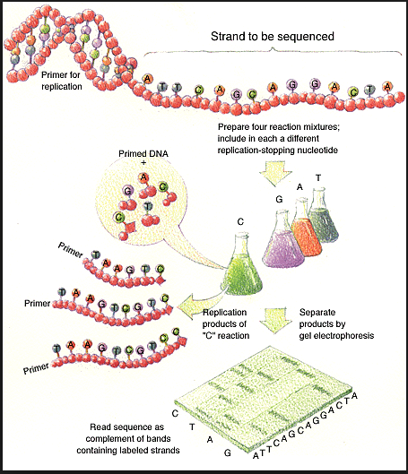

Slide 15
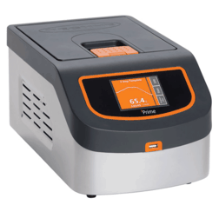
Polymerase Chain Reaction (PCR)
In 1985, Kary Mullis developed a new technique
that made it possible to synthesize large quantities of a DNA fragment .
PCR is used to make large quantities of a particular DNA sequence . The machine used is called a thermal cycler.

Slide 16
PCR
It is used to rapidly increase the amount of a specific DNA segment in a sample.
It can create millions of copies of a given region of DNA in a matter of hours.
The machine used is called “thermal cycler”.
Specific primers are used to selectively replicate only chosen regions of DNA that is called “target DNA”

Slide 17
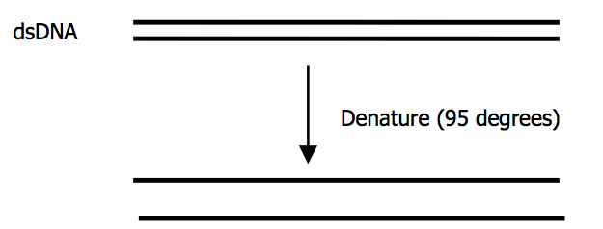
Steps of PCR technique
Step 1 ( heating to 95°C):
the target DNA containing the sequence to be amplified is heat denatured to separate its complementary strands.

Slide 18
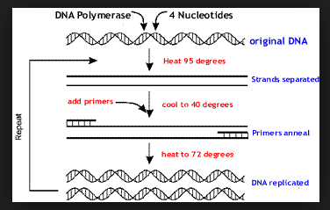
Step2 (lowered to 50°C):
the temperature is lowered so that the primers can anneal ( attach) to the complimentary DNA.

Slide 19
Steps of PCR technique
Step3 (higher up to 70°C):
Taq DNA polymerase extends the primers and synthesizes copies of the target DNA sequence by adding the corrosponding nucleotides.

Slide 21
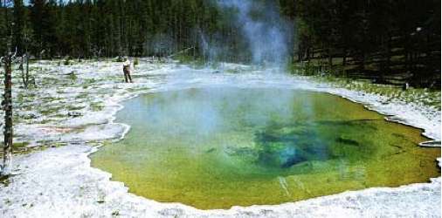
PCR
The heat stable DNA polymerase of a thermophilic bacterium
Thermus aquaticus.

Slide 22
PCR
This three-step cycle results in the duplication of the original target DNA.
After the first cycle there will be two ds-DNA molecules for every original ds-DNA target; after the next cycle, there will be four; after the next cycle there will be eight , and so on.

Slide 23
Application of PCR in medicine
PCR-based diagnostic tests for AIDS, Lyme disease, chlamydia, tuberculosis, hepatitis, the human papilloma virus, and other infectious agents are being developed.
Diagnosis using PCR tests are rapid, sensitive, and specific.
Detection of genetic diseases such as sickle
cell anemia, phenylketonuria, and muscular dystrophy.
In forensic science, it is used in criminal cases for DNA fingerprinting.

Slide 24
Probe Technology
This method is used to locate specific nucleotide sequences in DNA or RNA samples that have been affixed to a solid surface.

Slide 25
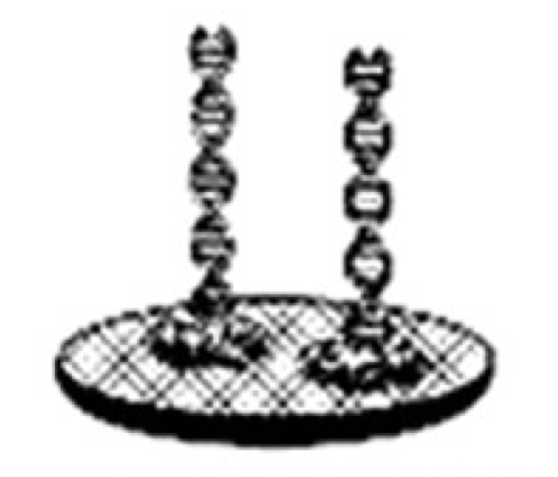
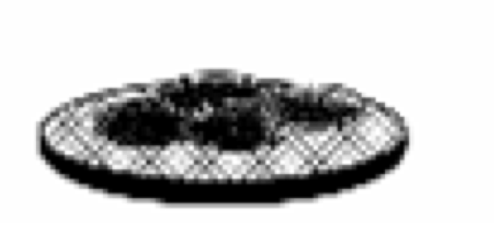
Probe Technology
Step 1
Isolate cells on a solid support
Step 2
Disrupt cells to obtain dsDNA

Slide 26
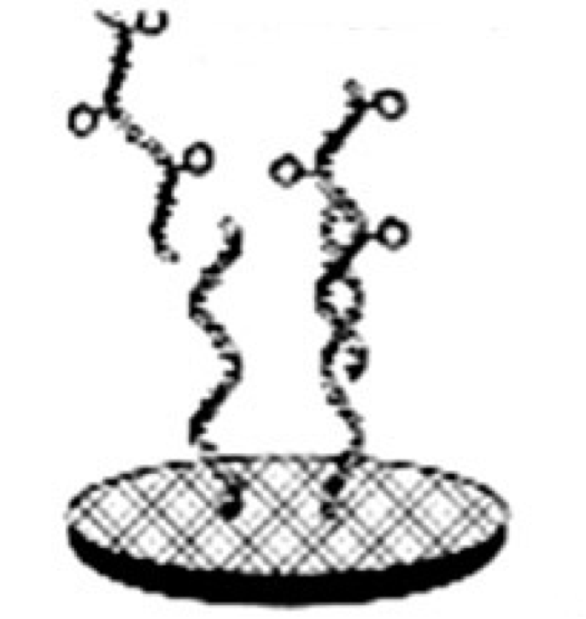
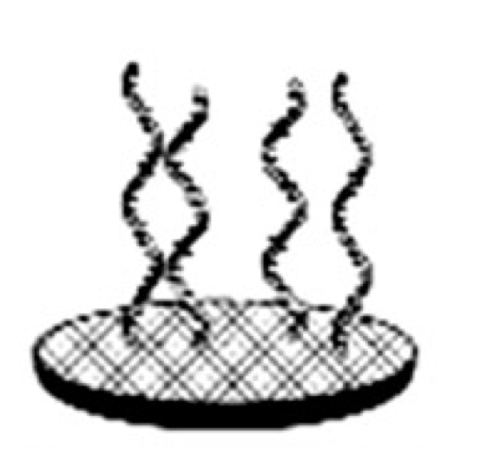
Probe Technology
Step 3
Convert dsDNA to ssDNA& bind to solid support
Step 4
Add labeled probe

Slide 27
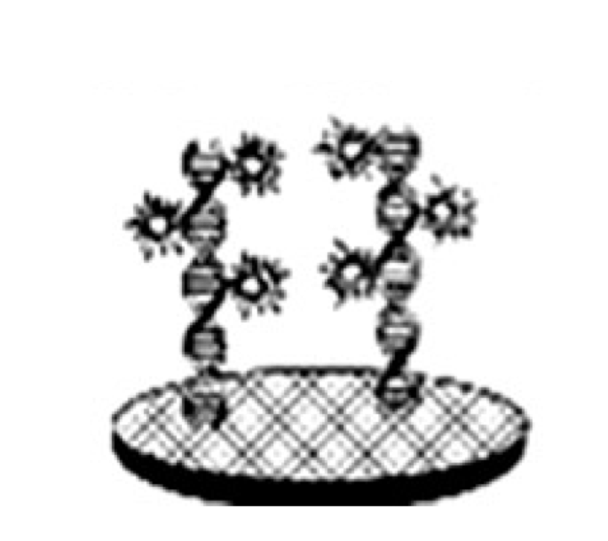
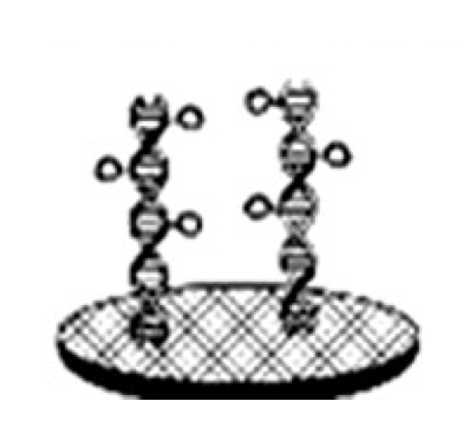
Probe Technology
Step 5
Hybridize probe to target
Step 6
Detect probe’s signal

Slide 28
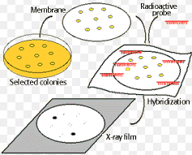
Probe Technology - Colony Blotting
Colony blotting uses probes to detect specific DNA sequences in colonies grown on agar plates.
This method is commonly used to determine which of a collection of clones contain the DNA of interest.

Slide 29
Probe Technology - FISH
FISH →flourescencein situ Hybridization
Used to identify cells directly in a specimen.
This method uses a flourescently labeled probe to detect specific nucleotide sequences within intact cells affixed to a microscope slide.

Slide 30
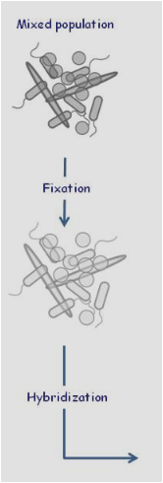
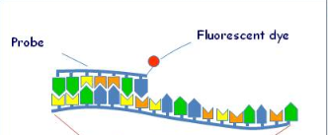
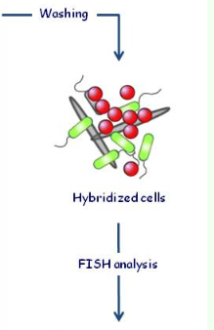
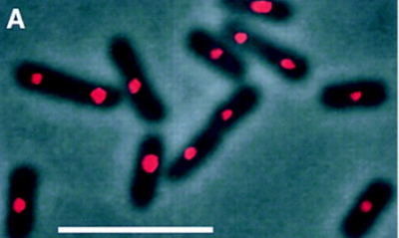

Slide 31
Probe Technology – DNA Microarray
Usually done on a glass slide where hundreds of short DNA fragments are fixed.
Then the DNA of the sample of interest is digested into small fragments , then labeled and then added to the appropriate microarray slide.

