Slide 1
CLS 231 Practical part Introduction
Lecture 1

Slide 2
Course syllabus
1- Basic laboratory equipment and procedures safety rules .
2- Standardization of sodium hydroxide and hydrochloric acid solutions (2 lectures).
3- Determination of bicarbonate in blood .
4- Mercurimetric determination of blood and urine chloride .
5. Complexometric determination of calcium in milk.
6- Determination of blood glucose by a Redox titration method .
7- Determination of chloride by the Vohlard method .
8- Gravimetric determination of chloride .
9- Revision

Slide 3
Marking criteria
1- Quiz ( 3 marks).
2- Final lab exam ( 15 marks).
3- Attendance and behaviour ( 2 marks ).
4- lab report ( 5 marks)..

Slide 4
Outline
1- laboratory regulations
2- Emergency procedure.
3- Safety rules and first aid procedures.
4- Lab tools and signs.
5- Units of concentration.

Slide 5
laboratory regulations
1- Read each experiment thoroughly before entering the lab.
2- Discard solids into the waste crocks.
3- leave reagent bottles at the side shelves.
4- Read the labels .
5- Avoid using excessive amounts of reagents.

Slide 6
6- Never return unused chemicals to the stock bottle.
7- Don’t inset your own pipets or medicine droppers into the reagent bottles.
8- Don’t lay down the stopper of a bottle.
9- Don’t heat heavy glassware .
10- Always maintain a clean work area in the laboratory.

Slide 7
11- Wash glassware with water and a cleaner if needed.
12- When heating a liquid in a test tube point it away in case it pumps.

Slide 8
Emergency procedure
1- Notify the instructor or demonstrator immediately in case of accident.
2- learn the location and proper use of fire extinguisher, blanket, first-aid kit.
3- Spillage of corrosive chemicals must be reported.

Slide 9
Safety rules and first aid procedures
1- Wear safety glasses in the lab.
2- Don’t eat or drink in the lab.
3- Never attempt unauthorized experiments..
4- Never leave heated laboratory reactions unattended.

Slide 10
6- No practical jocks.
7- Never dip pipets or spatulas into reagent bottles and don’t return unused portion to the stock bottles.
8- Be familiar with emergency exit.
9- Be prepared to administer first aid .

Slide 11
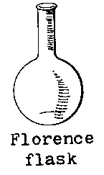
Lab tools
1- Florence flask:-
It is also known as a boiling flask. It is designed to be used for uniform heating and ease of swirling; it is produced in a number of different glass thicknesses to stand different types of use.

Slide 12
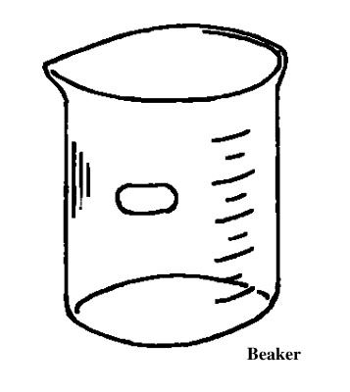
2- Beaker :
It is a simple container for stirring, mixing and heating liquids . They are generally cylindrical in shape, with a flat bottom.

Slide 13
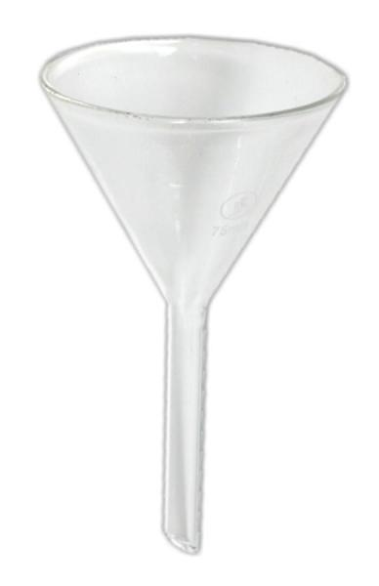
3- Funnel:
Different kinds of funnels that have been adapted for these specialized applications in laboratory. Main usage is transferring liquids to other containers through filtration.

Slide 14
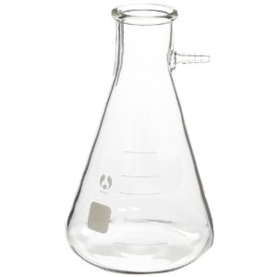
4- filter flask:
A filter flask is a flask fitted with a side arm for connecting to a vacuum source for fast filtering.

Slide 15
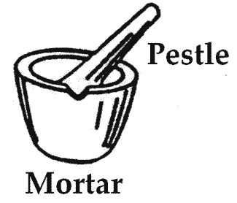
5- Mortar and pestle:
It is a tool used to grind and mix substances.

Slide 16
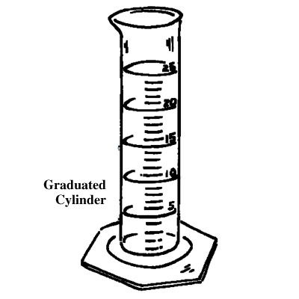
Graduated cylinder
5- Graduated cylinder :
used to measure the volume of a liquid. Graduated cylinders are generally more accurate and precise than laboratory flasks and beakers.

Slide 17
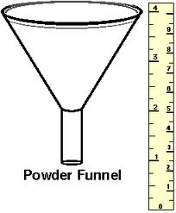
Powder funnel
6- Powder funnel :
It has a small and wide neck for fast pouring of powders.

Slide 18
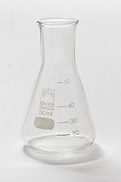
Erlenmeyer flask
7- Erlenmeyer flask:
The Erlenmeyer is usually marked on the side (graduated) to indicate the approximate volume of contents, and has a spot of ground glass or enamel where it can be labeled with a pencil. It differs from the beaker in its tapered body and narrow neck.

Slide 19
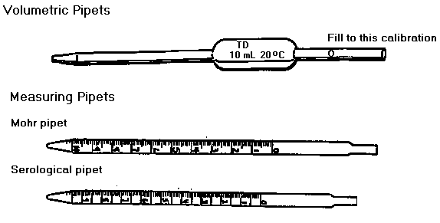
Mohr pipette
8- Mohr pipette :
Also known as a Graduated pipette, it is used to measure the volume of the liquid dispensed, although not as accurately as a volumetric pipette.

Slide 20
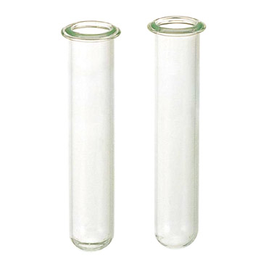
Test tubes
9- Test tubes:
Test tubes are widely used by chemist to hold, mix, or heat small quantities of solid or liquid chemicals, especially for qualitative experiments and assays.

Slide 21
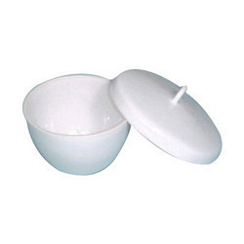
Crucible and cover
10- Crucible and cover:
A crucible is a ceramic container capable of withstanding extreme temperatures, whilst the cover is designed to prevent heat escaping from the crucible itself.

Slide 22
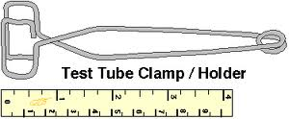
Test tube holder
11- Test tube holder:
The test tube holder is used to hold test tubes. They are used by squeezing the handles to open the other end, and inserting the test tube. Test tube holders are typically used when heating the test tube is necessary, or for when caustic materials are being handled.

Slide 23
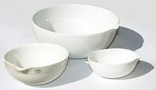
Evaporating dish
12- Evaporating dishes :
Are used to evaporate excess solvents, most commonly water - to produce a concentrated solution or a solid precipitate of the dissolved substance.

Slide 24
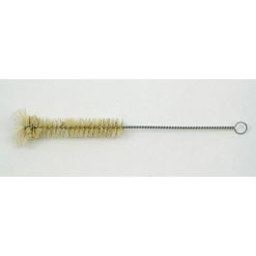
Test tube brush
13- Test tube brush:
Designed to clean test tubes.

Slide 25
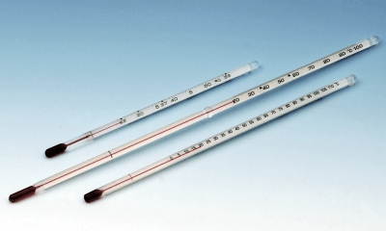
Thermometer
14- Thermometer:
It is a device that is used to measure temperature in different principles.

Slide 26
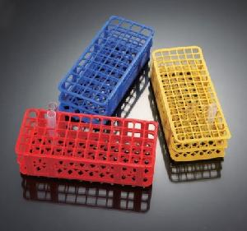
Test tube rack
15- Test tube rack:
it is used to hold/support test tubes containing chemicals waiting for further operations.

Slide 27
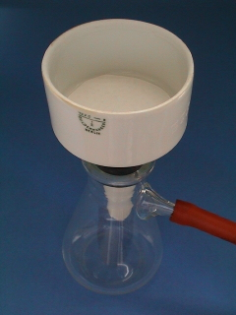
Buchner funnel
16-Buchner funnel:
It is used in filtrations .

Slide 28
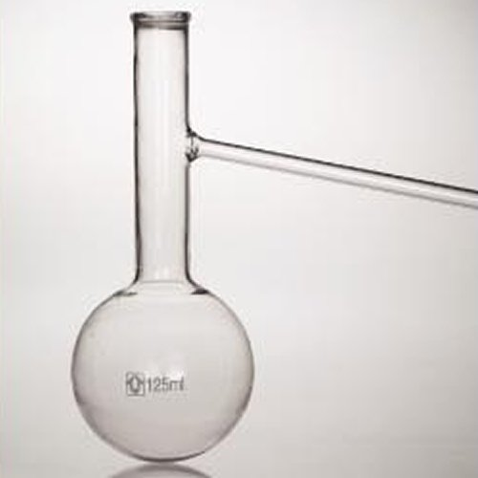
Distilling flask
17- A distilling flask:
Is used to separate mixtures of two liquids with different boiling points. Distillation occurs when the flask is heated and the components of the mixture change from liquid to gas, with the lowest boiling point liquids changing first and liquids with the highest boiling points changing last.

Slide 29
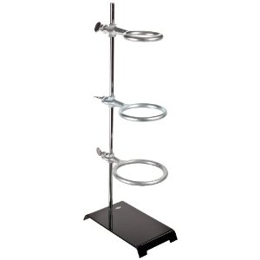
Ring stand, with rings
18- The ring stand :
Used to support laboratory apparatus.

Slide 30
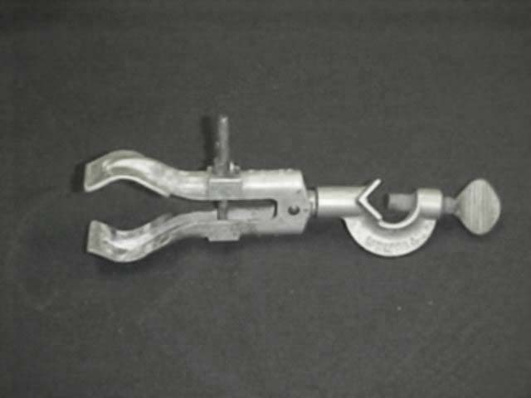
Burette clamp
19- A burette clamp is used to fasten glassware into place on a ring stand.
Other clamps are condenser and pinchcock clamps.

Slide 31
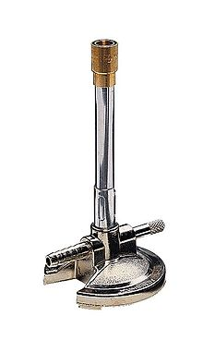
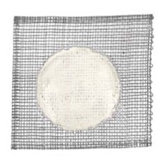
continue
20- Bunsen burner:
is used for heating, sterilization.
21- wire gauze with asbestos center:
It can be used to support a container (such as a beaker or flask) during heating as it helps to spread the heat evenly over the container.

Slide 32
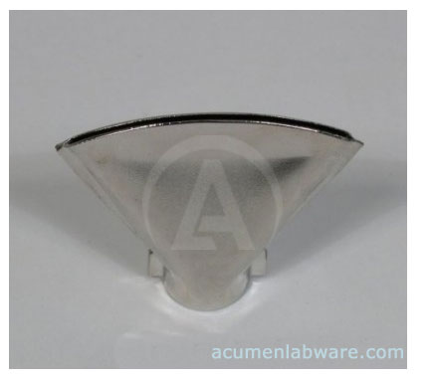
Wing top
22- A wing top :
is an accessory that can be used with a Bunsen burner to provide more uniform flame.

Slide 33
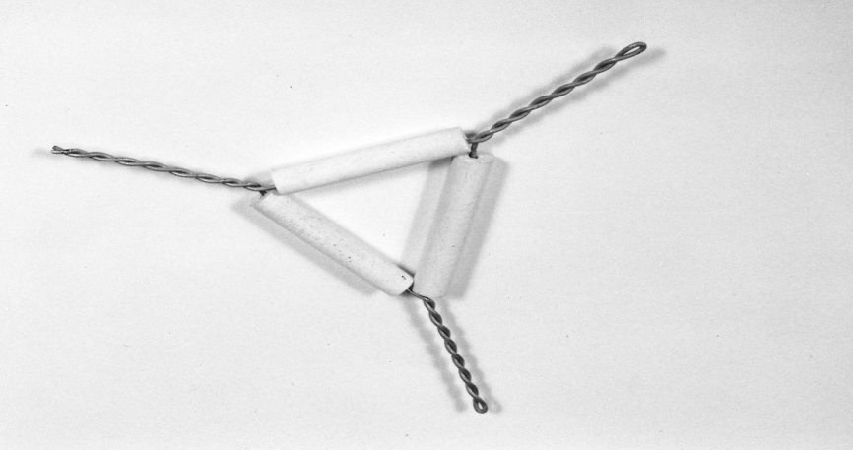
Wire triangle
23- wire triangle:
It's composed of twisted wire running through three clay pipes in the shape of an equilateral triangle and is used to hold a crucible over the flame of a Bunsen burner.

Slide 34
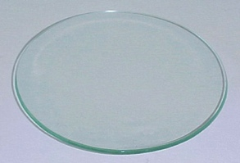
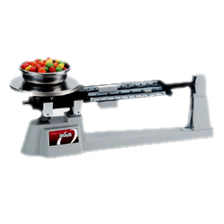
Watch glass
24- Watch glass:
used in chemistry as a surface to evaporate a liquid, to hold solids while being weighed, or as a cover for a beaker.
25- laboratory balance:
Is an instrument that can be used to determine the weight and mass of an object.

Slide 35
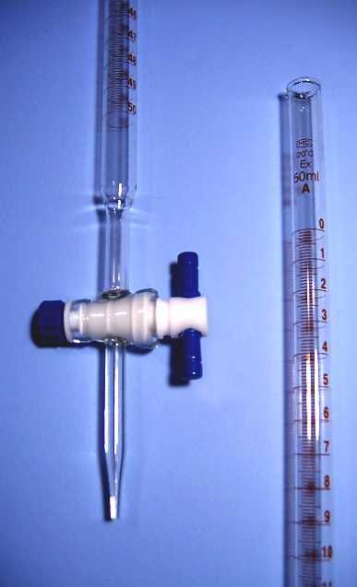
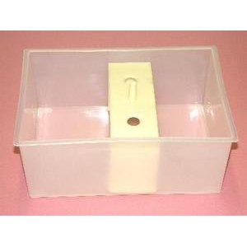
26- A burette is used to deliver solution in precisely-measured, variable volumes.
27- Pneumatic trough:
used for collecting gases, such as hydrogen, oxygen and nitrogen.

Slide 36
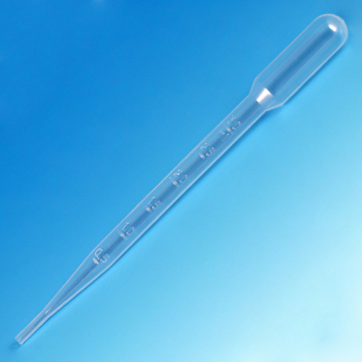
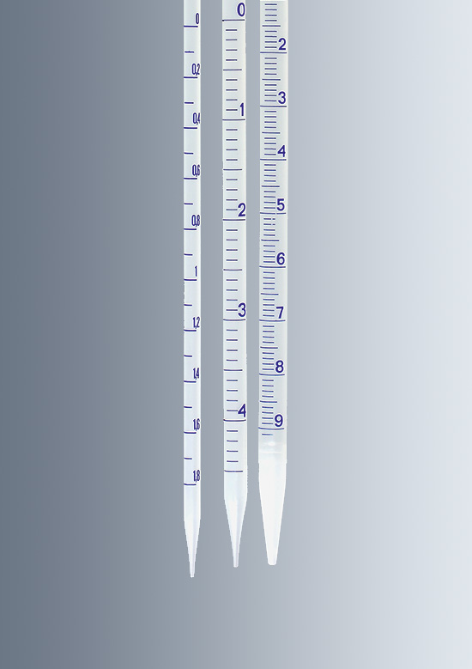
Pipettes
1- Transfer pipettes
2- Graduated pipettes

Slide 37
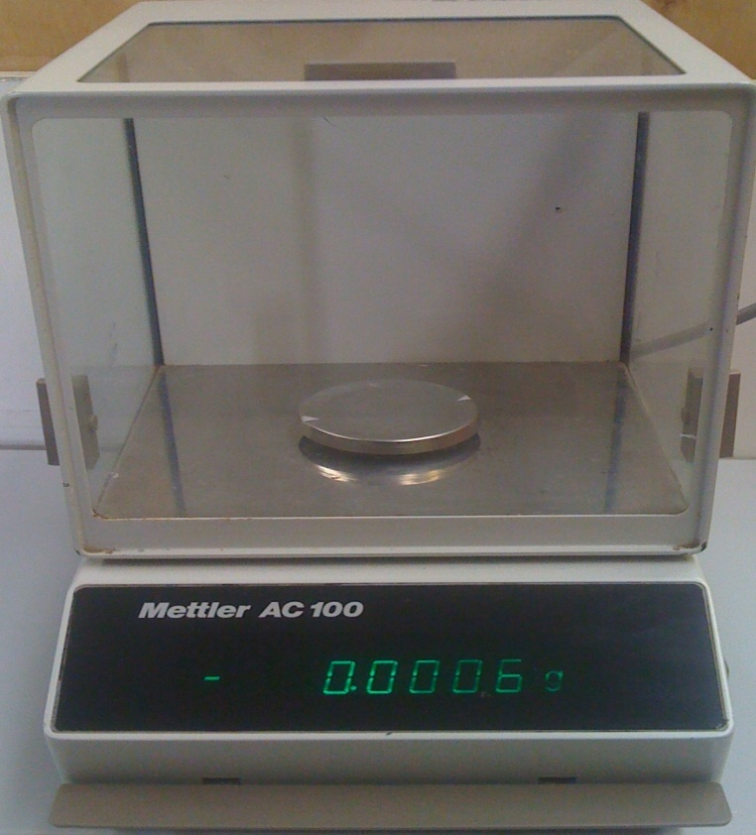
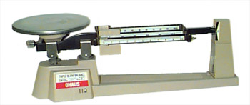
Analytical balances
`

Slide 38
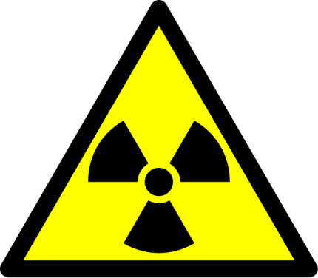
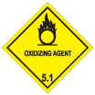
Laboratory Signs and Symbols
Biohazard
Radioactive
Toxic
Oxidizing

Slide 39
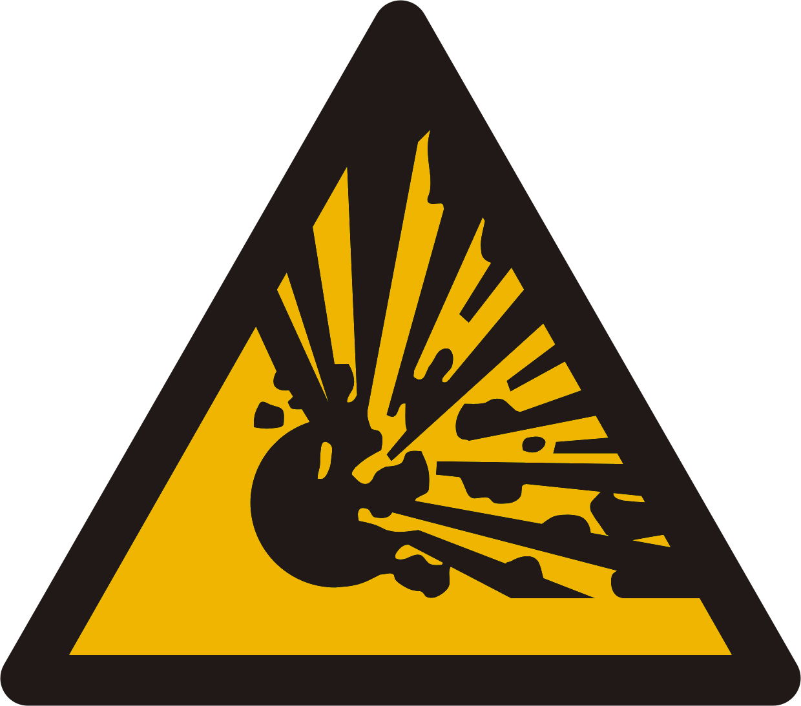
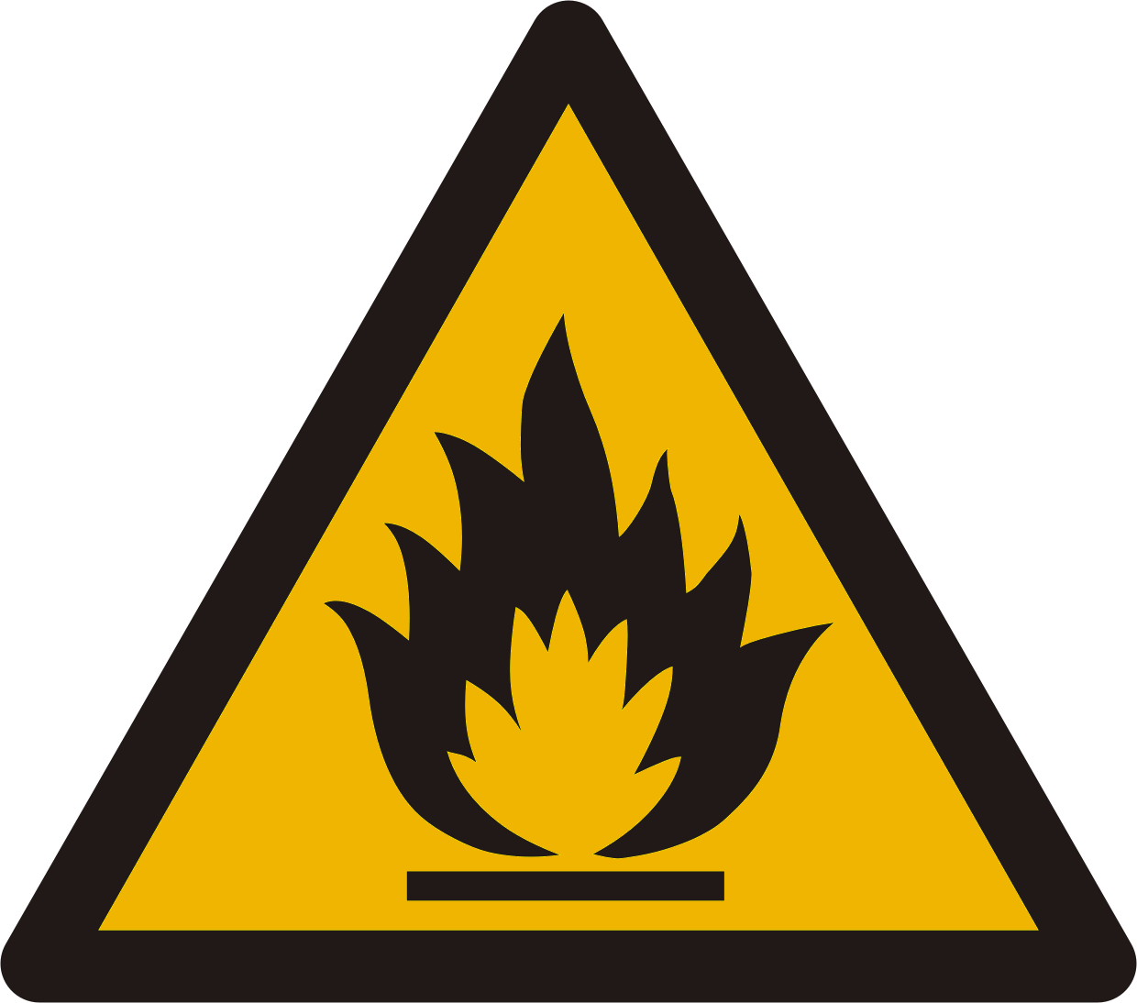
General danger
Explosive
Electrical hazard
Flammable

Slide 40
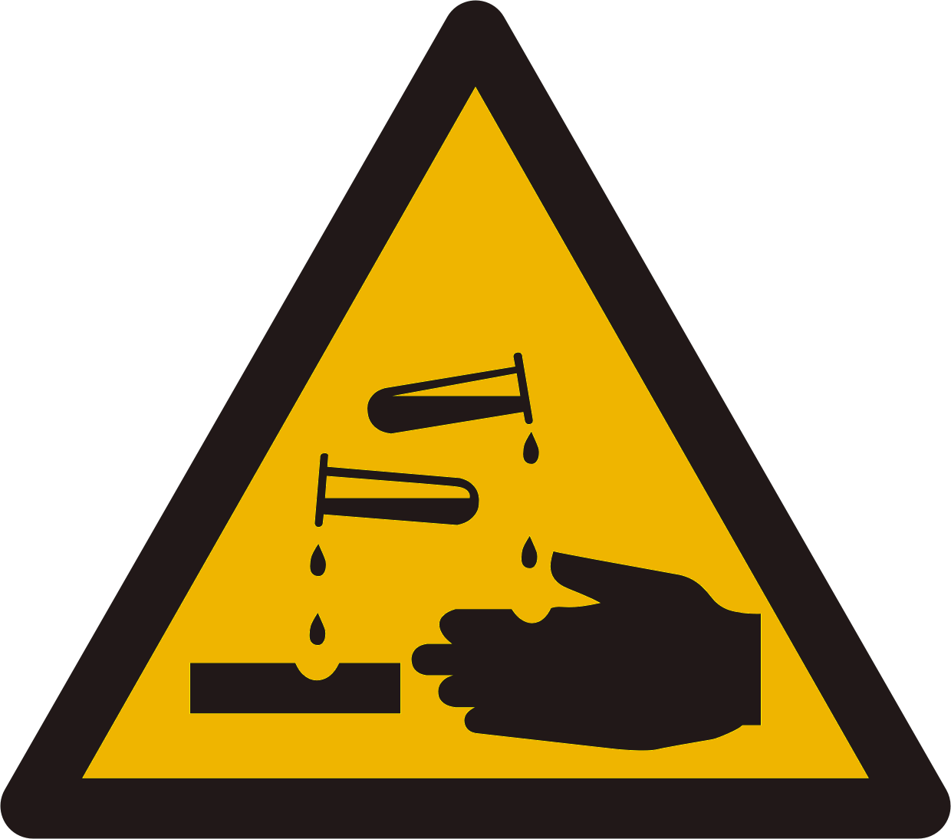
Corrosive
Harmful

Slide 41
Calculating Concentration
The concentration of a chemical solution refers to the amount of solute that is dissolved in a solvent. We normally think of a solute as a solid that is added to a solvent (e.g., adding table salt to water), but the solute could just as easily exist in another phase. For example, if we add a small amount of ethanol to water, then the ethanol is the solute and the water is the solvent. If we add a smaller amount of water to a larger amount of ethanol, then the water could be the solute!

Slide 42
Units of Concentration
Concentration may be expressed several different ways:
1- percent composition by mass.
2- volume percent.
3- mole fraction.
4- molarity.
5- molality.
6- normality.

Slide 43
Percent Composition by Mass (%)
This is the mass of the solute divided by the mass of the solution (mass of solute plus mass of solvent), multiplied by 100.
Example: Determine the percent composition by mass of a 100 g salt solution which contains 20 g salt.
Solution: 20 g NaCl / 100 g solution x 100 = 20% NaCl solution

Slide 44
Volume Percent (% v/v)
Volume percent or volume/volume percent most often is used when preparing solutions of liquids. Volume percent is defined as:
v/v % = [(volume of solute)/(volume of solution)] x 100%.
Example:
wine is about 12% v/v ethanol. This means there are 12 ml ethanol for every 100 ml of wine.

Slide 45
Mole Fraction (X)
This is the number of moles of a compound divided by the total number of moles of all chemical species in the solution. Keep in mind, the sum of all mole fractions in a solution always equals 1.
Example: What are the mole fractions of the components of the solution formed when 92 g glycerol is mixed with 90 g water? (molecular weight water = 18; molecular weight of glycerol = 92)

Slide 46
Solution: 90 g water = 90 g x 1 mol / 18 g = 5 mol water 92 g glycerol = 92 g x 1 mol / 92 g = 1 mol glycerol total mol = 5 + 1 = 6 mol xwater = 5 mol / 6 mol = 0.833 x glycerol = 1 mol / 6 mol = 0.167 It's a good idea to check your math by making sure the mole fractions add up to 1: xwater + xglycerol = .833 + 0.167 = 1.000

Slide 47
Molarity (M)
Molarity is probably the most commonly used unit of concentration. It is the number of moles of solute per liter of solution (not necessarily the same as the volume of solvent!).
Example: What is the molarity of a solution made when water is added to 11 g CaCl2 to make 100 mL of solution?
Solution: 11 g CaCl2 / (110 g CaCl2 / mol CaCl2) = 0.10 mol CaCl2 100 mL x 1 L / 1000 mL = 0.10 L molarity = 0.10 mol / 0.10 L molarity = 1.0 M

Slide 48
Molality (m)
Molality is the number of moles of solute per kilogram of solvent. Because the density of water at 25°C is about 1 kilogram per liter, molality is approximately equal to molarity for dilute aqueous solutions at this temperature. This is a useful approximation, but remember that it is only an approximation and doesn't apply when the solution is at a different temperature, isn't dilute, or uses a solvent other than water.

Slide 49
Example: What is the molality of a solution of 10 g NaOH in 500 g water?
Solution: 10 g NaOH / (40 g NaOH / 1 mol NaOH) = 0.25 mol NaOH 500 g water x 1 kg / 1000 g = 0.50 kg water molality = 0.25 mol / 0.50 kg molality = 0.05 M / kg molality = 0.50 m

Slide 50
Normality (N)
Normality is equal to the gram equivalent weight of a solute per liter of solution. A gram equivalent weight or equivalent is a measure of the reactive capacity of a given molecule. Normality is the only concentration unit that is reaction dependent. Example: 1 M sulfuric acid (H2SO4) is 2 N for acid-base reactions because each mole of sulfuric acid provides 2 moles of H+ ions. On the other hand, 1 M sulfuric acid is 1 N for sulfate precipitation, since 1 mole of sulfuric acid provides 1 mole of sulfate ions.

Slide 51
Dilutions
You dilute a solution whenever you add solvent to a solution. Adding solvent results in a solution of lower concentration. You can calculate the concentration of a solution following a dilution by applying this equation:
MiVi = MfVf
where M is molarity, V is volume, and the subscripts i and f refer to the initial and final values.

Slide 52
Example: How many millilieters of 5.5 M NaOH are needed to prepare 300 mL of 1.2 M NaOH?
Solution: 5.5 M x V1 = 1.2 M x 0.3 L V1 = 1.2 M x 0.3 L / 5.5 M V1 = 0.065 L V1 = 65 mL

