Slide 1
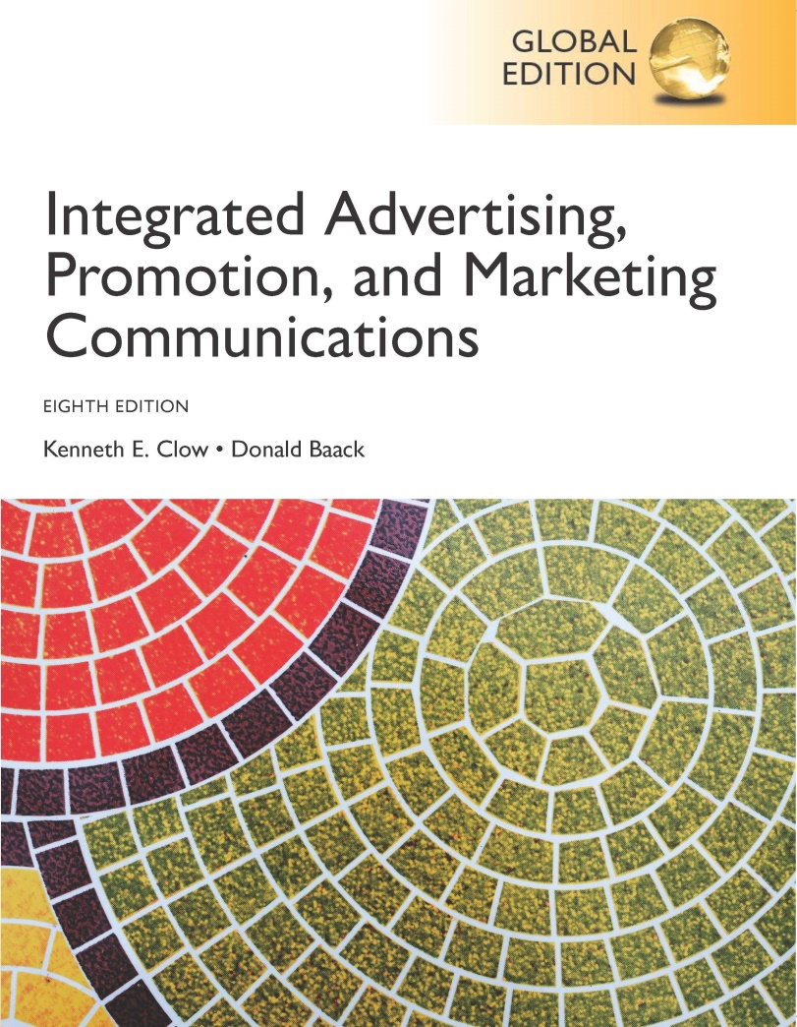
Integrated Advertising, Promotion, and Marketing Communications
Eighth Edition, Global Edition
Chapter 15
Evaluating an Integrated Marketing Program
Copyright © 2018 Pearson Education Ltd. All Rights Reserved
Notes:
The last chapter deals with methods of evaluating integrated marketing campaigns. These methods have changed considerably in the last 20 years due to advances in technology.

Slide 2
Chapter Objectives (1 of 2)
What are the three broad categories of evaluation tools used to evaluate IMC systems?
How do marketing teams match evaluation methods with IMC objectives?
What forms of message evaluations can be conducted to assess IMC programs?
Which evaluation criteria are suggested by the positioning advertising copytesting (PACT) system?
Notes:
These are the objectives for Chapter 15.

Slide 3
Chapter Objectives (2 of 2)
How do online evaluation systems assist advertising managers in assessing the quality of a firm’s Internet activities?
What types of behavioral evaluations can be employed to assess IMC programs?
How are evaluation programs adjusted to match international operations?
Notes:
Additional objectives for Chapter 15.

Slide 4
Sands Research, Inc.
Tangible evidence advertising works
Neuromarketing – Dr. Steve Sands
Cognitive neuroscience technology
EEG sensors
Measures brainwave activity
Ability to measure impact of advertising
Three memory structures
Knowledge memories
Emotion or episodic memories
Action or procedural memories
Notes:
Sands Research, Inc. is one of the companies that is on the leading edge in a new science, neuromarketing, which uses brain waves and neuroscience to study marketing and advertising. This new approach has been partially driven by the need for tangible evidence that advertising works. Neuromarketing is based on the work of Dr. Steve Sands and uses EEG sensors. It measures brainwave activity, which allows for an understanding of what is happening in the brain when a person views an ad. Cognitive neuroscience is able to measure three memory structures – knowledge memories, emotional or episodic memories, and action or procedural memories. Each memory structure occurs in a different part of the brain.

Slide 5
Chapter Overview
Evaluation of advertising
Accountability
Message evaluation techniques
Digital/social media metrics
Respondent behavior evaluations
Long-term success
Notes:
This chapter presents information on how marketing and advertising are evaluated. Accountability has driven companies to look for better ways to evaluate the success of marketing. Three primary approaches are used – message evaluation techniques, online evaluation metrics, and respondent behavior evaluations. Companies need to measure long-term success, not just immediate or short-term impact.

Slide 6
Evaluation Categories
Message evaluation techniques
Physical design of ads and marketing materials
Cognitive elements
Affective elements
Behavioral intentions
Online evaluation metrics
Digital and social media campaigns
Unique set of measures
Real-time measures
Respondent behavior evaluations
Conative elements
Measurable with numbers
Customer actions
Notes:
Message evaluation techniques examine the message and the physical design of an ad or marketing piece. It involves examining cognitive, affective, and conative (behavioral) aspects of the ad. Online evaluations examine online advertising and marketing campaigns with the unique measures the Internet is able to capture. Respondent behavior evaluations address the visible customer actions from inquiries to actual purchases.

Slide 7
Matching Methods with IMC Objectives
Match objectives
Before and after analyses
Levels of analyses
Short term
Long term
Product specific
Corporate level
Affective, cognitive, or conative
Plan evaluation prior to campaign
Use multiple measures
Notes:
It is important to match the objective with the evaluation procedure. Conducting before and after analyses allows companies to know if there was a change and the magnitude of that change. Levels of analyses include short-term results, long-term results, product-specific measures, corporate level results, and the components of attitude (affective, cognitive, and conative). Evaluation is easier if the evaluation procedure is discussed prior to launching the campaign. To ensure accurate measures, use multiple measures.

Slide 8
Message Evaluations (1 of 2)
Every stage of development
Concept testing
After ad design
Broadcast – storyboards
Print – artist sketches
Notes:
Evaluation of advertising communication occurs at every stage of the development process. Message evaluations can also occur at any stage. If it is before the ad is designed, then it is called concept testing. After the ad is designed, broadcast ads are evaluated using storyboards, similar to the one on this slide. Print ads are evaluated using artist sketches or photos downloaded from a photo stock house.

Slide 9
Message Evaluations (2 of 2)
Pretesting not used widely by agencies
Consumers are used to seeing finished ads
Advertising agencies tend to test
Post-production
Post-launch
Notes:
Evaluation of advertising communication occurs at every stage of the development process. Because of the cost and time involved, most agencies do not conduct much pretesting of ads. Agencies tend to test after production and before launch or after the ad has been launched. Most agencies do the latter.

Slide 10
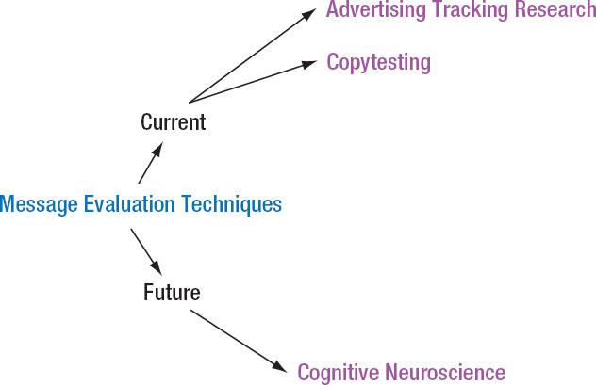
Figure 15.2 Evaluating Advertising Management
Notes:
Currently, message evaluations are conducted through advertising tracking research or copytesting. The future of advertising evaluation may be in cognitive neuroscience.

Slide 11
Advertising Tracking Research
Track ads after launch
Nielsen IAG
Millward Brown
Monitors
Brand performance
Advertising effectiveness
Specific time test
Continuous tracking
Notes:
A common method of evaluation involves tracking an advertisement by one of the advertising research firms, such as Nielsen IAG or Millward Brown. These tracking services monitor an ad’s performance and measure its effectiveness. Tests can be performed at specific times or continuously. Nielsen IAG, for instance, offers a syndicated database of real-time brand and ad performance based on more than 210,00 television program episodes and 250,000 commercials. Nielsen conducts thousands of surveys daily measuring viewer engagement with TV programs and effectiveness of ads.

Slide 12
Ad Tracking Methodology Advertising Tracking Research
Respondents shown brief portion of ad or stills with brand name removed
Measures
Brand and ad recognition
Unaided brand awareness
Memorability
Likability
Unaided and aided message recall
Unaided and aided campaign recall
Similar measures for magazines
Mediamark Research
Affinity
Notes:
With ad tracking research, respondents are typically shown a brief portion of the ad or a few stills of the TV ad with the brand name removed. Respondents are then asked if they recognize the ad, the company, or the brand. Through successive questions, researchers can measure brand ad recognition, unaided brand awareness, how memorable the ad was, likability, unaided and aided message recall and unaided and aided campaign recall. Similar techniques are now available for magazines through Mediamark Research and Affinity.

Slide 13
Report Cards and Benchmarks Advertising Tracking Research
Continuous report card – Nielsen IAG
Benchmark
New campaign performance
Compared to competitors
Compared to previous campaigns
Indicates when wear-out begins
Disadvantage – no diagnostics as to why
Notes:
Nielsen IAG also offers a continuous report card as well as a benchmark for ad campaigns. Within the second or third week of a new campaign, ad tracking research provides two types of information on the campaign’s performance by comparing current results 1) to competitors and 2) to previous campaigns. Nielsen builds a benchmark for a company as it measures performance over months and years. These benchmarks are extremely valuable for new campaigns. Ad tracking can provide input on when wear-out is beginning and consumers quit paying attention to the ad. The disadvantage is that ad tracking research cannot provide diagnostics. The ad tracking can tell a company that wear-out is occurring and a new campaign is not performing well, but it can’t tell why.

Slide 14
Copytesting
Finished or final stages of development
Evaluates main message and format
Portfolio tests
Theater tests
Online tests
Gaining in popularity
Immediate results and lower costs
Consumers pay more attention to ads
Measures ad potential
Notes:
Copytesting can occur during the final stages of development or after an ad is finished. The purpose of copytesting is to evaluate the main message and format of the ad. Portfolio tests are used with print ads and theater tests with TV ads. Because of costs, many advertising research firms are moving to some type of online copytests. It is also quicker. Consumers pay more attention to ads when copytesting is done online. Thus, copytesting really measures the ad’s potential since it has the full attention of the consumer.

Slide 15
Millward Brown - Copytesting
150 respondents
Breakthrough ability
Brand message and image
How memorable ad and brand are
How enjoyable ad is
What the ad communicates
How well the ad communicates intended message
Potential response
Persuasive power of ad
Engagement of the viewer with ad and brand
Notes:
When Millward Brown does copytesting, 150 respondents are typically used. This slide highlights the primary measures obtained from the copytesting.

Slide 16
Testing Emotional Reactions Copytesting
Millward Brown
Second by second emotional reaction chart
Respondents move computer mouse
150 emotional reactions on one graph
Indicates when emotions change
Does not measure level of emotions
Notes:
Millward Brown and other advertising research firms can provide second-by-second emotional reaction charts for television or video ads. Respondents move their mouse to indicate their emotions, either positive or negative. The emotional reactions of these 150 respondents are then placed on one graph, which will indicate when emotions change. It does not really measure the level of emotions accurately, but more when emotions change and when they are positive or negative.

Slide 17
Verbatim Comments Copytesting
Comments by respondents
Extremely valuable to clients
Open-ended questions
Tell story of ad
Can indicate why ad is performing poorly
Gain valuable ideas
Notes:
Millward Brown also provides clients with verbatim comments by respondents. These comments are valuable because they are replies to open-ended questions in the respondent’s own words. Millward Brown asks respondents to tell them the story they see in the ad, which provides clients with a valuable insight on what viewers think or see in an ad campaign. Copytesting and verbatim comments can provide information on why an ad or campaign is performing poorly.

Slide 18
Copytesting Controversies
Criticisms of copytesting
Some agencies not using
Stifles creativity
Focus groups not good judge
Support of copytesting
Issue of accountability
Majority support because clients want proof
Provides key consumer insights
Notes:
Not all clients and advertising professionals believe in copytesting. Some agencies do not use it because they feel it stifles creativity. They also feel that focus groups and consumers are not really good judges of good creative. Other agencies may not fully support copytesting, but do it because of the issue of accountability. Clients want proof or tests that show the ad is good, and copytesting can provide the evidence. Copytesting also can provide a key consumer insight into what works and what doesn’t and what in the ad triggers a consumer response.

Slide 19
Emotional Reaction Tests
Affective advertisements
Used for material designed to elicit emotions
Difficult to measure emotions with questions
Warmth monitor
Emotional reaction tests are self-reported instruments
Notes:
Many ads target feelings and emotions, the affective component of advertising. Emotional reaction tests are used to measure affective ads because it is difficult to measure with questions. Some companies use a warmth monitor, similar to the computer mouse used by Millward Brown to measure emotions during copytesting. The disadvantage is the emotions are still self-reported.

Slide 20
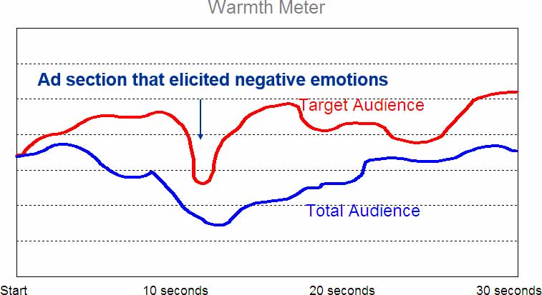
Sample Graph from a Warmth Meter 30-Second TV Advertisement
Sample Ad Rating
Bonus Slide
Notes:
(Bonus Slide, not in text) This graph shows the emotional reaction to a 30-second TV ad. Although the emotional reaction was different for the target audience versus the total audience, it does provide good information. Especially important is the one point in the ad where negative emotions occurred.

Slide 21
Cognitive Neuroscience (1 of 2)
Measures brainwave activity
Better indicator of respondent’s true reaction
Does not rely on self-reporting
Notes:
Cognitive neuroscience measures brainwave activity and is the latest advancement in advertising research. It is a better indicator of a person’s true reaction since it does not rely on self-reporting.

Slide 22
Cognitive Neuroscience (2 of 2)
Companies experimenting with neuroscience
EmSense
NeureoFocus
Sands Research
Frito-Lay
Power of cognitive neuroscience
Reveals physiological reactions
Understand how information is being processed
Notes:
A number of companies are experimenting with cognitive neuroscience. Frito-Lay used cognitive neuroscience to examine a particular ad that was rated inappropriate by a focus group. The neuroscience research showed women loved the ad. The power of neuroscience is that it reveals physiological reactions. It provides information on where the information is being processed in the brain and what consumers do with the information they receive. Instead of rely on self-reporting, cognitive neuroscience hopes to measure reactions accurately.

Slide 23
Figure 15.3 Copytesting Principles of PACT (1 of 2)
Testing procedure should be relevant to objectives.
Researchers should agree on how the results will be used in advance.
Multiple measures should be used.
The test should be based on some model or theory of human response to communication.
Source: Based on PACT document published in the Journal of Marketing, (1982) ,Vol. 11, No. 4, pp. 4-29.
Notes:
Positioning advertising copytesting (PACT) was created to evaluate television ads, but the principles can be used for testing any type of ad in any stage of production, or even finished ads. It was formulated by 21 leading advertising agencies and contains basic principles that should be used in evaluating advertising.

Slide 24
Figure 15.3 Copytesting Principles of PACT (2 of 2)
Testing procedure should allow for more than one exposure.
In selecting alternate ads to include in the test, they should be at the same stage in the process as test ad.
The test should provide controls to avoid biases.
Sample used for the test should be representative of the target sample.
Testing procedure should demonstrate reliability and validity.
Source: Based on PACT document published in the Journal of Marketing, (1982) ,Vol. 11, No. 4, pp. 4-29.
Notes:
Positioning advertising copytesting (PACT) was created to evaluate television ads, but the principles can be used for testing any type of ad in any stage of production, or even finished ads. It was formulated by 21 leading advertising agencies and contains basic principles that should be used in evaluating advertising.

Slide 25
Online Evaluation Metrics
Click-throughs primary measurement
Length of engagement
Dwell rate
Dwell time
Notes:
The online environment provides a number of metrics that cannot be obtained with other media, especially so quickly. Web metrics can be obtained in almost real-time. The primary measure of online ads is click-throughs, which is the number of people who click on the ad and go to the website. Length of engagement is a newer metric that measures how long a person stays at a website, regardless of where they are on the site. Dwell rate measures the proportion of ad impressions that result in users engaging with an ad. Dwell time measures the amount of time users spend engaged with a particular ad.

Slide 26
Figure 15.4 Digital Metrics
Web Metrics
Number of visits (Hits)
Number of visitors
New vs. repeat visitors
Page views
Page views per visit
Time on pages and site
Entry and exist pages
Bounce rates
Conversion/Campaign Metrics
Click-through rate (CTR)
Cost-per-click (CPC)
Conversion ratio
Cost-per-conversion (CPC)
Average order value (AOV)
Revenue-per-visit (RPV)
Shopping cart abandonment
Notes:
Website metrics measure various aspects of visits and visitors to a website. The conversion/campaign metrics are used to evaluate the effectiveness of digital campaigns. In addition to the standard click-through rate, marketers can measure the cost per click, the conversion ratio, the cost per conversion, etc. Shopping car abandonment rate is important because it is an indicator something has gone wrong.

Slide 27
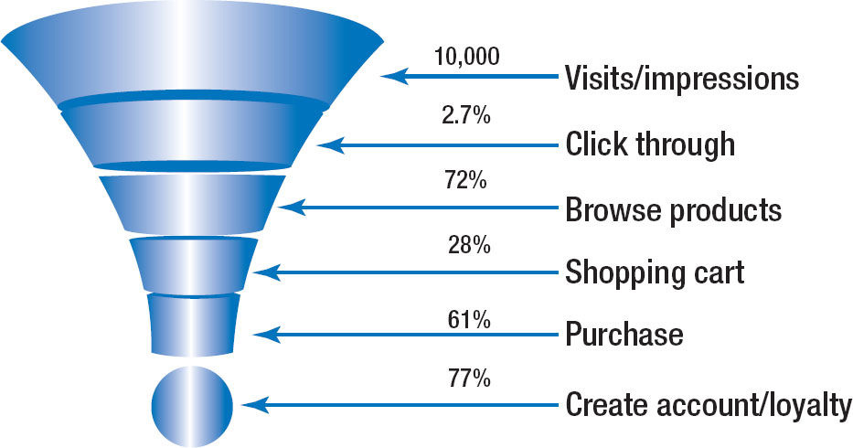
Figure 15.5 Sales Funnel Efficiency
Visits/impressions
Click through
Browse products
Shopping cart
Purchase
Create account/loyalty
Notes:
The sales funnel efficiency is an inverted pyramid that shows the percentage of individuals that pass to the next step in the sales process. It can identify where a problem exists. The percentages shown in this slide illustrate a sales funnel efficiency for Scott Equipment. It started with 10,000 visits or impressions of a banner ad. Of the 10,000 who saw the banner ad, 2.7% clicked through on it. Of those who clicked through, 72% browsed products. Of those who browsed the website, 28% put items in the shopping cart. Of those who put items in the shopping cart, 61% make a purchase. Of those who purchased 77% created an account or became loyal.

Slide 28
Web Chatter
Listen to web chatter
Listening software
Sentiment analysis
Notes:
Companies now monitor web chatter, listening to what consumers are saying. Software exists that can monitor and measure the level of web chatter. It can also measure the sentiment, whether it is positive or negative.

Slide 29
Figure 15.6 Social Media Metrics (1 of 2)
Volume Metrics
Views (total audience)
New likes/subscribers/followers
Lost likes/subscribers/followers
Location
Time/day of visit
Engagement Metrics
Mentions
Shares - Reposts/re-tweets
Likes
Comments
Time on page
Visits per (day, month)
Bounce rate
Notes:
Volume metrics measure the level of traffic to social media sites, and number of visitors to a social media site. Engagement measures show the level of engagement with social media sites and their level of involvement. Buzz score accounts for the number of times a brand receives a mention within a specific time frame. Conversion measures are important to evaluate the results of social media campaigns. Social media usually does not always result in sales so firms may want to have volume and engagement metrics as primary objectives.

Slide 30
Figure 15.6 Social Media Metrics (2 of 2)
Conversion Metrics
Click-through rate (CTR)
Conversion ratio
Cost-per-conversion (CPC)
Average order value (AOV)
Revenue per visit (RPV)
Funnel efficiency
Notes:
Volume metrics measure the level of traffic to social media sites, and number of visitors to a social media site. Engagement measures show the level of engagement with social media sites and their level of involvement. Buzz score accounts for the number of times a brand receives a mention within a specific time frame. Conversion measures are important to evaluate the results of social media campaigns. Social media usually does not always result in sales so firms may want to have volume and engagement metrics as primary objectives.

Slide 31
Behavioral Evaluations
Only evaluation – sales
Measures results
Not all communications objectives measurable
Promotions easier to measure than advertising
Notes:
Behavioral evaluations focus on the behaviors of consumers and the results of marketing efforts. For some, sales is the only legitimate measure of advertising and marketing. The difficulty with that view is that not all communication objectives are measurable and not all are designed to produce sales, at least in the short term. Also, promotions are easier to measure than advertising. Unless consumers mentioned to Flair that they saw this ad, Flair would have no way of measuring its impact on sales.

Slide 32
Figure 15.7 Behavioral Measures
Sales
Response rates
Redemption rates
Test markets
Purchase simulation tests
Notes:
In addition to sales, other behavioral measures include response rates, redemption rates, test markets, and purchase simulation tests.

Slide 33
Sales Behavioral Evaluations
Change in sales
UPC codes
Scanner data
Retailers
Manufacturers
Caused by other factors
Notes:
Sales can easily be measured using the UPC codes on every product. Scanner data is gathered by retailers on a regular basis and most share that scanner data with manufacturers. It can provide almost real-time sales figures. But, changes in sales can be caused by other factors than advertising or promotions.

Slide 34
Figure 15.8 Reasons Advertising is Difficult to Evaluate
Influence of other factors
Delayed impact of advertising
Consumers changing their minds
Brand in consumer’s evoked set
Level of brand parity
Notes:
Advertising is very difficult to evaluate for a number of reasons: 1) Other factors can influence sales, not just advertising. 2) The impact of advertising is delayed. It seldom will have an immediate impact. Further, advertisers really can’t predict how long that delay will last. 3) Consumers can change their minds. An ad can influence the brand choice, but once in the store, the consumer may choose a different brand. 4) If the brand is in the consumer’s evoked set, they are more likely to purchase it. If not, then it is unlikely one ad will move the brand into the evoked set. 5) Because of brand parity, consumers have a set of brands they choose from, not just one.

Slide 35
Response/Redemption Rates Behavioral Evaluations
Changes in sales
Telephone inquiries
Response cards
Internet responses
Direct response marketing results
Redemption rates of sales promotions
Notes:
In addition to sales, companies can use other forms of behavioral evaluations. Telephone calls and Internet responses can be tracked as the result of an advertisement. From direct mail and other direct response advertising, the number of response cards sent in can be measured. Lastly, redemption rates of promotions such as coupons, rebates, and premiums can be measured. All of these measures evaluate responses.

Slide 36
Test Markets Behavioral Evaluations (1 of 2)
Used to assess
Advertisements
Consumer and trade promotions
Pricing tactics
New products
Cost-effective method of evaluation prior to launch
Resembles actual situation
Design test market to model full marketing plan
Length of test market is a concern
Notes:
Test markets can be used to assess advertisements, consumer and trade promotions, pricing tactics, new products, and about any type of marketing program. Test markets provide a cost-effective means to evaluate a marketing tactic or new product before launching it nationwide or worldwide. The key is to make sure the test market resembles the actual situation as much as possible. It should mimic the full marketing plan. The length of the test market is a concern. If it is too short, then it may not be an accurate indicator of consumer reactions. If it is too long, then competitors and extraneous factors can interfere causing inaccurate results.

Slide 37
Test Markets Behavioral Evaluations (2 of 2)
Competitive responses
May introduce special promotion in test area
Not intervene
Prepare counter marketing campaign
Scanner data
Test results of test markets
Notes:
Competitive responses to a test market are a concern. Competitors may introduce a promotion in the test area to confound the results, or the competitor may choose not to intervene and prepare their own counter marketing campaign. Scanner data provide an accurate measure of sales in test markets, which can be compared to areas where there is no test market and also to data prior to the test market.

Slide 38
Purchase Simulation Tests Behavioral Evaluations
Bias in purchase intention questions
Simulated purchase tests
Research Systems Corporation
Does not rely on opinions and attitudes
Notes:
Another behavioral measure is purchase simulation tests. Purchase intention questions are biased with more people saying they will buy a product than actually do. Simulated tests are more accurate. Research Systems Corporation is a primary provider of simulation tests. It does not rely on opinions and attitudes. Research Systems Corporation uses a controlled lab and a simulated store to study consumer purchases. Subjects are given various scenarios or shown particular ads then asked to shop as they normally would at their store.

Slide 39
International Implications
Assessment of IMC Programs
Domestic results
Results in other countries
Overall organization
Individual ads and promotional programs
Local culture
Across national boundaries
Multinational – regional offices
Notes:
Measuring the IMC program in the domestic country is only part of the evaluation process, especially since many global firms have a large percentage of their sales outside of the domestic country. Results in other countries and the organization overall are important. It is also vital to measure individual ads and promotional programs because local culture can affect the results.

Slide 40
Copyright

