Slide 1
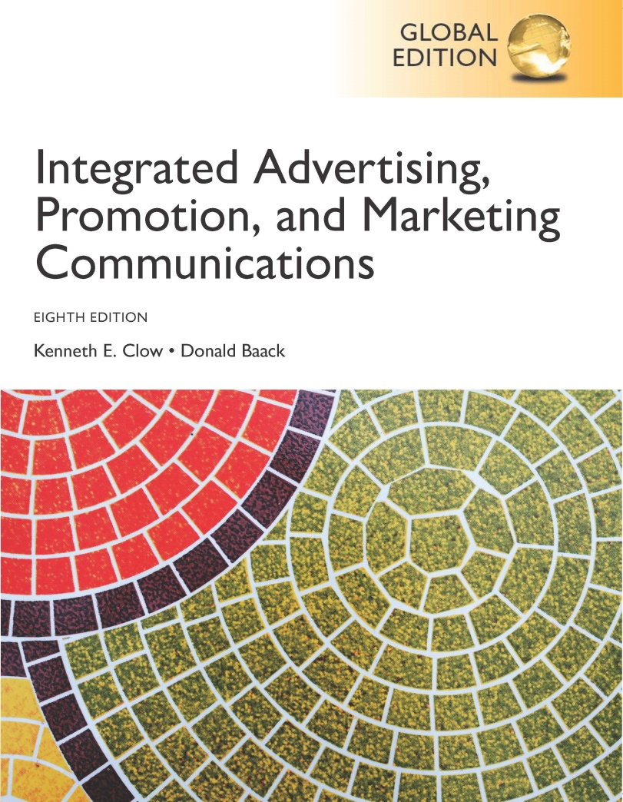
Integrated Advertising, Promotion, and Marketing Communications
Eighth Edition, Global Edition
Chapter 10
Alternative Marketing
Copyright © 2018 Pearson Education Ltd. All Rights Reserved
Notes:
Traditional mass media faces many challenges. Although advertisers are not ready to abandon mass media, they are looking for alternative ways to reach consumers.

Slide 2
Chapter Objectives
How can buzz marketing, guerilla marketing, lifestyle marketing, and experiential marketing enhance a marketing communications program?
What methods can be used to effectively employ product placements and branded entertainment?
Why has the use of alternative media venues, especially video game advertising, grown in marketing communications programs?
How have in-store marketing and point-of-purchase displays evolved into even more effective communications and sales tools?
How can brand communities enhance brand loyalty and devotion?
What methods are used to adapt alternative marketing programs to international marketing efforts?
Notes:
These are the objectives for Chapter 10.

Slide 3
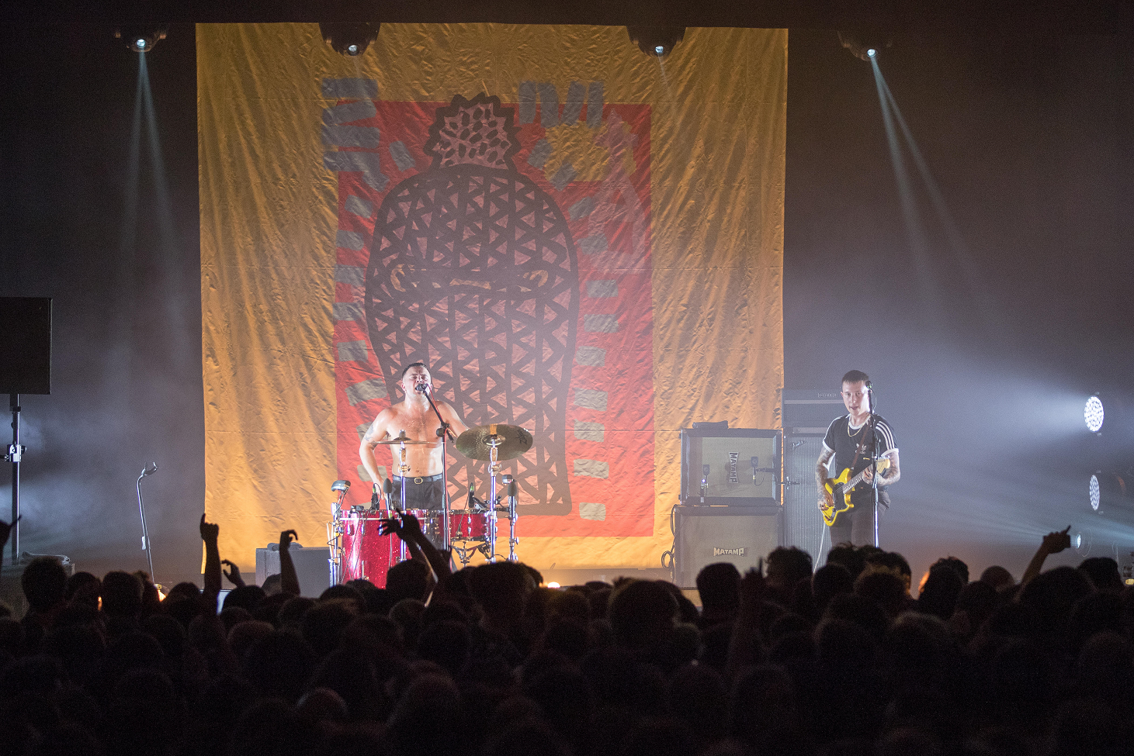
Take Control
Street teams in London
Latest release by Slaves
Targeted marketing campaign
Balaclava images
Interacted with fans queuing for the gigs
Notes:
The Prairie Fire Experience is an event held in Wichita, Kansas each year. Events range from a 5K run for fitness buffs to a fun race to go-carts, mini-golf, and rock climbing. The event utilizes a number of alternative marketing methods to promote the event as well as traditional advertising. Several demographic audiences are targeted – fitness buffs, parents with children, and visitors to Wichita.

Slide 4
Chapter Overview
Traditional media faces challenges
Alternative methods have emerged
Alternative media
In-store marketing
Brand communities
Notes:
Traditional media faces many challenges with clutter and declining attention. Alternative methods have emerged as advertisers look for new ways to reach consumers. Alternative approaches discussed in this chapter include buzz marketing, guerilla marketing, product placement, branded entertainment, and lifestyle marketing. Alternative media have also emerged, such as video games, mobile phones, and cinemas. In-store marketing has become more important since so many decisions are made in the retail store. Brand communities are an alternative approach that a few brands have been able to use.

Slide 5
Figure 10.1 Forms of Alternative Marketing
Buzz marketing
Guerrilla marketing
Lifestyle marketing
Experiential marketing
Product placement
Branded entertainment
Notes:
Alternative approaches discussed in this chapter include buzz marketing, guerilla marketing, lifestyle marketing, experiential marketing, product placement, branded entertainment. Each will be presented in greater detail in the chapter.

Slide 6
Alternative Marketing Programs
Requires creativity and imagination
Identify intersect paths
To succeed relies on
Buzz
Word-of-mouth
Lifestyle messages
Notes:
Developing alternative marketing programs requires creativity and imagination. Marketers look for new places where a consumer’s path intersects with a brand’s presence. The goal is to reach consumers in unexpected ways or in everyday life situations that resonate with consumers and where there is less competition for attention. Success is based on buzz, word-of-mouth communications, and people being receptive to lifestyle messages.

Slide 7
Buzz Marketing
Word-of-mouth marketing
Higher credibility
Fast growth – now $1 billion annually
More powerful than paid endorsers
Notes:
Buzz marketing has become one of the fastest growing areas in alternative marketing. Estimated expenditures for buzz marketing are now at $1 billion annually. Buzz marketing emphasizes consumers passing along information about a product. Since buzz marketing is word-of-mouth from an individual, it has a higher level of credibility.

Slide 8
Figure 10.2 Types of Buzz Marketing Approaches
Individuals who truly like a brand
Individuals sponsored by a brand
Company or agency employees
Notes:
Marketers can use three different approaches in buzz marketing – 1) locate individuals who truly like a brand, 2) sponsor individuals to promote and sell a brand, and 3) use company or agency employees as brand advocates.

Slide 9
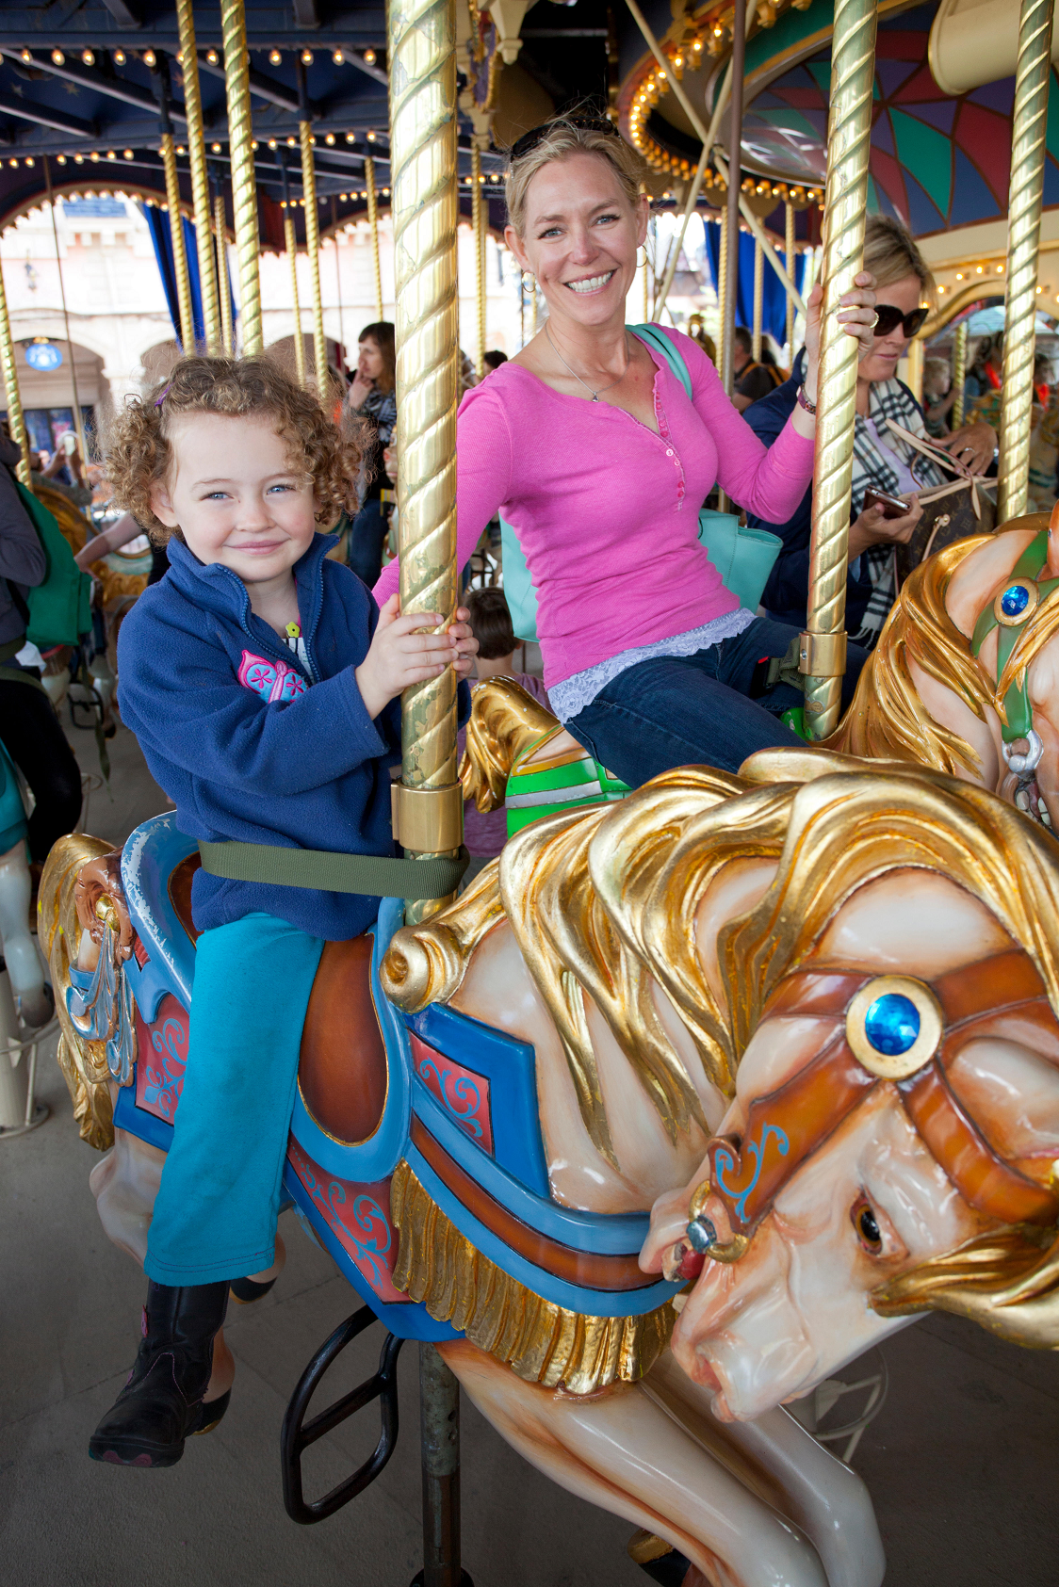
Consumers Who Like a Brand
Ideal ambassador
Buzz spread
In person
Internet
Chat rooms
Blogs
E-mails
Notes:
A consumer who likes a brand and uses it is the ideal brand ambassador. Such consumers can spread buzz through personal conversations with people and also online through chat rooms, blogs, and e-mails. While these are the ideal ambassadors, companies have no control of what they say or who they talk to.

Slide 10
Sponsored Consumers
Agent or advocate for a new brand
Brand ambassadors, customer evangelists
Typically individuals who already like brand
Offer incentives in exchange for advocacy
Selection based on
Devotion to brand
Size of social circles
Expected to deliver messages
Honest about relationship
Notes:
Many companies sponsor individuals as agents or advocates to introduce new products. It works best when the person likes the brand and uses it. Companies normally offer some type of incentive in exchange for the positive advocacy. It can be cash, but most of the time it is merchandise. The selection of brand ambassadors is based on a person’s devotion to a brand and the size of his/her social circle. Since the idea is to talk to their friends and other people, the size of the social influence is important. They are expected to design their own grassroots effort on how they will promote the brand. Many will use low-cost marketing events and even online social networks. Although the individual is being sponsored, the key to success is that they are genuine and really believe in the product being pitched.

Slide 11
House Parties
Nestle Purina
Spent $50,000 on 1,000 house parties
Chef Michael’s Canine Creations
Household
Incomes greater than $60,000
Pamper pets
BzzAgent
Offers house parties and brand ambassadors
Suzanne Ermel, Black Box wine
Notes:
Another approach is to use house parties. Nestle Purina spent about $50,000 on 1,000 house parties to introduce pet lovers to Chef Michael’s Canine Creations. The house party sponsors had to have incomes greater than $60,000 and believe in pampering pets. Pepsi used house parties to launch its Sierra Mist Ruby Splash. It contracted with a firm called Grow Marketing to locate individuals to host the parties. Pepsi delivered free drinks to about 300 parties.

Slide 12
Company Employees
Employees posing as customers
High-risk approach
Word of Mouth Marketing Association
Honesty of relationship
Honesty of opinion
Honesty of identity
Notes:
The last approach to buzz marketing is using company or agency employees. It is a high-risk strategy, especially if people don’t identify themselves as employees and the public finds out. The Word of Mouth Marketing Association (WOMMA) suggests three principles to follow for any type of buzz marketing campaign. 1) Be honest about the relationship you have with the company and what you get for being a sponsor. 2) Be honest with your opinion. Don’t say just what the sponsor company wants you to say. 3) Be honest about your identity.

Slide 13
Buzz Marketing Stages
Buzz marketing difficult during inoculation stage
Must use brand ambassadors or customer evangelists
True customer-generated buzz occurs after awareness
Awareness generated through traditional advertising
Notes:
Buzz marketing can be compared to the stages of a virus: inoculation, incubation, and infection. Inoculation is when the product is being introduced. It is difficult to generate buzz marketing during this stage. Incubation is when the product is being tried by a few innovators and trendsetters. Buzz marketing is easier, but still difficult. Infection is when widespread use of the product begins. During this stage is the best time for a buzz marketing program. True customer-generated buzz occurs after awareness, and often the awareness is generated through traditional media.

Slide 14
Figure 10.4 Preconditions of Buzz Marketing
Brand must be unique, new, or better performing
Brand must stand out
Advertising should be
Memorable
Intriguing
Different
Unique
Customer involvement with brand
Notes:
Buzz marketing works the best when the brand is unique, new, or performs better than the competition. The brand should stand out in some way. Its advertising should be memorable, intriguing, different, or unique. Buzz marketing works best if a company can get customers involved. Buzz marketing works because people trust someone else’s opinion, and people like to give their opinion.

Slide 15
Stealth Marketing
Surreptitious practices
Thrives in online world
Ethical debate
Shrewd method
or
Dishonest approach
Notes:
Stealth marketing uses surreptitious practices to introduce a product to someone or fails to reveal the individual’s true relationship with the brand. Stealth marketing thrives in the online world because people can hide their true relationship with the brand. Marketers debate if stealth marketing is ethical. Some argue it is a shrewd approach to get around all of the clutter. Others argue it is a dishonest approach since ambassadors hides their identities and are actually pitching products.

Slide 16
Guerilla Marketing
Developed by Jay Conrad Levinson
Instant results with unique, low-cost approaches
Focus on region or area
Involve interacting with consumers
Create excitement
Goal is to generate buzz
Grassroots efforts
Alternative media
Notes:
Guerilla marketing was developed by Jay Conrad Levinson. It is designed to bring instant results with low-cost, unique marketing methods. Guerilla marketing focuses on a region or area and involves interacting with consumers in a unique and different way. The goal is to create excitement and to generate buzz. It is often connected with grassroots efforts to launch a brand or to market a product. Often alternative media are used.

Slide 17
Figure 10.6 Reasons for Using Guerilla Marketing
To find new ways to communicate with customers
To interact with customers
To make advertising accessible to consumers
To impact a spot market
To create buzz
To build relationships with consumers
Source: Adapted from Lin Zuo and Shari Veil, “Guerilla Marketing and the Aqua Teen Hunger Force Fiasco,” Public Relations Quarterly, Vol. 51, No. 4 (Winter 2006/.2007), pp. 8-11.
Notes:
Marketers have a number of reasons for using guerilla marketing. Companies are looking for new ways to communicate and interact with customers that bypass the traditional methods. Guerilla marketing can make advertising more accessible to consumers. It can impact a spot market and create buzz that can quickly spread beyond where it is occurring. Guerilla marketing can be used to build relationships with customers.

Slide 18
Lifestyle Marketing
Associated with hobbies and entertainment
Contacting consumers where they go
Relaxation
Excitement
Socialization
Enjoyment
Notes:
Lifestyle marketing involves identifying marketing methods associated with the hobbies, entertainment, and lives of the target audience. It involves making contact with consumers where they go for relaxation, excitement, socialization, and enjoyment. The idea is to intersect with consumers during their daily lives. For instance, A/X Armani Exchange reaches young consumers by sponsoring and setting up booths at music festivals and fashion shows.

Slide 19
Experiential Marketing (1 of 2)
Direct marketing + Field Marketing + Sales Promotions
Direct marketing through interactive connection
Engage consumers
Cadillac
Current and perspective customers
Golf clinics
Culinary tour
High-performance driving
Cotton, Inc – Jack Morton Worldwide
Traveling mall exhibit
“The Fabric of Our Lives”
Notes:
Experiential marketing is the intersection of direct marketing, field marketing, and sales promotions. Its basic premise is increasing the experience of direct marketing through an interactive connection. Rather than just pass out samples, the idea is to make it an experience the consumer will remember. Nickelodeon used experiential marketing with its Slime Across America Tour. 30,000 kids were exposed to the exhibit, and 20 million television impressions resulted. Jack Morton Worldwide used a traveling mall exhibit to expose consumers to the benefits of cotton and cotton clothing. Consumers could sing and record their own version of the song “The Fabric of Our Lives.”

Slide 20
Experiential Marketing (2 of 2)
Steps to create positive experiences
Clear, concise target segment
Identify right time, right place
Engage emotionally
Engage logically
Clearly reveal brand’s promise
Notes:
Creating experiential marketing campaigns requires three steps. First, the target segment needs to be clearly and concisely identified. Second, identify the right time and right place to intersect with consumers to create a memorable experience. It needs to engage consumers emotionally and engage them logically. Third, the experience needs to clearly reveal the brand’s promise.

Slide 21
Product Placement and Branded Entertainment
“Getting products noticed has become increasingly difficult, so companies have shifted more dollars to product placements and branded entertainment.”
Notes:
Product placement and branded entertainment are alternative marketing methods designed to make an impression on people without looking like advertising.

Slide 22
Product Placement (1 of 2)
Planned insertion
Used since 1890s
Biggest surge in 1982 – E.T. and Reese’s Pieces
Product placements
Increase awareness
More positive attitude toward brand
No immediate impact on sales
Low cost per viewer
Movies
DVD movie rental
Pay-per-view television
Television
Notes:
Product placement is a planned insertion in a movie, television show, book, or other form of entertainment. It has been used since the 1890s, but only recently has grown in popularity. The biggest surge in product placement came in 1982 with E. T. and Reese’s Pieces. The placement of the Reese’s Pieces in the movie spurred a 65% increase in sales following the movie’s release. Research has found that product placement increases awareness of the brand and creates a more positive attitude towards the brand, but does not have any immediate impact on sales. From a cost standpoint, product placement has a low cost per viewer of impressions. A primary advantage is that the impressions do not stop with the movie. After the movie has played in theaters, it goes to DVD movie rentals, to pay-per-view television, then to the movie channels on television.

Slide 23
Figure 10.7 Top Television Product Placements
Top Brands | Blank | Top Shows | Blank
(Total occurrences/month) | Blank | (Total occurrences/month) | Blank
Coca-Cola | 99 | American Idol | 208
AT&T | 76 | Celebrity Apprentice | 127
Chevrolet | 45 | America’s Next Top Model | 88
Ford | 39 | Biggest Loser | 88
Apple | 32 | Amazing Race | 69
Everlast | 32 | Shedding the Wedding | 40
Nike | 32 | Dancing with the Stars | 38
Source: Based on “Product Placement Hits High Gear on American Idol, Broadcast’s Top Series for Brand Mentions,” Advertising Age, April 18, 2011, http://adage.com/article/media/product-placement-hits-high-gear-american-idol/227041/.
Notes:
In 2011, Coca-Cola and AT&T were the top brands in terms of product placement. The top show for product placement was American Idol with 208 per month. A distant second was Celebrity Apprentice with 127.

Slide 24
Product Placement (2 of 2)
Nielsen Research
Brands in “emotionally engaging” programs are recognized by 43% more viewers.
Brand recognition increased 29% in “highly enjoyed programs.”
Positive brand feelings increased 85% for brands in popular programs.
Source: Based on Linda Moss, “Nielsen: Product Placements Succeed in ‘Emotionally Engaging’ Shows,” Multichannel News, December 10, 2007.
Notes:
A.C. Nielsen research has further reinforced the positive impact of brand placements. Brands that were placed in “emotionally engaging” programs were recognized by 43% more viewers. Brand recognition increased 29% in programs deemed to be “highly enjoyable.” For other popular programs, positive feelings toward the brand increased by 85%.

Slide 25
Branded Entertainment
Brand woven into the storyline
Usage increased sharply with reality shows
Also found in novels, plays, songs, and movies
Notes:
Branded entertainment integrates entertainment and advertising by embedding the brand into the storyline of the movie, TV show, or other entertainment medium. The use of branded entertainment increased sharply with the rise of TV reality shows. It is also now found in novels, plays, songs, and movies.

Slide 26
Figure 10.8 Key Factors in Product Placement and Branded Entertainment
Media selection
Supporting promotional activities
Consumer attitudes toward placements
Placement characteristics
Regulations
Source: Adapted from Simon Hudson and David Hudson, “Branded Entertainment: A New Advertising Technique or Product Placement in Disguise?” Journal of Marketing Management, Vol. 22, No. 5/6 (July 2006), pp. 489-504.
Notes:
For successful product placement and branded entertainment, choosing the right media is important. It helps when other promotional materials are produced that reinforce or remind individuals of the brand and even the placement. Product placement and branded entertainment work because there is no call to action, so consumers tend to have a positive attitude towards the brand. Some consumers are more receptive than others. People in the 15-34 age group are more likely to notice product placements and be more receptive to them. Sometimes product placements allow companies to bypass regulations and get their products in front of their intended audience.

Slide 27
Company Tactics
Product Placement − Branded Entertainment
Reasons for increased spending:
Appeal stronger in non-advertising context
Perception of what others think is important
Provides post-purchase reassurance
Reaches people who place little value on brands
Notes:
Budgets for product placement and branded entertainment have been increasing for several reasons. 1) The appeal is stronger for a brand in a non-advertising context. 2) Perceptions of what others think is important, so if a favorite actor or actress is seen using the brand, then it supports the consumer using it. 3) It provides post-purchase reassurance that a good decision was made. 4) It can reach individuals who place little value on brands. If someone they admire uses a particular brand, then maybe he/she should consider purchasing it.

Slide 28
Media Perspective
Notes:
The media perspective on branded entertainment and product placement is very easy to understand – it generates revenue. With tight budgets, generating additional revenue by charging companies for brand placement makes sense.

Slide 29
Figure 10.9 Examples of Alternative Media
Video games
Cinemas
Subways
Street and mall kiosks
Escalators
Parking lots
Airlines
Shopping bags
Clothes
Notes:
Another approach to reaching consumers and breaking through ad clutter is to use some type of alternative media. This list contains some of the options advertisers have.

Slide 30
Video Game Advertising (1 of 2)
$7 billion per year spent on in-game ads
Very attractive market
75% of online households spend at least 1 hour per month playing online games
27% average 30 hours or more
Primary market is 16-34 year old males
Fastest growing market is females
Notes:
Product placement in video games has become common, generating about $1 billion a year in advertising revenue. Video games are a very attractive market. About 75% of online households spend at least 1 hour per month playing online games. About 27% of online households spend 30 or more hours a month playing online games. The primary market for video games is 17-34 year old males, which has been a market segment that has been difficult for marketers to reach. The fastest growing market for video games are females. It now makes up 40% of the market.

Slide 31
Figure 10.10 Video Game Advertising
In-game advertisements
Rotating in-game advertising
Interactive ads
Game-related websites
Advergames
Sponsored downloads
Mobile game apps
Notes:
Advertising in video games can take several forms. A common approach is static, in-game advertisements. To make it more interesting, companies can insert rotating in-game ads that will change over time. Interactive ads can be placed in video games, especially in online games. The Internet offers other possibilities, such as websites dedicated to games. Advergames are branded video games. An alternative is sponsored downloads, such as certain brands of cars for a racing game. The last form of video game advertising is mobile game apps.

Slide 32
Video Game Advertising (2 of 2)
Benefits
Game just as enjoyable with ads
Increases brand recall
Positive brand associations
New video game technology
Change ads in real time
Rotate ads
Deliver time-sensitive ads
Use interactive ads
Notes:
Video game advertising does not affect individuals playing video games. Well done ads in games can increase brand recall and produce positive brand associations. To combat ads becoming static, online games offer opportunities to change ads in real time and to rotate ads with new ones not seen before. Advertisers can deliver time-sensitive ads with special offers that expire. They can also create interactive ads.

Slide 33
Females and Video Games
130 million, 40% of gamers
WomenGamers.com
Need women to design games
Handheld games
Socially-oriented games
Notes:
Approximately 130 million females are now playing video games, which is about 40% of gamers. The website WomenGamers.com is dedicated to women who play video games. More women are needed to design games, especially for the female market. The types of games tend to be different. Females prefer handheld games and socially-oriented games.

Slide 34
Cinema Advertising
Ads prior to movie
Captive audience
Photosmart Premium Printer – HP
Cinema center of integrated campaign
30-second spot in pre-feature program
17,300 theaters
2,600 plasma screens in lobbies
Delivered 50,000 demonstrations
Delivered 700,000 lobby impressions
Notes:
Cinema advertising occurs prior to the movie. It is a captive audience. Most will watch the ad. HP recently used the cinema to launch its Photosmart Premium Printer. HP had a 30-second spot in the pre-feature programming on all screens in the theaters. It was shown in 17,300 theaters. HP placed 2,600 plasma screens in the lobbies of theaters and delivered 50,000 demonstrations of the printer. The lobby screens produced 700,000 gross impressions.

Slide 35
Other Alternative Media
Subways
Public facilities
Parking lots, stairs, escalators
Airlines
Visit South Walton
Unique airport signage
Facial recognition digital displays
Notes:
Other alternative media include subways, public facilities, parking lots, stairs, escalators, and airlines. An example of an alternative approach is Unleashed Dog Parks produced by Pink Jacket Creative that featured street kiosks, bus wraps, and billboards. Visit South Walton had a large out-of-home component that included signage at airports. A newer technology is facial recognition digital displays that produce ads based on the person’s gender.

Slide 36
In-Store Marketing
60% of purchase decisions made in stores
Receives limited funding
Notes:
Approximately 60% of all purchase decisions are made inside retail stores. In a survey of consumers, 52% said that in-store signage, displays, or point-of-purchase displays influenced their clothing purchase decision. Yet, the funds allocated to in-store marketing efforts are a very small part of marketing budgets.

Slide 37
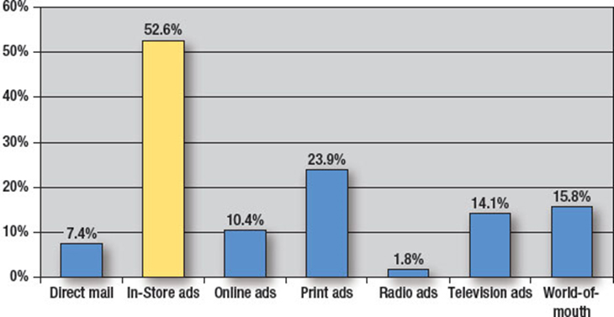
Figure 10.11 Types of Advertising that Most Influenced Clothing Purchases
Source: Adapted from Amy Johannes, “Snap Decisions,” Promo, Vol. 18, No. 11 (October 2005), p. 16.
Notes:
This graph shows the results of a survey of consumers about what most influenced their clothing purchases. In-store advertising was by far the most influential. The second closest was print ads, at 23.9% versus 52.6% for in-store advertising.

Slide 38
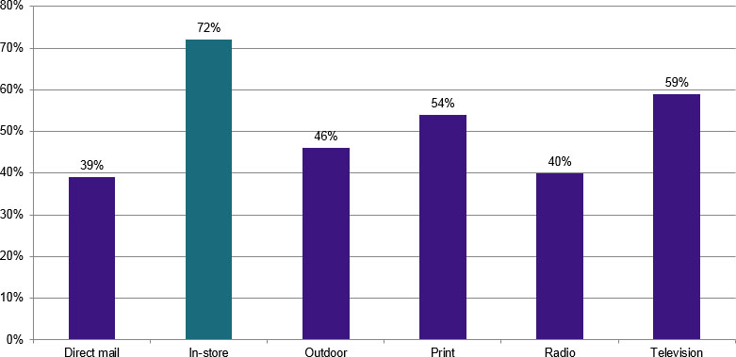
Awareness of New Products
Bonus slide
Source: Based on Wayne Friedman, “Brands Profit by In-Store, Word-of-Mouth Marketing, Media Daily News, http://www.mediapost.com/publications/article/193422/brands-profit-by-in-store-word-of-mouth-marketing.html, February 13, 2013”.
Notes:
(Bonus Slide, not in text) This slide shows how consumers become aware of new products. In-store location and displays are the number one source, 72%. Second is television ads (59%) followed closely by print ads (54%). Other sources of awareness include outdoor (46%), radio advertising (40%), and direct mail (39%).

Slide 39
In-Store Marketing Tactics
In-store “make or break” time
Engage customers
Most engaging
End-aisle displays
Merchandise displays
Lease engaging
Ceiling banners
Overhead mobiles
Use color, light, sound, taste, and smell
Motion
Video screens
Television monitors
Digital signage
Notes:
The in-store shopping experience has a major impact on purchase decisions. It is the “make or break” time in terms of a decision to purchase a particular brand. In-store advertising seeks to engage customers. The most engaging forms of advertising are end-aisle displays and merchandise displays. The least engaging are ceiling banners and overhead mobiles. Using color, light, sound, taste, and smell increases engagement. Motion also engages customers. The motion can be video screens, television monitors, or even digital signage.

Slide 40
Point-of-Purchase Tactics
Location is key
Last chance to reach buyer
Effective for increasing sales because
60% of decisions are in a store
50% of money spent at mass merchandisers and supermarkets is unplanned
50% of Coca-Cola products from displays
Average increase in sales is 9%
Half of POP displays not effective
Half that are effective – 20% increase in sales
Notes:
For point-of-purchase displays location is the key. It is the last chance to reach a potential buyer. POP displays have proven to be effective for increasing sales because most decisions are made in the store. The average increase in sales for a POP is 9%. Only about half of the displays actually impact sales, but for those half the boost is around 20%. Currently, manufacturers spend about $17 billion a year on POP displays.

Slide 41
Figure 10.12 Effective Point-of-Purchase Displays
Integrate the brand’s image into the display
Integrate the display with current advertising and promotions
Make the display dramatic to get attention
Keep the color of the display down so the product and signage stand out
Make the display versatile so it can be easily adapted by retailers
Make the display re-usable and easy to assemble
Make the display easy to stock
Customize the display to fit the retailer’s store
Notes:
An important key to developing POP displays is to tie the display into current advertising, promotions, and brand image so consumers recognize the display quickly. Making it dramatic with digital displays will get more attention than static displays. From a retailer’s standpoint, a POP needs to be easy to construct, be easy to use, and boost retail sales.

Slide 42
Measuring POP Effectiveness
Retailers and manufacturers want effective displays
Point-of-sales (POS) data
For retailers
Indicate time to withdraw or change display
Identify POP displays with largest impact
Test market different displays
For manufacturers
Data can improve quality of displays
Strengthen relationships with retailers
Notes:
Both retailers and manufacturers want effective displays because they benefit both parties. The advantage that POP displays offer is the POS data generated by the retail stores. This sales data will tell retailers when to withdraw or change displays and which displays have the most impact. The data can be used to test different displays. The benefit for manufacturers is similar. The data can help them know which displays work well and how to improve displays to improve performance. It can strengthen relationships with retailers as the two work together to boost sales.

Slide 43
Brand Communities
Ultimate demonstration of
Brand loyalty
Brand devotion
Symbolic meaning
Interactions between brand and consumer
Shared values and experiences
Cannot be created by brand itself
Marketing can enhance community experience
Notes:
Brand communities are the ultimate in brand loyalty and brand devotion. Jeep, Apple, and Harley Davidson are three brands that have developed strong brand communities. People join a brand community for several reasons. They offer symbolic meaning and provide for interaction between the brand, consumers, and companies that participate. People join because they have shared values and experiences. Brand communities cannot be created by brands or companies but have to be customer driven. Brands can enhance the community and provide a richer brand community experience.

Slide 44
Figure 10.13 Reasons Brand Communities Form
Affirmation of the buying decision
Social identity and bond
Exchange stories
Swap advice and provide help to others
Feedback and new ideas
Notes:
People join a brand community as an affirmation of their buying decision. It provides social identity and forms a bond with fellow brand owners. Brand owners can exchange stories, swap advice, and provide help to each other and to new members. A brand community provides a venue for feedback and new ideas.

Slide 45
Figure 10.14 Ways to Enhance a Brand Community
Create benefits to encourage new customers to join
Provide materials not available anywhere else
Involve firm representatives in the groups
Sponsor special events and regular meetings
Promote communications among members
Build a strong brand reputation
Source: Adapted from “Brand Communities,” Bulletpoint, No. 133 (July 2006), pp. 12-16.
Notes:
Companies can enhance a brand community. Companies can create benefits for individuals to encourage them to participate and join in the brand community. Materials and items not available to the public can be provided to members. Representatives from the firm can become involved and sponsor events and meetings. Brand communities can encourage and provide an avenue for members to communicate with each other. It is also important for the company to continue its strong brand name and maintain its reputation. Skyjacker is an active participant with Camp Jeep. It benefits the brand community and provides excellent exposure for the company.

Slide 46
International Implications
Alternative marketing – U.S. minorities
Alternative media used in other countries
A Sunny Day – China (Pepsi and Starbucks)
Brand communities developing in other countries
Jeep – China
Ad clutter a global problem
Growing use of alternative media tactics
New alternative marketing programs
Notes:
In addition to international markets, companies should consider alternative marketing to U.S. minorities. Alternative marketing is growing in other countries. For instance, in Japan Pepsi and Starbucks combined efforts to create the movie A Sunny Day that was tailored for Shanghai’s subway system. Camp Jeep and other Jeep events are held in China, very similar to the ones in the U.S. Ad clutter is a growing global problem, not just a U.S. problem. As a result, alternative programs are growing globally, and new alternative programs are being created that are unique to other regions and countries.

Slide 47
Blog Exercises
Coca-Cola
Harley Davidson
Buzz Marketing
Notes:
The blog exercises for Chapter 10 include Cola-Cola, Harley Davidson, and links to information on buzz marketing.

Slide 48
Copyright

