Slide 1
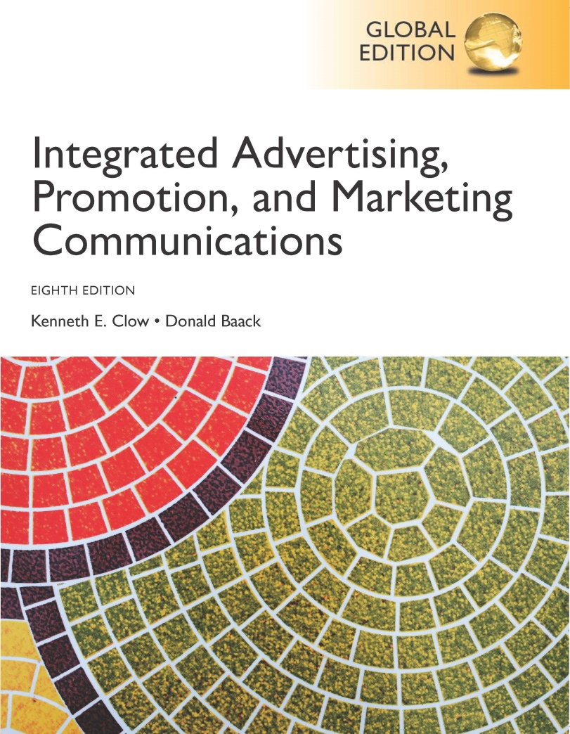
Integrated Advertising, Promotion, and Marketing Communications
Eighth Edition, Global Edition
Chapter 9
Social Media
Copyright © 2018 Pearson Education Ltd. All Rights Reserved
Notes:
The topic for this chapter is social media.

Slide 2
Chapter Objectives
What constitutes a social network?
What unique characteristics are parts of primary social media websites?
What is the nature of social media marketing?
Which social media marketing strategies do companies employ?
How can marketers use social media strategies in international operations?
Notes:
These are the objectives for Chapter 9.

Slide 3
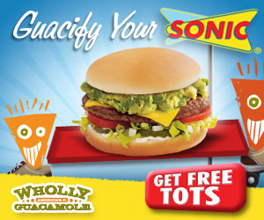
Wholly Guacamole
High pressure processing
Staple item, popular
Leverage social media
Brand alliances
Biggest Loser
Sonic
Disney
Notes:
Wholly Guacamole’s founder, Don Bowden, discovered a high pressure process that results in a “100% all natural, fresh tasting product.” Guacamole is now a popular item that is used on a large number of foods and for sandwich spread. Wholly Guacamole brand was built through leveraging social media to create brand awareness and boost sales To stretch limited advertising dollars, Wholly Guacamole developed brand alliances with the Biggest Loser television show, Sonic drive-in, and the Disney movies Diary of a Wimpy Kid and The Lion King.

Slide 4
Chapter Overview
Altered communications
Basics of social networks
Popular social networks
Social media marketing
Social media metrics
International issues
Notes:
Chapter 9 opens with a discussion of how social media has altered communications among individuals and between businesses and consumers. The basics of social networks are presented and the most popular social networking sites are described. Social media marketing strategies and tactics are explored. The chapter highlights some of the social metrics that can be used to evaluate a brand’s social strategy. The chapter concludes with a brief discussion of international issues with social media.

Slide 5
Social Media Terms
Social media – digital tool or venue that allows for social interaction
Social network – social structure of individuals or organizations
Social media marketing – utilization of social media or social networks to market a product, company, or brand
Notes:
Social media is any digital tool or venue that allows individuals to socialize on the web. A social network is a social structure of individuals or organizations that are tied together in some manner. Social media marketing is the utilization of social media and social networks to market a product, company, or brand.

Slide 6
Figure 9.1 Types of Social Networking Sites
General social networking sites
Niche social networking sites
Business
Family and lifestyle
Dating
Special interests and hobbies
Shopping
Social bookmarking sites
Notes:
General social networking sites are broadly based and are designed to appeal to all demographics. Facebook is an example. Niche social networking sites focus on a specific topic, hobby, interest or demographic group. LinkedIn is an example of a business niche site. Subcategories of niche sites include business, family and lifestyle, dating, special interests, hobbies, and shopping. Social bookmarking sites allow individuals to share bookmarks of their favorite websites.

Slide 7
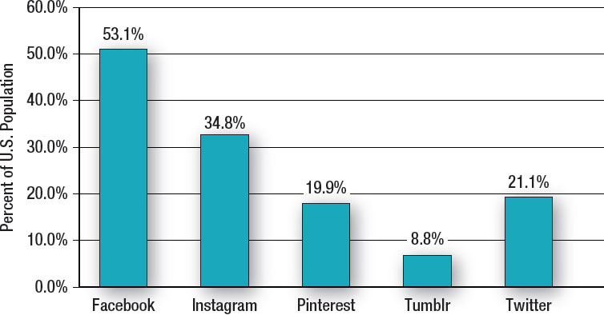
Figure 9.2 US Social Network Penetration
Source: Based on “This Year, More Than Half of Americans Will Use Facebook,” https://www.emarketer.com/Articles, February 8, 2016.
Notes:
This graph shows the penetration of the major social networking platforms.

Slide 8
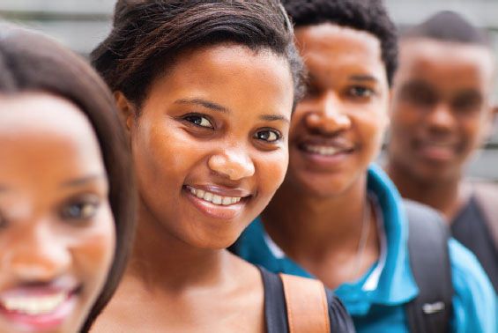
Facebook
Largest social media site
1.2 billion users worldwide
Advertising
72% of social media dollars
$10 billion
Custom audiences
Demographics
Teens decline 25%
Individuals 55+ increase 80%
Usage
Only 10% update status daily
Only 15% comment daily
Notes:
Facebook is the largest social media networking site with 1.2 billion users worldwide. In terms of advertising, Facebook generates $10 billion per year and captures 73% of social media advertising dollars. Facebook now allows custom audiences targeting – which allows marketers to gather information a company’s website then use that to target specific individuals on Facebook. Demographically, teens are deserting Facebook, a decline of 25% in the past 3 years. At the same time the number of seniors, 55 and older, has increased 80% to 28 million. Usage is concentrated on a small percentage. Only 10% update their status daily, 4% more than once a day, and only 15% make comments daily.

Slide 9
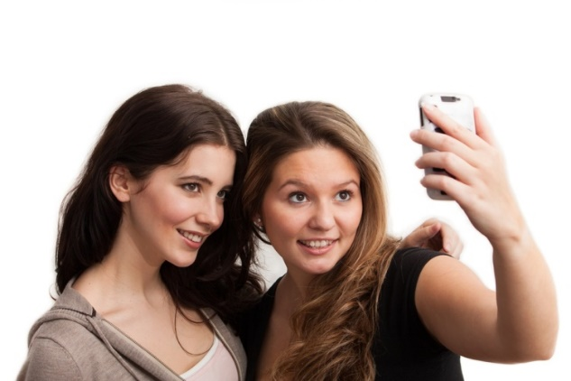
Instagram
Mobile photo and video sharing
Owned by Facebook
200 million users
Users young, wealthy, and female
60% visit daily
Popular marketing tactics
Contests
Crowdsourcing of photos
Uploading personal photos with brand clothes
Notes:
Instagram is a mobile photo and video sharing website owned by Facebook. It has 200 million plus users, 60% who tend to visit daily. Users tend to be young, wealthy, and female. Popular marketing tactics include photo and/or video contests and the crowdsourcing of photos. Consumers are also uploading personal photos wearing branded clothing. These are then uploaded to a brand’s page or links are provided from the brand’s website.

Slide 10
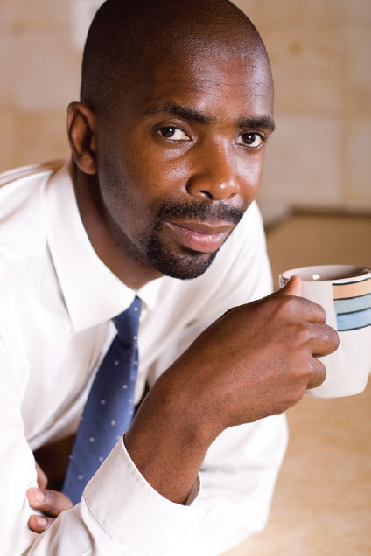
Twitter
Micro-blogging service
Maximum of 140 characters per message
54 million users
41 percent are minority
Effective method of reaching customers
Monitor what customers are saying
Effective for small businesses
Notes:
Twitter is a micro-blogging service that allows individuals and companies to send tweets with a maximum of 140 characters per message. Approximately 41 percent of users are minorities, with African-Americans the largest minority group. The number of Hispanics is also high. Twitter can be an effective tool for brands to reach consumers with a message. It can also be used to listen to what consumers say about a brand. Twitter can be an effective means of marketing for small businesses.

Slide 11
Figure 9.3 Tips for Using Twitter
Develop a strategy
Maintain consistent brand voice
Engage followers
Focus on relationships
Respond to customer comments
Avoid total automation
Notes:
This slide provides tips for using Twitter. It is critical to develop a strategy to maintain a consistent brand voice. A primary goal is to engage followers and focus on building relationships, not on pushing sales. It is important to respond to customer comments, both good and bad. Brands should avoid total automation as this will soon become evident to followers and will loose credibility.

Slide 12
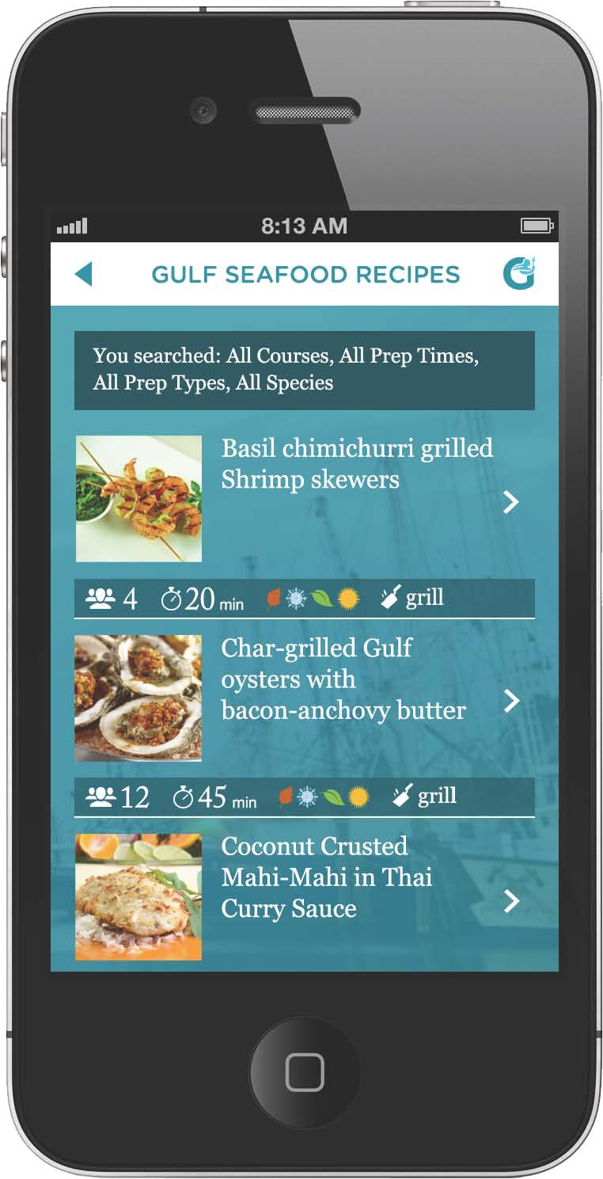
Pinterest
Bulletin-board style social network
70 million users
70% are female
Popular topics
Food
Fashion
Notes:
Pinterest is a bulletin-board style social networking site with over 70 million users, 70% of which are females. Popular topics are fashion and food.

Slide 13
YouTube
By 2017 YouTube will surpass Facebook and Twitter
Covergirl, Revlon – 99% views consumer generated
Swiffer ad re-creations – 10.5 million views
Fan-produced videos exceed brand-produced
Product usage or repair – videos instead of manuals
Brands monitor fan-created videos
Positive videos – support
Negative videos – creatively respond
Notes:
By 2017 YouTube is expected to have more views, likes, and shares than Facebook or Twitter. The previous slide highlighted the current trends in video sharing. Consumers produce the vast majority of videos on YouTube. For instance, for Covergirl and Revlon, 99% of videos viewed are fan-produced. A new trend is consumers re-creating broadcast ads, such as the Swiffer ads. Some follow the script of Swiffer, others create a variation of the script. Rather than access websites or technical support, many consumers access YouTube to watch how-to videos and repair videos. Brands must monitor fan-created videos. Companies may want to support positive videos. Negative videos may require a response, or they can serve as learning tools.

Slide 14
Figure 9.4 Trends in Consumer Video Sharing
Uploading broadcast ads
Video reviews of products
Re-creation of ads
Creating consumer produced how-to videos
Capturing real-time events
Creating branded videos
Notes:
Posting videos on YouTube and other video sharing sites has grown tremendously in the last few years. This slide shows current trends in consumer video sharing. Consumers are uploading broadcast ads, especially TV ads, to the Internet. Most are ads they like, but some are ones they dislike. Rather than writing a product review, consumers are posting video reviews. Consumers are re-creating ads for popular brands or ads they find appealing. Consumers are posting videos on how to use products or how to repair products. Recently, videos of real-time events are being posted. Most do not involve brands, but occasionally they do. Lastly, consumers are creating branded videos highlighting their personal experiences with a brand.

Slide 15
Figure 9.5 Reasons for Social Media Marketing
Engage fans
Increase brand exposure
Avenue for customer interaction
Increase traffic
Generate leads
Enhance brand image
Improve search rankings
Gather customer intelligence
Develop loyal fans
Increase sales
Source: Based on “Social Strategies for 2014,” Wildfire by Google Whitepaper, Ad Age Content Strategy Studio, October 2013; Michael A. Stelzner, “2013 Social Media Marketing Industry Report,” Social Media Examiner, http://www.socialmediaexaminer.com/, 2013.
Notes:
Listed on this slide are reasons companies become involved in social media marketing. The primary reasons are to engage fans and increase brand exposure. If increasing sales is a major reason, the social media marketing strategy is likely to fail. It can be a way to generate leads, increase traffic, and develop loyal fans. Such actions can be enhanced by creating an avenue for customer interaction. If done correctly, a brand’s image can be enhanced.

Slide 16
Reasons for Social Media Marketing (1 of 4)
Engage fans
Increase brand exposure
Hooters
Brand rejuvenation
Social media integral component
Engage females
Share experiences
Notes:
Hooters and Wholly Guacamole provide good examples of achieving the first three reasons for using social media. With Hooters brand re-vamp, the goal was to attract female fans while keeping the company’s male audience. Social media was an integral part of the campaign. Consumers were encouraged to share experiences at Hooters via social media. With Wholly Guacamole, the Lion King DVD giveaway yielded 95,000 impressions on Facebook and provided a means for customer interactions.

Slide 17
Reasons for Social Media Marketing (2 of 4)
Drive traffic
Enhance brand image
Provide Web URL in social media
Generate leads – business-to-business
Enhance brand image
Solve problems
Provide information
Gain insights into product usage
JD Powers
Online interactions impact brand perceptions
Notes:
Social media can drive traffic to a website by providing the URL in social media content. For business-to-business operations, social media can generate leads that can be followed up by sales staff. To enhance a brand’s image, social media must do more than offer communication opportunities. Brands must solve consumer problems, provide information, and offer insights into product usage. According to JD Powers, online interactions impact brand perceptions, either positively or negatively.

Slide 18
Reasons for Social Media Marketing (3 of 4)
Improve [organic] search rankings
Brand name mentioned in social media
Search engine algorithms examine mentions
Content or comments fit search terms
Quality of interactions enhanced
Notes:
Social media can boost organic search rankings in two ways: 1) brand name mentions in social media and 2) content or comments in social media that fit search terms. In the first case, search engine algorithms examine brand mentions in social media as part of determining search rankings. In the second case, the quality of search results is enhanced if the comment or content fits the search terms.

Slide 19
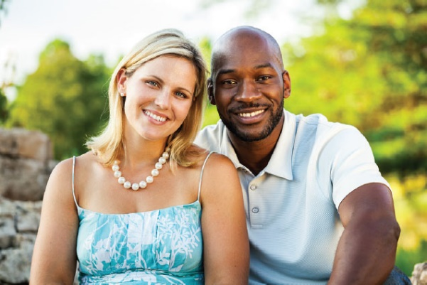
Reasons for Social Media Marketing (4 of 4)
Customer intelligence
Social listening, social chatter
Provides insight into customer thoughts
Occasionally, social buzz requires a reaction
General Mills
Cheerios ad
Negative racist comment
Comment section disabled
Believed comments were a minority
Did not discontinue ad
Notes:
Customer intelligence involves social listening or listening to social chatter. It provides insight about customer thoughts, both negative and positive. Most comments are honest and reveal what individuals think. Occasionally, social buzz requires a brand reaction, such as the case with General Mills. A Cheerios ad featured a mixed-race marriage. When posted to YouTube, the ad received a large number of views and some negative, racist comments. General Mills believed these comments represented a minority so disabled the comment feature, but did not discontinue the ad.

Slide 20
Figure 9.6 Functions of Social Listening
React to negative feedback
Detect problems
Gather topics for branded content
Predict trends
Detect patterns or shifts in views
Identify brand advocates
Notes:
Social listening allows a firm to react to negative comments made by individuals. Social listening can be used to detect problems with the product. It can also be used to gather ideas for branded content because it will show problems people are facing. Social listening can be used to detect consumer behavior patterns or shifts in consumer views and to predict trends. Lastly, social chatter can identify brand advocates, individuals who really love a brand.

Slide 21
Brand Advocates Social Listening
4.7% fans generate most social buzz
Most customers do not make comments
Brand advocate characteristics
Behavioral commitment
Emotional connection
Quality communication skills
Recruit brand advocates
Notes:
One purpose of social listening is to locate brand advocates. The majority of customers do not make comments about a brand on social media. Nearly all social buzz is generated by 4.7% of fans. Some say it is 20%, but the idea is that a small percentage generates most of the buzz. These brand advocates should be recruited. Characteristics of brand advocates are behavioral commitment to the brand, emotional connection to the brand, and quality communication skills.

Slide 22
Reasons for Social Media Marketing
Increase sales
Build brand loyalty
Should be secondary objectives
Coca-Cola study
No relationship between buzz and sales
McKinsey study
Negative buzz – 8% sales decline
Notes:
Increasing sales and building brand loyalty should be secondary goals of a social media marketing program. Engaging consumers with the brand should be the primary reason. A study by Coca-Cola found no relationship between social buzz and sales. But, for mega brands like Coca-Cola, social media is not an option, it is a must. A study by McKinsey & Co. found negative buzz about a telecom company caused an 8% decline in sales.

Slide 23
Successful Social Media Marketing L’Oreal
Goal is to keep in touch with customers
Three-part strategy
Different marketing strategies and Facebook for each country
Create content that leads to social conversations
Works best when encountered before and after a purchase
Notes:
L’Oreal provides a good example of successful social media marketing. The goal of the brand’s social media program is to keep in touch with customers in each step of the purchase decision. To maximize the impact of the social media effort, L’Oreal uses a 3-part strategy. First, different marketing strategies and different Facebook pages are used for each country. Each country is unique so requires a different approach. Second, L’Oreal creates content that leads to social conversation. The company will ask questions, provide beauty advice and ask customers to share stories. Third, social media works best both before and after a purchase.

Slide 24
Figure 9.7 Building a Social Media Presence
Determine social media goals
Determine online personality
Decide on social media platforms
Develop social media strategies
Develop an analytical feedback loop
Notes:
This slide shows the steps involved in building a social media presence. It starts with determining the social media goals. The type of goal set determines the best strategies. Once goals have been set, then determine the online personality the company wants to convey in social media and then decide on the social media platforms. Social media strategies are chosen based on the goals, online personality and social media platforms. The last step is to develop an analytical loop that examines data from social media to make changes in what is happening with social media.

Slide 25
Figure 9.8 Social Media Strategies
Content seeding
Real-time marketing
Video marketing
Influencer marketing
Interactive blogs
Consumer-generated reviews
Viral marketing
Notes:
Social interaction is the primary purpose of social media. Marketers realize that this social interaction provides opportunities if approached properly. This slide highlights current strategies being used. Because of the newness of social media, companies are still developing strategies and experimenting with different marketing programs.

Slide 26
Content Seeding
Provide incentives to encourage sharing
Financial incentives
Coupons
Rebates
Contests
Esurance post-Super Bowl ad
Value-added incentive - Exclusivity
Notes:
Just as plants grow from seeds, marketers can plant seeds that consumers will then share with others. Financial incentives are the most common and have the best track record of working. Coupons, rebates, and contests are often used. Occasionally, a mistake can be a seed for a brand. Esurance purchased an ad after the Super Bowl for $3.5 million. Held a contest offering $1.5 million. Value-added incentives used by brands include some type of exclusive information or benefit.

Slide 27
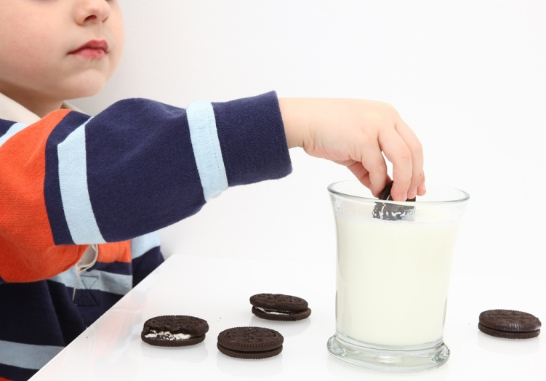
Real-Time Marketing
2013 Super Bowl – Oreos
Instantaneous marketing message
Live event
Upfront strategic planning
Maintain brand image
Notes:
Real-time marketing is the creation and execution of an instantaneous marketing message in response to or during a live event. It began as a legitimate strategy in the 2013 Super Bowl when Oreo cookies sent out a tweet during a blackout. Now brands have “war rooms” where company experts gather during a live sporting event. War rooms look for opportunities to create and send out marketing messages. To be successful, however, there needs to be upfront strategic planning as well as policies and rules governing real-time marketing messages. A natural event, such as a snowstorm, can also be used for real-time marketing.

Slide 28
Video Marketing
58% US population watch videos
75% Internet users watch videos
Spending now $4.6 billion
Growing 20% to 40% annually
More receptive to online videos
Notes:
Video marketing has increased in popularity. About 58% of US population watch videos and 75% of Internet users watch digital videos. Spending on videos sites such as YouTube is now at $4.6 billion, growing at a rate of 20% to 40% per year. Individuals watching digital videos are more receptive than individuals watching TV ads, and they watch the ad longer.

Slide 29
Figure 9.9 Video Marketing
Advertising on videos
Posting of television ads
Informational videos
Cause-related videos
Product reviews
Vloggers
Notes:
Brands have a variety of video marketing tactics from which to choose.

Slide 30
Location of Video Ads
Pre-roll
Higher impressions
Enhance recall
Mid-roll
Higher completion rate
Enhance brand recognition, brand image
Post-roll
Higher click-through rate
Direct response, call to action ads
Notes:
Video ads that are pre-rolled have a higher level of impressions and is good to enhance brand recall. Mid-roll ads have the highest completion rate and a good to enhance brand recognition and brand image. Post-roll ads have a higher click-through rate and are good for direct response ads and ads with a call-to-action of some type.

Slide 31
Influencer Marketing
Individual marketing a brand
Match opinion leaders with brands
Number of followers not always key
Lead conversations and shape opinions
Align brand message & influencer’s motivation
Authenticity important
Notes:
Because most brand content is ignored, brands are using influencer marketing, which is individuals posting positive comments and information about brands. It is important to match opinion leaders with brands where the brand message is aligned with an influencer’s motivation. Number of followers not always a key to success. Most important is if they lead conversations and shape opinions. To be effective, influencers must be seen as authentic.

Slide 32
Interactive Blogs
Internet provides platform for
Dissatisfied consumers
Satisfied consumers
Interactive allows two-way communication
Higher level of risk
Notes:
The Internet provides a platform for consumers to vent their feelings. In the past, a dissatisfied customer told 12-15 friends and relatives, now he/she can tell thousands or even millions via social media. Satisfied customers also have the opportunity to share their feelings. Interactive blogs allow visitor comments. By doing so, brands have a higher level of risk since they cannot control what individuals post. Decisions do have to be made, however, on how the brand will handle negative comments.

Slide 33
Figure 9.11 Types of Interactive Blogs
Brand blog
Individuals sponsored by a brand
Individual speaking about a brand

Slide 34
Company-Sponsored Blogs
Benefits
Reassure shoppers
Glimpse of how firm deals with customers
Release company information
Customers can voice opinions
Company controls site
Difficult to solicit honest opinions
Employees may be more sensitive to negative comments
Notes:
A number of companies have developed blogs for their customers and consumers to visit. Having a company-sponsored blog reassures shoppers and gives them a glimpse of how the company deals with customers. It is an avenue for the company to release new information and for customers to voice opinions. Most importantly, the company controls the website, so it has an opportunity to respond to complaints. It is important to be honest and not suppress negative comments.

Slide 35
Personal Blogs
Sponsored by brands
New FTC regulations
Limited freedom since blog is sponsored
Visitors’ comments may be tempered
Individuals speak about brands
No financial connection
Visitors feel more comfortable in commenting
Brands can learn
Brands can post comments or questions
Notes:
Personal blogs can be sponsored by a brand. New FTC regulations require that if a blog is being sponsored by a brand, the blogger must reveal this information on the blog. Since the blog is sponsored by a brand, bloggers have limited freedom to make comments if they want to retain the sponsorship and visitors’ comments are also often tempered. Blogs where individuals speak about a brand have the most freedom for bloggers as well as visitors. These blogs can be a good way for a brand to learn what people think. Brands can also post comments or ask questions.

Slide 36
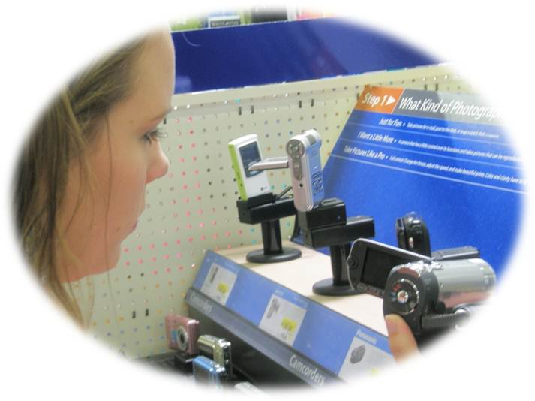
Consumer-Generated Reviews
Amazon.com – leader
Best Buy – online reviews of brands
Provide important information
Challenge – managing reviews
Notes:
Consumer-generated reviews have grown in popularity. The leader is Amazon.com., which provides reviews on most books and items sold. Amazon encourages customers to write reviews for other customers. Best Buy also offers customer reviews on various brands. Customer reviews are a good way to reach early adopters. Customer reviews can have some negative implications if a company or brand receives negative reviews and low-star ratings. This information can be used for developing marketing plans, modifying products, and creating service strategies. Customer reviews have driven companies to focus more on consistent product quality.

Slide 37
Viral Marketing
Message passed from one consumer to another
E-mail
Blogs
Form of advocacy or word-of-mouth endorsement
Viral marketing messages
Advertisements
Hyperlinked promotions
Online newsletters
Streaming videos
Games
Notes:
Viral marketing involves passing along a marketing message to others in some way. It can be through an e-mail or on a blog. It is form of word-of-mouth endorsement. Viral messages can be advertisements, hyperlinks to promotions, online newsletters, streaming videos, or games.

Slide 38
Figure 9.12 Keys to Successful Viral Marketing
Focus on the product or business
Determine why individuals would want to share the message
Offer an incentive
Make it personal
Track the results and analyze the data
Notes:
To create successful viral marketing programs requires a focus on the product or business. Viral marketing needs to be related in some way to the brand. The business must seriously think about why individuals would want to pass the message along. What makes the message unique or different? It has to be fun and cause a person to say, “I’ve got to send this to my friends. They have to see it.” An incentive can be offered, but that does not always work because it is seen as a sales trick. The viral message should be personal in some way. It is important to track results and analyze the data to see what worked and what didn’t, and what people did with the viral message.

Slide 39
Figure 9.13 Why Consumers Follow Brands
Keep up with activities
Learn about products or services
Sweepstakes or promotion
Provide feedback
Join community of fans
Make purchases
To complain
Source: Based on Lenna Garibian, “Digital Influence: Blogs Beat Social Networks for Driving Purchases,” MarketingProfs, http://www.marketingprofs.com/charts/2013/10336/digital-influence-blogs-beat-social-networks-for-driving-purchases, March 18, 2013.
Notes:
The top two reasons consumers follow a brand are to keep up with the brand’s activities and to learn about new products and services. Sweepstakes and promotions can entice some consumers to follow a brand. Fans of a brand may provide positive feedback. If someone likes a brand, they may follow it in social media to interact with other fans and to make purchases. Customers who have had a poor experience typically do not follow a brand but may complain about the brand in social media.

Slide 40
International Implications
Social media worldwide
Most Facebook users outside U.S.
Language differences
Social norms
Technological issues
Notes:
Social media is worldwide with users from almost every country. Facebook has more users outside the United States. Companies face three challenges – language differences, social norms, and technological issues.

Slide 41
Blog Exercises
Hooters
Covergirl
Social Media
Notes:
The blog exercises for Chapter 9 include Hooters, Covergirl, and links about social media.

Slide 42
Copyright

