Slide 1
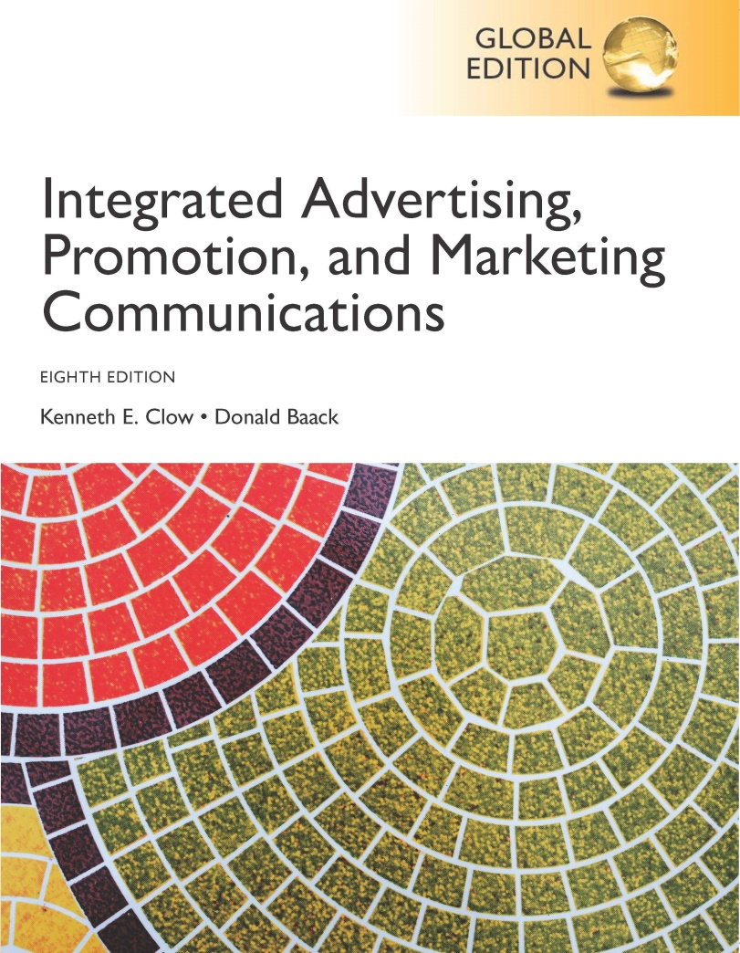
Integrated Advertising, Promotion, and Marketing Communications
Eighth Edition, Global Edition
Chapter 8
Digital Marketing
Copyright © 2018 Pearson Education Ltd. All Rights Reserved
Notes:
Digital marketing is the topic for this chapter.

Slide 2
Chapter Objectives (1 of 2)
What is digital marketing?
How has the transition to Web 4.0 affected the field of marketing communications?
How can e-commerce programs and incentives build a stronger customer base and overcome customer concerns at the same time?
How do mobile marketing systems enhance digital marketing programs?
Notes:
These are the objectives for Chapter 8.

Slide 3
Chapter Objectives (2 of 2)
What digital strategies do marketing professionals employ?
What types of web advertising can companies use to reach consumers?
What is a search engine optimization strategy?
How can companies successfully conduct digital marketing programs in international markets?
Notes:
Additional objectives for Chapter 8.

Slide 4
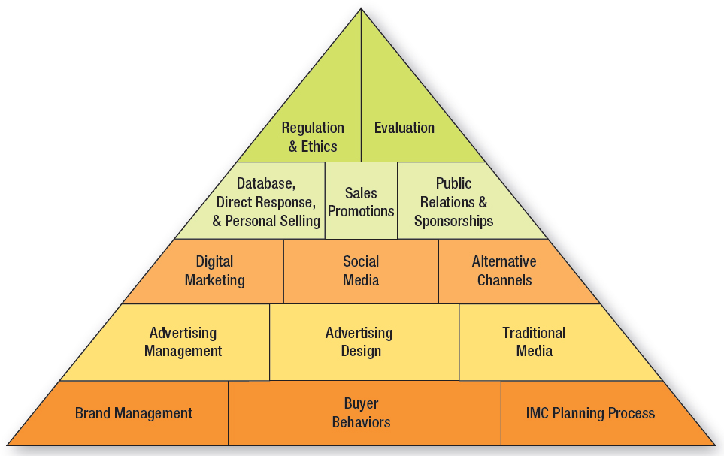
Figure 8.1 Overview of Marketing Communications
Notes:
Section 3 of this text examines digital marketing (Chapter 8), social media (Chapter 9), and alternative marketing channels (Chapter 10).

Slide 5
Choice Marketing
Began operations in 2000
Karen Plott (Founder, CEO)
Traditional marketing services
Digital and social media marketing
Mobile marketing exploding
Current trends
Second and third screens
Customer to customer
Notes:
Choice Marketing is a local agency in Joplin, Missouri that serves a four-state area. It was founded in 2000 by Karen Plott. Choice Marketing provides traditional advertising and marketing services, but also provides digital and social media marketing expertise. Two new trends are 1) second and third screens. Consumers do not use just one medium, they often multi-screen and 2) with social media now customer-to-customer interactions need to be managed.

Slide 6
Chapter Overview
Web 1.0 → Web 4.0
E-commerce
Mobile marketing
Digital strategies
Web advertising
Search engine optimization
Notes:
Chapter 8 opens with a discussion of Web 1.0 and the migration to Web 4.0, which is a new way of communicating and engaging consumers. Digital marketing involves e-commerce, Internet marketing, and mobile marketing. After Web 4.0 comes a discussion of e-commerce programs followed by mobile marketing methods. The chapter concludes with information about strategies, online advertising methodologies, and search engine optimization.

Slide 7
Figure 8.2 Primary Characteristics Web 1.0 to Web 4.0
Web 1.0
Static content provided by creator
Dominated by institutions and businesses
Commercially and technically based
Web 2.0
Content is socially-based and audience generated
Web 3.0
Content driven by online metrics
Integration of content and communications
Instant real-time communications
Web 4.0
Customer engagement
Cloud operating systems
Web participation a necessity
Notes:
Web 1.0 contained static content provided by the creator the site. It was dominated by businesses and was commercially and technically-based. Web 2.0 moved to content that was socially based and generated by the audience.
Web 3.0 advanced to the integration of content and communications with an emphasis on real-time communications. Sites were driven by online metrics.
Web 4.0 focuses on customer engagement and cloud operating systems. Web participation is essential now.

Slide 8
E-Commerce
Click-only operations to bricks-and-clicks
B2C and B2B online commerce
Online sales 7.5 percent of retail activity
Design is Critical
Notes:
Selling goods and services on the Internet is known as e-commerce. E-commerce consists of click-only operations that sell exclusively online and bricks-and-clicks that operate both retail and online stores. E-commerce is being conducted in both the consumer sector and the B-to-B sector. Online sales now account for nearly 7.5% of total retail activity. Many consumers conduct research online prior to making a purchase.

Slide 9
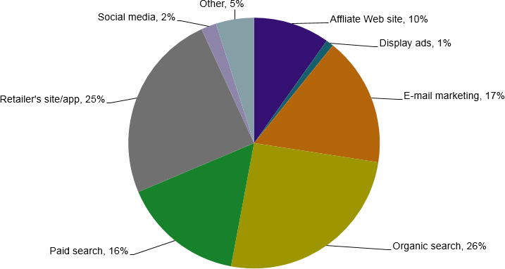
Online Retail Sales by Digital Channel
Bonus Slide
Source: Based on “Social Yields Just 2% of Online Holiday Retail Sales,” Advertising Age, http://adage.com/print/245625, December 11, 2013.
Notes:
(Bonus Slide, not in text) The graph shows online retail sales by the various digital channels. Organic search results generate the highest percent of online sales (26%), but retailer sites or apps are a very close second at 25%. Third is e-mail marketing (17%), and paid search is fourth at 16%. Social media generates only 2% of online retail sales.

Slide 10
Figure 8.3 Characteristics of Successful E-Commerce Sites
Search-optimized design
Customer-centric design
Mobile-optimized design
Consistent customer experience
Channel integration
Brand engagement
Shopping cart abandonment strategies
E-commerce incentives
Offline marketing
Notes:
This is a list of what it takes to create successful e-commerce sites. The focus is on e-commerce being customer-centric with opportunities for engagement and communication. The other main aspect is channel integration.

Slide 11
Successful E-Commerce Search-Optimized Design
80% Americans – online research
Location on Search engine results page (SERP)
Design important
Web search crawlers
Page title
Title tags
Notes:
Successful e-commerce are optimized for search engines. The design of the website impacts where a company or brand will appear on the SERP. In addition to content, web search crawlers look at page titles and title tags.

Slide 12
Successful E-Commerce Customer-Centric Design
Easily locate merchandise
Indexed using customer terms
Drill-down search function
Unique product descriptions
Avoid thin and duplicate copy
Pictures over words
Optimal is 4-6 products per page
Notes:
Successful e-commerce are customer-centric. Customers should be able to easily locate merchandise. If the site has a large number of products, then a drill-down search function is needed. Search engines like unique product descriptions and penalize sites with thin and duplicate copy. Pictures are better than words. Optimal number of products is 4-6 per page.

Slide 13
Successful E-Commerce Mobile-Optimized Design
Adaptive design
Higher interactions and conversions
Advantages
Average conversions 3.4% compared to 1.6%
50% of online purchases made on mobile devices
Without adaptive design, ranked lower in search
Notes:
Successful e-commerce are mobile-optimized with adaptive design, which automatically adjusts to the scree size. Mobile-optimized designs have a higher conversion rate, 3.4% compared to 1.6%. About 50% of consumers making online purchases do so on their mobile device. Research found that websites without adaptive design ranked lower on searches.

Slide 14
Successful E-Commerce
Consistent customer experience
Zero tolerance for poor Web performance
Dissatisfaction – lost sales
Load time
Channel integration
Online and offline catalogs integrated
Access from any digital platform
Notes:
E-commerce sites must be customer-centric and offer a consistent customer experience. With online shopping, consumers have nearly a zero tolerance for poor performance. Dissatisfaction results in lost sales. Especially important is the load time of pages and information. Second, channel integration is essential. If a company has offline catalogs, they must match its online catalogs. Ordering has to be available through multiple platforms, such as mobile phones and tablets as well as through desktop computers.

Slide 15
Successful E-Commerce Brand Engagement
Opportunities for engagement
Blogs, reviews, social media
Reviews and feedback
Personalization and customization
Notes:
Successful e-commerce provides opportunities for brand engagement. Blogs, reviews, and feedback mechanisms allow consumers to become involved with a brand. Reviews are an emerging trend in Web 4.0 and provide a way for customers to express their thoughts. They can serve as positive word-of-mouth endorsements. Visitors to a site appreciate personalization and customization of pages and information. Web 4.0 is characterized by websites with faster loading times as well as information more relevant to the browser.

Slide 16
Successful E-Commerce Shopping Cart Abandonment
Show any additional costs
Make checkout simple
Make it easy to enter discount codes
Provide safe checkout procedures
Notes:
A high percentage of shoppers place items in a shopping basket, but never complete the transaction. This is a list of strategies firms can use to reduce the rate of shopping cart abandonment.

Slide 17
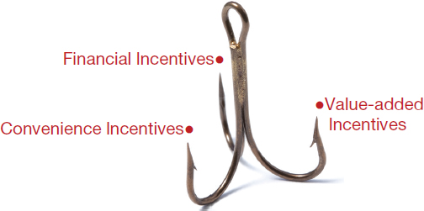
Figure 8.4 Common Forms of Cyberbait
Notes:
Cyberbait is any lure or attraction that brings people to a website. The various forms of incentives to encourage people to visit a website are finance-, convenience-, and value-based. These incentives are especially important for click-only businesses. Financial incentives can persuade an individual or business to make that first purchase. The most effective financial incentives are reduced prices, free shipping, and e-coupons. Convenience incentives make the online shopping experience easier and encourage return visits. Value-added incentives encourage customers to come back to an e-commerce site and change purchasing habits long-term.

Slide 18
Figure 8.5 Value-Added Incentives
Customized shopping
Unique product information
Mobile apps
Social media engagement
Exclusive shopping
Tutorials, usage tips and repair instructions
Notes:
Value-added incentives lead consumers to change purchasing habits over the long term. This slide lists some of the value-added incentives that can be used. The goal is to provide a unique experience or unique opportunities that cannot be obtained in a retail store or at other websites.

Slide 19
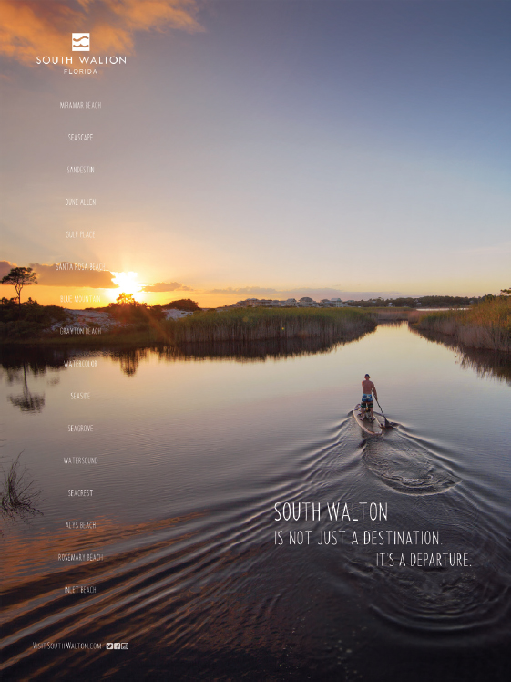
Successful E-Commerce Offline Marketing Integration
Visit South Walton Beach Website
Notes:
Offline advertising needs to be integrated with the e-commerce sites. What is seen in a TV or print ad needs to be seen on the website.

Slide 20
Mobile Marketing (1 of 2)
Smartphones (60%)
Ways people use smartphones
Communication
Social networks
Search for product information
Method of shopping
Notes:
The percent of the population currently using smartphones is 60% and growing rapidly. Smartphones are used as social interaction devices, to search for product information, and as a means of shopping. QR codes have become an important part of marketing and allow consumers to access sites via QR codes.

Slide 21
Figure 8.6 Ways Mobile Differs from Other Media
Personal
Geo-location
Two-way communication
Camera/video technology
Voice recognition
Phone sensors
Notes:
Mobile marketing differs from other media that provides marketers with opportunities, but also challenges. Mobile devices are personal, and typically used by only one individuals. This provides an opportunity to engage with the individuals. Embedded GPS technology allows for geo-locating of marketing messages based on a person’s location. Individuals use mobile phones to share photos and videos, and communicate with others. Brands can take advantage of these features. Phones now have voice recognition and number of sensors that can monitor the temperature, human gesturing, and other activities.

Slide 22
Mobile Marketing (2 of 2)
Mobile Apps
Engage consumers with brand
Streamline business use
Action codes
QR codes, watermarks, and 2D barcodes
Goal is engagement
Notes:
Mobile apps either engage consumers with the brand or streamline the business transaction that occurs. Globally, consumers download 32 billion apps per year. Another form of mobile marketing is using action codes, such as QR codes, watermarks, and 2D bar codes. These action codes are designed to engage the consumer with the brand in some manner, such as accessing a website or watching a video.

Slide 23
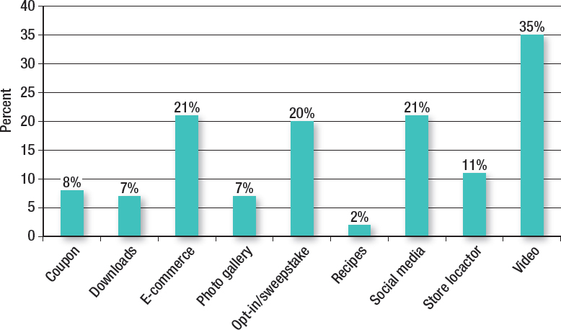
Figure 8.7 Marketing Uses for Action Codes in Magazines
Source: Adapted from Roger Matus, “Mobile Action Codes in Magazine Advertising,” Whitepaper from Nellymoser, Inc http://www.blue-soho.com/, p. 4.
Notes:
This graph provides data on how marketers are using QR codes. The number one usage is to access videos. Other important uses are e-commerce, opt-in sweepstakes, and social media.

Slide 24
Figure 8.8 Digital Marketing Strategies
Interactive marketing
Content and native marketing
Location-based advertising
Remarketing
Behavioral targeting
Blogs and newsletters
E-mail marketing
Notes:
As society has shifted from desktop computers to laptops, tablets, and smartphones, marketers have adapted to these multi-screen formats. This has created challenges as well as opportunities for the various digital marketing strategies shown on this slide.

Slide 25
Interactive Marketing
Two-way communication and involvement
Internet ideal medium
Can track activity
Personalize messages
Emphasizes two primary activities
Targeting individuals
Engaging consumers
Notes:
Interactive marketing is the development of marketing programs that create two-way communications and enhance engagement of consumers with the brand. The Internet is the ideal medium for interactive marketing. It can track activity, where a person goes and what they do. It can personalize messages. The emphasis of interactive marketing is two-fold – to target individuals and to engage consumers.

Slide 26
Figure 8.9 Content Marketing vs Native Advertising
Blank | Content Marketing Branded Content | Content Marketing Sponsored Content | Native Advertising
Location | Brand’s website or microsite | Third-party site | Third-party site
Goals | Provide information Increase brand awareness Improve search results | Provide information Increase brand awareness Increase social engagement | Generate sales Increase brand awareness Increase social engagement
Tone | Educational Solve a problem | Educational Authentic, expert tone | Solve problem through brand purchase
Audience | Brand’s customers and prospects | Sponsor’s audience | Third-party’s audience
Notes:
Content marketing is not self-promotion or trickery to generate sales. It focuses on providing information and solutions that are important to consumers, that is authentic. Content marketing should provide shareable content. It should be integrated with the website content. It needs to enhance search results and integrate with the social pages of the brand. It is vital that content is updated regularly. Rather than create branded content, a brand may sponsor a blog or related websites. The same keys to success are important. Information needs to be sharable and relevant to consumers. There is a potential for negative reaction if consumers see the sponsored content as self-promotion or just a venue for pushing sales. Native advertising is always on a third-party website and the goals are to generate sales, increase brand awareness or engagement. While it looks like an article, the tone is to solve a problem through purchasing the brand.

Slide 27
Figure 8.10 Location-Based Advertising
Targeting by DMAs (Designated marketing areas), 30%
Geo-fencing, 27%
Audience-data targeting, 24%
Geo-aware advertising, 14%
City or zip code, 5%
Source: Mark Walsch, “Location-Based Mobile Ads Deliver Best Engagement, Performance,” Online Media Daily, http://www.mediapost.com/publications/article/192780/, February 6, 2013.
Notes:
Location-based advertising, often called geo-targeting, utilizes the GPS on mobile devices to send targeted messages to individuals based on their geographic location. Restaurants and retailers are investing dollars into this form of mobile marketing. This slide shows the various ways location-based advertising is done. Targeting by DMAs is a broad approach reaching a high number of consumers with a specified DMA. Geo-fencing targets individuals within a short distance of a retail location. Audience-data targeting adds information about consumers to the geographical location information. Geo-aware uses real-time location information to target individuals close to the retail outlet.

Slide 28
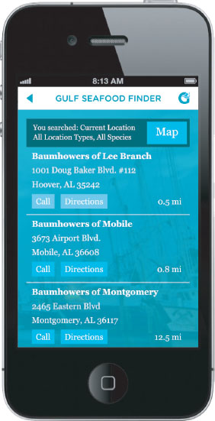
Mobile App
Location-based Advertising
Notes:
This Gulf Seafood Finder app utilizes location-based advertising through the GPS and smartphone.

Slide 29
Remarketing
Engages past visitor to website
Shown interest in brand/product
Higher conversions
Ad to computer or mobile device
Abandon shopping cart
Notes:
Remarketing involves sending an ad to a person’s computer or mobile device based on his/her visit to the website. The visit shows the individuals has some level of interest, which results in a higher conversion rate. Individuals who abandon shopping carts are excellent to target this way.

Slide 30
Behavioral Targeting
Uses Web data
Pages visited on the Internet
Keyword searches or content read
Past visitors to a site
Notes:
Behavioral targeting uses Web data to identify and create targeted advertising messages. Behavioral targeting can be based on pages a person has visited on the Internet. It can be based on keyword searches an individual has typed into a search engine or content that has been read. Behavioral targeting can be based on the browsing behavior of other visitors. Amazon does this when the company says “others who purchased this book also purchased ….”

Slide 31
Blogs and Newsletters
Blogs are online musings
Power of online buzz
Company-sponsored blogs
Objective of blog
Reaction strategy for negative comments
Small businesses
Newsletters
Offer solutions and information
Update regularly
Notes:
Blogs are online musings, written content put on the Web for others to read. Some blogs permit visitor comments, others do not. Blogs provide a venue for people to talk online and can generate considerable online buzz, especially for hot topics. Having a company-sponsored blog reassures shoppers and gives them a glimpse of how the company deals with customers. It is an avenue for the company to release new information and for customers to voice opinions. Most importantly, the company controls the website and has an opportunity to respond to complaints. It is important to be honest and not suppress negative comments.

Slide 32
E-Mail Marketing
Important component of digital strategy
Integrate with other channels
Resemble information on website
Using Web analytics to direct e-mail campaign
Individuals who visit website
Individuals who abandon shopping cart
Targeted e-mails have higher conversion rates
Notes:
E-mail is an important component of digital marketing. It can be easily integrated with other channels of communication. It can resemble information that is posted on the website. E-mail campaigns offer the advantage of having Web analytics for an analysis of effectiveness. Web analytics can be used to measure how many people visit a website, where they go on the site, how long they stay at each place on the site, and who abandons the shopping cart before making a purchase. By using Web analytics, companies can target specific individuals, such as those who abandon their shopping carts. These targeted e-mails have a much higher conversion rate.

Slide 33
Figure 8.11 Email Marketing Tactics
Behavior targeting
Browsing history
Demographics
Abandoned shopping carts
Past purchases
Dynamic web cropping
Event targeting
Weather targeting
Geo-targeting
Notes:
Companies have several options in terms of email marketing. Mass emails are not successful. Thy must be targeted. Behavioral targeting can be based on a person’s browsing history, demographic characteristics, abandoned shopping carts, and past purchases. Dynamic web cropping involves placing live snippet of content within the email. Email marketing can be around special events, such as hunting season. It can be based on weather, using GPS technology. Geo-targeting involves sending an email based on a persons geographic location.

Slide 34
Figure 8.12 Developing Successful E-mail Campaigns
Be upfront, honest with subscribers
Build list for quality, not quantity
Give subscribers what they want
Be familiar to your audience
Keep e-mails neat and clean
Be eye-catching
Integrate social media
Test, test, and test
Source; Interview with Holly Betts, Marketing Zen, February 12, 2014.
Notes:
Marketing Zen is a successful digit marketing firm. Holly Betts, an e-mail expert, suggests these key points to develop a successful e-mail marketing campaign. It is important to be upfront and honest with subscribers. Build a list for quality, not quantity. Give subscribers what they want, something of value, and show you understand and are familiar with the audience. Keep e-mails neat and clean, but make them eye-catching. Integrate the e-mail campaign with the social media components. Lastly, be sure to test everything to learn the most successful tactics.

Slide 35
Web Advertising
Highly effective
Younger, affluent, Internet savvy
Online budgets have increased
Multi-screen approach
Notes:
Web advertising is effective if ads are placed on the right websites, and the messages resonate with individuals. It is an excellent method of reaching consumers who tend to be younger, more affluent, and Internet savvy. Budgets for online advertising have increased in recent years and will continue to increase. One reason for the shift to online advertising is the metrics available to measure results. Online metrics provide almost instant measurements of results. Because of the different platforms now being used by consumers, Web advertising should incorporate a multi-screen approach.

Slide 36
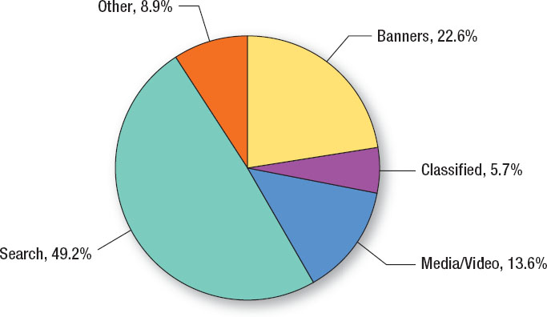
Figure 8.13 U.S. Online Ad Spending by Format
Source: Based on “Online Ad Spending Consolidates Among Search, Banners, Video,” eMarkter Digital Intelligence, February 3, 2012, www.smarketer.com/articles/print.aspx?R=1008815.
Notes:
Online advertising represents a highly effective method for reaching today’s consumers, especially the younger, more Internet-savvy market. Four distinct forms of online advertising exist – display or banner ads, classified ads, search ads, and media/video ads. This chart shows the percentage of ad spending on each format, with search advertising accounting for almost half of all online ad dollars (49.2%).

Slide 37
Banner Advertising
First online advertising
Accounts for 22.6% of online advertising
Can embed videos and widgets
Targeted display ads
Auction exchanges
Matches audience
Notes:
The first online advertising was banner ads. It still accounts for 22.6% of online advertising. The first ads were very basic ads that looked very much like billboard ads. With advances in technology, the current banner ads are more sophisticated. Companies can embed videos and widgets into the banner ads. Targeted display ads can be created that will appear only to certain people who match a particular audience profile. Auction exchanges now exist that do instant bidding for a targeted ad that is sent to a consumer in almost real time.

Slide 38
Widgets Banner Advertising
Mini-applications embedded in banners
Access external dynamic content
Provide personalized access to information
Micro-site landing pages
Geo-targeted ads
Notes:
Widgets are mini-applications embedded in banners. The widget can access external content. It can provide personalized access to information that resides outside of the banner ad and even outside of the website. When clicked, widgets will often take individuals to micro-site landing pages designed for that widget and that brand. These landing pages can even be geo-targeted where different individuals will be taken to different micro-sites based on their geographic location.

Slide 39
Video Ad for Swimways
A video ad produced for the Internet by Newcomer, Morris, and Young showing two surfers playing soccer from surfboards
Notes:
An designed for the Internet. Notice it is longer than a television ad and quickly captures attention of viewers.

Slide 40
Impact of Online Advertising
Banner click-through rate 0.27%
Improve response through targeting
Third-party tags
Ads not seen
Below the fold
Blocking software
Fraud
Notes:
More advertising dollars have shifted to online, but consumers have become more immune, resulting in a response click-through rate for banner ads of 0.27%. To improve response rates, advertisers are targeting individuals using Web metrics. Third-party tags have increased dramatically, 267%. Three primary reasons for poor response rates and ads not being seen – 1) ads are below the fold and browsers have to scroll down to see them, 2) consumers are using software to block ads, and 3) fraud. Malicious software and bots can be used to create impressions that ads are being seen when they are not.

Slide 41
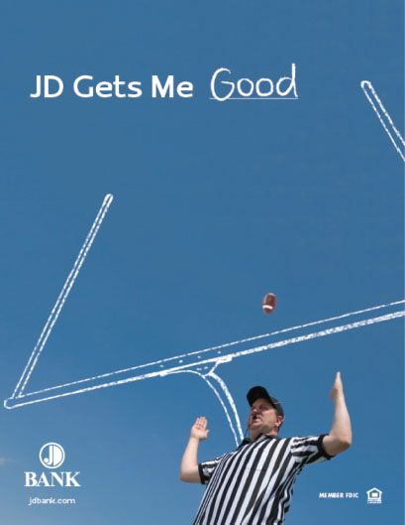
Offline Advertising
Integration of offline with online
Brand spiraling
Personalized URLs
Notes:
Brand reputations and brand loyalty require integrating offline and online advertising. Brand spiraling involves using traditional media to promote and attract consumers to a website. Magazine ads appear to be better for driving Web traffic A current trend is to use PURLs, personalized websites, which allow for a personalized page on a website.

Slide 42
Search Engine Optimization
Largest category of online expenditures
Text ads on search results
Nearly 50% of online advertising
80% of Web traffic begins with a search
Three methods of SEO
Paid search insertion
Natural or organic emergence
Paid search ads
Local businesses
Notes:
The largest category of online expenditures is now for search engine optimization (SEO). About 41% of online advertising is for SEO. About 80% of Web traffic begins with an online search, so having a presence in that search process is important. SEO can be reached in three different ways. First, with paid insertions, advertisers pay to have their website appear as the result of a search. The second method involves using paid search ads that will appear on the page. Third, natural or organic emergence. This is the best method because it is natural and the result of the search engine’s algorithms. It takes time to be near the top of natural or organic search results, but the method yields the best results. Search engine optimization is effective for local businesses.

Slide 43
Results Search Engine Optimization
Organic results
First page – results 9x
Second or third page – results 6x
Paid search
Unaided awareness higher
Search click-through rate
5% (typical 0.2%)
Notes:
Organic results on a first page tend to yield nine-fold results while second and third page results yield six-fold results. Sales from first pages are 42% higher the first month and 100% the first two months. For paid search ads, unaided awareness is higher – 20% more likely to have a positive perception of a brand and 30% more likely to consider a brand on the next purchase. SEO advertising typically has a click rate of 5%, compared to 0.2% for online ads.

Slide 44
International Implications
Shipping issues
Communication issues
Technology issues
Notes:
A major advantage of digital marketing is that it can be global. It doesn’t matter where the customer is or where the company is located. But, a number of e-commerce businesses do not take advantage of global customers. Shipping can be an issue. It may be difficult and expensive to ship a product to Japan or India. Communication can be an issue, although many people can read English. Technology is important to consider. Videos that play well with broadband connections may not work well in other countries with slower speeds.

Slide 45
Blog Exercises
Advil
Digital Strategies
SEO
Notes:
The blog exercises for Chapter 8 include Advil, digital strategies, and search engine optimization.

Slide 46
Copyright

