Slide 1
Lab# 8
BCH 471
Coagulation Profile

Slide 2
Objectives:
1- To estimate Clotting time, Bleeding time, and Prothrombin time
.

Slide 3
The term "coagulation profile“, refers to a set of laboratory tests that are used to assess the clotting ability of a person's blood. It provides information about the various factors involved in the coagulation cascade, which is a complex series of chemical reactions that lead to the formation of blood clots.

Slide 4
Coagulation:
Coagulation, is a complex process by which blood forms clots.
It is an important part of hemostasis, WHICH IS the physiological process that the body employs to stop bleeding and maintain blood within a damaged blood vessel.
Disorders of coagulation can lead to an increased risk of bleeding (hemorrhage) or clotting (thrombosis).
NOTE: Hemostasis combines the terms “hemo” (meaning “blood”) and “stasis” (meaning “standing still”).
Notes:
"Hemostasis" refers to the physiological process that the body employs to stop bleeding and maintain blood within a damaged blood vessel. It involves a complex series of events that work together to achieve hemostatic balance, preventing excessive bleeding while also avoiding the formation of harmful blood clots.

Slide 5
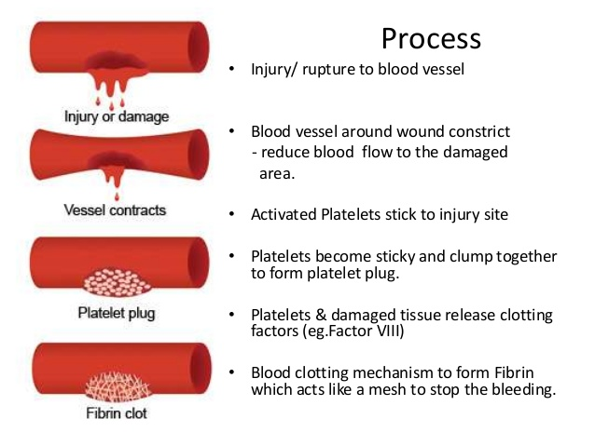
Hemostasis is maintained in the body via three steps:
1- Vascular spasm, Damaged blood vessels constrict.
2- Platelet plug formation, Platelets adhere to damaged endothelium to form platelet plug (primary hemostasis)
3- Blood Coagulation, Clots form upon the conversion of fibrinogen to Fibrin (secondary hemostasis).

Slide 6
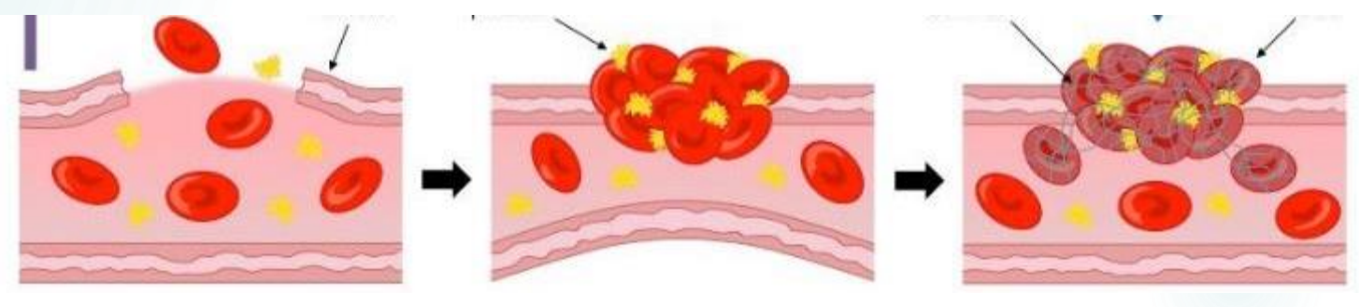

Slide 7
Clotting Cascade
A cascade is a mechanism in which enzymes activate other enzymes sequentially usually leading to an amplification of an initial signal.
Pathways
  Extrinsic
  Intrinsic
Each of these pathways leads to the conversion of factor X (inactive) to factor Xa (active)
Initially independent, then they converge on common pathway leading to the formation of a fibrin clot
Notes:
The cascade involves the activation and sequential activation of different clotting factors, ultimately leading to the conversion of fibrinogen into fibrin, which forms a meshwork that stabilizes the clot.

Slide 8
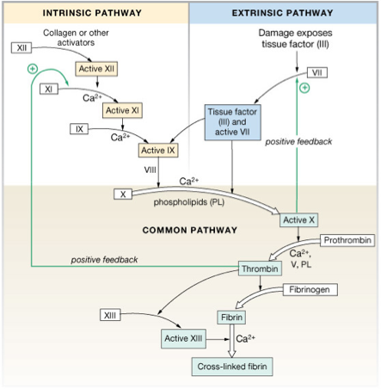

Slide 9
What triggers extrinsic and intrinsic pathways:
Extrinsic—Triggered by tissue damage; starts with tissue factor[TF] and Factor VII activation.
Intrinsic—Triggered by blood vessel damage; starts with Factor XII activation.

Slide 10
Clotting time - capillary method
Simple test but takes time and rarely done now.
Evaluates the intrinsic and common pathways of the coagulation cascade.
Method:
  Venous blood is taken and placed on glass capillary tube at 37°C and it observed at time intervals until clotting occurs.
Normal blood takes 5-10min to clot.
Longer periods → Coagulation defects (e.g. Hemophilia, disorder characterized by a deficiency or dysfunction of specific clotting factors.)

Slide 11

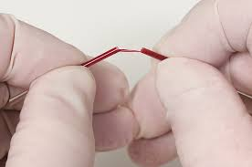
Clotting time - capillary method
https://www.youtube.com/watch?v=TSlHOCPrKIo

Slide 12
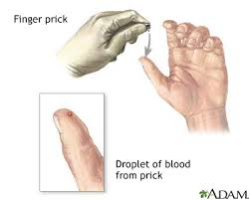
Bleeding Time:
Provides assessment of platelet count and function.
Method:
It is determined by noting time at which blood coming out a small cut, no longer forms a spot on a piece of filter paper placed in contact with cut surface.
The normal range from 2-4 min
https://www.youtube.com/watch?v=pbQMDlPG0kY

Slide 13
Prothrombin Time (PT)
Test measures how long it takes for a clot to form in a blood sample.
Prothrombin is a protein, which is clotting (coagulation) factors.
How fast the blood clots, depends on the amount of clotting factors in your blood. and whether they're working correctly.
Primarily assesses the extrinsic pathway and the common pathway of coagulation.

Slide 14
Method:
  An excess of tissue factor and Ca2+ ions are added to diluted plasma containing citrate (anticoagulant) and then the time taken for the mixture to clot is measured
Normal value →10-15 secs
High PT → low levels of thrombin. And vice versa.
Results from liver disease due to deficiency of prothrombin, fibrinogen, V, VII and X factors

Slide 15
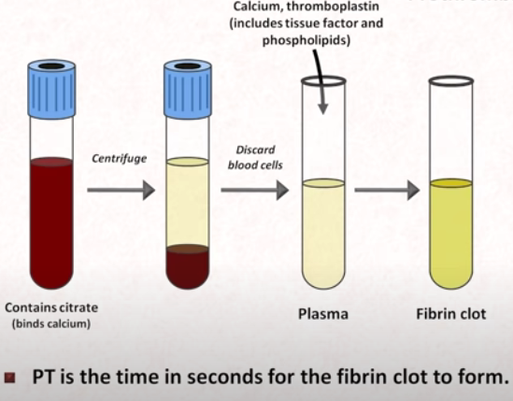
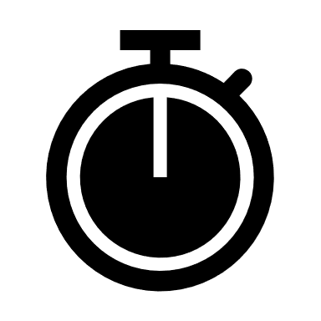
(which contain clotting factors)
The image source:
https://www.youtube.com/watch?v=q548IZGbt28

Slide 16
Bleeding Time: Focuses on platelet function and vessel integrity; assessed through skin puncture.
Clotting Time: Evaluates the overall clotting process in the intrinsic pathway; measured in a blood sample.
Prothrombin Time: Assesses the extrinsic pathway; uses added tissue factor to evaluate clotting time.

