Slide 1
Simulation & Systems

Slide 2
Another definition of Simulation
Simulation: experimentation with a simplified imitation (on a computer) of an operations system as it progresses through time, for the purpose of better understanding and/or improving that system.

Slide 3
Optimization
Optimization is a key to success.
Organizations tend to provide their products and services with the minimum cost possible which means optimizing the use of their resources
Concepts of quality like “lean systems” and “Kaizen” brought the concepts of avoiding waste and improving products.
To avoid waste means to execute your operations and production efficiently from the first time, every time
Don not forget that we live in a changing world !

Slide 4
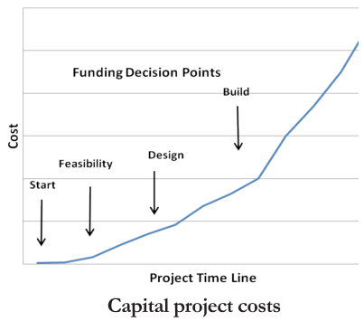
We must be correct the first time !
Project costs increase exponentially as time progress; therefore, the earlier a serious problem discovered the lower the sunk cost will be.

Slide 5
Systems
Definition
A system is a set of related elements within some stated boundary
A system could be as big as the planet or as small as a work cell. What matters is how the system behave internally and with its external environment.

Slide 6
Systems
Types of Systems
Natural Systems such as weather and the galaxies, etc.
Human Activity Systems: call centers and train stations, etc.
Designed Physical Systems: buildings, equipment, etc.
Designed Abstract Systems: mathematics, literature, etc.
The interaction of the human activity systems and the designed physical systems is often known as operations systems which is the focus of this course.

Slide 7
Systems
Think about consequences
Decision makers try to understand what is happening in their systems or what is going to happen and finally what are the consequences of every possible action prior to taking an action.
Keep in mind that the only certainty we know is that nothing is certain !!!! (the dynamic and random nature of systems)

Slide 8
General characteristics of systems
Boundaries: what’s inside and what’s outside (environment)
Components: more than one element inside
Internal organization: elements organized in some way; elements are related
Behavior: interaction of elements; properties do not come just from the elements, but from their interactions (emergent behavior)
States: status of the system at some point in time
Purpose: in mechanical systems, by design, purpose is hard-wired in and does not evolve; living or natural systems have the capacity to change over time and evolve.

Slide 9
So……..
As a result of all that, and to help decision makers, many attempts were taken to develop methods that can analysis such systems.
These methods are known as Decision Support Systems (DSS), simulation is considered as a decision support tool.

Slide 10
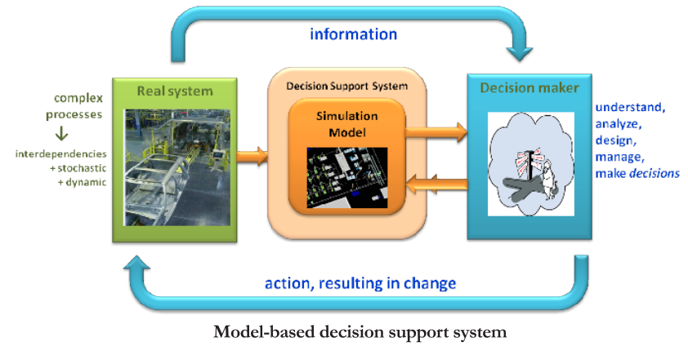
Simulation in a decision support role

Slide 11
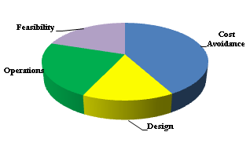
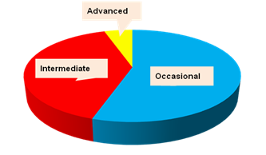
Simulation Benefits & Users
Benefits
Users

Slide 12
Types of simulation users
Occasional user
Oftentimes owner of the problem
Model “consumer” - uses pre-built models, customized analysis reports, specialized interfaces
Intermediate user
Model “consumer” and “producer” - uses pre-built models, but can modify and extend them; builds basic models
Designs and conducts experiments and performs analyses
Advanced user
Model infrastructure “developer”– provides extensive customized logic, custom libraries, custom controls and decision support capabilities
Skilled in supporting technologies, e.g. database, graphics, statistics, optimization
Extensive experience in simulation modeling and analysis applications

