Slide 1
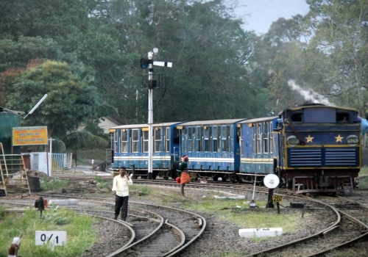
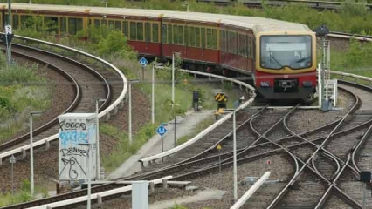
CIRCULAR CURVE

Slide 2
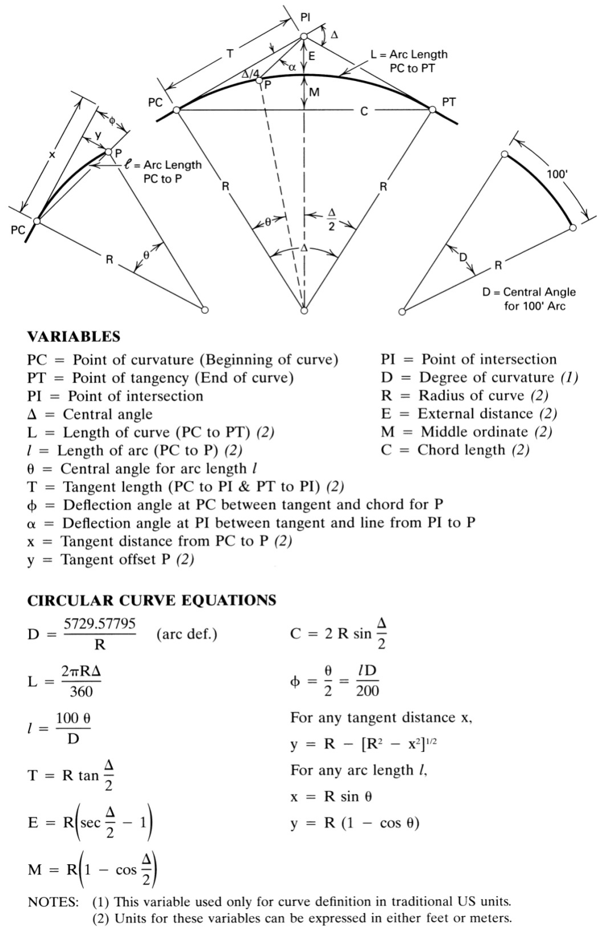
CIRCULAR CURVE

Slide 3
CIRCULAR CURVE

Slide 4
Example 1 :
Given Δ = 32°, R = 410 m, and the PI station 1+120 . 744, compute the curve data and the station of the PT using. Compute the deflection angles at even 20-m stations.
Solution :
𝑃𝐶 𝑆𝑡𝑎.= 𝑃𝐼 𝑆𝑡𝑎.– 𝑇
𝑃𝑇 𝑆𝑡𝑎.= 𝑃𝐶 𝑆𝑡𝑎.+ 𝐿
𝑇= 𝑅 tan $\frac{\text{Δ}}{2}$
𝐿 = $\frac{\text{2}\text{π}\text{R}\text{Δ}}{360}$
𝑇= 410 * tan $\frac{\text{32}}{2}$= 117.533 m
𝐿 = $\frac{\text{2}\text{π} \text{∗}\text{410} \text{∗ }\text{32} }{360}$= 228.987 m
𝑃𝐶 𝑆𝑡𝑎.= 1120.744 – 117.566 = 1003.178 𝑚 →→ 1+ 003.178 Sta
𝑃𝑇 𝑆𝑡𝑎.= 1003.178 + 228.987 = 1232.165 𝑚 →→ 1+ 232.165 Sta

Slide 5
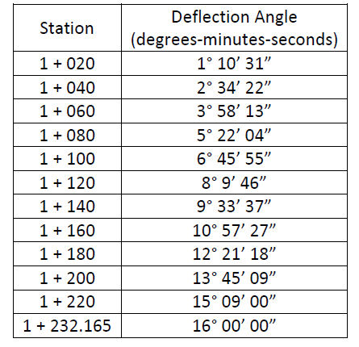
The deflection angle to the P.T. is $\frac{\text{Δ}}{2}$
The deflection angle to intermediate stations is proportional to the distance from the P.C.
The distance to station 1 + 020.000 is = (1020.000) – (1003.178) = 16.822 m.
𝐷𝑒𝑓𝑙𝑒𝑐𝑡𝑖𝑜𝑛 𝑎𝑛𝑔𝑙𝑒 = $\frac{\text{Δ}}{2}$× $\frac{\text{16.822}}{\text{228.987}}$= 1°10′31′′
Other deflection angles are computed similarly in the Table :

Slide 6
Example 2 :
A horizontal curve is to be constructed as part of a railway section with a curve length of 2100 m and a central angle of 20º. If the PI station is 1+ 430:
Determine the curve radius, external distance, middle ordinate and chord length.
Compute PC and PT stations and the deflection angle (from the first tangent) for a point on the curve located at a distance of 100 m from PC (arc length).
Solution :
𝐿 = $\frac{\text{2}\text{π}\text{R}\text{Δ}}{360}$
2100 = $\frac{\text{2}\text{π} \text{∗}\text{R}\text{ ∗ }\text{20} }{360}$
R = 6016.05 m

Slide 7
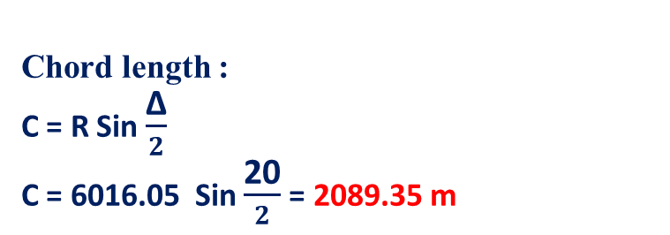
External distance :
E = R (Sec $\frac{\text{Δ}}{2}$ -1)
E = 6016.05 (Sec $\frac{\text{20}}{2}$ -1) = 92.8 m
Middle ordinate :
M = R ( 1- Cos $\frac{\text{Δ}}{2}$ )
M = 6016.05 ( 1- Cos $\frac{\text{20}}{2}$ ) = 91.25 m
Chord length :
C = R Sin $\frac{\text{Δ}}{2}$
C = 6016.05 Sin $\frac{\text{20}}{2}$= 2089.35 m

Slide 8
𝑃𝐶 𝑆𝑡𝑎.= 𝑃𝐼 𝑆𝑡𝑎.– 𝑇
𝑃𝑇 𝑆𝑡𝑎.= 𝑃𝐶 𝑆𝑡𝑎.+ 𝐿
𝑇= 𝑅 tan $\frac{\text{Δ}}{2}$
𝑇= 6016.05 * tan $\frac{\text{20}}{2}$= 1060.8 m
𝑃𝐶 𝑆𝑡𝑎.= 1430 – 1060.8 = 369.2 𝑚 →→ 0 + 369.2 Sta
𝑃𝑇 𝑆𝑡𝑎.= 369.2 + 2100 = 2469.2 𝑚 →→ 2 + 469.2 Sta
D = $\frac{5729.57}{R}$ = 0.9523º = 0°57′8.28 ′′
Φ= $\frac{θ}{2}$ = $\frac{l D}{200}$= $\frac{\text{100 }\text{∗ }\text{0.9523 }}{200}$= 0.47615 = 0°28′34.14 ′′

