Slide 1
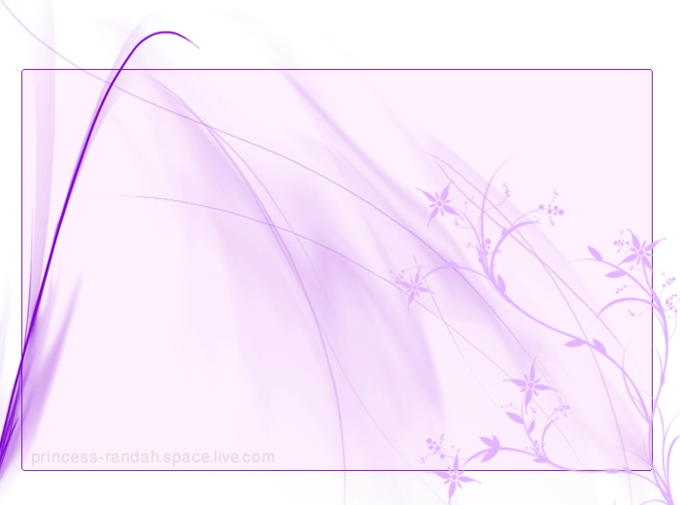
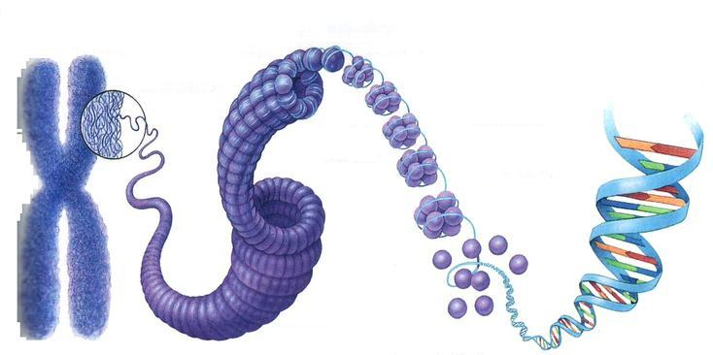
Chromosomes & Cell Division
Prepared by:
Nouf khalid AL-Sultan

Slide 2

INTRODUCTION
Chromosomes are the structures that contain the genetic material.
They are complexes of DNA and proteins.
In bacteria, it is typically a single circular chromosome.
In eukaryotes, it refers to one complete set of nuclear chromosomes.
The main function of the genetic material is to store information required to produce an organism.

Slide 3
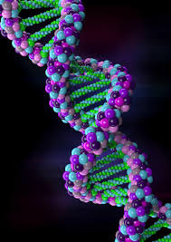
Introduction chromosomes
Normal human cells contain 23 pairs of chromosomes.
This includes one pair of sex chromosome XX or XY .
During cell division we can identify chromosomes.
Haploid: set of 23 chromosomes.
Diploid: normal number of 46 chromosomes.
Chromosomes in eukaryotes found in the nucleus condensed and visible during cell division.
At the beginning of mitosis they can be seen to consist of two threads (sister chromatids) joined by a centromere.
The sister chromatids are identical copies.

Slide 4
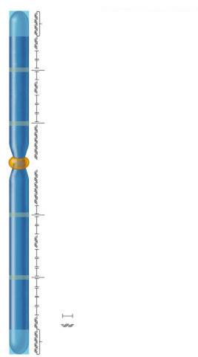
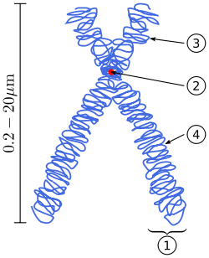
Diagram of a duplicated and condensed metaphase eukaryotic chromosome.
1. Chromatid– one of the two identical parts of the chromosome after S phase.
2. Centromere – the point where the two chromatids touch, and where the microtubules attach.
3. Short arm.
4 Long arm.
Telomere
Origin of replication
Origin of replication
Kinetochore proteins
Centromere
Origin of replication
Origin of replication
Genes
Repetitive sequences
Telomere

Slide 5
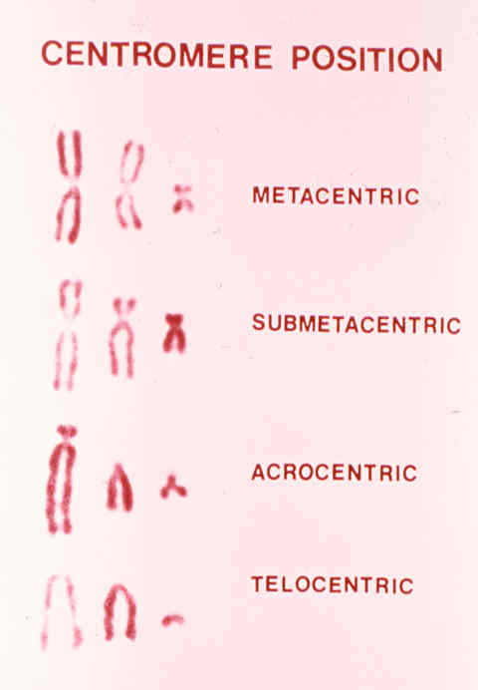
CHROMOSOME STRUCTURE
Chromosomes can vary considerably in size and shape
-Various features used for identification
    Size, Centromere location, Banding patterns.
-Centromere location differs between chromosomes.
  At the middle in a metacentric chromosome.
  Near the middle in a submetacentric chromosome.
  Near an end in an acrocentric chromosome.
  At an end in a telocentric chromosome.

Slide 6
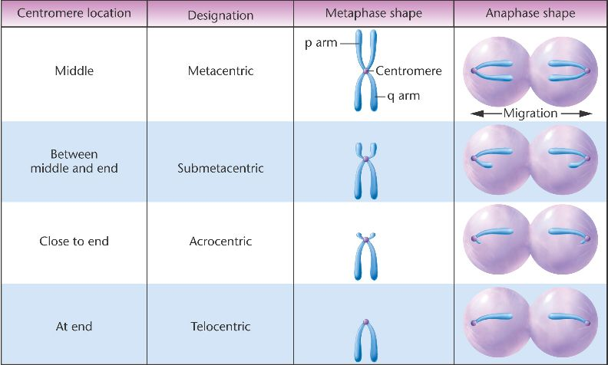
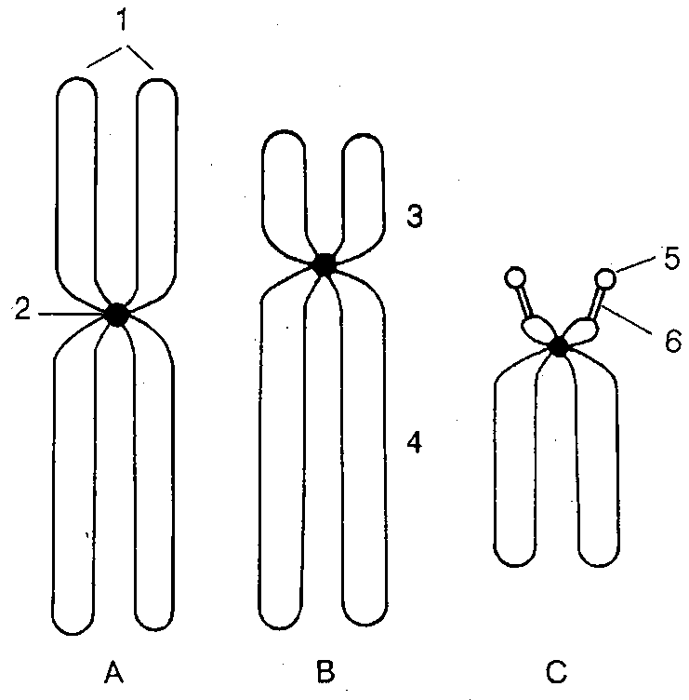
Shapes of chromosomes
1: sister chromatids.
2: centromere.
3:Short arm.
4: long arm.
5: satellite.
6: secondary constriction.
A: metacentric, B: submetacentric, C: acrocentric

Slide 7
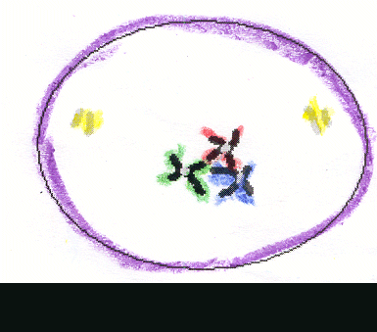
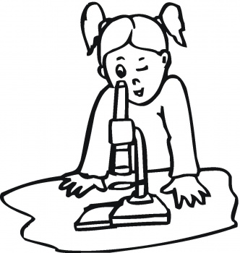
Cell Division

Slide 8
Cell division :- Is a process by which the cellular material is divided between 2 new daughter cell
There are two types of cell division:
1- Mitosis ( indirect division )
ANIMAL CELLS PLANT CELLS
2- Meiosis ( reduction division )
Types of Cell Division
Meiosis1
Meiosis2

Slide 9
Comparison points between Mitosis and Meiosis
Meiosis | Mitosis | The comparison points
Germ cells ((Diploid | Somatic cells (2n) | occurring place
Having a haploid number of chromosomes (23) | Having the same number of the chromosomes of the mother cell (46) | Chromosome's number in the results cells
M1= 2 daughter cells M2= 4 daughter cells | 2 daughter cells | Division results

Slide 10
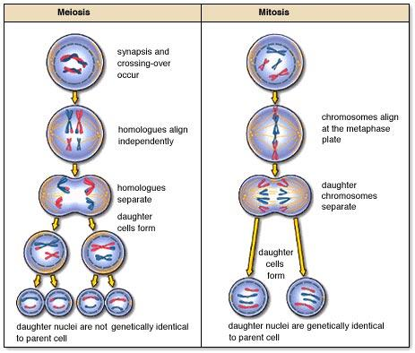

Slide 11
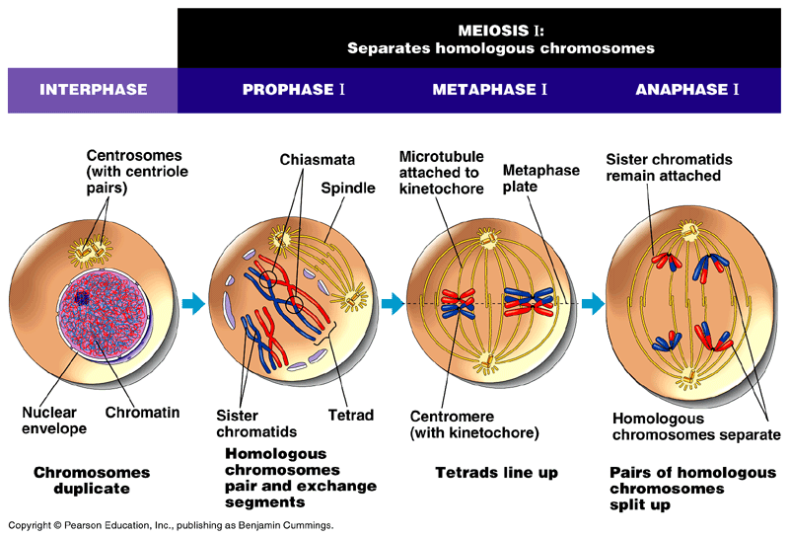
Interphase
* When the cell is not undergoing Division, it is in a phase called interphase.
This stage occurs between two successive divisions.
* The chromosomes are thin , delicate , long and can be seen as chromatin granules inside the nucleus.
* During the preceding interphase the chromosomes are replicated to form sister chromatids.
* These are genetically identical and joined at the centromere.
*Chromosomes are usually not visible under a light microscope.

Slide 12
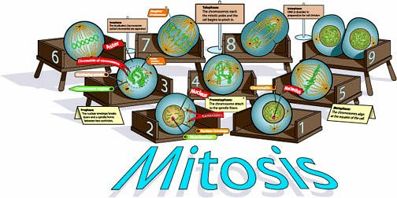
Mitosis Division

Slide 13
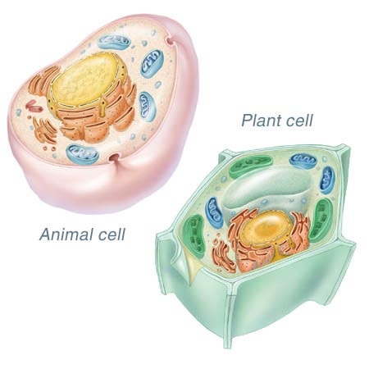
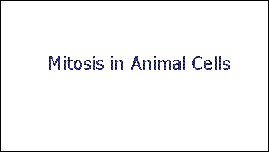
The phases of Mitosis in
1_ Animal cells
2_Plant cells

Slide 14
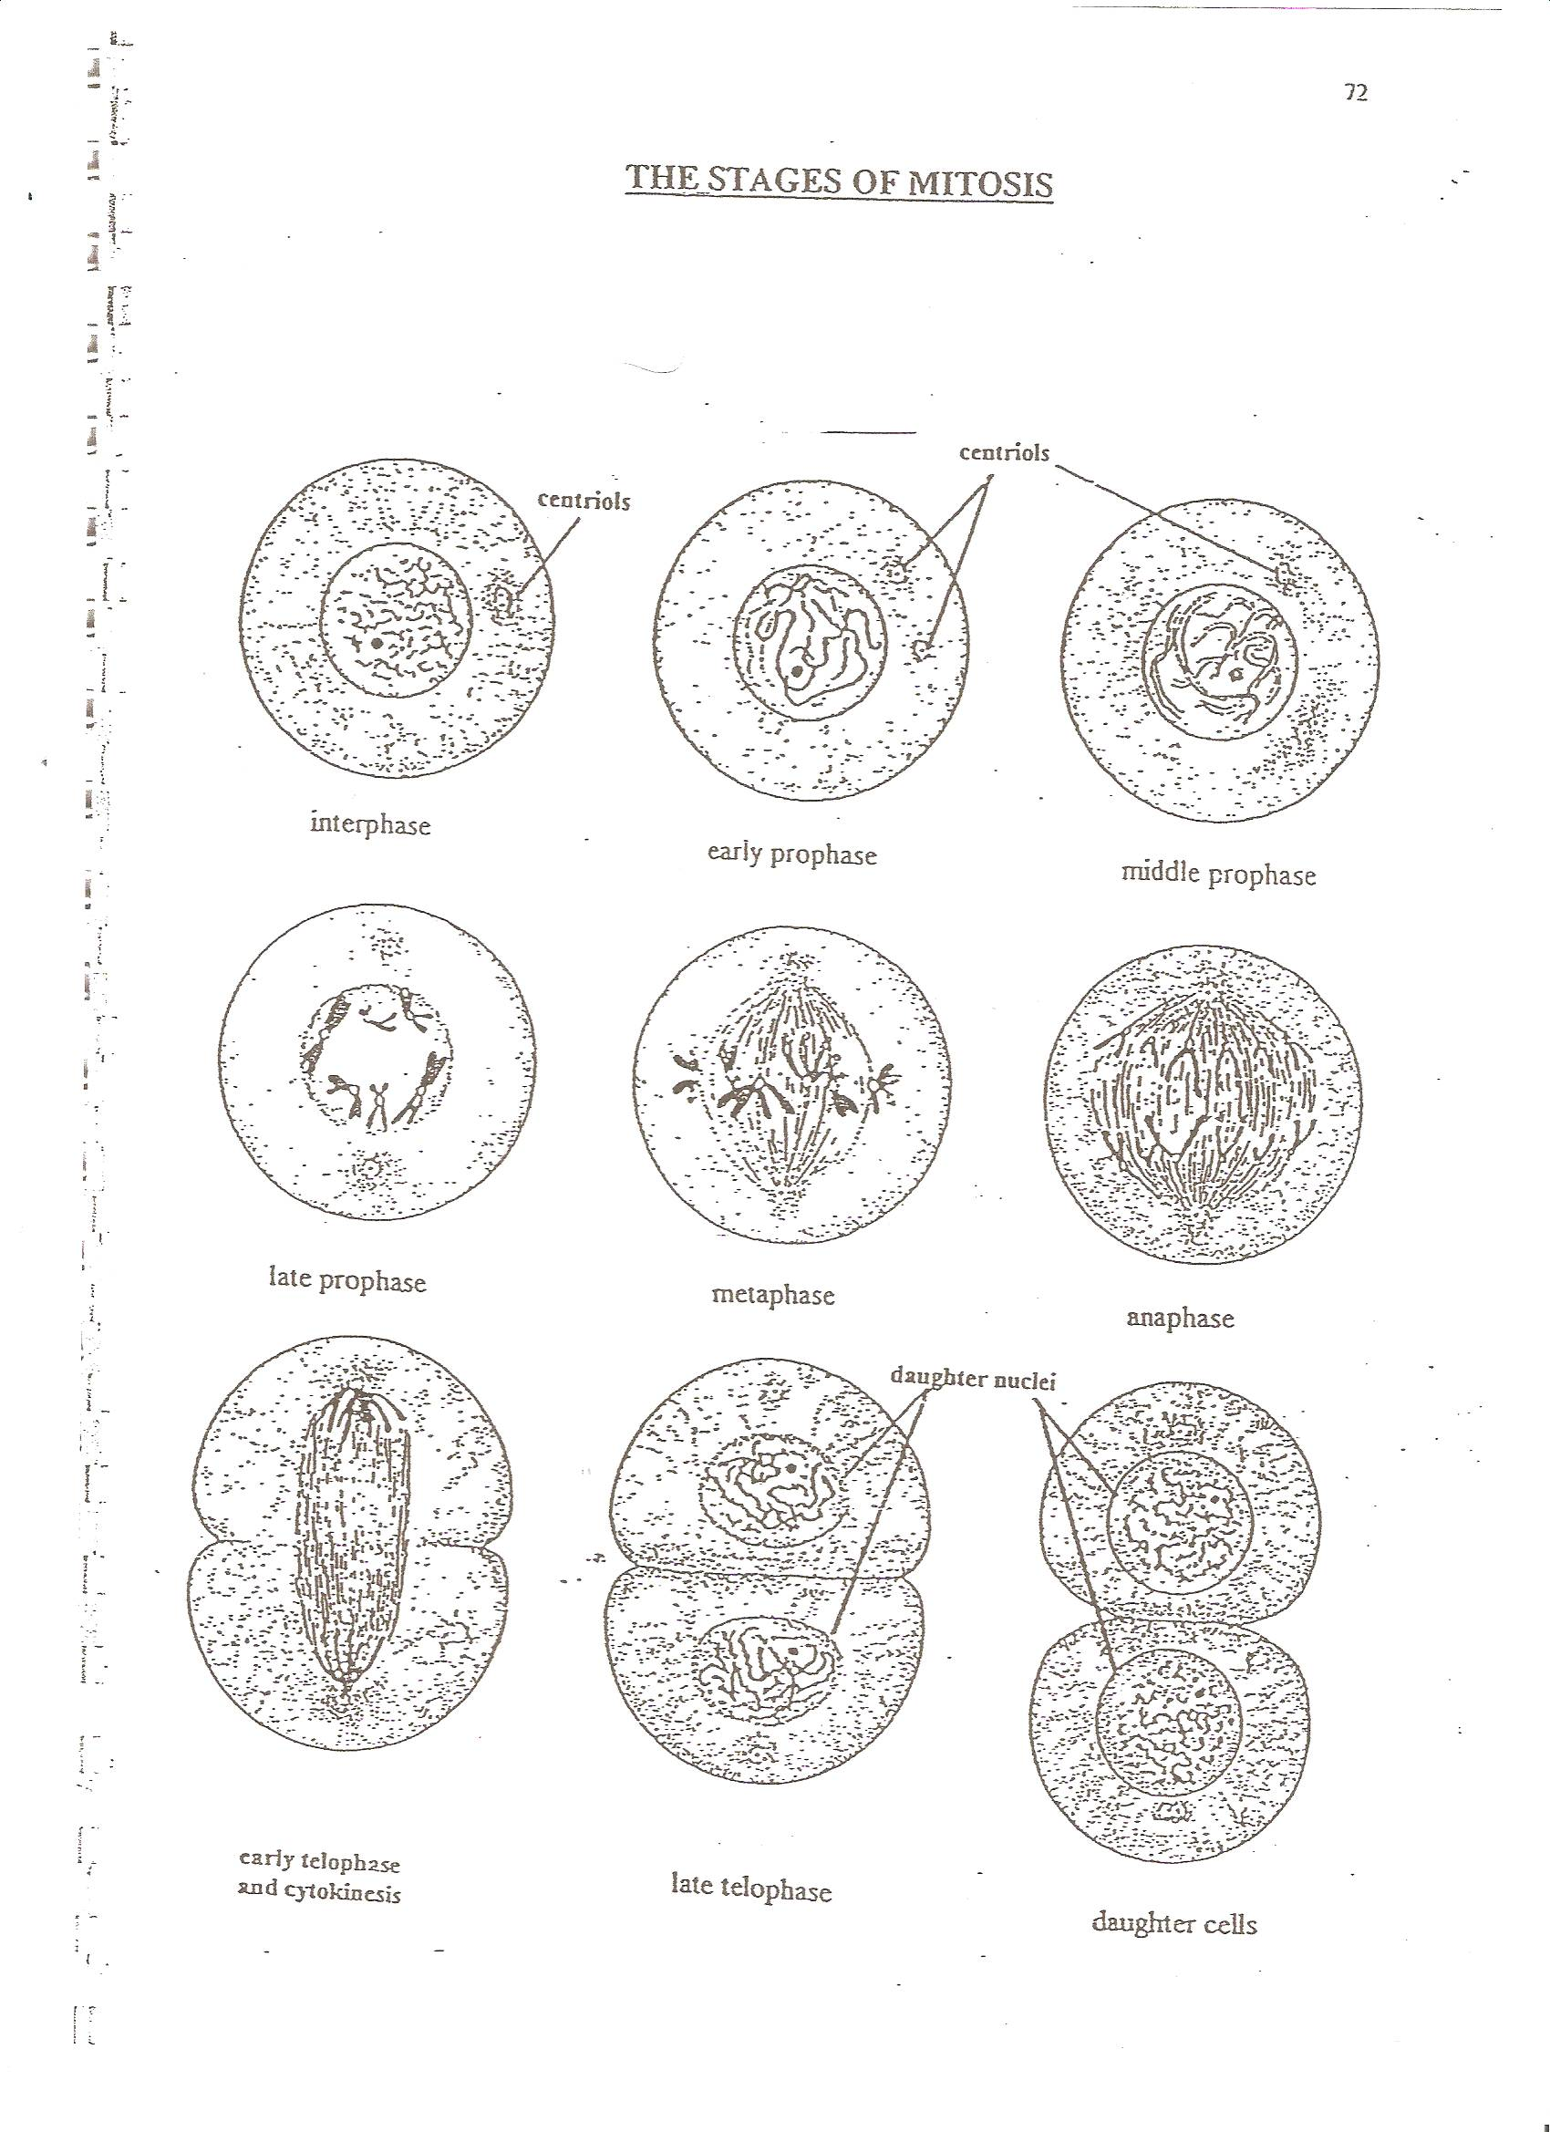
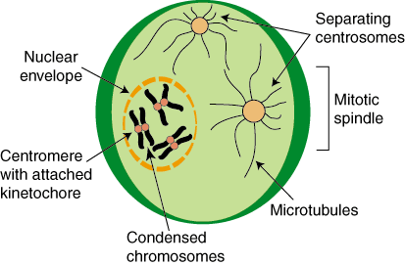
The stages of the Mitosis Division
1
Mitosis in the Animal
1-Chromosomes become shorter and denser.
2- The nuclear envelope dissolves .
3- The nucleolus disappears .
4- The centrioles and astral rays start to
magrate toward opposite poles of the cell.
5- The spindle fibers begin to form .
Prophase

Slide 15
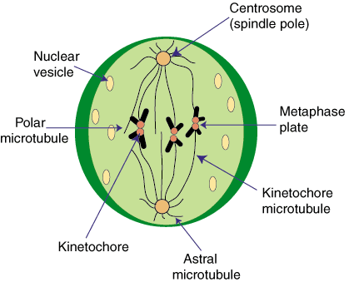
1- The spindle fibers are fully formed.
2-The astral rays appear around the centioles .
3- The chromosomes are arranged in the equatorial plane.
4- The centromeres appear attached to the spindle fibers .
2
Metaphase

Slide 16
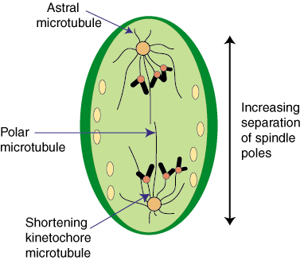
3
1- The centromeres split .
2- The 2 chromatids of each chromosome become separated .
3- The chromosome pulled toward the corresponding cell pole .
4- Now each chromatid is a chromosome .
Anaphase

Slide 17
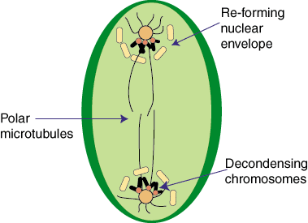
4
1- The chromosome have reached the opposite poles.
2- The spindle disperses .
3- The nucleolus reappears .
4- A nuclear envelope forms around each chromosome set , thus a nucleus is formed .
Teloaphase

Slide 18
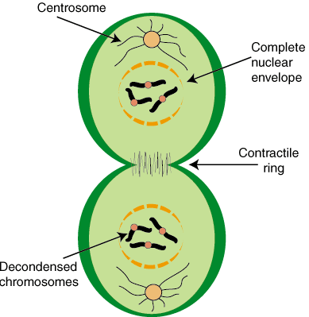
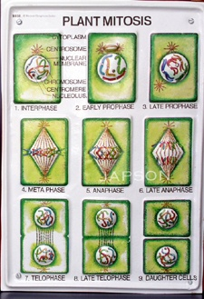
Cytokinesis
Cytokinesis is the division of the cytoplasm.
1- This process usually begins during telophase or anaphase .
2- The cytoplasm gradually constricts at the
equatorial plane.
In plant cells :- Each daughter cell secretes its own cell wall .
* This process is not part of mitosis.

Slide 19
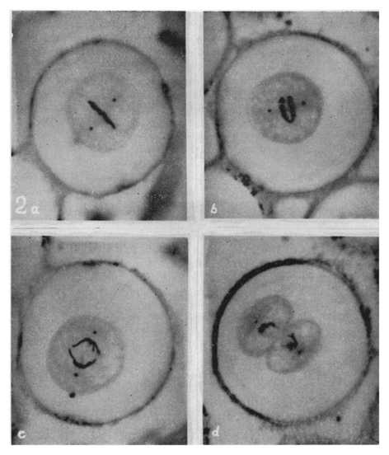

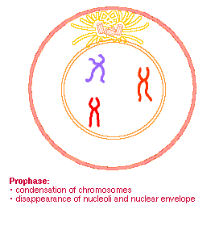
Mitosis in the Animal
Ascares cells
Metaphase
Prophase
Anaphase
Telophase

Slide 20
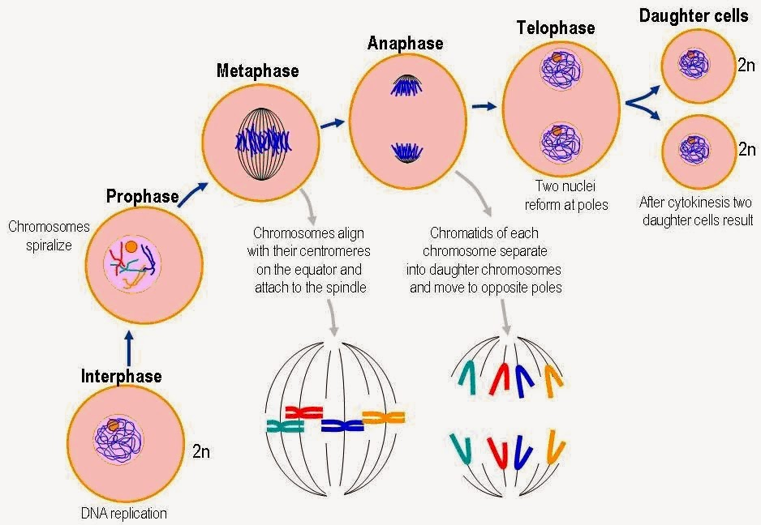

Slide 21
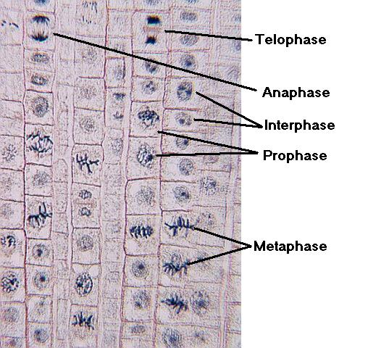
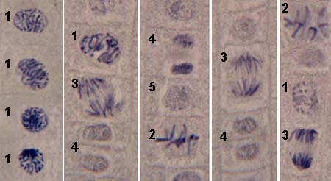
Mitosis in the Plant
interphase
Prophase
Telophase
Anaphase
interphase
Prophase
Telophase
Metaphase
Anaphase
Metaphase

Slide 22
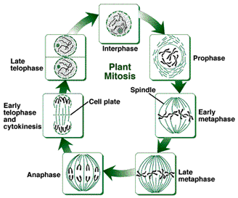

Slide 23



Slide 24


