Slide 1
Political, Legal, and Regulatory Environments
Chapter 5

Slide 2
Learning Objectives
Understand the elements of a country’s political environment that can impact global marketing activities.
Define international law and describe the main types of legal systems found in different parts of the world.
Understand the most important business issues that can lead to legal problems for global marketers.
Describe the available alternatives for conflict resolution and dispute settlement when doing business outside the home country.

Slide 3
Types of Country Risk
Country Risk
Political Environment
Legal System
Notes:
Governments seize corporate assets in two major ways: confiscation and expropriation. Confiscation is the seizure of corporate assets without compensation. Expropriation is seizure with compensation. The industry sectors most frequently targeted by such events are natural resources (for example, mining and petroleum), utilities, and manufacturing. In Venezuela, ExxonMobil and ConocoPhillips were forced to abandon multibillion- dollar investments in the local oil industry. Recently, Venezuela President Hugo Chavez ordered troops to seize two plants owned by Mexico’s Cemex, the country’s largest cement producer. In 2008, gradual yet persistent pressure from the Russian government led TNK-BP, a Russian subsidiary of British energy giant BP, to sell a major stake in its oil business to the national gas monopoly Gazprom. A third category of takeover, nationalization, describes government’s seizing not a firm but an entire industry, with or without compensation. In 2006, the government of Bolivia nationalized much of the oil and gas industry in that country.15 Nationalization occurs in advanced economies as well. Following the recent global financial crisis, the federal government of the Netherlands nationalized part of the financial-services company Fortis NV, and Britain nationalized the Royal Bank of Scotland. In the decades following World War II, confiscation and expropriation were the main country risk confronting firms with extensive international operations, particularly in developing economies. In the 1960s and 1960s, Egypt, Nigeria, Peru, and other countries with nationalist and leftist host governments undertook numerous nationalizations. A wave of confiscations occurred under revolutionary regimes in Cuba, Iran, and Nicaragua. Such events have become less common in recent years as governments in developing countries have adopted institutional reforms that aim to attract FDI from abroad and foster economic growth.

Slide 4
Sovereignty
Sovereignty: Supreme and independent political authority
“A sovereign state was considered free and independent. It regulated trade, managed the flow of people into and out of its boundaries, and exercised undivided jurisdiction over all persons and property within its territory. It had the right, authority, and ability to conduct its domestic affairs without outside interference and to use its international power and influence with full discretion.”
Richard Stanley
President, Stanley Foundation
Notes:
A century ago, U.S. Supreme Court Chief Justice Melville Fuller said, “Every sovereign state is bound to respect the independence of every other sovereign state, and the courts in one country will not sit in judgment on the acts of government of another done within its territory.”
Government actions taken in the name of sovereignty occur in the context of two important criteria: a country’s stage of development, and the political and economic systems in place in the country.

Slide 5
Sovereignty & Global Market Integration
Some believe that global market integration is eroding national economic sovereignty
In the EU, individual countries gave up their rights to a national currency, product standards in exchange for better market access
“The ultimate resource of a government is power, and we’ve seen repeatedly that the willpower of governments can be overcome by persistent attacks from the marketplace.”
~ Neal Soss, Economic Consultant

Slide 6
Political Risk
Risk of change in political environment or in government policy that would adversely affect a company’s ability to operate effectively and profitably.
When perceived political risk is high, a country will have a difficult time attracting foreign direct investment.
Some governments offer political risk insurance.
Notes:
Executives often fail to understand political risk because they have not studied political science. Businesspeople need to study the political environment through reading publications like The Economist, Financial Times or consulting web-based sources like the Business Environment Risk Intelligence (www.beri.com) or the PRS Group (www.prs.com).
Companies can purchase insurance to offset potential risks arising from the political environment. In Japan, Germany, France, Britain, the United States, and other industrialized nations, various agencies offer investment insurance to corporations doing business abroad. The Overseas Private Investment Corporation provides various types of political risk insurance to U.S. companies; in Canada, the Export Development Corporation performs a similar function.

Slide 7
Political Risk
Some examples of political risk include:
  War
  Social unrest, fractionalized by language, ethnic and/or religious groups
  Orderly political transfer
  Politically motivated violence
  International disputes
  Change in government/pro-business orientation
  Social conditions (population density and wealth distribution)
  Corruption, nepotism
  Crime
  Labor costs
  Tax discrimination
  Exchange controls, tariff barriers
  Dependence on and/or importance to a major hostile power
  Repatriation restrictions
Notes:
Companies can buy insurance to protect against political risk. The U.S. government agency, the Overseas Private Investment Corp. (OPIC; www.opic.gov), offers insurance to companies doing business abroad. Japan, Germany, France, Canada, and Britain offer similar protection.
The political maneuverings of the Russian government create a high level of political risk. During his first two terms as Russia’s president, Vladimir Putin implemented reforms in an effort to pave the way for Russia’s membership in the WTO and to attract foreign investment. In 2008, when Dmitry Medvedev was elected president, Putin became prime minister. It was generally perceived that Putin was the more powerful member of this “ruling tandem.” The Russian government has a number of bills pending that, if adopted, will strengthen intellectual property and contract law. Meanwhile, the level of political risk remains high; compounding matters is the fact that Russia’s economy has been severely impacted by the global economic crisis. As Paul Melling, a partner at the law firm of Baker & McKenzie, explains, “Many multinationals are thinking long and hard about how big their company in Russia ought to be—the bigger the company, the bigger the risk.”
Companies can purchase insurance to offset potential risks arising from the political environment. In Japan, Germany, France, Britain, the United States, and other industrialized nations, various agencies offer investment insurance to corporations doing business abroad. The Overseas Private Investment Corporation provides various types of political risk insurance to U.S. companies; in Canada, the Export Development Corporation performs a similar function.

Slide 8
Taxes
Government taxation policies
  High taxation can lead to black market growth and cross-border shopping
    High taxes in China leads to smuggling of oil, cigarettes, PCs, film
Corporate taxation
  Companies attempt to limit tax liability by shifting location of income
Notes:
Governments rely on tax revenues to generate funds necessary for social services, the military, and other expenditures. Unfortunately, government taxation policies on the sale of goods and services frequently motivate for companies and individuals to profit by not paying taxes. In China, for example, even though import duties have dropped since it joined the WTO, many imports are subject to double-digit duties plus a 17 percent value-added tax. As a result, significant quantities of oil, cigarettes, photographic film, personal computers, and other products are smuggled into China. It is estimated that 90% of cigarettes are smuggled into China. Companies can still profit. For Philip Morris, this means annual sales of $100 million to Hong Kong distributors! Cross-border shopping can be spurred on by high excise and VAT taxes. It is estimated that British citizens who travel to France by car return home with 80 bottles of wine.
Corporate taxation is another issue. The high level of political risk currently evident in Russia can be attributed in part to excessively high taxes on business operations. High taxes encourage many enterprises to engage in cash or barter transactions that are off the books and sheltered from the eyes of tax authorities. This, in turn, has created a liquidity squeeze that prevents companies from paying wages to employees. Unpaid, disgruntled employees can contribute to political instability. Putin’s government is pursuing a tough new tax policy in order to shrink Russia’s deficit and qualify for IMF loans.
“Earnings stripping” refers to the practice of foreign companies making loans to U.S. affiliates rather than using direct investment to finance U.S. activities. The U.S. subsidiary can deduct interest on these loans and reduce its tax burden. It is estimated that tax minimization costs the U.S. government billions a year.

Slide 9
The Highest Taxes
1 | Belgium | 39.8
2 | Germany | 39.7
3 | Denmark | 35.8
4 | Slovenia | 34.1
5 | Hungary | 33.5
6 | Austria | 32.8
7 | Italy | 31.4
8 | Netherlands | 30.5
9 | Finland | 30
10 | Luxembourg | 29.5
11 | France | 28.7
12 | Iceland | 28.7
13 | Latvia | 28.4
14 | Turkey | 28.2

Slide 10
Seizure of Assets
Expropriation–governmental action to dispossess a foreign company or investor
  Compensation should be provided in a “prompt, effective, and adequate manner”
Confiscation occurs when no compensation is provided
  ExxonMobil and ConocoPhillips
Notes:
In 1959 Castro’s Cuban government nationalized U.S. sugar companies’ properties and paid in Cuban government bonds. Viewed as inadequate by the U.S. State Dept.
More recently, late Venezuelan President Hugo Chávez nationalized Electricidad de Caracas, a utility company, and CANTV, a telecommunications provider. The Venezuelan government paid AES Corporation $739.3 million for Electricidad de Caracas; Verizon Communications received $572 million for its stake in CANTV.

Slide 11
Seizure of Assets
Nationalization–a government takes control of some or all of the enterprises in an entire industry
  Acceptable according to international law if:
    satisfies public purpose
    includes compensation
Notes:
Castro’s Cuban government nationalized property of American sugar companies. The government offered Cuban bonds for compensation, which was all that was required under Cuban law. Viewed as inadequate by the U.S. State Department
Hugo Chavez of Venezuela seized the public electric company and paid AES Corp. $739.3 million; Verizon got $572 for its stake in CANTV.

Slide 12
Seizure of Assets
Creeping expropriation–limits economic activities of foreign firms
May include:
  Limits on repatriation of profits, dividends, or royalties
  Technical assistance fees
  Increased local content laws
  Quotas for hiring local nationals
  Price controls
  Discriminatory tariff and nontariff barriers
  Discriminatory laws on patents and trademarks
Notes:
In the mid-1970s, Johnson & Johnson and other foreign investors in India had to submit to a host of government regulations to retain majority equity positions in companies already established. Many of these rules were copied by Malaysia, Indonesia, the Philippines, Nigeria, and Brazil. By the late 1980s, after a “lost decade” in Latin America characterized by debt crises and low GNP growth, lawmakers reversed many of these restrictive and discriminatory laws. The end of the Cold War contributed significantly to these changes.
It is difficult to reclaim expropriated property. U.S. courts will not get involved if foreign governments are involved. Companies can seek recourse through the World Bank Investment Dispute Settlement Center. It is possible to purchase expropriation insurance from private companies or a government agency such as OPIC.

Slide 13
Country Risk in Selected Countries
Source: Based on Economist Intelligence Unit (2015), “Risk Briefing,” www.viewswire.eiu.com, and Euler Hermes Country Risk Ratings (2015), http://www.eulerhermes.com.
Notes:
Iraq is one of the riskiest countries in the wake of war and the emergence of a new political regime. Zimbabwe is risky because of ongoing bribery, fraud, and political turmoil. Canada, Ireland, and Singapore are among the most politically stable countries. For the complete list of countries ranked by risk, visit the Risk Briefing site at the Economist Intelligence Unit (viewswire.eiu.com). Country risk may affect all firms in a country equally or only a subset. Civil war in the former Yugoslavia in the 1990s tended to affect all firms. By contrast, the Russian government targeted only Yukos with politically motivated persecution, despite the presence of several competitors in Russia like ConocoPhillips and Royal Dutch Shell.3 India is often characterized by high country risk. Hindu nationalists who came to political power in 1996 openly opposed foreign investment and influence on Indian society and enacted laws that targeted foreign firms for harassment. The KFC restaurant chain was forced to step up security after threats by local political groups to destroy the firm’s fast-food outlets. About one hundred farmers ransacked a KFC restaurant in Bangalore. In an earlier incident, the same restaurant was forced to close after health officials said its chicken contained excessive levels of monosodium glutamate, a common flavor enhancer.

Slide 14
International Law
The rules and principles that nation-states consider binding among themselves
Pertains to property, trade, immigration and other areas
Disputes between nations are issues of public international law
  World Court or International Court of Justice (ICJ);
  Judicial arm of the United Nations
Notes:
Roots of international law can be traced to the 17th century Peace of Westfalia. Early laws were concerned with war and peace and political issues. As trade increased, issues of commercial affairs grew in importance.
If a nation refuses to accept a decision against it made by the World Court, it can appeal to the Security Council of the U.N.
The Court, whose function is to decide in accordance with international law such disputes as are submitted to it, shall apply:
a. international conventions, whether general or particular, establishing rules expressly recognized by the contesting states;
b. international custom, as evidence of a general practice accepted as law;
c. the general principles of law recognized by civilized nations;
d. subject to the provisions of Article 59, judicial decisions and the teachings of the most highly qualified publicists of the various nations, as subsidiary means for the determination of rules of law

Slide 15
International Court of Justice
Judicial arm of the United Nations founded in 1947
Settles disputes between nations
Offers advice on legal issues submitted by various international agencies
ICJ, The Hague, Netherlands
Notes:
15 judges serve 9 year terms

Slide 16
Jurisdiction
Refers to a court’s authority to rule on particular types of issues arising outside of a nation’s borders or to exercise power over individuals or entities from different countries.
Employees of foreign companies should understand the extent to which they are subject to the jurisdiction of host-country courts.
Courts have jurisdiction if it can be demonstrated that the company is doing business in the state in which the court sits.
Notes:
Revlon sued a British company, UOL, for breach of contract in a federal court in New York. UOL claimed the court lacked jurisdiction. Revlon cited the presence of UOL’s name on an office building in the city in which the company had 50% ownership. The judge ruled against the motion to dismiss.

Slide 17
Types of Law
Islamic
Law
Civil
Law
mixed system
Common Law

Slide 18
1- Common Law
A legal system that originated in England and spread to Australia, Canada, USA, and other former members of the British Commonwealth (also known as case law).
The basis of law is tradition, past practices, and legal precedents set by courts via interpretation of legislation, and past rulings.
Judges have much power to interpret laws based on the circumstances of individual cases. Thus, common law is relatively flexible.
Notes:
Also known as case law, common law is a legal system that originated in England and spread to Australia, Canada, the United States, and former members of the British Commonwealth. The basis of common law is tradition, previous cases, and legal precedents set by the nation’s courts through interpretation of statutes, legislation, and past rulings. The national legislature in common-law countries (such as Parliament in Britain and Congress in the United States) holds ultimate power to pass or amend laws. In the United States, because the constitution is difficult to amend, the Supreme Court and even lower courts have much flexibility to interpret the law. Because common law is more open to interpretation by courts, it is more flexible than other legal systems. Thus, judges in a common-law system have substantial power to interpret laws based on the unique circumstances of individual cases, including commercial disputes and other business situations.

Slide 19
2- Civil Law
Found in France, Germany, Italy, Japan, Turkey, and much of Latin America.
Based on an all-inclusive system of laws that have been “codified” – clearly written by legislative bodies.
Laws are more “cast in stone” and not strongly subject to interpretation by courts.
A key difference is that common law is mainly judicial in origin and based on court decisions, whereas civil law is mainly legislative and based on laws passed by national and state legislatures.
Notes:
Also known as code law, civil law is found in France, Germany, Italy, Japan, Turkey, and Latin America. Its origins go back to Roman law and the Napoleonic Code. based on an all-inclusive system of laws that have been “codified”; the laws are clearly written and accessible. It is divided into three separate codes: commercial, civil, and criminal. Civil law is considered complete as a result of catch-all provisions found within the law. Rules and principles form the starting point for legal reasoning and administering justice. The codified rules emerge as specific laws and codes of conduct produced by a legislative body or some other supreme authority. Both common law and civil law systems originated in western Europe and represent the common values of western Europeans. difference between the two systems is that common law is primarily judicial in origin and based on court decisions, whereas civil law is primarily legislative in origin and based on laws passed by national and local legislatures. Common law and civil law pose various differences for international business. These are highlighted in Exhibit 6.6. In reality, common-law systems generally contain elements of civil law and vice versa. The two systems complement each other, and countries that employ one also tend to employ some elements of the other.

Slide 20
3. Islamic Law
Legal system in many Middle Eastern countries
Sharia–a comprehensive code governing Muslim conduct in all areas of life, including business
  Koran–Holy Book; like code law
  Hadith–like common law
    Based on life, sayings, and practices of Muhammad
    Identifies forbidden practices “haram”
Notes:
Any Westerner doing business in Malaysia and in the Middle East should have, at minimum, a rudimentary understanding of Islamic law and its implications for commercial activities. Brewers, for example, must refrain from advertising beer on billboards or in local-language newspapers.

Slide 21
4- Mixed Systems
Two or more legal systems operating together.
The contrast between civil and common law has become unclear as countries combine both systems.
Example
Legal systems in Lebanon, Morocco, and Tunisia share elements of civil law and Islamic law.
Notes:
Mixed systems consist of two or more legal systems operating together. In most countries, legal systems evolve over time, adopting elements of one system or another that reflect their unique needs. The contrast between civil law and common law has become blurred as many countries combine them. For example, legal systems in South Africa and the Philippines mix elements of civil law and common law. Legal systems in Indonesia and most Middle East countries share elements of civil law and Islamic law. Historically, socialist law was a legal system found in the former Soviet Union, China, and a few states in Africa. It was based on civil law, with elements of socialist principles that emphasized state ownership of property. The rights of the state dominated those of the individual. When the Soviet Union collapsed and China began transitioning to capitalism, socialist law gave way to other legal systems, especially civil law.

Slide 22
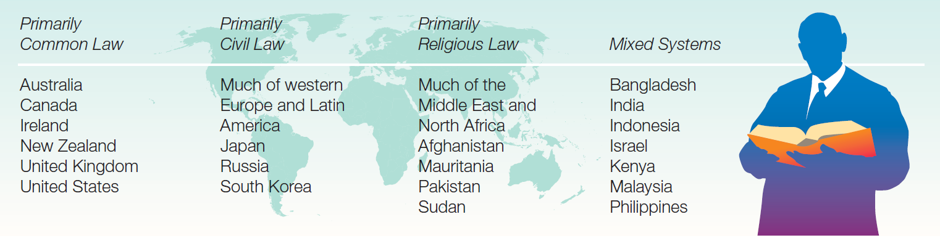
Dominant Legal Systems in Selected Countries
Source: Based on World Legal Systems at www.juriglobe.ca.

Slide 23
Sidestepping Legal Issues
Get expert legal help
Prevent conflicts
  Establish jurisdiction
  Protect intellectual property
  Protect licenses and trade secrets
  Avoid bribery
  Advertising & promotion

Slide 24
Intellectual Property
Intellectual property must be registered in each country where business is conducted.
  Patent–gives an inventor exclusive right to make, use, and sell an invention for a specified period of time
  Trademark–distinctive mark, motto, device, or emblem used to distinguish it from competing products
  Copyright–establishes ownership of a written, recorded, performed, or filmed creative work

Slide 25
Infringement of Intellectual Property
Counterfeiting–unauthorized copying and production of a product
Associative Counterfeit/Imitation–product name differs slightly from a well-known brand
Piracy–unauthorized publication or reproduction of copyrighted work
Notes:
Counterfeiting and piracy are particularly important in industries such as motion pictures, recorded music, computer software, and textbook publishing. Companies in these industries produce products that can be easily duplicated and distributed on a mass basis. The United States in particular has a vested interest in intellectual property protection around the globe because it is home to many companies in the industries just mentioned. However, the United States faces significant challenges in countries such as China. As one expert has noted: Current attempts to establish intellectual property law, particularly on the Chinese mainland, have been deeply flawed in their failure to address the difficulties of reconciling legal values, institutions, and forms generated in the West with the legacy of China’s past and the constraints imposed by its present circumstances.

Slide 26
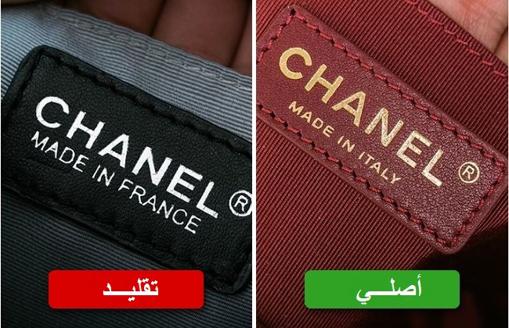
Piracy

Slide 27
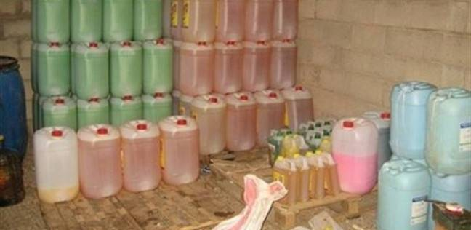
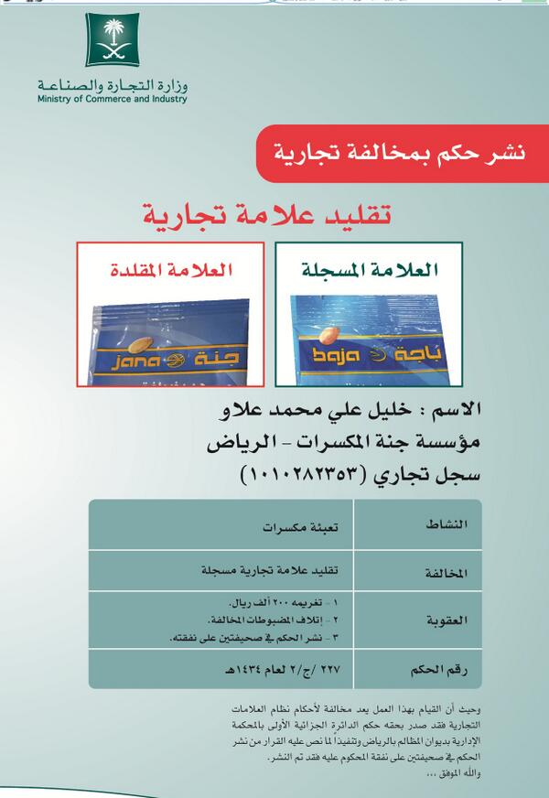
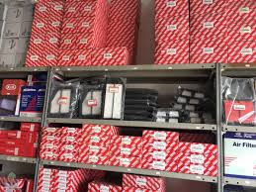

Slide 28
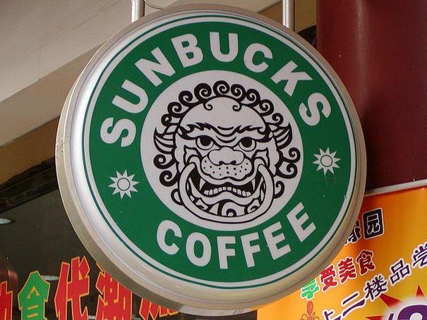
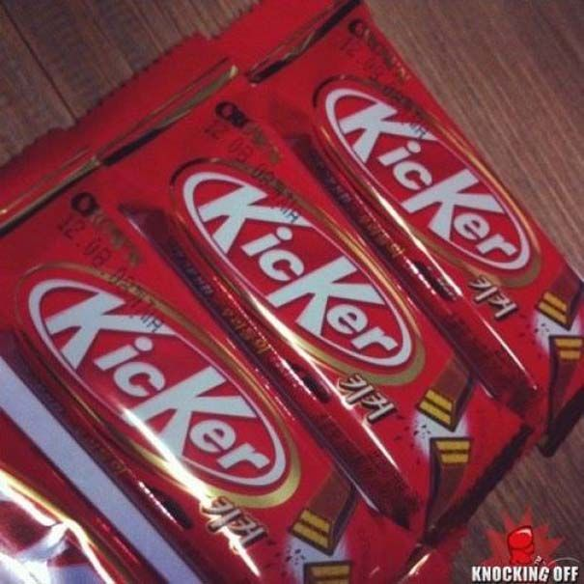
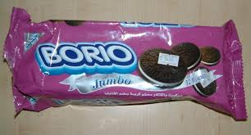

Slide 29

Intellectual Property
“You may not realize it, but by using the name Kleenex ® as a generic term for tissue, you risk erasing our coveted brand name that we’ve worked so hard for all these years. Kleenex ® is a registered trademark and should always be followed by the ® and the words ‘Brand Tissue’. Just Pretend it’s in permanent marker.”
Notes:
Kimberly-Clark Corporation markets Kleenex® brand tissues and is the registered trademark owner. Trademarks and other forms of intellectual property are valuable assets; this ad, which appeared in Advertising Age magazine, serves notice that Kimberly-Clark is protecting its investment in the Kleenex® brand name. Companies take this type of action to prevent brand names from becoming generic terms.

Slide 30
Protecting Intellectual Property
In the U.S., registration is with the Federal Patent Office
In Europe, applicants use the European Patent Office or register country-by-country
Soon the Community Patent Convention will cover 27 countries
Madrid Protocol trademark owners are protected in 74 countries with 1 application
Notes:
European patents are expensive because of the need to translate technical documents into all of the languages of the EU.
Companies sometimes find ways to exploit loopholes or other unique opportunities offered by patent and trademark laws in individual nations. Sometimes, individuals register trademarks in local country markets before the actual corporate entity files for trademark protection. For example, Starbucks filed for trademark protection in 1997 in Russia but did not open any cafés there. Sergei Zuykov, an attorney in Moscow, filed a petition in court in 2002 to cancel Starbucks’ claim to the brand name because it had not been used in commerce. Technically, Zuykov was merely taking advantage of provisions in Russia’s civil code; even though he has been denounced as a “trademark squatter,” he was not violating the law. Zuykov then offered to sell Seattle-based Starbucks its name back for $600,000.

Slide 31
Protecting Intellectual Property
World Intellectual Property Organization
  Governed by the Madrid Agreement and the Madrid Protocol
  A specialized unit of the UN; based in Geneva, Switzerland
  Misson: Promote and protect intellectual property worldwide
  Has easy-to-understand booklets that can be printed directly from its website

Slide 32
Protecting Intellectual Property
International Convention for the Protection of Industrial Property
  Also known as the Paris Convention
  Honored by almost 100 countries
  Facilitates multi-country patent registration, ensures that once a company files, it has a “right of priority” in other countries for one year from that date
Patent Cooperation Treaty
  Over 100 countries cooperate with patent applications
European Patent Convention
  the EU and Switzerland
Notes:
International concern about intellectual property issues in the 19th Century resulted in two important agreements. The first is the International Convention for the Protection of Industrial Property. Also known as the Paris Union or Paris Convention, the convention dates to 1883 and is now honored by nearly 100 countries. This treaty facilitates multi-country patent registrations by ensuring that, once a company files in a signatory country, it will be afforded a “right of priority” in other countries for one year from the date of the original filing. A U.S. company wishing to obtain foreign patent rights must apply to the Paris Union within one year of filing in the United States or risk a permanent loss of patent rights abroad.
The Patent Cooperation Treaty (PCT) has more than 100 signatories, including Australia, Brazil, France, Germany, Japan, North Korea, South Korea, the Netherlands, Switzerland, Russia and other former Soviet states, and the United States. The members constitute a union that provides certain technical services and cooperates in the filing, searching, and examination of patent applications in all member countries. The European Patent Office administers applications for the European Patent Convention, which is effective in the EU and Switzerland. An applicant can file a single patent application covering all of the convention states; the advantage is that the application will be subject to only one procedure of grant. Although national patent laws remain effective under this system, approved patents are effective in all member countries for a period of 20 years from the filing date.
In 1886, the International Union for the Protection of Literary and Artistic Property was formed. Also known as the Berne Convention, this was a landmark agreement on copyright protection. References to the convention pop up in some unexpected places. For example, as the credits roll at the end of The Late Show with David Letterman, the following message appears:
Worldwide Pants Incorporated is the author of this motion picture for purposes of the Berne Convention and all laws giving effect thereto. Unauthorized duplication, distribution, exhibition, or use may result in civil liabilities and/or criminal prosecution.

Slide 33
The 5 requirements for obtaining a patent
Requirement | What it means
1. The innovation is patentable subject matter | PatentableNew products such as toys, appliances, tools, medical devices, pharmaceutical drugs New process, such as a manufacturing process or an industrial method Not patentable Plans or schemes Principles or theories
2. The innovation is new (called 'novelty') | You cannot patent something that is already publicly known, as it would be unfair to confer the economic benefits of a patent in relation to something that is already publicly known.
3. The innovation is inventive | This requirement of an inventive step relates to the 'obviousness' of the new product, process or invention. If it is 'obvious' to a skilled person, it is not patentable.
4. The innovation is useful (called 'utility') | This requirement does not relate to whether the new product, process or invention is 'useful' in terms of whether or not someone would buy it.
5. The innovation must not have prior use | If you have been selling the product, using the process in your business, or if you have licensed it, this prior use disqualifies it from being patentable.

Slide 34
The World’s Most Innovative Companies 2018
15. Amazon.com
14. BoE Systems
13. Toshiba
12. Apple
11. Sony
10. Taiwan Semiconductor Manufacturing
9. Microsoft
8. Toyota Motors
7. Qualcomm
6. Alphabet
5. Canon
4. Intel
3. LG Electronics
2. Samsung
1. International Business Machines

Slide 35
Antitrust
Laws are designed to combat restrictive business practices and to encourage competition
  Enforced by FTC in the U.S., Fair Trade Commission in Japan, European Commission in the EU
  The Sherman Act of 1890 prohibits certain restrictive business practices including fixing prices, limiting production, allocating markets, or any other scheme designed to limit or avoid competition.
    Applies to U.S. companies outside U.S. borders and to foreign companies operating in the U.S.
Notes:
Although antitrust laws are on the books in many countries, they are often weak or loosely enforced.
A recent rash of antitrust actions brought in the United States against foreign companies has raised concerns that the United States is violating international law as well as the sovereignty of other nations. The U.S. antitrust laws are a legacy of the nineteenth-century trust-busting era and are intended to maintain free competition by limiting the concentration of economic power.
There have been calls for the EU to revamp its approach to antitrust issues and reduce its caseload. Any proposed changes will pit modernists against traditionalists. As one European attorney complained, “The commission is putting resources into regulating cases that don’t actually restrict competition, which means that the cases that do need to be looked at are not being resolved efficiently.”
For the past four decades, the competition authority of the European Commission has had the power to prohibit agreements and practices that prevent, restrict, and distort competition. The commission has jurisdiction over European-based companies as well as non-European-based ones that generate significant revenues in Europe. The commission can block a proposed merger or joint venture, approve it with only minor modifications, or demand substantial concessions before granting approval

Slide 36
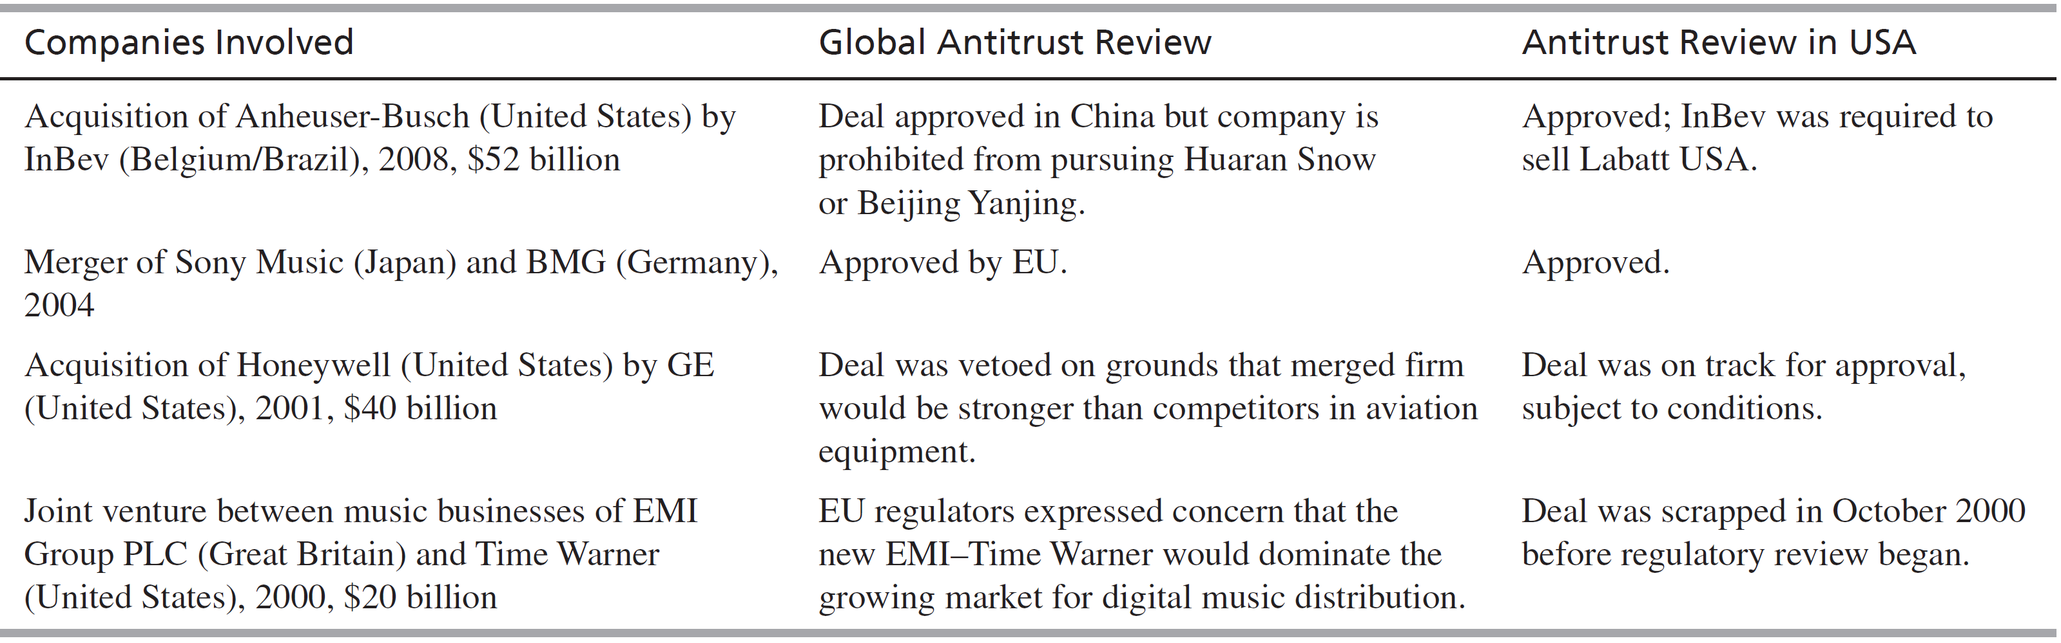
Antitrust Rulings

Slide 37
Licensing and Trade Secrets
Licensing is a contractual agreement in which a licensor allows a licensee to use patents, trademarks, trade secrets, technology, and other intangible assets in return for royalty payments or other forms of compensation
Important considerations
  What assets may be licensed
  How to price assets
  The rights granted
Notes:
The duration of the licensing agreement and the amount of royalties a company can receive are considered a matter of commercial negotiation between licensor and licensee, and there are no government restrictions on remittances of royalties abroad. Important considerations in licensing include what assets a firm may offer for license, how to price the assets, and whether to grant only the right to “make” the product or the rights to “use” and to “sell” the product as well. The right to sublicense is another important issue. As with distribution agreements, decisions must also be made regarding exclusive or nonexclusive arrangements and the size of the licensee’s territory.
The licensor may limit the licensee to sell only in its home country in order to avoid direct competition. The licensee may also be required to stop using the technology after the license has expired.
The U.S. courts ruled that S.C. Johnson and Co. could not license an insecticide from the German company, Bayer AG. To do so would have allowed Johnson to monopolize the $450 million home market.

Slide 38
Licensing and Trade Secrets
Trade secrets are confidential information or knowledge that has commercial value and is not in the public domain and for which steps have been taken to keep it secret
To prevent disclosure, use confidentiality contracts
The Uniform Trade Secrets Act has been adopted by most U.S. states
NAFTA was first international agreement protecting trade secrets
TRIPS, Trade-Related Aspects of Intellectual Property Rights signed by members of GATT
Notes:
Trade secrets include manufacturing processes, formulas, designs, and customer lists.
In the U.S. states have jurisdiction over trade secrets. Several countries adopted trade secret law for the first time during the 1990s. Mexico (1991), China (1993).
The TRIPs agreement requires signatory countries to protect against acquisition, disclosure, or use of trade secrets “in a manner contrary to honest commercial practices.” Despite these formal legal developments, in practice, enforcement is the key issue. Companies transferring trade secrets across borders should apprise themselves not only of the existence of legal protection but also of the risks associated with lax enforcement.

Slide 39
Bribery and Corruption
Foreign Corrupt Practices Act
  Requires publicly held companies to institute internal accounting controls that would record all transactions
  Makes it a crime for a U.S. corporation to bribe an official of a foreign government or political party to obtain or retain business
  Prohibits payments to third parties when there is reason to believe it may be channeled to foreign officials
Omnibus Trade and Competitiveness Act
  Allows for “grease” payments to cut red tape; i.e., getting shipments through customs, getting permits
Notes:
Briberyis the corrupt business practice of demanding or offering some type of consideration—typically a cash payment—when negotiating a cross-border deal.
History does not record a burst of international outrage when Charles M. Schwab, head of Bethlehem steel at the beginning of the 20th century, presented a $200,000 diamond and pearl necklace to the mistress of Czar Alexander III’s nephew. In return for that consideration, Bethlehem Steel won the contract to supply the rails for the Trans-Siberian railroad. Things have changed. However, companies doing business in Central and Eastern Europe, the Middle East, and other parts of the world find that corruption and bribery are widespread.
The Foreign Corrupt Practices Act (FCPA) is a legacy of the Watergate scandal during Richard Nixon’s presidency. In the course of his investigation, the Watergate special prosecutor discovered that more than 300 American companies had made undisclosed payments to foreign officials totaling hundreds of millions of dollars. The act was unanimously passed by Congress and signed into law by President Jimmy Carter on December 17, 1977.
After U.S. companies complained that their activities abroad were severely curtailed, President Reagan signed the OTCA in 1988.
Penalties for violating the law: 1-5 years in jail and fines in excess of $1 million. Critics say that the law puts American companies at a disadvantage. In 1994, bribes offered by non-U.S. companies were a factor in 100 business deals valued at $45 million of which 80% were awarded to non-U.S. firms. Bribery is legal and tax-deductible in some European countries.

Slide 40
2018 Corruption Rankings
# | COUNTRY | REGION | 2018 | 2017 | 2016 | 2015
1 | Denmark | Western Europe & European Union | 88 | 88 | 90 | 91
2 | New Zealand | Asia Pacific | 87 | 89 | 90 | 91
3 | Finland | Western Europe & European Union | 85 | 85 | 89 | 90
3 | Singapore | Asia Pacific | 85 | 84 | 84 | 85
3 | Sweden | Western Europe & European Union | 85 | 84 | 88 | 89
3 | Switzerland | Western Europe & European Union | 85 | 85 | 86 | 86
7 | Norway | Western Europe & European Union | 84 | 85 | 85 | 88
8 | Netherlands | Western Europe & European Union | 82 | 82 | 83 | 84
9 | Canada | Americas | 81 | 82 | 82 | 83
9 | Luxembourg | Western Europe & European Union | 81 | 82 | 81 | 85
11 | Germany | Western Europe & European Union | 80 | 81 | 81 | 81
11 | United Kingdom | Western Europe & European Union | 80 | 82 | 81 | 81
13 | Australia | Asia Pacific | 77 | 77 | 79 | 79
14 | Austria | Western Europe & European Union | 76 | 75 | 75 | 76
14 | Hong Kong | Asia Pacific | 76 | 77 | 77 | 75
14 | Iceland | Western Europe & European Union | 76 | 77 | 78 | 79
17 | Belgium | Western Europe & European Union | 75 | 75 | 77 | 77

Slide 41
2018 Corruption Rankings
# | COUNTRY | REGION | 2018 | 2017 | 2016 | 2015
45 | Dominica | Americas | 57 | 57 | 59 | N/A
45 | Korea, South | Asia Pacific | 57 | 54 | 53 | 54
48 | Costa Rica | Americas | 56 | 59 | 58 | 55
48 | Rwanda | Sub-Saharan Africa | 56 | 55 | 54 | 54
50 | Saint Lucia | Americas | 55 | 55 | 60 | N/A
51 | Malta | Western Europe & European Union | 54 | 56 | 55 | 60
52 | Namibia | Sub-Saharan Africa | 53 | 51 | 52 | 53
53 | Grenada | Americas | 52 | 52 | 56 | N/A
53 | Italy | Western Europe & European Union | 52 | 50 | 47 | 44
53 | Oman | Middle East & North Africa | 52 | 44 | 45 | 45
56 | Mauritius | Sub-Saharan Africa | 51 | 50 | 54 | 53
57 | Slovakia | Western Europe & European Union | 50 | 50 | 51 | 51
58 | Jordan | Middle East & North Africa | 49 | 48 | 48 | 53
58 | Saudi Arabia | Middle East & North Africa | 49 | 49 | 46 | 52
60 | Croatia | Western Europe & European Union | 48 | 49 | 49 | 51

