Slide 1
Global Marketing Communications Decisions I: Advertising
and Public Relations
Chapter 13

Slide 2
Learning Objectives
Define global advertising and identify the top-ranked companies in terms of worldwide ad spending.
Explain the structure of the advertising industry and describe the difference between agency holding companies and individual agency brands.
Identify the key roles of ad agency personnel and describe their respective roles in creating global advertising.
Explain how different media availability varies around the world.
Compare and contrast publicity and public relations and identify global companies that have recently been impacted by negative publicity.

Slide 3
IMC
Integrated Marketing Communications (IMC) is becoming more popular because of the challenges of communicating across national borders
“We have an integrated marketing model that involves all elements of the marketing mix from digital to sports marketing, from event marketing to advertising to entertainment, all sitting at the table driving ideas.”
Trevor Edwards, President, Nike Brand

Slide 4
Global Advertising
Advertising is any sponsored, paid message that is communicated in a non-personal way
Single country
Regional
Global
Global advertising is the use of the same advertising appeals, messages, art, copy, photographs, stories, and video segments for worldwide suitability
Surpassed $560 billion in 2019
Notes:
A global company that has the ability to successfully transform a domestic campaign into a worldwide one, or to create a new global campaign from the ground up, possesses a critical advantage. The first company to find a global market for any product is frequently at an advantage relative to competitors that make the same discovery later. The search for a global advertising campaign should bring together everyone involved with the product to share information and leverage their experiences. Global campaigns with unified themes can help to build long-term product and brand identities and offer significant savings by reducing costs associated with producing ads.
McDonalds: I’m lovin’ it
IBM: Solutions for a Small Planet
BP: Beyond Petroleum
Global advertising also offers companies economies of scale in advertising as well as improved access to distribution channels. Where shelf space is at a premium, as with food products, a company has to convince retailers to carry its products rather than those of competitors. A global brand supported by global advertising may be very attractive because, from the retailer’s standpoint, a global brand is less likely to languish on the shelves.

Slide 5
Globalization and Product Cultures
Products such as coffee and soft drink have emerged as true global products
Starbucks and the coffee culture
Coke halls in every where

Slide 6
Worldwide Market Segments
“Eighteen-year olds in Paris have more in common with 18-year-olds in New York than with their own parents. They buy the same products, go to the same movies, listen to the same music, sip the same colas. Global advertising merely works on that premise.”
- William Roedy, Director, MTV Europe
Notes:
According to data compiled by various industry groups, worldwide advertising expenditures in 2012 passed the $500 billion milestone. Because advertising is often designed to add Psychological value to a product or brand, it plays a more important communications role in marketing consumer products than in marketing industrial products. Frequently purchased, low-cost Products generally require heavy promotional support, which often takes the form of reminder advertising. Consumer products companies top the list of big global advertising spenders.

Slide 7
Ad Age World's Five Largest Avertisers 2017
Rank | Marketer | Headquarters | Category | 2017 total worldwide advertising spending
1 | Samsung Electronics Co. | South Korea | Technology | $11.2B
2 | Procter & Gamble Co. | U.S. | Personal care | 10.5B
3 | L'Oréal | France | Personal care | 8.6B
4 | Unilever | U.K./Netherlands | Personal care | 8.5B
5 | Nestlé | Switzerland | Food and beverages | 7.2B

Slide 8
Standardization vs. Adaptation
Primary Issue
Must the specific advertising message and media strategy be changed from region to region or country to country?
Think of cultural and legal issues
Notes:
Communication experts generally agree that the overall requirements of effective communication and persuasion are fixed and do not vary from country to country. The same thing is true of the components of the communication process: The marketer is the source of the message; the message must be encoded, conveyed via the appropriate channel(s), and decoded by a member of the target audience. Communication takes place only when the intended meaning is transferred from the source to the receiver.
Proponents of the “one world, one voice” approach to global advertising believe that the era of the global village has arrived and that tastes and preferences are converging worldwide. According to the standardization argument, people everywhere want the same products for the same reasons. This means that companies can achieve significant economies of scale by unifying advertising around the globe. Advertisers who prefer the localized approach are skeptical of the global village argument. Instead, they assert that consumers still differ from country to country and must be reached by advertising tailored to their respective countries. Proponents of localization point out that most blunders occur because advertisers have failed to understand—and adapt to—foreign cultures.

Slide 9
Standardization vs. Adaptation
Four difficulties that compromise an organization’s communication efforts
The message may not get through to the intended recipient. (media)
The message may reach the target audience but may not be understood or may even be misunderstood. (target)
The message may reach the target audience and may be understood but still may not induce the recipient to take the action desired by the sender. (cultur)
The effectiveness of the message can be impaired by noise.
Notes:
The message may not get through to the intended recipient. This problem may be the result of an advertiser’s lack of knowledge about appropriate media for reaching certain types of audiences.
The message may reach the target audience but may not be understood or may even be misunderstood. This can be the result of an inadequate understanding of the target audience’s level of sophistication or improper encoding.
3. The message may reach the target audience and may be understood but still may not compel the recipient to take action. This could result from a lack of cultural knowledge about a target audience.
4. The effectiveness of the message may be impaired by noise. Noise, in this case, is an external influence, such as competitive advertising, other sales personnel, or confusion at the receiving end, that can detract from the ultimate effectiveness of the communication.

Slide 10
Standardization vs. Adaptation Localization Argument
“We have been in Sweden for 60 years and in China for only 4 or 5 so our feeling is that retailing is local. It is important to take advantage of local humor, and the things on people’s minds.”
Nils Larsson,
IKEA
“I can think of very few truly global ads that work. Brands are often at different stages around the world, and that means there are different advertising jobs to do.”
Michael Conrad, Chief Creative Officer, Leo Burnett Worldwide

Slide 11
Standardization vs. Adaptation Globalization Argument
“Why should three artists in three different countries sit drawing the same electric iron and three copywriters write about what, after all, is largely the same copy for the same iron?”
Eric Elinder, Swedish ad agency exec in the 1960s
Notes:
Much of the research on this issue has focused on the match between advertising messages and local culture. For example, Ali Kanso surveyed two different groups of advertising managers, those adopting localized approaches to advertising and those adopting standardized approaches. One finding was that managers who are attuned to cultural issues tend to prefer the localized approach, whereas managers less sensitive to cultural issues prefer a standardized approach.

Slide 12
Pattern Advertising
A middle ground between 100% standardization and 100% adaptation
A basic pan-regional or global communication concept for which copy, artwork, or other elements can be adapted as required for individual countries
Notes:
The question of when to use each approach depends on the product involved and a company’s objectives in a particular market. The following generalizations can serve as guidelines:
● Standardized print campaigns can be used for industrial products or for high-tech consumer products. Examples: Apple’s iPhone and iPad.
● Standardized print campaigns with a strong visual appeal often travel well. Example: Similarly, no text appears in the assembly instructions for IKEA furniture. Picture-based instructions can be used throughout the world without translation.
● TV commercials that use voiceovers instead of actors or celebrity endorsers speaking dialogue can use standardized visuals with translated copy for the voiceover. Examples: Gillette (“The best a man can get”); GE (“Imagination at work”); UPS (“We ♥ Logistics”).

Slide 13
Pattern Advertising
Similar:
Layout
Dominant visuals on left
Brand signature and slogan
Contrasting:
Photos
Body copy is localized, not simply translated
Notes:
Layouts are similar.
Dominant visual elements are on the left side.
The Better Bt brand name is printed in reverse against a dark background.
The trapezoid-shaped brand signature and the slogan “Technology That Yields” also are common elements.
By contrast, the visuals themselves are different and the subheads and body copy have been localized, not simply translated.

Slide 14
Advertising Agencies: Organizations and Brands
Understanding the term organization is key
Umbrella corporations/holding companies have one or more ‘core’ advertising agencies
Each ‘organization’ has units specializing in direct marketing, marketing services, public relations, or research
Individual agencies are considered brands
Full service brands create advertising, and provide services such as market research, media buying, and direct marketing
Notes:
Advertising is a fast-paced business, and the ad agency world is fluid and dynamic. New agencies are formed, existing agencies are dismantled, and cross-border investment, spinoffs, joint ventures, and mergers and acquisitions are a fact of life. There is also a great deal of mobility in the industry as executives and top talent move from one agency to another.

Slide 15
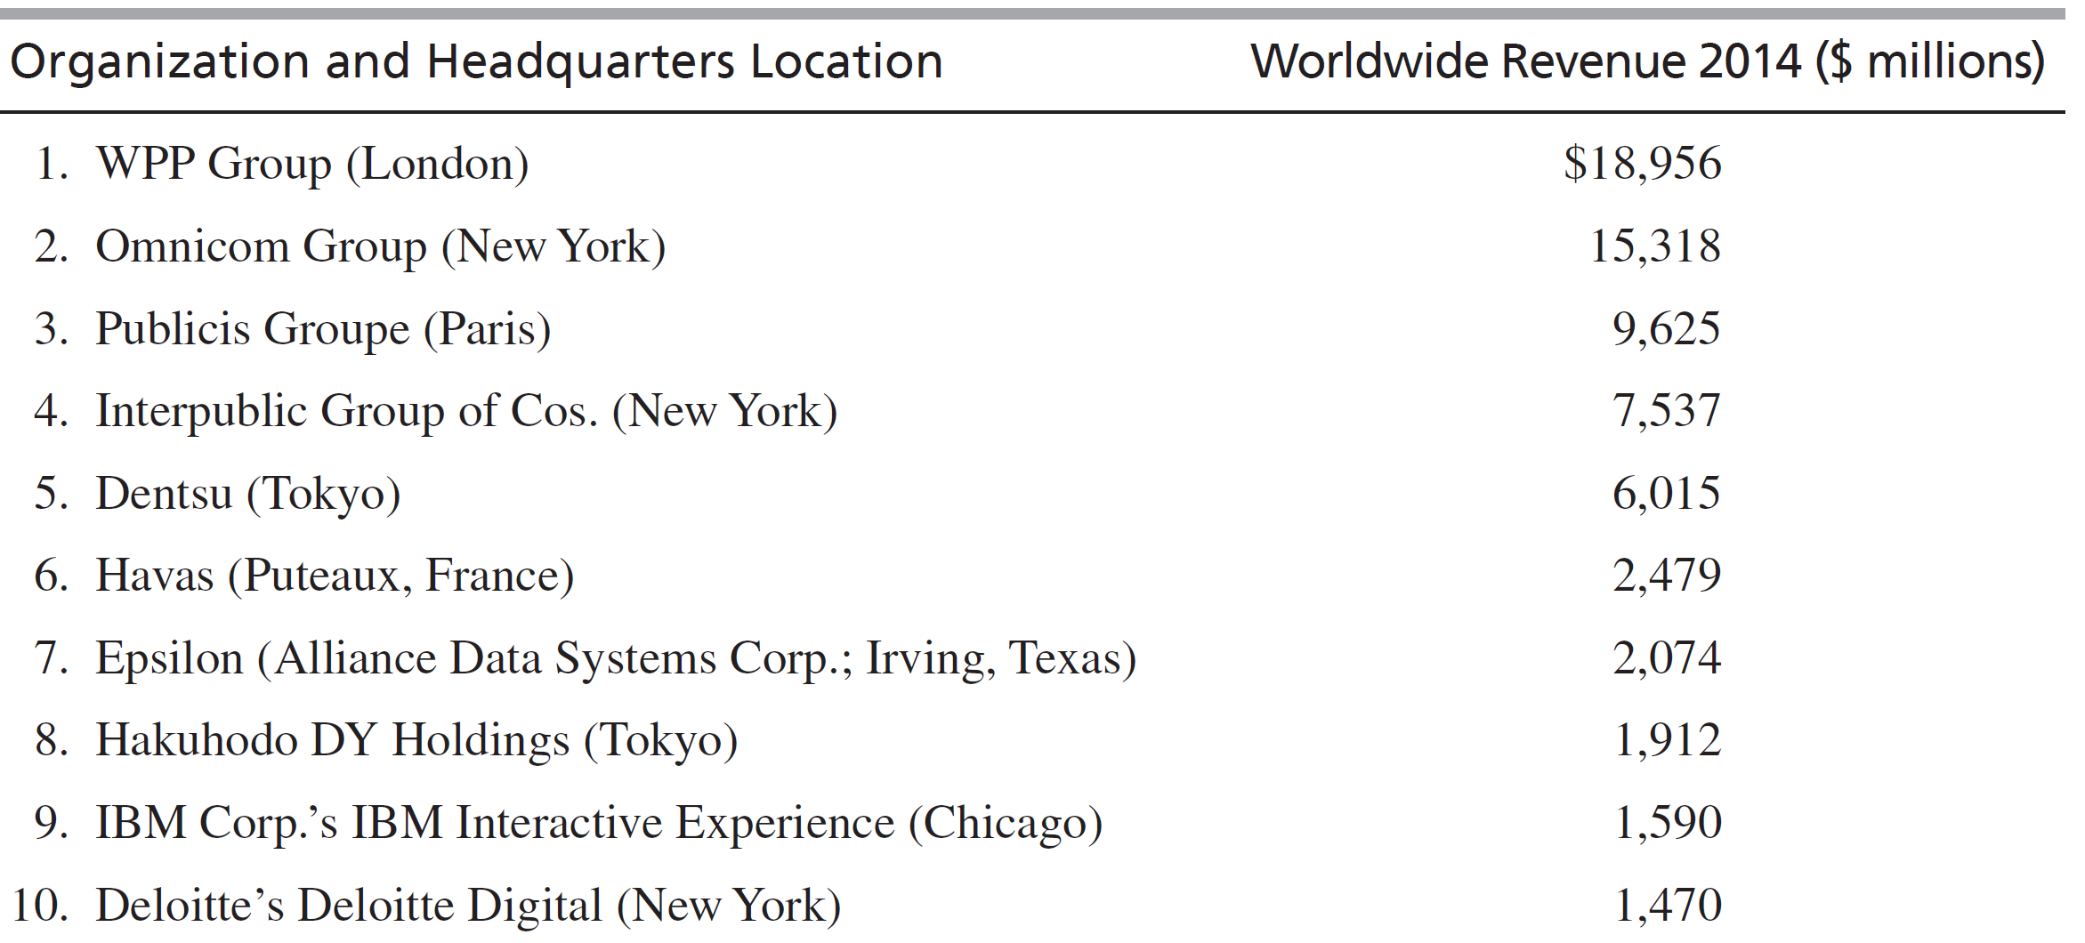
Top 10 Global Advertising Agency Companies, 2014
Notes:
See Table 13-2 for the top 20

Slide 16
The Largest Advertising Companies in the World 2018
Rank | ﻿Agency Name | Headquarters | Worldwide Revenue (Billions)
1 | WPP Group | London | 19
2 | Omnicom Group | New York | 15.3
3 | Publicis Groupe | Paris | 9.6
4 | Interpublic Group | New York | 7.5
5 | Dentsu | Tokyo | 6

Slide 17
Selecting an Advertising Agency
Company organization
Companies that are decentralized may want to leave the choice to the local subsidiary
National responsiveness
Is the global agency familiar with local culture and buying habits of a particular country?
Area coverage
Does the agency cover all relevant markets?
Buyer perception
What kind of brand awareness does the company want to project?
Notes:
When selecting an advertising agency it is important to consider the four areas listed on this slide. Also, despite an unmistakable trend toward using global agencies to support global marketing efforts, companies with geocentric orientations will adapt to the global market requirements and select the best agency or agencies accordingly. Advertising professionals face escalating pressure to achieve new heights of creativity. Some critics of advertising complain that agencies sometimes try to create advertising that will win awards and generate acclaim and prestige rather than advertising that serves clients’ needs. The search for fresh answers to promotion challenges has prompted some client companies to look to new sources for creative ideas.
Companies can create ads in-house, use an outside agency, or combine both strategies. For example, Chanel, Benetton, H&M, and Diesel rely on in-house marketing and advertising staffs for creative work; Coca-Cola has its own agency, Edge Creative, but also uses the services of outside agencies such as Leo Burnett. When one or more outside agencies are used, they can serve product accounts on a multicountry or even global basis. It is possible to select a local agency in each national market or an agency with both domestic and overseas offices. Like Coca-Cola, Levi Strauss and Polaroid also use local agencies.
There is a growing tendency for Western clients to designate global agencies for product accounts to support the integration of the marketing and advertising functions; Japan-based companies are less inclined to use this approach. For example, in 1995, Colgate-Palmolive consolidated its $500 million in global billings with Young & Rubicam. That same year, IBM consolidated its ad account with Ogilvy & Mather for the launch of the “Solutions for a small planet” global campaign. Similarly, Bayer AG consolidated most of its $300 million consumer products advertising with BBDO Worldwide; Bayer had previously relied on 50 agencies around the globe. Agencies are aware of this trend and are themselves pursuing international acquisitions and joint ventures to extend their geographic reach and their ability to serve clients on a global account basis. In an effort to remain competitive, many small independent agencies in Europe, Asia, and the United States belong to the Transworld Advertising Agency Network. TAAN allows member agencies to tap into worldwide resources that would not otherwise be available to them.

Slide 18
Creating Global Advertising
The message is at the heart of advertising
Creative strategy—a statement or concept of what a particular message or campaign will say
Big idea— “The flash of insight that synthesizes the purpose of the strategy, joins the product benefit with consumer desire in a fresh, involving way, brings the subject to life, and makes the reader or audience stop, look, and listen.”
John O’Toole, legendary ad man
Notes:
The message is at the heart of advertising. The particular message and the way it is presented will depend on the advertiser’s objective. Is the ad designed to inform, entertain, remind, or persuade? Moreover, in a world characterized by information overload, ads must break through the clutter, grab the audience’s attention, and linger in their minds.
In his book about Subaru of America, Randall Rothenberg describes the big idea in the following way:
“The Big Idea is easier to illustrate than define, and easier to illustrate by what it is not than by what it is. It is not a “position” (although the place a product occupies in the consumer’s mind may be a part of it). It is not an “execution” (although the writing or graphic style of an ad certainly contributes to it). It is not a slogan (although a tag line may encapsulate it). The Big Idea is the bridge between an advertising strategy, temporal and worldly, and an image, powerful and lasting. The theory of the Big Idea assumes that average consumers are at best bored and more likely irrational when it comes to deciding what to buy.”
Ex.: MSN “Life’s Better with the Butterfly;” MasterCard “There are some things in life money can’t buy”

Slide 19
Advertising Appeal
Rational approach
Depend on logic and speak to the consumer’s intellect; based on the consumer’s need for information
Emotional approach
Tugs at the heartstrings or uses humor

Slide 20
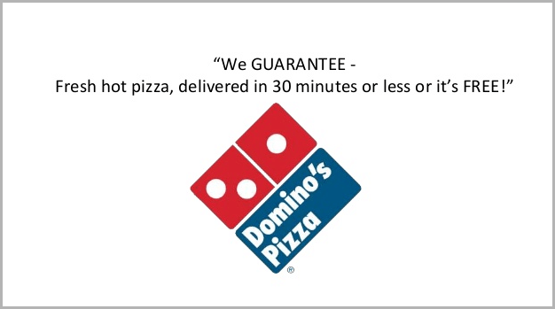
Advertising Appeal
Selling proposition
The promise or claim that captures the reason for buying the product or the benefit that ownership confers
Since products are at differing stages of the product life cycle in different national markets and because of cultural, social and economic differences, the most effective appeal or selling proposition may vary.

Slide 21
Creative Execution
Creative execution
The way an appeal or proposition is presented
straight sell
scientific evidence
demonstration
comparison
slice of life
animation
fantasy
dramatization

Slide 22
Creatives and Their Tasks
Art Directors
Advertising professional who has the general responsibility for the overall look of an ad
Will choose graphics, pictures, type styles, and other visual elements that appear in an ad
Art Direction
The visional presentation of an advertisement
Copy is written or spoken communication elements
Copywriters are language specialists who develop headlines, subheads, and body copy
Notes:
The global advertiser must make sure that visual executions are not inappropriately extended into markets. In the mid-1990s, Benetton’s United Colors of Benetton campaign generated considerable controversy. The campaign appeared in scores of countries, primarily in print and on billboards. The art direction focused on striking, provocative interracial juxtapositions—a white hand and a black hand handcuffed together, for example. Another version of the campaign, depicting a black woman nursing a white baby, won advertising awards in France and Italy. However, because the image evoked the history of slavery in the United States, that particular creative execution was not used in the U.S. market.
Art directors and copywriters are known as the creatives.

Slide 23
Copywriting Decisions
Prepare new copy for foreign markets in host country’s language
Translate the original copy into target language
Leave some or all copy elements in home country language
Notes:
The next issue facing advertisers is which medium or media to use when communicating with target audiences. In some instances, the agency that creates advertising also makes recommendations about media placement; however, many advertisers use the services of specialized media planning and buying organizations. The available alternatives can be broadly categorized as print media, electronic media, and other. Print media range in form from local daily and weekly newspapers to magazines and business publications with national, regional, or international audiences. Electronic media include broadcast television, cable television, radio, and the Internet. Additionally, advertisers may utilize various forms of outdoor, transit, and direct mail advertising. Globally, media decisions must take into account country specific regulations.
A copywriter who can think in the target language and understands the consumers in the target country will be able to create the most effective appeals, organize the ideas, and craft the specific language, especially if colloquialisms, idioms, or humor are involved.

Slide 24
Advertising Copy Mistakes
In Asia, Pepsi’s “Come Alive” was interpreted as asking to bring ancestors back from the dead
In China, Citicorp’s “Citi Never Sleeps” was taken to mean that Citi had a sleeping disorder, like insomnia
McDonald’s does not use multiple 4’s in advertising prices in China; “four” sounds like the word “death”
Notes:
Translating copy has been the subject of great debate in advertising circles. Advertising slogans often present the most difficult translation problems. The challenge of encoding and decoding slogans and tag lines in different national and cultural contexts can lead to unintentional errors. For example, the Asian version of Pepsi’s “Come alive” copy line was rendered as a call to bring ancestors back from the grave.
Advertising executives may elect to prepare new copy for a foreign market in the language of the target country or to translate the original copy into the target language. A third option is to leave some (or all) copy elements in the original (home-country) language. In choosing from these alternatives, the advertiser must consider whether a translated message can be received and comprehended by the intended foreign audience. Anyone with knowledge of two or more languages realizes that the ability to think in another language facilitates accurate communication. To be confident that a message will be understood correctly after it is received, one must understand the connotations of words, phrases, and sentence structures, as well as their translated meaning.

Slide 25
Cultural Considerations
Images of male/female intimacy are in bad taste in Japan; illegal in Saudi Arabia
Wedding rings are worn on the right hand in Spain, Denmark, Holland, Germany
European men kiss the hands of married women only, not single women
In Germany, France and Japan, a man enters a door before a woman; no ladies first!

Slide 26
Cultural Considerations
Humorous or irritating ads may be perceived differently in other countries
American ads with direct comparisons & spokespeople use logic to appeal to the viewer’s sense of reason; Japanese ads rely on implied sentiment
Partial nudity & same-sex couples are featured in Latin America & Europe
Food is the most culturally sensitive category
Notes:
Some American companies have canceled television ads created for the Latin American market portraying racial stereotypes that were offensive to persons of color. Nabisco, Goodyear, and other companies are also being more careful about the shows during which they buy airtime; some very popular Latin American programs feature content that exploits class, race, and ethnic differences.
Standards vary widely with regard to the use of sexually explicit or provocative imagery. Partial nudity and same-sex couples are frequently seen in ads in Latin America and Europe. In the U.S. market, however, network television decency standards and the threat of boycotts by conservative consumer activists constrain advertisers.
Food is the product category most likely to elicit cultural sensitivity. Thus, marketers of food and food products must be alert to the need to localize their advertising. A good example of this is the effort by H. J. Heinz Company to develop the overseas market for ketchup. More than 20 years ago, marketing managers at Heinz formulated a strategy that called for adapting both the product and the advertising to target country tastes. In Greece, for example, ads show ketchup pouring over pasta, eggs, and cuts of meat. In Japan, they instruct Japanese homemakers on using ketchup as an ingredient in Western-style food such as omelets, sausages, and pasta.
Americans like a sweet ketchup, but Europeans prefer a spicier, more piquant variety. Significantly, Heinz’s foreign marketing efforts are most successful when the company quickly adapts to local cultural preferences. In Sweden, the made-in-America theme is so muted in Heinz’s ads that “Swedes don’t realize Heinz is American. They think it is German because of the name,” says Tilley. In contrast to this, American themes still work well in Germany. Kraft and Heinz are trying to outdo each other with ads featuring strong American images.

Slide 27
Cultural Considerations– Japanese & American Differences
Indirect rather than direct forms of expression are preferred in the messages
There is often little relationship between ad content and the advertised product
Only brief dialogue or narration is used in television commercials, with minimal explanatory content
Humor is used to create a bond of mutual feelings
Famous celebrities appear as close acquaintances or everyday people
Priority is placed on company trust rather than product quality
The product name is impressed on the viewer with short, 15-second commercials
Notes:
Knowledge of cultural diversity, especially the symbolism associated with cultural traits, is essential for creating advertising. Local country managers can share important information, such as when to use caution in advertising creativity. Use of colors and man-woman relationships can often be stumbling blocks.

Slide 28
Global Media Decisions
Which medium or media to use?
Print such as daily and weekly newspapers to magazines with regional, national, or international audiences
Electronic media like broadcast TV, cable TV, radio, and the internet
Other such as outdoor, transit, and direct mail
Must know country-specific regulations
Ex. France bans TV ads by retailers

Slide 29
Global Advertising Expenditures and Media Vehicles
More money spent in U.S. than anywhere else in the world; $176 billion in 2014
China is #2 at $52 billion
1/3 of current growth in ad spending in BRICS
Worldwide, TV is the #1 medium with estimated spending of $206 billion in 2014; TV captured slightly less than 40% of global ad spending
In Germany newspapers are #1 advertising vehicle
Notes:
Media consumption patterns can vary from country to country. For example, television is the number one medium in both the United States and Japan. By contrast, newspapers are the leading medium in Germany; television ranks second. In Germany, outlays for newspaper advertising surpass those for television by a ratio of two to one. In real terms, television captured slightly more than 40 percent of global expenditures. Serbia leads the world in terms of watching the most television; daily viewership is 5 hours, 39 minutes each day. Macedonia ranks second, with 5:19; the United States is third with 5:04. Newspapers rank second on a worldwide basis, accounting for about 27 percent of advertising spending.
Television is also important in the Latin American market. In Brazil, expenditures on television advertising are nearly three times higher than those for newspapers. The availability of media to advertisers and the conditions affecting media buys also vary greatly around the world. In Mexico, an advertiser that can pay for a full-page ad may get the front page, while in India, paper shortages may require booking an ad six months in advance. In some countries, especially those where the electronic media are government owned, television and radio stations can broadcast only a restricted number of advertising messages. In Saudi Arabia, no commercial television advertising was allowed prior to May 1986; currently, ad content and visual presentation are restricted.
Radio is a less important medium than print and TV. It is effective in countries where literacy rates are low. CRM spending and Internet advertising is gaining ground worldwide at the expense of TV and print.

Slide 30
Media Decisions
The availability of TV, newspapers and other media varies widely globally
In developed countries, newspapers are declining as Internet usage rises
In India, newly redesigned papers are growing
300 daily papers, only 4 million Indians subscribe to Internet service
In Moscow, billboards are #1; In a city built for 30,000 cars, there are 3 million, creating massive traffic jams and captive audiences
Notes:
India is home to nearly 300 daily newspapers, including the Times of India and the Hindustan Times; the price per copy is only 5 rupees—about 10 cents. Additional critical factors in India’s media environment include the lack of penetration by cable television and the fact that only about 4 million Indians currently subscribe to an Internet service. By contrast, billboards are the medium of choice in Moscow. As Thomas L. Friedman has pointed out, Moscow is a city built for about 30,000 cars; during the past decade, the number of cars has grown from 300,000 to 3 million. The result is massive traffic jams and commuting delays; thus, affluent businesspeople spend hours in traffic and have little time to read the newspaper
or watch TV.
Even when media availability is high, its use as an advertising vehicle may be limited. For example, in Europe, television advertising is very limited in Denmark, Norway, and Sweden. Regulations concerning content of commercials vary; Sweden bans advertising to children younger than 12 years of age. In 2001, when Sweden headed the EU, its policymakers tried to extend the ban to the rest of Europe. Although the effort failed, Sweden retained its domestic ban. This helps explain why annual spending on print media in Sweden is three times the annual spending for television.

Slide 31
Media Decisions: Arab Countries
People are depicted less often than in the U.S.
Women may only appear in those commercials that relate the advertised product
Women must wear long dresses
Brevity is a virtue in ads
Use of comparative advertising claims very limited
U.S. ads have more price information

Slide 32
Media Decisions: Scandinavia
Limited TV ads in Sweden, Norway, and Denmark
No advertising to children under 12 in Sweden
Spending on print media is 3 times higher than TV

Slide 33
Public Relations
Fosters goodwill and understanding
Generates favorable publicity
Tools
News releases
Media kits
Press conferences
Tours
Articles in trade, professional journals
TV and radio talk show appearances
Special events
Social media
Corporate Web sites
Notes:
Public relations (PR) is the department or function responsible for evaluating public opinion about, and attitudes toward, the organization and its products and brands. Public relations personnel also are responsible for fostering goodwill, understanding, and acceptance among a company’s various constituents and publics. Like advertising, public relations is one of four variables in the promotion mix. One of the tasks of the PR practitioner is to generate favorable publicity. By definition, publicity is communication about a company or product for which the company does not pay.

Slide 34
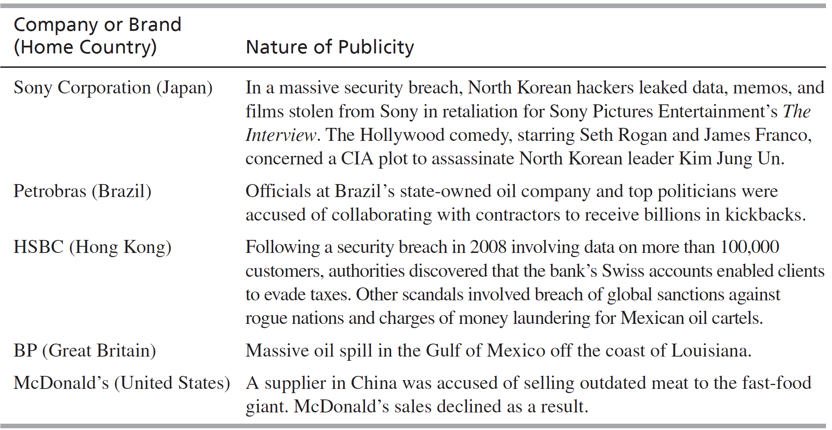
Negative Publicity Affecting Global Marketers

Slide 35
Advertising as a PR Function
Corporate advertising
Compensates for lack of control over publicity
Calls attention to the company’s other communication efforts
Image advertising
Enhances the public’s perception, creates goodwill
Advocacy advertising
Presents the company’s point of view on a particular issue
Notes:
Corporate : Daimler AG is one of the world’s leading producers of diesel automobiles. This corporate image advertisement is not about the company’s cars per se; rather, it is about the company’s ongoing efforts to create more eco-friendly diesel fuels to power its cars. Translated, the headline reads, “If you invent the car, you’re also committed to Energy for the Future.” The ad positions Daimler both as an innovator and as a responsible corporate citizen. Because the message and the associated image have worldwide appeal, this ad lends itself to an extension strategy.
Image: In 2008, for example, Anheuser-Busch InBev placed full-page ads in the business press to announce their merger. Global companies frequently use image advertising in an effort to present themselves as good corporate citizens in foreign countries. BASF uses advertising to raise awareness about the company’s innovative products that are used in the automotive, home construction, and pharmaceutical industries. Similarly, a campaign from Daimler AG was designed to raise awareness of the company’s eco-friendly electric drive vehicles (see Exhibit 13-5).
Advocacy: A company presents its point of view on a particular issue. The ad from the Consumer Electronics Association in Chapter 2 supporting free trade agreements is one example.

Slide 36
Role of Public Relations in Global Marketing Communications
PR’s role is growing in the post global recession
Build consensus and understanding
Create harmony and trust
Articulate and influence public opinion
Anticipate conflicts and resolve disputes
Smartphones, broadband Internet, social media, satellite links allow PR pros to stay in touch with media anywhere, anytime
Notes:
Public relations professionals with international responsibility must go beyond media relations and serve as more than a company mouthpiece. As companies become more involved in global marketing and the globalization of industries continues, company management must recognize the value of international public relations.
In spite of these technological advances, PR professionals must still build good personal working relationships with journalists and other media representatives, as well as with leaders of other primary constituencies. Therefore, strong interpersonal skills are needed. One of the most basic concepts of the practice of PR is to know the audience. For the global PR practitioner, this means knowing the audiences in both the home country and the host country or countries. Specific skills needed include the ability to communicate in the language of the host country and familiarity with local customs. A PR professional who is unable to speak the language of the host country will be unable to communicate directly with a huge portion of an essential audience. Likewise, the PR professional working outside the home country must be sensitive to nonverbal communication issues in order to maintain good working relationships with host-country nationals. Commenting on the complexity of the international PR professional’s job, one expert notes that, in general, audiences are “increasingly more unfamiliar and more hostile, as well as more organized and powerful…more demanding, more skeptical and more diverse.” International PR practitioners can play an important role as “bridges over the shrinking chasm of the global village”.

Slide 37
Public Relations Practices Around the World
Public relations practices can be affected by:
Cultural traditions
Social and political contexts
Economic environments
Public relations professionals must understand these differences and tailor the message appropriately
PR can shine in a crisis; best to be forthright, direct, reassure the public, be accurate with the media
Notes:
Mass media and the written word are important vehicles for information dissemination in many industrialized countries. In developing countries, however, the best way to communicate might be through the gongman, the town crier, the market square, or the chief’s courts. In Ghana, dance, songs, and storytelling are important communication channels. In India, where half of the population cannot read, writing press releases will not be the most effective way to communicate. In Turkey, the practice of PR is thriving in spite of that country’s reputation for harsh treatment of political prisoners. Although the Turkish government still asserts absolute control as it has for generations, corporate PR and journalism are allowed to flourish so that Turkish organizations can compete globally.
Even in industrialized countries, there are some important differences between PR practices. In the United States, much of the news in a small, local newspaper is placed by means of the hometown news release. In Canada, on the other hand, large metropolitan population centers have combined with Canadian economic and climatic conditions to thwart the emergence of a local press. The dearth of small newspapers means that the practice of sending out hometown news releases is almost nonexistent. In the United States, PR is increasingly viewed as a separate management function. In Europe that perspective has not been widely accepted; PR professionals are viewed as part of the marketing function rather than as distinct and separate specialists in a company.

