Slide 1
Brand and Product Decisions
in Global Marketing
Chapter 10

Slide 2
Learning Objectives
Review the basic product concepts that underlie a successful global marketing product strategy.
Compare & contrast local products & brands, international products & brands, and global products & brands.
Explain how Maslow’s needs hierarchy helps global marketers understand the benefits sought by buyers in different parts of the world.
Outline the importance of the “country of origin” as a brand element.
List the five strategic alternatives that marketers can utilize during the global product planning process.
Explain the new-product continuum and compare and contrast the types of innovation.
Notes:
The product “P” of the marketing mix is at the heart of the challenges and opportunities facing global companies today: Management must develop product and brand policies and strategies that are sensitive to market needs, competition, and company ambitions and resources on a global scale. Effective global marketing often entails finding a balance between the payoff from extensively adapting products and brands to local market preferences and the benefits that come from concentrating company resources on relatively standardized global products and brands.

Slide 3
Basic Product Concepts
A product is a good, service, or idea
Tangible Attributes (Weight, dimensions, materials)
Intangible Attributes (Services, Brand)
Product types
Consumer goods
Industrial goods
Notes:
A product’s tangible attributes can be assessed in physical terms such as weight, dimensions, or materials used. Consider, for example, a flat-panel TV with an LCD screen that measures 42 inches across. The unit weighs 100 pounds, is four inches thick, and has a tuner capable of receiving high-definition TV signals over the air. These tangible, physical features translate into benefits that enhance the enjoyment of watching prime time TV and movies on DVR’s.
Intangible product attributes, including status associated with product ownership, a manufacturer’s service commitment, and a brand’s overall reputation or mystique, are also important. When shopping for a new TV set, for example, many people want “the best:” They want a TV loaded with features (tangible product elements), as well as one that is “cool” and makes a status statement (intangible product element).

Slide 4
Product Types
Buyer orientation
Amount of effort expended
Level of risk
Buyer involvement
Buyer orientation framework
Convenience goods
Preference goods
Shopping goods
Specialty goods
Notes:
A frequently used framework for classifying products distinguishes between consumer and industrial goods. Consumer and industrial goods, in turn, can be further classified on the basis of criteria such as buyer orientation. Buyer orientation is a composite measure of the amount of effort a customer expends, the level of risk associated with a purchase, and buyer involvement in the purchase. The buyer orientation framework includes such categories as convenience, preference, shopping, and specialty goods.

Slide 5
Product Warranties
An Express Warranty is a written guarantee that assures the buyer is getting what he or she paid for or provides a remedy in case of a product failure
Warranties can be used as a competitive tool
Hyundai 1998- 2011 (90-500)
Notes:
In the late 1990s, Hyundai Motor America chief executive Finbarr O’Neill realized that many American car buyers perceived Korean cars as “cheap” and were skeptical about the Hyundai nameplate’s reliability. In fact, the company had made significant improvements in the quality and reliability of its vehicles, but consumer perceptions of the brand had not kept pace with the changes. O’Neill instituted a 10-year, 100,000-mile warranty program that represents the most comprehensive coverage in the auto industry. Concurrently, Hyundai launched several new vehicles and increased expenditures for advertising. The results are impressive: Hyundai’s U.S. sales jumped from about 90,000 vehicles in 1998 to nearly 500,000 vehicles in 2011.

Slide 6
Packaging
Consumer Packaged Goods are a variety of products whose packaging protects or contains the product from production to the end user
Eco-packaging addresses environmental issues like recycling, biodegradability, & sustainable forestry
Must engage the senses, make an emotional connection, & enhance the brand experience

Slide 7
Labeling
Provides consumers with various types of information
Regulations differ by country regarding various products
Health warnings on tobacco products
American Automobile Labeling Act clarifies the country of origin, and final assembly point
European Union requires labels on all food products that include ingredients from genetically modified crops
COOL in USA
Notes:
One hallmark of the modern global marketplace is the abundance of multi-language labeling that appears on many products. In today’s self-service retail environments, product labels may be designed to attract attention, to support a product’s positioning, and to help persuade consumers to buy.
Today, virtually all food products sold in the United States must present information regarding nutrition (e.g., calories and fat content) and serving size in a standard format. The use of certain terms such as “light” and “natural” is also restricted. Other examples of labeling in global marketing include:
Mandatory health warnings on tobacco products are required in most countries.
The American Automobile Labeling Act clarifies the country of origin, the final assembly point, and the percentages of the major sources of foreign content of every car, truck, and minivan sold in the United States (effective since October 1, 1994).
Responding to pressure from consumer groups, in 2006 McDonald’s began posting nutrition information on all food packaging and wrappers in approximately 20,000 restaurants in key markets worldwide. Executives indicated that issues pertaining to language and nutritional testing would delay labeling in 10,000 additional restaurants in smaller country markets.
Nestlé recently introduced Nan, an infant-formula brand that is popular in Latin America, in the American market. Targeted at Hispanic mothers, Nestlé Nan’s instructions are printed in Spanish on the front of the can. Other brands have English-language labeling on the outside; Spanish-language instructions are printed on the reverse side.
In 2008, the United States enacted a country-of-origin labeling (COOL) law. The law requires supermarkets and other food retailers to display information that identifies the country that meat, poultry, and certain other food products come from.

Slide 8
Aesthetics
Global marketers must understand the importance of visual aesthetics
Aesthetic styles (degree of complexity found on a label) differ around the world
Notes:
Global marketers must understand the importance of visual aesthetics embodied in the color or shape of a product, label, or package. Likewise, aesthetic styles, such as the degree of complexity found on a label, are perceived differently in different parts of the world. For example, it has been said that In some cases, a standardized color can be used in all countries; examples include the distinctive yellow color on Caterpillar’s earthmoving equipment and its licensed outdoor gear, the red Marlboro chevron, and John Deere’s signature green. In other instances, color choices should be changed in response to local perceptions.

Slide 9
Basic Brand Concepts
Bundle of images and experiences in the customer’s mind
A promise made by a particular company about a particular product
A quality certification
Differentiation between competing products
The sum of impressions about a brand is the Brand Image
Notes:
Customers integrate all their experiences of observing, using, or consuming a product with everything they hear and read about it. The essence of a brand exists in the mind; as such, brands are intangible. However, companies develop logos, distinctive packaging, and other communication devices to provide visual representations of their brands. A logo can take a variety of forms, starting with the brand name itself.

Slide 10
Brand Equity
The total value that accrues to a product as a result of investments in the marketing of the brand
An asset that represents the value created by the relationship between the brand and customer over time
Notes:
The value of global megabrands such as Coca-Cola and Marlboro runs in the tens of billions of dollars.
Warren Buffett, the legendary American investor who heads Berkshire Hathaway, asserts that the global power of brands such as Coca-Cola and Gillette permits the companies that own them to set up a protective moat around their economic castles. As Buffett once explained, “The average company, by contrast, does battle daily without any such means of protection.” That protection often yields added profit, because the owners of powerful brand names can typically command higher prices for their products than can owners of lesser brands. In other words, the strongest global brands have tremendous brand equity.

Slide 11
Brand Equity Benefits
Greater loyalty
Less vulnerability to marketing actions
Less vulnerability to marketing crises
Larger margins
More inelastic consumer response to price increases
More elastic consumer response to price decreases
Increased marketing communication effectiveness
Notes:
Source: Kevin Keller

Slide 12
International Products and Brands
Products and brands offered in several markets in a particular region
‘Euro-brands’
Honda 5-door hatchback auto is known as Fit in Japan and Jazz in Europe

Slide 13
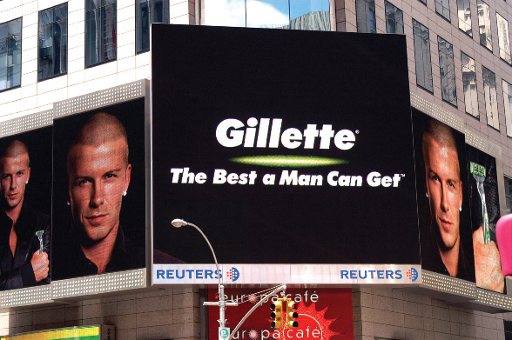
Global Products and Brands
Global brands are not the same as global products
iPod = brand
mp3 player= product
Global products meet the wants and needs of a global market and are offered in all world regions
Global brands have the same name and similar image and positioning throughout the world
BMW : “Ultimate Driving Machine
GE: Imagination at Work
Visa: Life takes Visa
Harley-Davidson: An American Legend
In any language Gillette’s trademarked brand promise is easy to understand.

Slide 14
Global Brand Characteristics
Quality signal—allows a company to charge premium price in a highly competitive market
Global myth—marketers can use global consumer culture positioning to link the brand identity to any part of the world
Social responsibility—shows how a company addresses social problems
Notes:
Worldwide, consumers, corporate buyers, governments, activists, and other groups associate global brands with three characteristics; consumers use these characteristics as a guide when making purchase decisions.
• Quality signal. Global brands compete fiercely with each other to provide world-class quality. A global brand name differentiates product offerings and allows marketers to charge premium prices.
• Global myth. Global brands are symbols of cultural ideals. As noted in Chapter 7, marketers can use global consumer culture positioning (GCCP) to communicate a brand’s global identity and link that identity to aspirations in any part of the world.
• Social responsibility. Customers evaluate companies and brands in terms of how they address social problems and how they conduct business.

Slide 15
Branding Strategies
Combination branding allows marketers to leverage a company’s reputation while developing a distinctive identity for a line of products
Sony Walkman
Co-branding features two or more company or product brands
NutraSweet and Coca-Cola
Intel Inside
Credit card
Notes:
Properly implemented, co-branding can engender customer loyalty and allow companies to achieve synergy. However, co-branding can also confuse consumers and dilute brand equity. The approach works most effectively when the products involved complement each other. Credit card companies were the pioneers, and today it is possible to use cards to earn frequent flyer miles and discounts on automobiles.

Slide 16
Brand Extension
Brand acts as an umbrella for new products
Example: The Virgin Group
Virgin Entertainment: Virgin Mega-stores and MGM Cinemas
Virgin Radio
Virgin Rail (UK only)
Virgin Media Group: Virgin Publishing, Virgin Television, Virgin Net (UK only)
Virgin Hotels
Virgin Travel Group: Virgin America Airways, Virgin Holidays, Virgin Galactic
Notes:
The brand has been built on Richard Branson’s shrewd ability to exploit weaknesses in competitors’ customer service skills, as well as a flair for self-promotion. Branson’s business philosophy is that brands are built around reputation, quality, innovation, and price rather than image. Although Branson is intent on establishing Virgin as the British brand of the new millennium, some industry observers wonder if the brand has been spread too thin.

Slide 17
Product/Brand Matrix
Notes:
This table shows the four combinations of local and global products and brands in matrix form. Each represents a different strategy; a global company can use one or more strategies as appropriate. Some global companies pursue strategy 1 by developing local products and brands for individual country or regional markets. Coca-Cola makes extensive use of this strategy; Georgia canned coffee in Japan is one example. Coca-Cola’s flagship cola brand is an example of strategy 4. In South Africa, Coca-Cola markets Valpre brand bottled water (strategy 2). The global cosmetics industry makes extensive use of strategy 3; the marketers of Chanel, Givenchy, Clarins, Guerlain, and other leading cosmetics brands create different formulations for different regions of the world. However, the brand name and the packaging may be uniform everywhere.

Slide 18
World’s Most Valuable Brands, 2019
Amazon $315.5 billion.
Apple $309.5 billion.
Google $309 billion.
Microsoft $251.2 billion.
Visa $177.9 billion.
Facebook $159 billion.
Alibaba $131.2 billion.
Notes:
Table 10-2 shows global brands ranked in terms of their economic value as determined by analysts at the Interbrand consultancy and Citigroup. To be included in the rankings, the brand has to generate about one-third of sales outside the home country; brands owned by privately held companies, such as Mars, are not included. Not surprisingly, technology giants Apple and Google occupy the top two spots. Coincidentally, Google also ranked number 2 in the Global Brand Simplicity Index compiled by Siegel & Gale; German discounter Aldi topped the rankings.
The rankings show that strong brand management is being practiced by companies in a wide range of industries, from consumer packaged goods to electronics to automobiles. Even top brands have their ups and downs; in the 2012 rankings, Nokia dropped out of the top 10. When he was president and CEO of Nokia, Stephen Elop partnered with Microsoft to develop a new generation of smartphones. Even so, in the 2014 rankings, Nokia dropped out of the top 25.

Slide 19
Country of Origin as Brand Element
Perceptions about and attitudes toward particular countries often extend to products and brands known to originate in those countries
Japan
Germany
France
Italy
Notes:
One of the facts of life in global marketing is that perceptions about and attitudes toward particular countries often extend to products and brands known to originate in those countries. Such perceptions contribute to the country-of-origin effect; they become part of a brand’s image and contribute to brand equity. This is particularly true for automobiles, electronics, fashion, beer, recorded music, and certain other product categories. Perceptions and attitudes about a product’s origins can be positive or negative. On the positive side, as one marketing expert has pointed out, “‘German’ is synonymous with quality engineering, ‘Italian’ is synonymous with style, and ‘French’ is synonymous with chic.”
English tea
French perfume
Jamaican rum
Chinese silk
Italian leather
Japanese electronics
USA: Polo, Land’s End, Budweiser, Marlboro
Korea: LG, Hyundai, Daewoo, Samsung

Slide 20
Global Brand Development
Questions to ask when management seeks to build a global brand:
Does this move fit the company and/or its markets?
Will anticipated scale economies materialize?
How difficult will it be to develop a global brand team?
Can a single brand be imposed on all markets successfully?
Notes:
Aacker and Joachimsthaler’s research

Slide 21
Global Brand Development
Global Brand Leadership
Using organizational structures, processes, and cultures to allocate brand-building resources globally, to create global synergies, and to develop a global brand strategy that coordinates and leverages country brand strategies
Notes:
Companies should place a priority on creating strong brands in all markets through global brand leadership.

Slide 22
Global Brand Development
Create a compelling value proposition, beginning with the home-country market
Think about all elements of brand identity and select names, marks, and symbols that have the potential for globalization
Develop a company-wide communication system to share & leverage knowledge and information about marketing programs & customers in different markets
Notes:
Both this slide and the next offer eight suggestions for managers that are seeking to develop global brand leadership.

Slide 23
Global Brand Development
4. Develop a consistent planning process across markets & products. Make a process template available to managers in all markets
5. Assign specific responsibility for managing branding issues to ensure local brand managers accept global best practices.
6. Execute brand-building strategies that leverage global strengths & respond to relevant local differences.
Notes:
Coke is arguably the quintessential global product and global brand. Coke relies on similar positioning and marketing in all countries; it projects a global image of fun, good times, and enjoyment. The product itself, though, may vary to suit local tastes; for example, Coke increased the sweetness of its beverages in the Middle East, where customers prefer a sweeter drink. Also, prices may vary to suit local competitive conditions, and the channels of distribution may differ. In 2009, Coke adopted the global advertising theme “Open Happiness.” The previous slogan, “The Coke Side of Life,” was also global but required adaptation in emerging markets such as Russia and China. However, the basic, underlying strategic principles that guide the management of the brand are the same worldwide. The issue is not exact uniformity but rather: Are we offering essentially the same product and brand promise? As discussed in the next few chapters, other elements of the marketing mix—for example, price, communications appeal and media strategy, and distribution channels—may also vary.

Slide 24
A Needs-Based Approach to Product Planning
Maslow’s Needs Hierarchy helps marketers understand how & why local products go beyond the home-country
Needs and wants aren’t the same thing
Global giants like Coca-Cola, McDonald’s and Sony understand and build local products or products that fulfill social functions
Notes:
At the most basic level of human existence, physiological and safety needs must be met. People need food, clothing, and shelter, and a product that meets these basic needs has potential for globalization.
However, the basic human need to consume food and drink is not the same thing as wanting or preferring a Big Mac or a Coke. Before the Coca-Cola Company and McDonald’s conquered the world, they built their brands and business systems at home. Because their products fulfilled basic human needs and because both companies are masterful marketers, they were able to cross geographic boundaries and build global brand franchises. At the same time, Coca-Cola and McDonald’s have learned from experience that some food and drink preferences—China is a case in point—remain deeply embedded in culture. Responding to those differences has meant creating local products and brands for particular country markets. Sony has prospered for a similar reason. Audio and video entertainment products fulfill important social functions. Throughout its history, Sony’s corporate vision has called for developing new products such as the transistor radio and the Walkman personal stereo that fulfill the need for mobile entertainment.

Slide 25
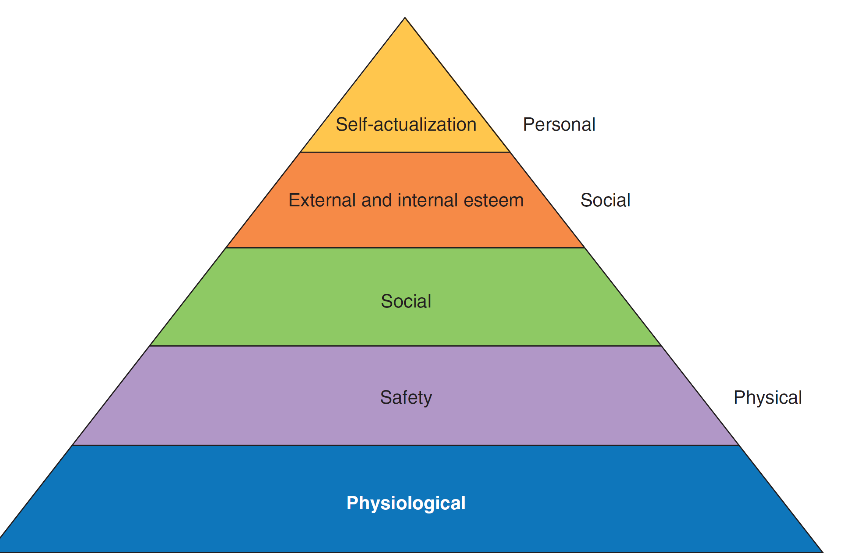
Maslow’s Hierarchy of Needs
Notes:
The essence of marketing is finding needs and filling them. Maslow’s hierarchy of needs, a staple of sociology and psychology courses, provides a useful framework for understanding how and why local products and brands can be extended beyond home country borders. Maslow hypothesized that people’s desires can be arranged into a hierarchy of five needs. As an individual fulfills needs at each level, he or she progresses to higher levels. At the most basic level of human existence, physiological and safety needs must be met. People need food, clothing, and shelter, and a product that meets these basic needs has potential for globalization. Mid-level needs in the hierarchy include self-respect, self-esteem, and the esteem of others. These social needs, which can create a powerful internal motivation driving demand for status-oriented products, cut across the various stages of country development.
Rolex, Louis Vuitton, and Dom Perignon are just a few of the global brands that consumers buy in an effort to satisfy esteem needs. Some consumers flaunt their wealth by buying expensive products and brands that others will notice. Such behavior is referred to as conspicuous consumption or luxury badging.
Note: Luxury brands are doing exceptionally well thanks to the growth of millionaires in China and India and the demands they have for such goods.

Slide 26
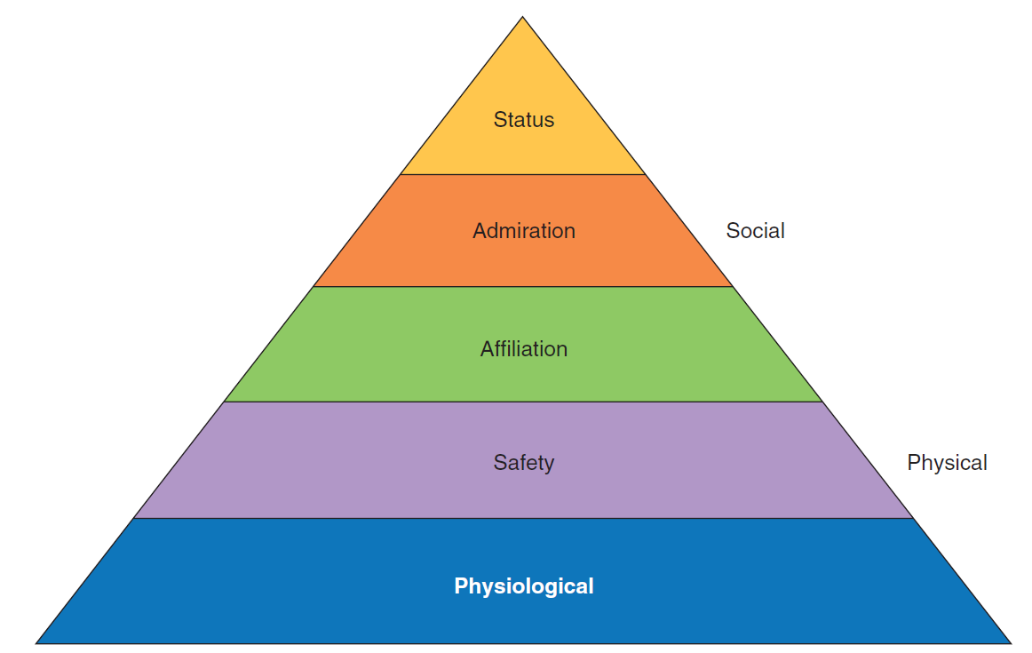
Asian Hierarchy of Needs Hellmut Schütte
Notes:
Hellmut Schütte has proposed a modified hierarchy to explain the needs and wants of Asian consumers. Although the two lower-level needs are the same as in the traditional hierarchy, the three highest levels emphasize social needs. Affiliation needs in Asia are satisfied when an individual has been accepted by a group. Conformity with group norms becomes a key force driving consumer behavior. For example, when a cool new cell phone hits the market, every teenager who wants to fit in buys one. Knowing this, managers at Japanese companies develop local products specifically designed to appeal to teens. The next level is admiration, a higher-level need that can be satisfied through acts that command respect within a group. At the top of the Asian hierarchy is status, the esteem of society as a whole. In part, attainment of high status is character driven. However, the quest for status also leads to luxury badging. Support for Schütte’s contention that status is the highest-ranking need in the Asian hierarchy can be seen in the geographic breakdown of the $200-plus billion global luxury goods market. Fully 20 percent of industry sales are generated in Japan alone, with another 22 percent of sales occurring in the rest of the Asia-Pacific region. Nearly half of all sales revenues of Italy’s Gucci Group are generated in Asia.

Slide 27
Extend, Adapt, Create: Strategic Alternatives in Global Marketing
Extension – offering product virtually unchanged in markets outside of home country
Adaptation – changing elements of design, function, and packaging according to needs of different country markets
Product Invention– developing new products for the world market
Notes:
Laws and regulations in different countries frequently lead to obligatory product design adaptations. This may be seen most clearly in Europe, where one impetus for the creation of the single market was the desire to dismantle regulatory and legal barriers that prevented pan-European sales of standardized products. These were particularly prevalent in the areas of technical standards and health and safety standards. In the food industry, for example, there were 200 legal and regulatory barriers to cross-border trade within the EU in 10 food categories.

Slide 28
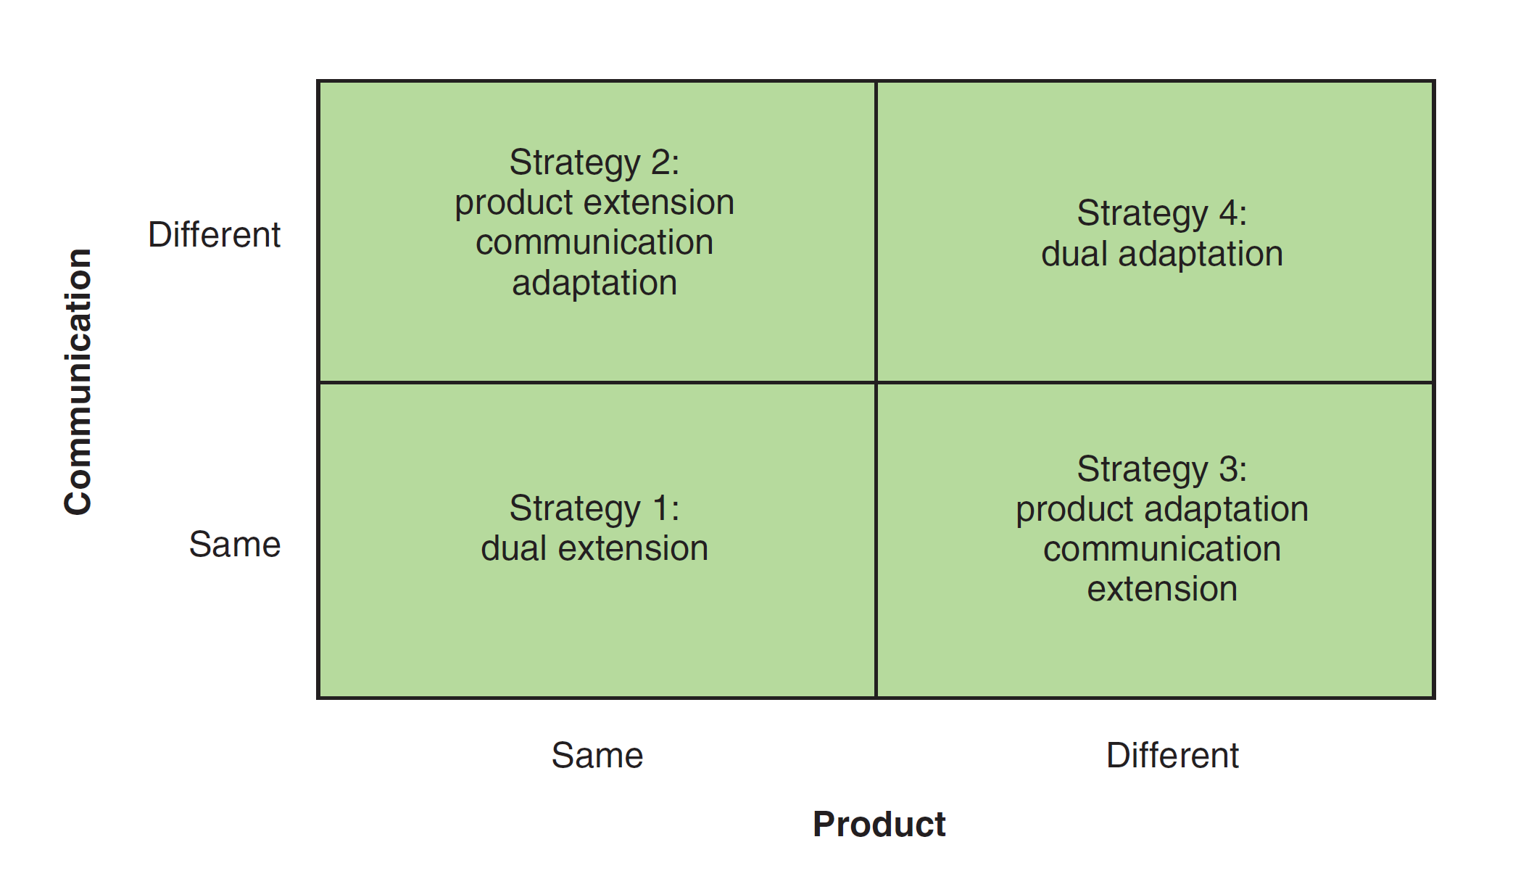
Global Product Planning: Strategic Alternatives
Notes:
Extension strategies are employed by companies in the international, global, and transnational stages of development. The critical difference is one of execution and mind-set. In an international company, for example, the extension strategy reflects an ethnocentric orientation and the assumption that all markets are alike. A global company such as Gillette does not fall victim to such assumptions; the company’s geocentric orientation allows it to thoroughly understand its markets and consciously take advantage of similarities in world markets. Likewise, a multinational company utilizes the adaptation strategy because of its polycentric orientation and the assumption that all markets are different. By contrast, the geocentric orientation of managers and executives in a global company has sensitized them to actual, rather than assumed, differences between markets.
Strategy 1: Common for B2B
Strategy 2: Low-cost because the product is unchanged, communication is adapted
Strategy 3: Cadillac wanted to sell 20,000 autos outside the U.S. by 2010; will adapt to local market requirements
Strategy 4: Combines local market conditions recognized in Strategies 2 and 3

Slide 29
Strategy 1: Dual Extension
Product-Communication Extension
May be very profitable, simple
Almost no adaptation
Same advertising and promotional appeals
Used with B2B or industrial products
Apple iPhone
Microsoft Windows 7
Notes:
As a general rule, extension/standardization strategies are utilized more frequently with industrial (business-to-business) products than with consumer products. The reason is simple: Industrial products tend to be less deeply rooted in culture than are consumer goods.

Slide 30
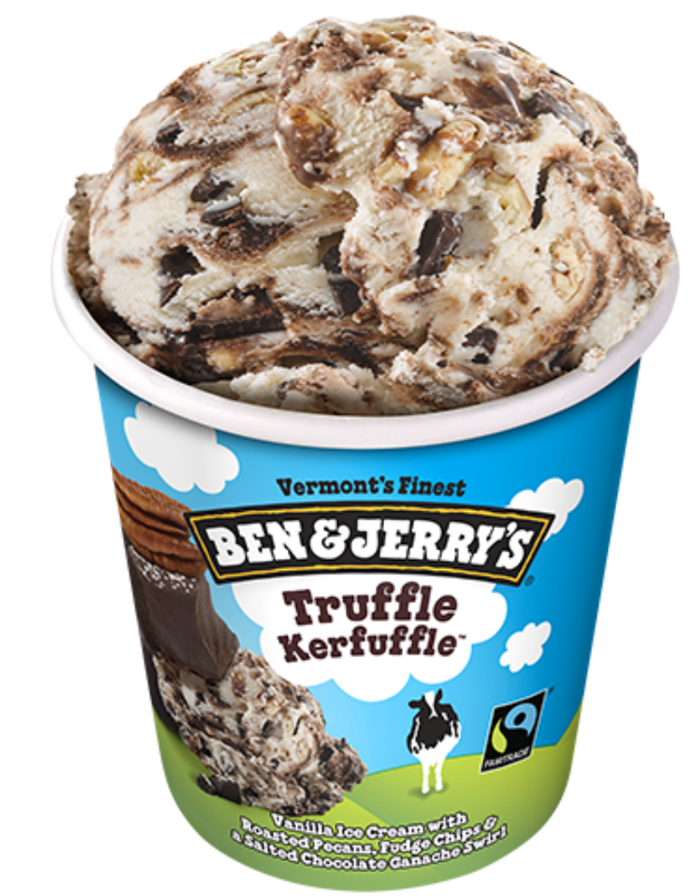
Strategy 2: Product Extension-Communications Adaptation
Products may serve the same or different needs in different markets
No product changes reduce expense
Costs in market research advertising, sales promotion, point-of-sale material
Ben& Jerry’s changed packaging color in the U.K

Slide 31
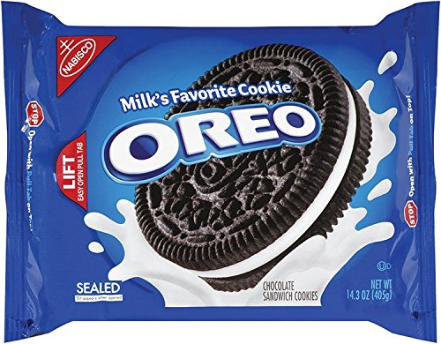
Strategy 3: Product Adaptation-Communications Extension
Adapt the product to local use but the message stays the same
Cadillac BTS in Sweden is 6” shorter that the CTS; available in diesel
Oreos in China failed until they were reformulated to be less sweet and expensive
Notes:
When Kraft Foods launched Oreo brand cookies in China in 1996, it used a product extension approach. Following several years of flat sales, Kraft’s in-country marketing team launched a research study, which alerted the team to the fact that Oreos were too sweet for the Chinese palate and that the price—14 cookies for 72 cents—was too high. Oreos were then reformulated as a less-sweet, chocolate-covered, four-layer wafer filled with vanilla and chocolate cream. Packages of the new wafer Oreo contain fewer cookies but sell for about 29 cents. Today, Oreo is the best-selling cookie brand in China.

Slide 32
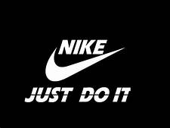
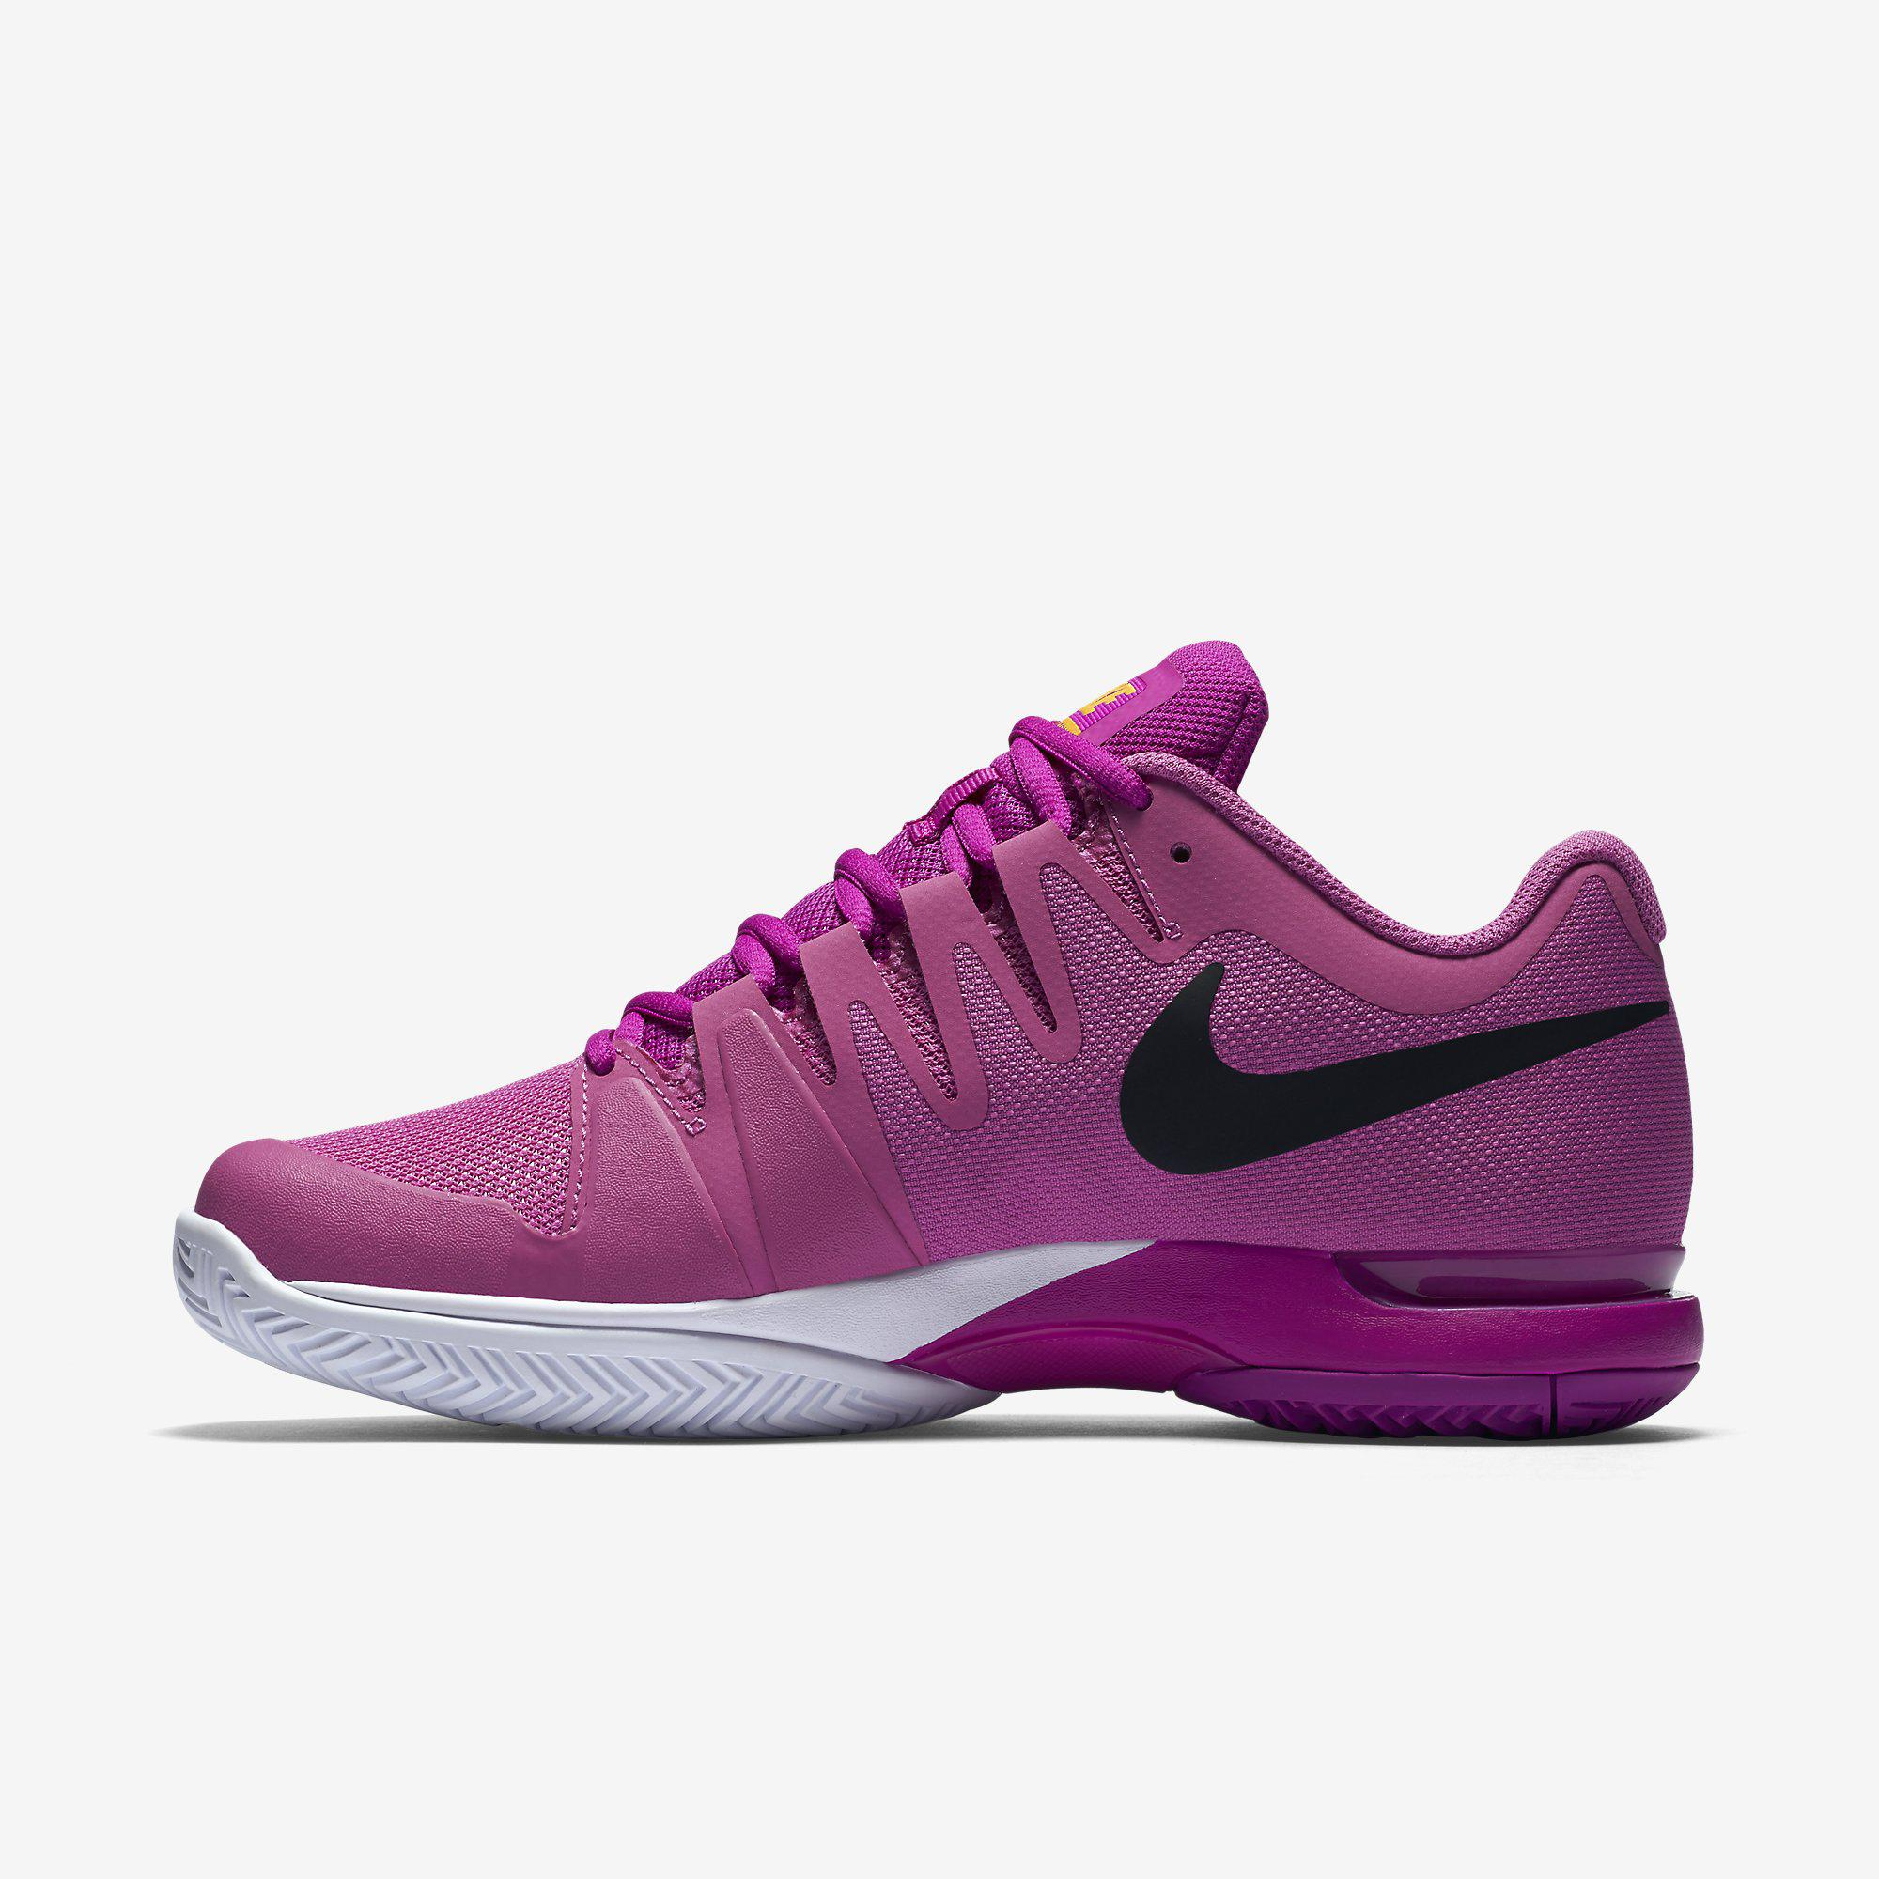
Strategy 4: Product- Communications Adaptation
Dual Adaptation
Both may need to change for legal, cultural or other environmental reasons
Regional managers may simply act independently
Nike global shoes and “Just Do It” approach didn’t work in China
Less expensive shoes created in country and ads featuring Chinese athletes in line with cultural principles of harmony and respect for authority
Notes:
Nike has built a global brand by marketing technologically advanced, premium-priced athletic shoes in conjunction with advertising that emphasizes U.S.-style, in-your-face brashness and a “Just Do It” attitude. In the huge and strategically important China market, however, this approach had several limitations. For one thing, Nike’s “bad boy” image is at odds with ingrained Chinese values such as respect for authority and filial piety. As a general rule, Nike advertisements in China do not show disruption of harmony; this is due, in part, to a government that discourages dissent. Price was another issue: A regular pair of Nike shoes cost the equivalent of $60–$78, while average annual family income ranges from about $200 in rural areas to $500 in urban areas. In the mid-1990s, Nike responded by creating a shoe that could be assembled in China specifically for the Chinese market using less expensive material and sold for less than $40. After years of running ads designed for Western markets by longtime agency Wieden & Kennedy, Nike hired Chinese-speaking art directors and copywriters working in WPP Group’s J. Walter Thompson ad agency in Shanghai to create new advertising featuring local athletes that would appeal to Chinese nationalistic sentiments.

Slide 33
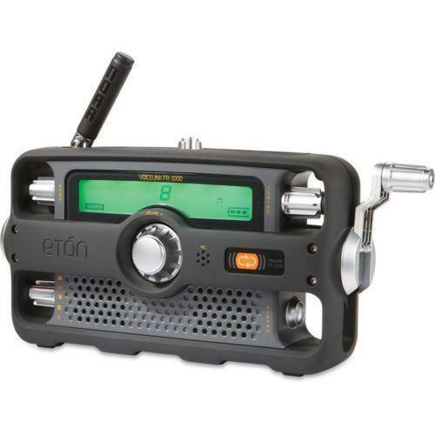
Strategy 5: Innovation
Important for reaching mass markets in less industrialized nations and certain segments in industrialized countries
Hand-cranked radios for areas with no electricity
Thermax, an Indian producer of small industrial boilers, created new products for industrialized countries
Notes:
Thermex had achieved great success in the domestic market. A new design focused on ease of installation., a factor not important in low-wage India but extremely important in industrialized nations.

Slide 34
How to Choose a Strategy?
Managers face two types of errors:
NIH “Not Invented Here” and Ethnocentrism
The product itself, defined in terms of the function or need it serves
The market, defined in terms of the conditions under which the product is used, preferences of potential customers, and ability to buy the product
Adaptation and manufacturing costs the company will incur
Notes:
This slide sums up the section regarding choosing a product-communication strategy. It is important to note that only after analysis of the product-market fit and of company capabilities and costs can executives choose the most profitable strategy.

Slide 35
Identifying New Product Ideas
What is a new product?
New to those who use it or buy it
New to the organization
New to a market
Notes:
The starting point for an effective worldwide new-product program is an information system that seeks new-product ideas from all potentially useful sources and channels these ideas to relevant screening and decision centers within the organization. Ideas can come from many sources, including customers, suppliers, competitors, company salespeople, distributors and agents, subsidiary executives, headquarters executives, documentary sources (e.g., information service reports and publications), and, finally, actual firsthand observation of the market environment. The diagram on this slide illustrates the continuum that new products will fall into and the amount of learning that consumers will have to go through in order to use the product.
Continuous innovations = “new and improved;” less R&D needed; a faster computer May be in the form of line extension
Dynamically continuous innovations = require less learning and is less disruptive; Gillette Sensor, Sensor Excel, and MACH3 brings news technology for an unchanged category, wet shaving; Music on the go 1050s transistor radios to Sony Walkman; TVs to high def, flat screen products
Discontinuous innovations = represent a break with the past; VCRs, PCs, Apple products: iPod, iPhone, iPad

Slide 36
The International New Product Department
How big is the market for this product at various prices?
What are the likely competitive moves in response to our activity?
Can we market the product through existing structure?
Can we source the product at a cost that will yield an adequate profit?
Does product fit our strategic development plan?
Notes:
A high volume of information flow is required to scan adequately for new-product opportunities, and considerable effort is subsequently required to screen these opportunities to identify candidates for product development. The best organizational design for addressing these requirements is a new product department. Managers in such a department engage in several activities. First, they ensure that all relevant information sources are continuously tapped for new-product ideas. Second, they screen these ideas to identify candidates for investigation. Third, they investigate and analyze selected new-product ideas. Finally, they ensure that the organization commits resources to the most likely new-product candidates and is continuously involved in an orderly program of new-product introduction and development on a worldwide basis.
1. How big is the market for this product at various prices?
2. What are the likely competitive moves in response to our activity with this product?
3. Can we market the product through our existing structure? If not, what changes will be required, and what costs will be incurred to make the changes?
4. Given estimates of potential demand for this product at specified prices and estimated levels of competition, can we source the product at a cost that will yield an adequate profit?
5. Does this product fit our strategic development plan? (a) Is the product consistent with our overall goals and objectives? (b) Is the product consistent with our available resources? (c) Is the product consistent with our management structure? (d) Does the product have adequate global potential?

Slide 37
Testing New Products
When do you test a new product?
Whenever a product interacts with human, mechanical, or chemical elements because there is the potential for a surprising and unexpected incompatibility
Test could simply be observing the product being used within the market
Notes:
Failure to assess actual use conditions can lead to big surprises, as Unilever learned when it rolled out a new detergent brand in Europe without sufficient testing. Unilever spent $150 million to develop the new detergent, which was formulated with a stain-fighting manganese complex molecule intended to clean fabrics faster at lower temperatures than competing products such as Procter & Gamble’s Ariel. Backed by a $300 million marketing budget, the detergent was launched in April 1994 as Persil Power, Omo Power, and other brand names. After a restructuring, Unilever had cut the time required to roll out new products in Europe from 3 years to 16 months. In this particular instance, the increased efficiency combined with corporate enthusiasm for the new formula resulted in a marketing debacle. Consumers discovered that some clothing items were damaged after being washed with Power. P&G, quick to capitalize on the situation, ran newspaper ads denouncing Power and commissioned lab tests to verify that the damage did, in fact, occur. Unilever chairman Sir Michael Perry called the Power fiasco, “the greatest marketing setback we’ve seen.” Unilever reformulated Power, but it was too late to save the brand. The company lost the opportunity to gain share against P&G in Europe.

