Slide 1
Introduction to PL/SQL
Chapter 9

Slide 2
Objectives
Explain the need for PL/SQL
Explain the benefits of PL/SQL
Identify the different types of PL/SQL blocks
Use Oracle SQL Developer as a development environment for PL/SQL
Output messages from PL/SQL

Slide 5
Benefits of PL/SQL
Integration of procedural constructs with SQL:
SQL is a nonprocedural language. When you issue a SQL command, your command tells the database server what to do. However, you cannot specify how to do it. PL/SQL integrates control statements and conditional statements . with SQL, giving you better control of your SQL statements and their execution.

Slide 6
Benefits of PL/SQL
2. Improved performance: Without PL/SQL, you would not be able to logically combine SQL statements as one unit. If you have designed an application containing forms, you may have many different forms with fields in each form. When a form submits the data, you may have to execute a number of SQL statements. SQL statements are sent to the database one at a time. This results in many network trips and one call to the database for each SQL statement, thereby increasing network traffic and reducing performance (especially in a client/server model). With PL/SQL, you can combine all these SQL statements into a single program unit. The application can send the entire block to the database instead of sending the SQL statements one at a time. This significantly reduces the number of database calls.

Slide 7
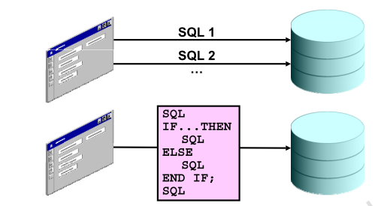

Slide 8
Benefits of PL/SQL
3.Exception handling: PL/SQL enables you to handle exceptions efficiently. You can define separate blocks for dealing with exceptions. You will learn more about exception handling later
PL/SQL shares the same data type system as SQL (with some extensions) and uses the same expression syntax.

Slide 10
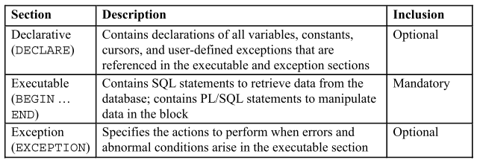
PL/SQL Block Structure

Slide 11
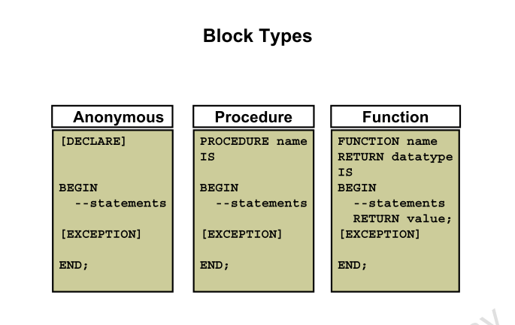

Slide 12
Anonymous blocks
Anonymous blocks are unnamed blocks. They are declared inline at the point in an application where they are to be executed and are compiled each time the application is executed. These blocks are not stored in the database. They are passed to the PL/SQL engine for execution at run time. These anonymous blocks get executed at run time because they are inline. If you want to execute the same block again, you have to rewrite the block. You are unable to invoke or call the block that you wrote earlier because blocks are anonymous and do not exist after they are executed.

Slide 13
Subprograms
Subprograms are complementary to anonymous blocks. They are named PL/SQL blocks that are stored in the database. Because they are named and stored, you can invoke them whenever you want (depending on your application). You can declare them either as procedures or as functions. You typically use a procedure to perform an action and a function to compute and return a value.

Slide 14
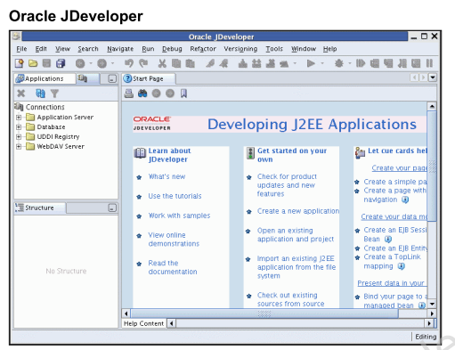
PL/SQL Programming Environments
You can use both Oracle JDeveloper and Oracle SQL Developer as programming environments. However, this course uses Oracle SQL Developer for all demonstrations and practices.

