Slide 1
Phys 110 Chapter 8 Potential Energy and Energy Conservation

Slide 2
LECTURE OUTLINE
8.1 Potential Energy of a System
8.2 The Isolated System—Conservation of Mechanical Energy
8.3 Conservative and Nonconservative Forces
8.4 Changes in Mechanical Energy for Nonconservative Forces
8.5 Relationship Between Conservative Forces and Potential Energy

Slide 3
Introduction
In Chapter 7 we introduced the concepts of kinetic energy associated with the motion of members of a system and internal energy associated with the temperature of a system.
In this chapter we introduce potential energy, the energy associated with the configuration of a system of objects that exert forces on each other.
The potential energy concept can be used only when dealing with a special class of forces called conservative forces.
When only conservative forces act within an isolated system, the kinetic energy gained (or lost) by the system as its members change their relative positions is balanced by an equal loss (or gain) in potential energy. This balancing of the two forms of energy is known as the principle of conservation of mechanical energy.

Slide 4
8.1 Potential Energy of a System
Let us now derive an expression for the gravitational potential energy (U_{g}) associated with an object (m) at a given location (y) above the surface of the Earth:
$$U_{g}=mgy$$
Mathematical description of the work done on a system that changes the gravitational potential energy of the system is give by:
$${W=△U}_{g}$$
The gravitational potential energy depends only on the vertical height of the object above the surface of the Earth. The same amount of work must be done on an object–Earth system whether the object is lifted vertically from the Earth or is pushed starting from the same point up a frictionless incline, ending up at the same height.

Slide 5
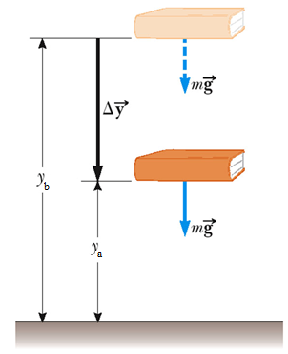
8.2 The Isolated System— Conservation of Mechanical Energy
As the book, shown in the figure, falls back to its original height, from y_{b} to y_{a}, the work done by the gravitational force on the book is:
$${W=mgy}_{b}−{mgy}_{a}=△K=−{△U}_{g}$$
So
$$△K+{△U}_{g}=0 ∗$$
Mechanical energy is defined as:
$$E_{mech}=K+U_{g}$$
Or, in general:
$$E_{mech}=K+U$$

Slide 6
8.2 The Isolated System— Conservation of Mechanical Energy
Let us now write the changes in energy in Equation * explicitly:
$$\left(K_{f}−K_{i}\right)+\left(U_{f}−U_{i}\right)=0$$
$$\left(K_{f}+U_{f}\right)−\left(K_{i}+U_{i}\right)=0$$
$$K_{f}+U_{f}=K_{i}+U_{i}$$
This equation is a statement of conservation of mechanical energy for an isolated system.
An isolated system is one for which there are no energy transfers across the boundary.
The energy in such a system is conserved—the sum of the kinetic and
Potential energies remains constant.
This statement assumes that no nonconservative forces act within the system.

Slide 7
c). The total mechanical energy, kinetic plus potential, is conserved.
(a). The more massive rock has twice as much gravitational potential energy associated with it compared to the lighter rock. Because mechanical energy of an isolated system is conserved, the more massive rock will arrive at the ground with twice as much kinetic energy as the lighter rock.

Slide 8
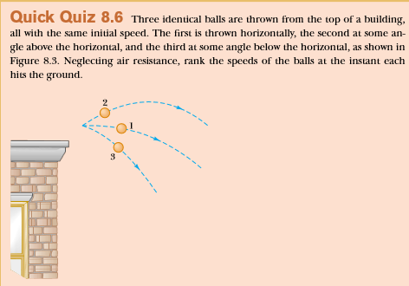
V1=V2=V3. The ﬁrst and third balls speed up after they are thrown, while the second ball initially slows down but then speeds up after reaching its peak. The paths of all three balls are parabolas, and the balls take different times to reach the ground because they have different initial velocities. However, all three balls have the same speed at the moment they hit the ground because all start with the same kinetic energy and the ball–Earth system undergoes the same change in gravitational potential energy in all three cases.

Slide 9
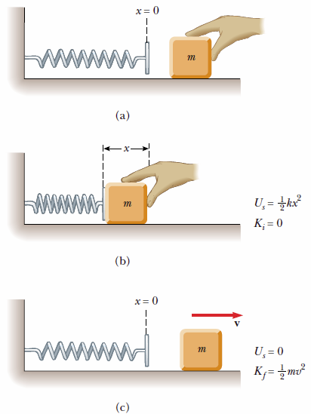
8.2 The Isolated System— Conservation of Mechanical Energy
Potential Energy of a Spring
Potential Energy of a Spring is given by:
$${ U}_{s}=\frac{1}{2}kx^{2}$$
When the block is released from rest,
the spring exerts a force on the block and returns
to its original length.
The stored elastic potential energy
is transformed into kinetic energy of the block.
The elastic potential energy stored in a spring is zero when: x = 0
Energy is stored in the spring only when the spring is either stretched or compressed.

Slide 10
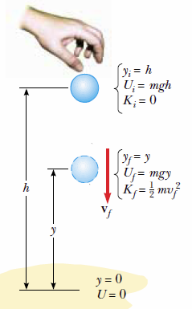
8.2 The Isolated System— Conservation of Mechanical Energy
Example 8.2 Ball in Free Fall
A ball of mass m is dropped from a height h above the ground, as shown in Figure . Neglecting air resistance, determine the speed of the ball when it is at a height y above the ground.
Solution:
$$K_{f}+U_{f}=K_{i}+U_{i}$$
$${\frac{1}{2}mv_{f}^{2}}_{}+mgy=0+mgh$$
$$v_{f}=\sqrt{2g(h−y)}$$

Slide 11
Conservation of Mechanical Energy
A block of mass m = 0.40 kg slides across a horizontal frictionless counter with a speed of v = 0.50 m/s. It runs into and compresses a spring of spring constant k = 750 N/m. When the block is momentarily stopped by the spring, by what distance d is the spring compressed?
$$K_{f}+U_{f}=K_{i}+U_{f}$$

Slide 12
8.3 Conservative and Nonconservative Forces
Conservative Forces
Conservative forces have these two equivalent properties:
1. The work done by a conservative force on a particle moving between any two points is independent of the path taken by the particle.
2. The work done by a conservative force on a particle moving through any closed path is zero. (A closed path is one in which the beginning and end points are identical.)
Examples of Conservative Forces:
1.gravitational force
2.Spring force

Slide 13
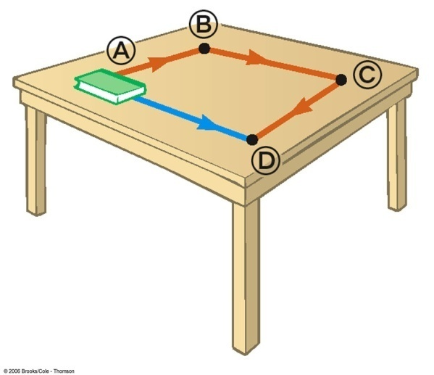
8.4 Changes in Mechanical Energy for Nonconservative Forces
A force is nonconservative if the work it does on an object depends on the path taken by the object between its final and starting points.
The work depends upon the movement path
For a non-conservative force, potential energy can NOT be defined
Work done by a nonconservative force
It is generally dissipative. The dispersal
of energy takes the form of heat or sound

Slide 14
8.4 Changes in Mechanical Energy for Nonconservative Forces
Consider a body sliding across a surface. As the body moves through a distance d, the only force that does work on it is the force of kinetic friction. This force causes a decrease in the kinetic energy of the body:
$$△K=−f_{k}d$$
If there is also a change in potential energy then:
$$E_{mech}=△K+{△U}_{g}$$
Or in general, for any potential:
$$E_{mech}=△K+△U=−f_{k}d$$
where ΔU is the change in all forms of potential energy.

Slide 15
(c). The friction force must transform four times as much mechanical energy into internal energy if the speed is doubled, because kinetic energy depends on the square of the speed. Thus, the force must act over four times the distance

Slide 16
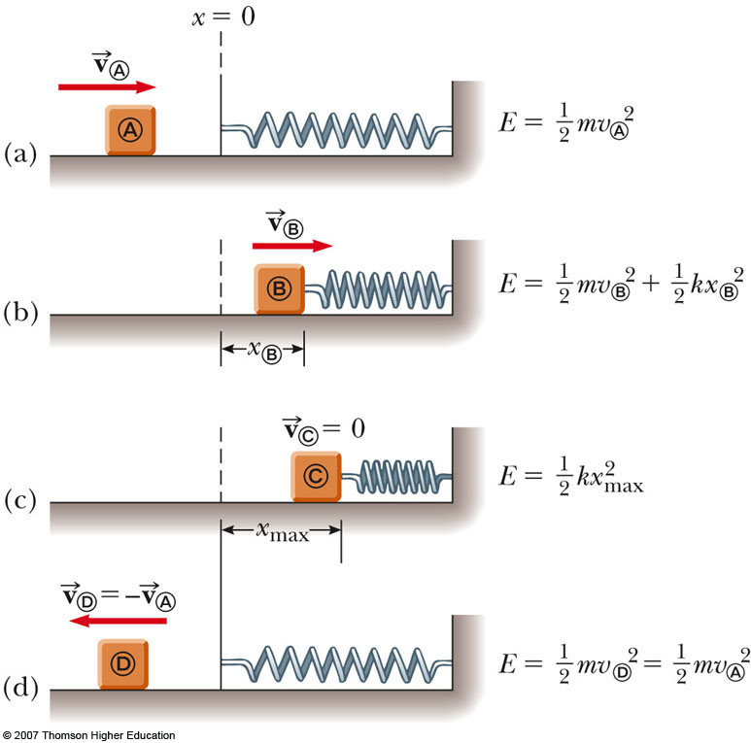
Block-Spring Collision
A block having a mass of 0.8 kg is given an initial velocity v_{A} = 1.2 m/s to the right and collides with a spring whose mass is negligible and whose force constant is k = 50 N/m as shown in figure. Assuming the surface to be frictionless, calculate the maximum compression of the spring after the collision.
$$0+0+\frac{1}{2}kx_{max}^{2}=\frac{1}{2}mv_{A}^{2}+0+0$$

Slide 17
Block-Spring Collision
A block having a mass of 0.8 kg is given an initial velocity v_{A} = 1.2 m/s to the right and collides with a spring whose mass is negligible and whose force constant is k = 50 N/m as shown in figure. Suppose a constant force of kinetic friction acts between the block and the surface, with µ_{k} = 0.5, what is the maximum compression x_{c} in the spring.

Slide 18
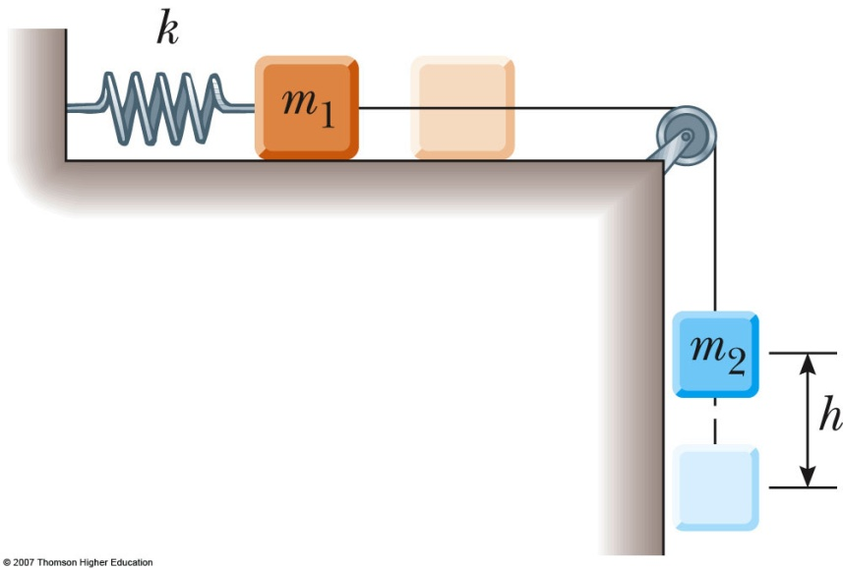
Connected Blocks in Motion
Two blocks are connected by a light string that passes over a frictionless pulley. The block of mass m₁ lies on a horizontal surface and is connected to a spring of force constant k. The system is released from rest when the spring is unstretched. If the hanging block of mass m₂ falls a distance h before coming to rest, calculate the coefficient of kinetic friction between the block of mass m₁ and the surface.
$$∆K+∆U=−fd+\sum{W_{other force}}$$
But $K_{f}=K_{i}=0$
ΔU = $∆U_{g}$+$∆U_{s}$
$∆U_{g}$=$U_{gf}−U_{gi}=0−m_{2}gh$
, $∆U_{s}$=$U_{sf}−U_{si}=$ $\frac{1}{2}Kh^{2}−0$
$f_{k }=μ_{k}n$ , for $m_{1 }:$ $\sum{F_{y}=0 }→$ $m_{1 }g−n=0→n=m_{1 }g$
Then,

Slide 19
8.5 Relationship Between Conservative Forces and Potential Energy
The work done by a cons. force F as a particle moves along the x axis is:
$$W_{c}=\int_{x_{i}}^{x_{f}}{F_{x} dx}=−△U$$
$${Or△U =U}_{f}−U_{i}=−\int_{x_{i}}^{x_{f}}{F_{x} dx}$$
Therefore, ΔU is negative when F_{x} and dx are in the same direction, as when an object is lowered in a gravitational field or when a spring pushes an object toward equilibrium.
We can then define the potential energy function as:
$$U_{f}(x)=−\int_{x_{i}}^{x_{f}}{F_{x} dx}+U_{i}$$

Slide 20
8.5 Relationship Between Conservative Forces and Potential Energy
The conservative force is related to the potential energy function through the relationship
$$F_{x}=−\frac{dU}{dx }$$
That is, the x component of a conservative force acting on an object within a system equals the negative derivative of the potential energy of the system with respect to x.

Slide 21
Lecture Summary
If a particle of mass m is at a distance y above the Earth’s surface, the gravitational potential energy of the particle–Earth system is
$$U_{g}=mgy$$
The elastic potential energy stored in a spring of force constant k is
$$U_{s}=\frac{1}{2}kx^{2}$$
Total Energy of a system is:
$$K_{f}+U_{f}=K_{i}+U_{i}$$

Slide 22
Lecture Summary
A force is conservative if the work it does on a particle moving between two points is independent of the path the particle takes between the two points, Or if the work it does on a particle is zero when the particle moves through an arbitrary closed path and returns to its initial position. A force that does not meet these criteria is said to be nonconservative.
The total mechanical energy of a system is defined as the sum of the kinetic energy and the potential energy:
$$E_{mech}=K+U$$
If a system is isolated and if no nonconservative forces are acting on objects inside the system, then the total mechanical energy of the system is constant:
$$K_{f}+U_{f}=K_{i}+U_{i}$$
For nonconservative forces :
$$∆K+∆U=−fd+\sum{W_{other force}}$$

