Slide 1
Chapter 8: An Introduction to
Asset Pricing Models

Slide 2
Capital Market Theory: An Overview
Capital market theory extends portfolio theory and develops a model for pricing all risky assets, while capital asset pricing model (CAPM) will allow you to determine the required rate of return for any risky asset
Four Areas
  Background for Capital Market Theory
  Developing the Capital Market Line
  Risk, Diversification, and the Market Portfolio
  Investing with the CML: An Example

Slide 3
Background for Capital Market Theory
Assumptions of Capital Market Theory
  All investors are Markowitz efficient investors who want to target points on the efficient frontier
  Investors can borrow or lend any amount of money at the risk-free rate of return (RFR)
  All investors have homogeneous expectations; that is, they estimate identical probability distributions for future rates of return
  All investors have the same one-period time horizon such as one-month, six months, or one year

Slide 4
Background for Capital Market Theory
Assumptions (Continued)
  All investments are infinitely divisible, which means that it is possible to buy or sell fractional shares of any asset or portfolio
  There are no taxes or transaction costs involved in buying or selling assets
  There is no inflation or any change in interest rates, or inflation is fully anticipated
  Capital markets are in equilibrium, implying that all investments are properly priced in line with their risk levels

Slide 5
Background for Capital Market Theory
Development of Capital Market Theory
  The major factor that allowed portfolio theory to develop into capital market theory is the concept of a risk-free asset
    An asset with zero standard deviation
    Zero correlation with all other risky assets
    Provides the risk-free rate of return (RFR)
    Will lie on the vertical axis of a portfolio graph

Slide 6
Developing the Capital Market Line
Covariance with a Risk-Free Asset
  Covariance between two sets of returns is
  Because the returns for the risk free asset are certain, thus Ri = E(R_{i}), and R_{i} - E(R_{i}) = 0, which means that the covariance between the risk-free asset and any risky asset or portfolio will always be zero
  Similarly, the correlation between any risky asset and the risk-free asset would be zero too since r_{RF,i}= Cov_{RF, I} / σ_{RF} σ_{i}

Slide 7
Developing the Capital Market Line
Combining a Risk-Free Asset with a Risky Portfolio, M
  Expected return: It is the weighted average of the two returns
  Standard deviation: Applying the two-asset standard deviation formula, we will have
    Since σ_{RF} =0, σ_{port} =(1-W_{RF}) σ_{M}

Slide 8
Developing the Capital Market Line
The Capital Market Line
  With these results, we can develop the risk–return relationship between E(R_{port}) and σ_{port}
  This relationship holds for every combination of the risk-free asset with any collection of risky assets
  However, when the risky portfolio, M, is the market portfolio containing all risky assets held anywhere in the marketplace, this linear relationship is called the Capital Market Line (Exhibit 8.1)

Slide 9
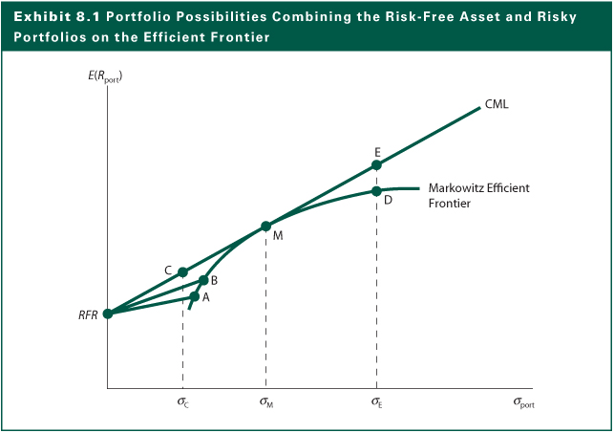
Exhibit 8.1

Slide 10
Developing the Capital Market Line
Risk-Return Possibilities with Leverage
  One can attain a higher expected return than is available at point M
  One can invest along the efficient frontier beyond point M, such as point D
  With the risk-free asset, one can add leverage to the portfolio by borrowing money at the risk-free rate and investing in the risky portfolio at point M to achieve a point like E
  Clearly, point E dominates point D
  Similarly, one can reduce the investment risk by lending money at the risk-free asset to reach points like C (see Exhibit 8.2)

Slide 11
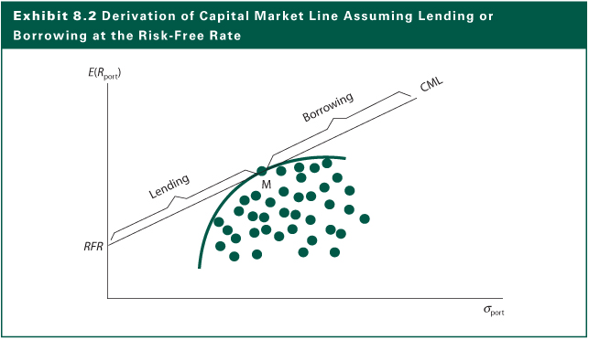
Exhibit 8.2

Slide 12
Risk, Diversification & the Market Portfolio
The Market Portfolio
  Because portfolio M lies at the point of tangency, it has the highest portfolio possibility line
  Everybody will want to invest in Portfolio M and borrow or lend to be somewhere on the CML
  It must include ALL RISKY ASSETS
  Since the market is in equilibrium, all assets in this portfolio are in proportion to their market values
  Because it contains all risky assets, it is a completely diversified portfolio, which means that all the unique risk of individual assets (unsystematic risk) is diversified away

Slide 13
Risk, Diversification & the Market Portfolio
Systematic Risk
  Only systematic risk remains in the market portfolio
  Systematic risk is the variability in all risky assets caused by macroeconomic variables
    Variability in growth of money supply
    Interest rate volatility
    Variability in factors like (1) industrial production (2) corporate earnings (3) cash flow
  Systematic risk can be measured by the standard deviation of returns of the market portfolio and can change over time

Slide 14
Risk, Diversification & the Market Portfolio
How to Measure Diversification
  All portfolios on the CML are perfectly positively correlated with each other and with the completely diversified market Portfolio M
  That is, a completely diversified portfolio would have a correlation with the market portfolio of +1.00
  The reason is that complete risk diversification means the elimination of all the unsystematic or unique risk and the systematic risk correlates perfectly with the market portfolio

Slide 15
Risk, Diversification & the Market Portfolio
Diversification and the Elimination of Unsystematic Risk
  The purpose of diversification is to reduce the standard deviation of the total portfolio
  This assumes that imperfect correlations exist among securities
  As you add securities, you expect the average covariance for the portfolio to decline
  How many securities must you add to obtain a completely diversified portfolio?
  See Exhibit 8.3

Slide 16
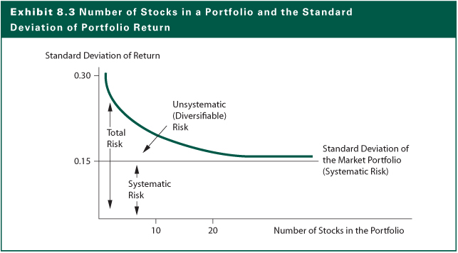
Exhibit 8.3

Slide 17
Risk, Diversification & the Market Portfolio
The CML and the Separation Theorem
  The CML leads all investors to invest in the M portfolio
  Individual investors should differ in position on the CML depending on risk preferences
  How an investor gets to a point on the CML is based on financing decisions
  Risk averse investors will lend at the risk-free rate while investors preferring more risk might borrow funds at the RFR and invest in the market portfolio
  The investment decision of choosing the point on CML is separate from the financing decision of reaching there through either lending or borrowing

Slide 18
Risk, Diversification & the Market Portfolio
A Risk Measure for the CML
  The Markowitz portfolio model considers the average covariance with all other assets
  The only important consideration is the asset’s covariance with the market portfolio
  Covariance with the market portfolio is the systematic risk of an asset
  Variance of a risky asset i
  Var (R_{it})= Var (b_{i}R_{Mt})+ Var(ε)
  =Systematic Variance + Unsystematic Variance
  where b_{i}= slope coefficient for asset i
  ε = random error term

Slide 19
Investing with the CML: An Example
Suppose you have a riskless security at 4% and a market portfolio with a return of 9% and a standard deviation of 10%. How should you go about investing your money so that your investment will have a risk level of 15%?
Portfolio Return
  E(R_{port})=RFR+σ_{port}[(E(R_{M})-RFR)/σ_{M})
  =4%+15%[(9%-4%)/10%]=11.5%
Money invested in riskless security, w_{RF}
  11.5%= w_{RF} (4%) + (1-w_{RF} )(9%) ----> w_{RF}= -0.5
The investment strategy is to borrow 50% and invest 150% of equity in the market portfolio

Slide 20
The Capital Asset Pricing Model
A Conceptual Development of the CAPM
  The existence of a risk-free asset resulted in deriving a capital market line (CML) that became the relevant frontier
  However, CML cannot be used to measure the expected return on an individual asset
  For individual asset (or any portfolio), the relevant risk measure is the asset’s covariance with the market portfolio
  That is, for an individual asset i, the relevant risk is not σ_{i}, but rather σ_{i} r_{iM}, where r_{iM} is the correlation coefficient between the asset and the market

Slide 21
The Capital Asset Pricing Model
  Applying the CML using this relevant risk measure
  Let β_{i}=(σ_{i} r_{iM}) / σ_{M} be the asset beta measuring the relative risk with the market, the systematic risk
  The CAPM indicates what should be the expected or required rates of return on risky assets
  This helps to value an asset by providing an appropriate discount rate to use in dividend valuation models

Slide 22
The Capital Asset Pricing Model
The Security Market Line (SML)
  The SML is a graphical form of the CAPM
  Exhibit 8.5 shows the relationship between the expected or required rate of return and the systematic risk on a risky asset
  The expected rate of return of a risk asset is determined by the RFR plus a risk premium for the individual asset
  The risk premium is determined by the systematic risk of the asset (beta) and the prevailing market risk premium (R_{M}-RFR)

Slide 23
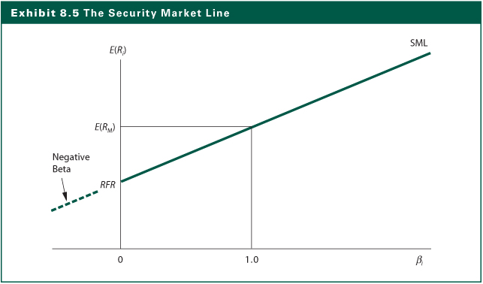
Exhibit 8.5

Slide 24
The Capital Asset Pricing Model
Determining the Expected Rate of Return
  Risk-free rate is 5% and the market return is 9%
  Stock A B C D E
  Beta 0.70 1.00 1.15 1.40 -0.30
Applying
  E(R_{A}) = 0.05 + 0.70 (0.09-0.05) = 0.078 = 7.8%
  E(R_{B}) = 0.05 + 1.00 (0.09-0.05) = 0.090 = 09.0%
  E(R_{C}) = 0.05 + 1.15 (0.09-0.05) = 0.096 = 09.6%
  E(R_{D}) = 0.05 + 1.40 (0.09-0.05) = 0.106 = 10.6%
  E(R_{E}) = 0.05 + -0.30 (0.09-0.05) = 0.038 = 03.8%

Slide 25
The Capital Asset Pricing Model
Identifying Undervalued & Overvalued Assets
  In equilibrium, all assets and all portfolios of assets should plot on the SML
  Any security with an estimated return that plots above the SML is underpriced
  Any security with an estimated return that plots below the SML is overpriced
  A superior investor must derive value estimates for assets that are consistently superior to the consensus market evaluation to earn better risk-adjusted rates of return than the average investor

Slide 26
The Capital Asset Pricing Model
  Compare the required rate of return to the estimated rate of return for a specific risky asset using the SML over a specific investment horizon to determine if it is an appropriate investment
  Exhibit 8.8 shows A, C and E are underpriced but B and D are over priced because
  Stock Required Return Estimated Return
  A 7.8% 8.0%
  B 9.0% 6.2%
  C 9.6% 15.15%
  D 10.6% 5.15%
  E 3.8% 6.0%

Slide 27
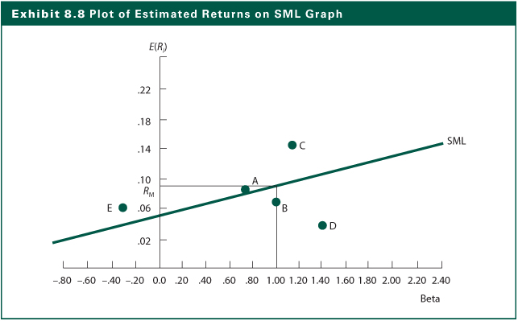
Exhibit 8.8

Slide 28
The Capital Asset Pricing Model
Calculating Systematic Risk
  The formula
  The characteristic line
    A regression line between the returns to the security (R_{it}) over time and the returns (R_{Mt}) to the market portfolio
    The slope of the regression line is beta
    See Exhibit 8.10
σ
Cov
(
R
,
R
)
β
=
i
r
=
i
M
i
σ
iM
σ
2
M
M

Slide 29
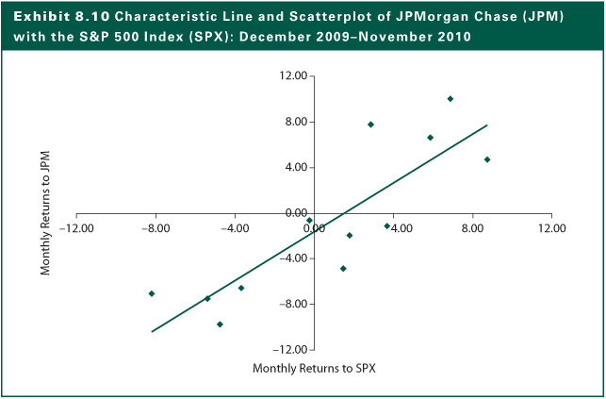
Exhibit 8.10

Slide 30
The Capital Asset Pricing Model
The Impact of the Time Interval
  The number of observations and time interval used in the calculation of beta vary widely, causing beta to vary
  There is no “correct” interval for analysis
  Morningstar uses monthly returns over five years
  Bloomberg uses weekly returns over two years, although the system allows users to change the time intervals
  Reuters Analytics uses daily returns over two years

Slide 31
The Capital Asset Pricing Model
The Effect of the Market Proxy
  Theoretically, the market portfolio should include all U.S. and non-U.S. stocks and bonds, real estate, coins, stamps, art, antiques, and any other marketable risky asset from around the world
  Most people use the Standard & Poor’s 500 Composite Index as the proxy due to
    It contains large proportion of the total market value of U.S. stocks
    It is a value weighted index
  Using a different proxy for the market portfolio will lead to a different beta value

Slide 32
The Capital Asset Pricing Model
Industry Characteristic Line
  The characteristic line used to estimate beta value can be computed for sector indexes
  Exhibit 8.12 shows the result of nine industry characteristic lines with the S&P 500 index over December 2009 to December 2010
  The correlation coefficients ranges from 0.7 to 0.98, seven of which are above 0.9
  The beta coefficients ranges from 0.54 for Utilities to 1.28 for Materials

Slide 33
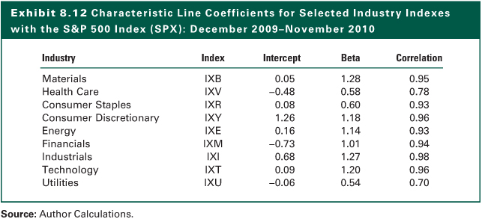
Exhibit 8.12

Slide 34
Relaxing the Assumptions
Differential Borrowing and Lending Rates
  When borrowing rate, R _{b}, is higher than RFR, the SML will be “broken” into two lines
  See Exhibit 8.13
Zero Beta Model
  Instead of a risk-free rate, a zero-beta portfolio (uncorrelated with the market portfolio) can be used to draw the “SML” line
  Since the zero-beta portfolio is likely to have a higher return than the risk-free rate, this “SML” will have a less steep slope

Slide 35
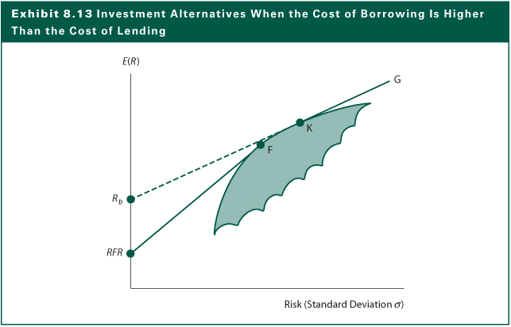
Exhibit 8.13

Slide 36
Relaxing the Assumptions
Transaction Costs
  With transactions costs, the SML will be a band of securities, rather than a straight line
Heterogeneous Expectations and Planning Periods
  Heterogeneous expectations will create a set (band) of lines with a breadth determined by the divergence of expectations
  The impact of planning periods is similar
Taxes
  Differential tax rates could cause major differences in the CML and SML among investors

Slide 37
Empirical Tests of the CAPM
Stability of Beta
  Betas for individual stocks are not stable
  Portfolio betas are reasonably stable
  The larger the portfolio of stocks and longer the period, the more stable the beta of the portfolio
  High-beta portfolios tend to decline over time toward 1 whereas low-beta portfolio tend to increase over time toward 1
  Trading volumes may affect the beta stability

Slide 38
Empirical Tests of the CAPM
Relationship between Systematic Risk and Return
  Effect of Skewness on Relationship
    Investors prefer stocks with high positive skewness that provide an opportunity for very large returns
  Effect of Size, P/E, and Leverage
    Size, and P/E have an inverse impact on returns after considering the CAPM. Financial Leverage also helps explain cross-section of returns
  Effect of Book-to-Market Value
    Fama and French (1992) found the BV/MV ratio to be a key determinant of returns

Slide 39
Market Portfolio: Theory vs. Practice
The true market portfolio should
  Included all the risky assets in the world
  In equilibrium, the assets would be included in the portfolio in proportion to their market value
Using U.S. Index as a market proxy
  Most studies use an U.S. index
  The U.S. stocks constitutes less than 15% of a truly global risky asset portfolio

Slide 40
Market Portfolio: Theory vs. Practice
The beta intercept of the SML will differ if
  There is an error in selecting the risk-free asset
  There is an error in selecting the market portfolio
Using the incorrect SML may lead to incorrect evaluation of a portfolio performance
Exhibit 8.18 illustrates the effects of two market proxies on betas of the 30 DJIA stocks over three different periods
Exhibit 8.19 contains the risk-free rates, market returns, the slopes of the SMLs

Slide 41
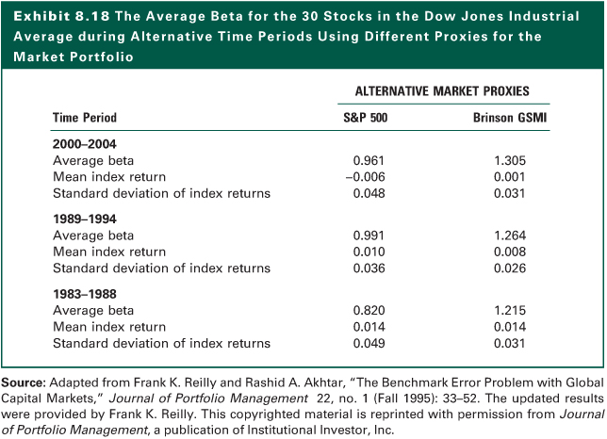
Exhibit 8.18

Slide 42
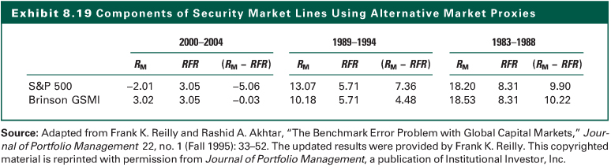
Exhibit 8.19

Slide 43
The Internet Investments Online
http://www.valueline.com
http://www.wsharpe.com
http://gsb.uchicago.edu/fac/eugene.fama/
http://www.moneychimp.com

