Slide 1
Phys 110
Chapter 7
Energy and Energy Transfer
By
Prof. Dr. Bandar Ali Al-Asbahi

Slide 2
PROBLEMS
Section 7.2 Work Done by a Constant Force
1. A block of mass 2.50 kg is pushed 2.20 m along a frictionless horizontal table by a constant 16.0-N force directed 25.0° below the horizontal. Determine the work done on the block by (a) the applied force, (b) the normal force exerted by the table, and (c) the gravitational force. (d) Determine the total work done on the block.
SOLUTIONS TO PROBLEM:
W = FΔr cosθ = (16.0 N) (2.20 m) cos 25.0°=31.9 J
The normal force and the weight are both at 90° to the displacement in any time interval. Both do 0 work.

Slide 3
PROBLEMS
Section 7.2 Work Done by a Constant Force
4. A raindrop of mass 3.35 * 10⁻⁵ kg falls vertically at constant speed under the influence of gravity and air resistance.
Model the drop as a particle. As it falls 100 m, what is the work done on the raindrop (a) by the gravitational force and (b) by air resistance?
SOLUTIONS TO PROBLEM:
3.28 × 10⁻² J
- 3.28 × 10⁻² J
W = mgh
Since R = mg
W_{air resistance} =-W

Slide 4

PROBLEMS
Section 7.3 The Scalar Product of Two Vectors
7. A force F = (6ˆi - 2ˆj) N acts on a particle that undergoes a displacement $∆$r = (3ˆi +ˆj) m. Find (a) the work done by the force on the particle and (b) the angle between F and $∆$r.
SOLUTIONS TO PROBLEM:
16.0 J
36.9⁰
W = F⋅Δr = F_{x} x + F_{y} y = 6.00(3.00) N⋅m+ (−2.00)(1.00) N⋅m= 16.0 J
$$θ=\cos^{−1}\left(\frac{F.∆r}{F∆r}\right)=\cos^{−1}{(\frac{16}{\sqrt{{F_{x}}^{2}+{F_{y}}^{2}}\sqrt{x^{2}+y^{2}}})}$$

Slide 5
PROBLEMS
Section 7.4 Work Done by a Varying Force
13. A particle is subject to a force Fx that varies with position as in Figure P7.13. Find the work done by the force on the particle as it moves (a) from x = 0 to x = 5.00 m, (b) from x = 5.00 m to x = 10.0 m, and (c) from x = 10.0 m to x = 15.0 m. (d) What is the total work done by the force over the distance x = 0 to x = 15.0 m?
SOLUTIONS TO PROBLEM:
(a) 7.5 J (b) 15 J (c) 7.5 J (d) 30 J

Slide 6
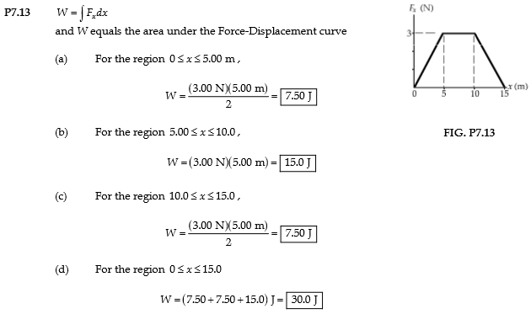

Slide 7

PROBLEMS
Section 7.4 Work Done by a Varying Force
14. A force F = (4xˆi + 3yˆj) N acts on an object as the object moves in the x direction from the origin to x = 5.00 m. Find the work
done on the object by the force.
SOLUTIONS TO PROBLEM:
Answ.: 50 J
$W=\int_{i}^{f}{F. dr}$=$\int_{0}^{5}{F. dx \hat{i}}$

Slide 8
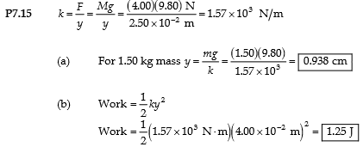
PROBLEMS
Section 7.4 Work Done by a Varying Force
15. When a 4.00-kg object is hung vertically on a certain light spring that obeys Hooke’s law, the spring stretches 2.50 cm. If the 4.00-kg object is removed, (a) how far will the spring stretch if a 1.50-kg block is hung on it, and (b) how much work must an external agent do to stretch the same spring 4.00 cm from its unstretched position?
SOLUTIONS TO PROBLEM:
0.983 cm
1.25 J

Slide 9
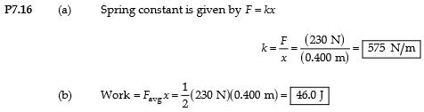
PROBLEMS
Section 7.4 Work Done by a Varying Force
16. An archer pulls his bowstring back 0.400 m by exerting a force that increases uniformly from zero to 230 N. (a) What is the equivalent spring constant of the bow? (b) How much work does the archer do in pulling the bow?
SOLUTIONS TO PROBLEM:
575 N/m
46 J
W=1/2 kx² = 46.0 J

Slide 10
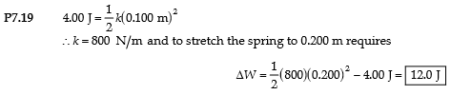
PROBLEMS
Section 7.4 Work Done by a Varying Force
19. If it takes 4.00 J of work to stretch a Hooke’s-law spring 10.0 cm from its unstressed length, determine the extra work required to stretch it an additional 10.0 cm.
SOLUTIONS TO PROBLEM:
Answ.: 12 J

Slide 11
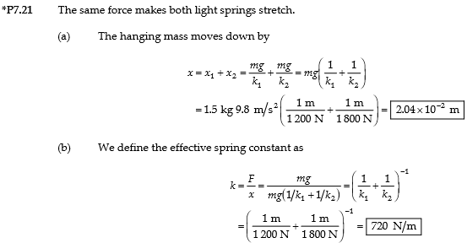
PROBLEMS
Section 7.4 Work Done by a Varying Force
21. A light spring with spring constant 1 200 N/m is hung from an elevated support. From its lower end a second light spring is hung, which has spring constant 1 800 N/m. An object of mass 1.50 kg is hung at rest from the lower end of the second spring. (a) Find the total extension distance of the pair of springs. (b) Find the effective spring constant of the pair of springs as a system. We describe these springs as in series.
SOLUTIONS TO PROBLEM:
2.04 x 10⁻² m
720 N/m

Slide 12
PROBLEMS
Section 7.5 Kinetic Energy and the Work–Kinetic Energy Theorem
Section 7.6 The Nonisolated System—Conservation of Energy
24. A 0.600-kg particle has a speed of 2.00 m/s at point A and kinetic energy of 7.50 J at point B. What is (a) its kinetic energy at A? (b) its speed at B? (c) the total work done on the particle as it moves from A to B?
SOLUTIONS TO PROBLEM:
1.2 J
5 m/s
6.3 J

Slide 13
PROBLEMS
Section 7.5 Kinetic Energy and the Work–Kinetic Energy Theorem
Section 7.6 The Nonisolated System—Conservation of Energy
25. A 0.300-kg ball has a speed of 15.0 m/s. (a) What is its kinetic energy? (b) What If? If its speed were doubled, what would be its kinetic energy?
SOLUTIONS TO PROBLEM:

Slide 14
PROBLEMS
Section 7.5 Kinetic Energy and the Work–Kinetic Energy Theorem
Section 7.6 The Nonisolated System—Conservation of Energy
26. A 3.00-kg object has a velocity (6.00ˆi - 2.00ˆj) m/s. (a) What is its kinetic energy at this time? (b) Find the total work done on the object if its velocity changes to (8.00ˆi + 4.00ˆj) m/s.
SOLUTIONS TO PROBLEM:
60 J
60 J

Slide 15
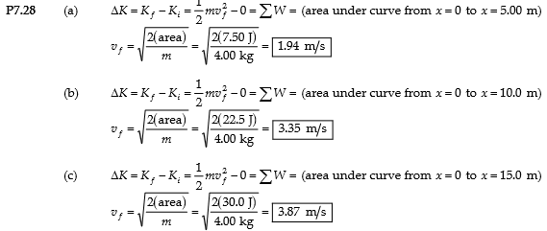
PROBLEMS
Section 7.5 Kinetic Energy and the Work–Kinetic Energy Theorem
Section 7.6 The Nonisolated System—Conservation of Energy
28. A 4.00-kg particle is subject to a total force that varies with position as shown in Figure below. The particle starts from rest at x = 0. What is its speed at (a) x = 5.00 m, (b) x = 10.0 m, (c) x= 15.0 m?
SOLUTIONS TO PROBLEM:
(a) 1.94 m/s (b) 3.35 m/s (c) 3.87 m/s

Slide 16
PROBLEMS
Section 7.7 Situations Involving Kinetic Friction
31. A 40.0-kg box initially at rest is pushed 5.00 m along a rough, horizontal floor with a constant applied horizontal force of 130 N. If the coefficient of friction between box and floor is 0.300, find (a) the work done by the applied force, (b) the increase in internal energy in the box-floor system due to friction, (c) the work done by the normal force, (d) the work done by the gravitational force, (e) the change in kinetic energy of the box, and (f) the final speed of the box.
SOLUTIONS TO PROBLEM:
650 J
588 J
0
0 (e) 62 J (f) 1.76 m/s

Slide 17
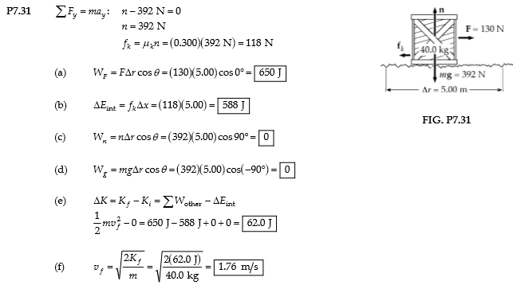

Slide 18
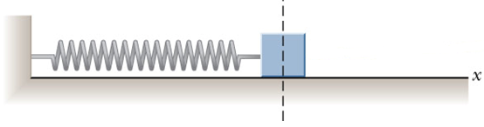
PROBLEMS
Section 7.7 Situations Involving Kinetic Friction
32. A 2.00-kg block is attached to a spring of force constant 500 N/m as in Figure below. The block is pulled 5.00 cm to the right of equilibrium and released from rest. Find the speed of the block as it passes through equilibrium if (a) the horizontal surface is frictionless and (b) the coefficient of friction between block and surface is 0.350.
SOLUTIONS TO PROBLEM:
0.791 m/s
0.531 m/s

Slide 19
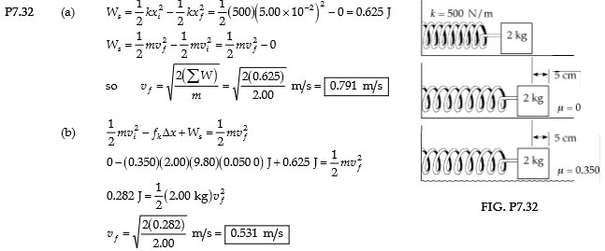

Slide 20
PROBLEMS
Section 7.7 Situations Involving Kinetic Friction
33. A crate of mass 10.0 kg is pulled up a rough incline with an initial speed of 1.50 m/s. The pulling force is 100 N parallel to the incline, which makes an angle of 20.0° with the horizontal. The coefficient of kinetic friction is 0.400, and the crate is pulled 5.00 m. (a) How much work is done by the gravitational force on the crate? (b) Determine the increase in internal energy of the crate–incline system due to friction. (c) How much work is done by the 100-N force on the crate? (d) What is the change in kinetic energy of the crate? (e) What is the speed of the crate after being pulled 5.00 m?
SOLUTIONS TO PROBLEM:
−168 J
184 J
500 J (d) 148 J (e) 5.65 m/s

Slide 21
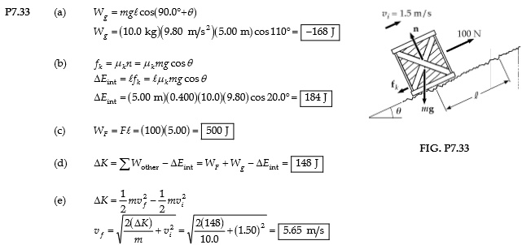

Slide 22

PROBLEMS
Section 7.7 Situations Involving Kinetic Friction
35. A sled of mass m is given a kick on a frozen pond. The kick imparts to it an initial speed of 2.00 m/s. The coefficient of kinetic friction between sled and ice is 0.100. Use energy considerations to find the distance the sled moves before it stops.
SOLUTIONS TO PROBLEM:
Answ.: 2.04 m

Slide 23

PROBLEMS
Section 7.8 Power
37. A 700-N Marine in basic training climbs a 10.0-m vertical rope at a constant speed in 8.00 s. What is his power output?
SOLUTIONS TO PROBLEM:
Answ.: 875 W

Slide 24
PROBLEMS
Section 7.8 Power
40. A 650-kg elevator starts from rest. It moves upward for 3.00 s with constant acceleration until it reaches its cruising speed of 1.75 m/s. (a) What is the average power of the elevator motor during this period? (b) How does this power compare with the motor power when the elevator moves at its cruising speed?
SOLUTIONS TO PROBLEM:

Slide 25
The End

