Slide 1
Chapter 7: An Introduction to
Portfolio Management

Slide 2
Some Background Assumptions
As an investor you want to maximize the returns for a given level of risk.
Your portfolio includes all of your assets and liabilities.
The relationship between the returns for assets in the portfolio is important.
A good portfolio is not simply a collection of individually good investments.

Slide 3
Some Background Assumptions
Risk Aversion
  Given a choice between two assets with equal rates of return, risk-averse investors will select the asset with the lower level of risk
  Evidence
    Many investors purchase insurance for: Life, Automobile, Health, and Disability Income.
    Yield on bonds increases with risk classifications from AAA to AA to A, etc.
  Not all Investors are risk averse
    It may depends on the amount of money involved: Risking small amounts, but insuring large losses

Slide 4
Some Background Assumptions
Definition of Risk
  Uncertainty: Risk means the uncertainty of future outcomes. For instance, the future value of an investment in Google’s stock is uncertain; so the investment is risky. On the other hand, the purchase of a six-month CD has a certain future value; the investment is not risky.
  Probability: Risk is measured by the probability of an adverse outcome. For instance, there is 40% chance you will receive a return less than 8%.

Slide 5
Markowitz Portfolio Theory
Main Results
  Quantifies risk
  Derives the expected rate of return for a portfolio of assets and an expected risk measure
  Shows that the variance of the rate of return is a meaningful measure of portfolio risk
  Derives the formula for computing the variance of a portfolio, showing how to effectively diversify a portfolio

Slide 6
Markowitz Portfolio Theory
Assumptions for Investors
  Consider investments as probability distributions of expected returns over some holding period
  Maximize one-period expected utility, which demonstrate diminishing marginal utility of wealth
  Estimate the risk of the portfolio on the basis of the variability of expected returns
  Base decisions solely on expected return and risk
  Prefer higher returns for a given risk level. Similarly, for a given level of expected returns, investors prefer less risk to more risk

Slide 7
Markowitz Portfolio Theory
Using these five assumptions, a single asset or portfolio of assets is considered to be efficient if no other asset or portfolio of assets offers higher expected return with the same (or lower) risk, or lower risk with the same (or higher) expected return.

Slide 8
Alternative Measures of Risk
Variance or standard deviation of expected return
Range of returns
Returns below expectations
  Semivariance – a measure that only considers deviations below the mean
  These measures of risk implicitly assume that investors want to minimize the damage from returns less than some target rate

Slide 9
Alternative Measures of Risk
The Advantages of Using Standard Deviation of Returns
  This measure is somewhat intuitive
  It is a correct and widely recognized risk measure
  It has been used in most of the theoretical asset pricing models

Slide 10
Expected Rates of Return
For An Individual Asset
  It is equal to the sum of the potential returns multiplied with the corresponding probability of the returns
  See Exhibit 7.1
For A Portfolio of Investments
  It is equal to the weighted average of the expected rates of return for the individual investments in the portfolio

Slide 11
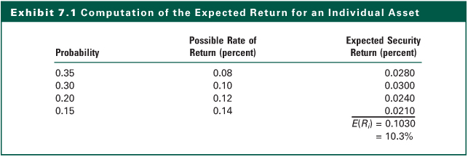
Exhibit 7.1

Slide 12
Expected Rates of Return
If you want to construct a portfolio of n risky assets, what will be the expected rate of return on the portfolio is you know the expected rates of return on each individual assets?
  The formula
  See Exhibit 7.2

Slide 13
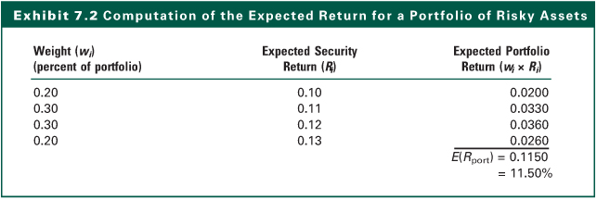
Exhibit 7.2

Slide 14
Individual Investment Risk Measure
Variance
  It is a measure of the variation of possible rates of return R_{i}, from the expected rate of return [E(R_{i})]
  where P_{i} is the probability of the possible rate of return, R_{i}
Standard Deviation (σ)
  It is simply the square root of the variance

Slide 15
Individual Investment Risk Measure
Exhibit 7.3
Variance ( ²) = 0.000451
Standard Deviation ( ) = 0.021237=2.1237%

Slide 16
Covariance of Returns
A measure of the degree to which two variables “move together” relative to their individual mean values over time
For two assets, i and j, the covariance of rates of return is defined as:
Cov_{ij} = E{[R_{i} - E(R_{i})] [R_{j} - E(R_{j})]}
Example
  The Wilshire 5000 Stock Index and Barclays Capital Treasury Bond Index in 2010
  See Exhibits 7.4 and 7.7

Slide 17
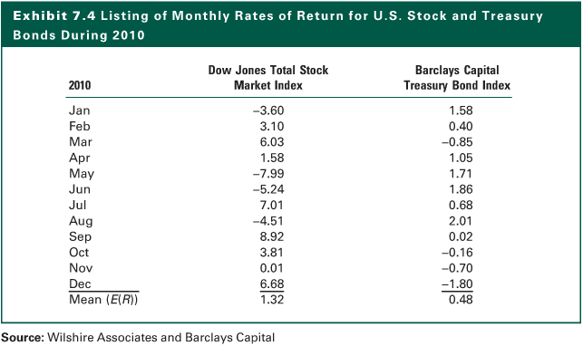
Exhibit 7.4

Slide 18
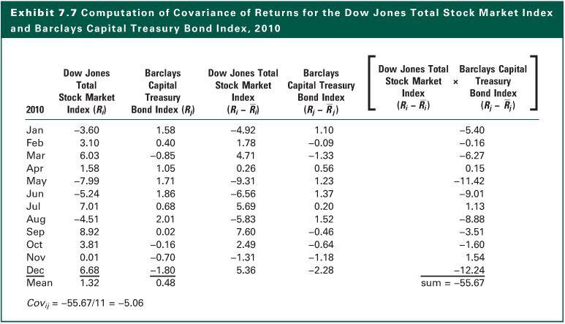
Exhibit 7.7

Slide 19
Covariance and Correlation
The correlation coefficient is obtained by standardizing (dividing) the covariance by the product of the individual standard deviations
Computing correlation from covariance

Slide 20
Correlation Coefficient
The coefficient can vary in the range +1 to -1.
A value of +1 would indicate perfect positive correlation. This means that returns for the two assets move together in a positively and completely linear manner.
A value of –1 would indicate perfect negative correlation. This means that the returns for two assets move together in a completely linear manner, but in opposite directions.
See Exhibit 7.8

Slide 21
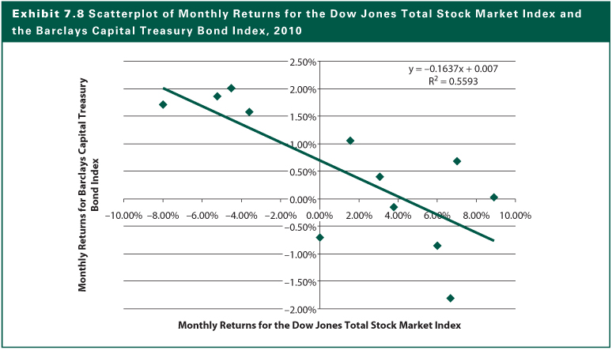
Exhibit 7.8

Slide 22
Standard Deviation of a Portfolio
The Formula

Slide 23
Standard Deviation of a Portfolio
Computations with A Two-Stock Portfolio
  Any asset of a portfolio may be described by two characteristics:
    The expected rate of return
    The expected standard deviations of returns
  The correlation, measured by covariance, affects the portfolio standard deviation
  Low correlation reduces portfolio risk while not affecting the expected return

Slide 24
Standard Deviation of a Portfolio
Two Stocks with Different Returns and Risk
Asset
E(R
)
W
σ
2
σ
i
i
i
i
1 .10 .50 .0049 .07
2 .20 .50 .0100 .10
Case Correlation Coefficient Covariance
a +1.00 .0070
b +0.50 .0035
c 0.00 .0000
d -0.50 -.0035
e -1.00 -.0070

Slide 25
Standard Deviation of a Portfolio
  Assets may differ in expected rates of return and individual standard deviations
  Negative correlation reduces portfolio risk
  Combining two assets with +1.0 correlation will not reduces the portfolio standard deviation
  Combining two assets with -1.0 correlation may reduces the portfolio standard deviation to zero
  See Exhibits 7.10 and 7.12

Slide 26
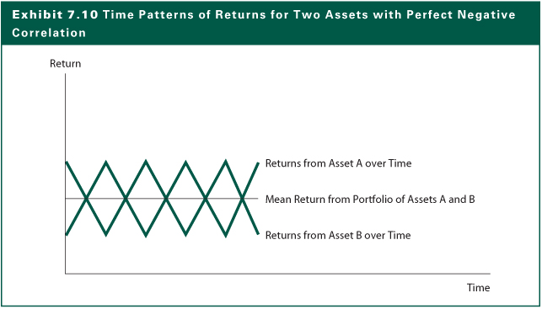
Exhibit 7.10

Slide 27
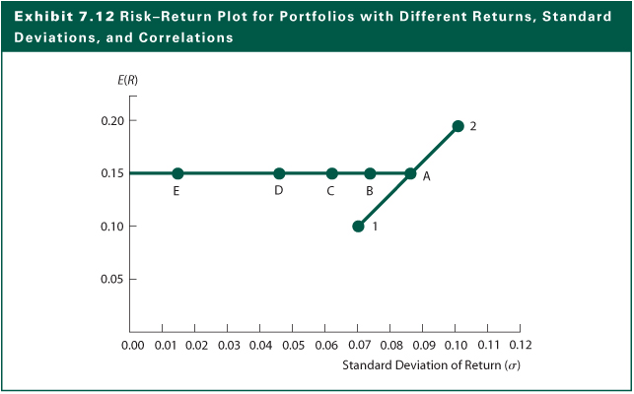
Exhibit 7.12

Slide 28
Standard Deviation of a Portfolio
Constant Correlation with Changing Weights
  Assume the correlation is 0 in the earlier example and let the weight vary as shown below.
  Portfolio return and risk are (See Exhibit 7.13):

Slide 29
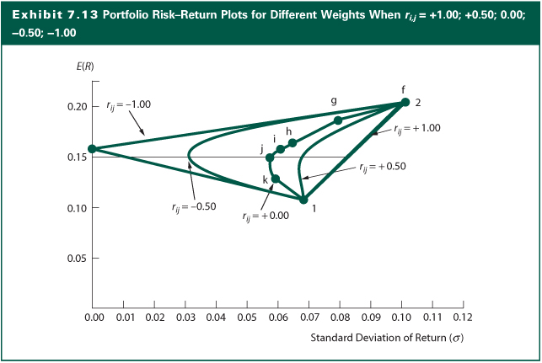
Exhibit 7.13

Slide 30
Standard Deviation of a Portfolio
A Three-Asset Portfolio
  The results presented earlier for the two-asset portfolio can extended to a portfolio of n assets
  As more assets are added to the portfolio, more risk will be reduced everything else being the same
  The general computing procedure is still the same, but the amount of computation has increase rapidly
  For the three-asset portfolio, the computation has doubled in comparison with the two-asset portfolio

Slide 31
Estimation Issues
Results of portfolio allocation depend on accurate statistical inputs
Estimates of
  Expected returns
  Standard deviation
  Correlation coefficient
    Among entire set of assets
    With 100 assets, 4,950 correlation estimates
Estimation risk refers to potential errors

Slide 32
Estimation Issues
With the assumption that stock returns can be described by a single market model, the number of correlations required reduces to the number of assets
Single index market model:
b_{i} = the slope coefficient that relates the returns for security i to the returns for the aggregate market
R_{m} = the returns for the aggregate stock market

Slide 33
Estimation Issues
If all the securities are similarly related to the market and a b_{i} derived for each one, it can be shown that the correlation coefficient between two securities i and j is given as:

Slide 34
The Efficient Frontier
The efficient frontier represents that set of portfolios with the maximum rate of return for every given level of risk, or the minimum risk for every level of return
Efficient frontier are portfolios of investments rather than individual securities except the assets with the highest return and the asset with the lowest risk
The efficient frontier curves
  Exhibit 7.14 shows the process of deriving the efficient frontier curve
  Exhibit 7.15 shows the final efficient frontier curve

Slide 35
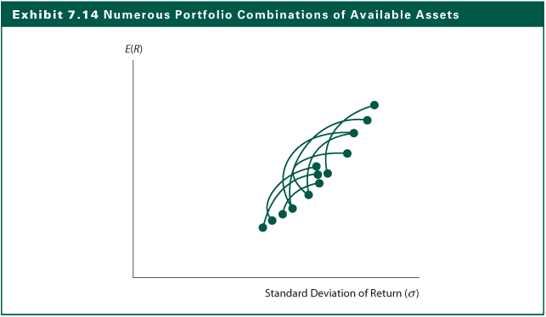
Exhibit 7.14

Slide 36
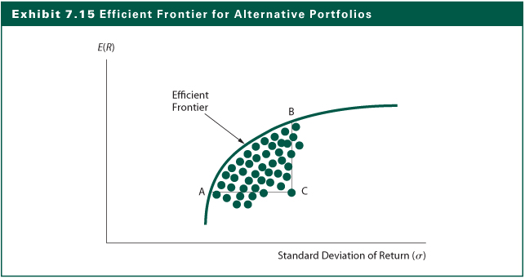
Exhibit 7.15

Slide 37
Efficient Frontier and Investor Utility
An individual investor’s utility curve specifies the trade-offs he is willing to make between expected return and risk
The slope of the efficient frontier curve decreases steadily as you move upward
The interactions of these two curves will determine the particular portfolio selected by an individual investor
The optimal portfolio has the highest utility for a given investor

Slide 38
Efficient Frontier and Investor Utility
The optimal lies at the point of tangency between the efficient frontier and the utility curve with the highest possible utility
As shown in Exhibit 7.16, Investor X with the set of utility curves will achieve the highest utility by investing the portfolio at X
As shown in Exhibit 7.16, with a different set of utility curves, Investor Y will achieve the highest utility by investing the portfolio at Y
Which investor is more risk averse?

Slide 39
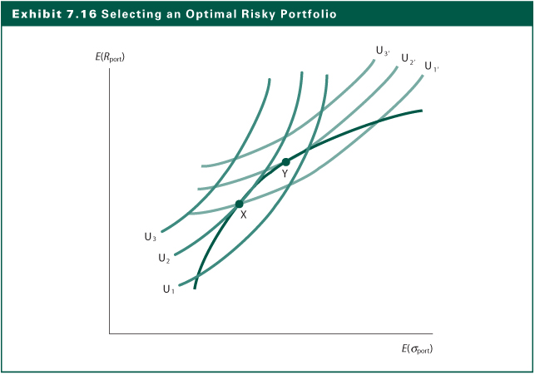
Exhibit 7.16

Slide 40
The Internet Investments Online
http://www.pionlie.com
http://www.investmentnews.com
http://www.ibbotson.com
http://www.styleadvisor.com
http://www.wagner.com
http://www.effisols.com
http://www.efficientfrontier.com

