Slide 1
Why do financial institutions exist?

Slide 2
Basic facts about financial structure throughout the world
Financial system is complex in both structure and function throughout the world.
Includes many different types of institutions: banks, insurance companies, mutual funds, stock and bond markets, and so on.
Eight basic facts about financial structure throughout the world.

Slide 3
Basic facts about financial structure throughout the world
1. Stocks are not the most important source of external financing for businesses.
2. Issuing marketable debt and equity securities is not the primary way in which businesses finance their operations.

Slide 4
Basic facts about financial structure throughout the world
Indirect finance, which involves the activities of financial intermediaries, is many times more important than direct finance, in which businesses raise funds directly from lenders in financial markets.
Financial intermediaries, particularly banks, are the most important source of external funds used to finance businesses

Slide 5
Basic facts about financial structure throughout the world
The financial system is among the most heavily regulated sectors of economy.
Only large, well-established corporations have easy access to securities markets to finance their activities.

Slide 6
Basic facts about financial structure throughout the world
Collateral is a prevalent feature of debt contracts for both households and businesses.
Debt contracts are typically extremely complicated legal documents that place substantial restrictions on the behavior of the borrowers.

Slide 7
Transaction costs
Transaction costs influence financial structure
Financial intermediaries reduce transaction costs

Slide 8
Transaction costs influence financial structure
E.g., a $5,000 investment only allows you to purchase 100 shares @ $50 / share (equity)
No diversification
Bonds even worse—most have a $1,000 size
In sum, transactions costs can hinder flow of funds to people with productive investment opportunities

Slide 9
Transaction costs
You have only a small amount available, you can make only a restricted number of investments because a large number of small transactions would result in very high transaction costs

Slide 10
How financial intermediaries reduce transaction costs
Financial intermediaries reduce transaction costs
Allow small savers and borrowers from the existence of financial markets

Slide 11
Economies of scale
Bundle the funds of many investors together
Take advantage of ‘economies of scale’
Reduce in transaction costs per dollar of investment as the size of transactions increases
Reduces transaction costs for each individual investor

Slide 12
Economies of scale
Economies of scale possible because the total cost of carrying out a transaction in financial markets increases only a little as the size of the transaction grows
Mutual fund
Sells shares to individuals
Invests the proceeds in bonds or stocks

Slide 13
Economies of scale
Lower transaction costs because of economies of scale
Cost savings are passed on to individual investors after management fees
Funds are large enough to buy a widely diversified portfolio of securities
Reduces risk

Slide 14
Expertise
FI develop expertise to lower transaction costs
For example, computer technology
Provide customers liquidity services, customers find easy to conduct transactions
Also provides investors with liquidity, which explains Fact # 3

Slide 15
Asymmetric Information: Adverse Selection and Moral Hazard
In your introductory finance course, you probably assumed a world of symmetric information—the case where all parties to a transaction or contract have the same information, be that little or a lot
In many situations, this is not the case. We refer to this as asymmetric information.

Slide 16
Asymmetric information
Arises when one party’s insufficient knowledge about the other party involved in a transaction
Makes it impossible to make accurate decisions when conducting the transaction
For example, managers of a corporation know whether they are honest or have better information about how well their business is doing than the stockholders do

Slide 17
Asymmetric information
Take two forms:
1. Adverse selection
2. Moral hazard

Slide 18
Adverse selection
Occurs when one party in a transaction has better information than the other party
Before transaction occurs
Potential borrowers most likely to produce adverse outcome are ones most likely to seek loan and be selected

Slide 19
Adverse selection
For example, big risk takers or outright crooks might be the most eager to take out a loan because they know they are unlikely to pay it back
Lenders might decide not to make any loans, even though there are good credit risks in the marketplace

Slide 20
Moral hazard
Occurs when one party has an incentive to behave differently once an agreement is made between parties
After transaction occurs
Hazard that borrower has incentives to engage in undesirable (immoral) activities making it more likely that won't pay loan back

Slide 21
Moral hazard
For example, after the loan borrowers may take big risks which have high possible returns but increases default risk

Slide 22
Asymmetric Information: Adverse Selection and Moral Hazard
The analysis of how asymmetric information problems affect behavior is known as agency theory.
We will now use these ideas of adverse selection and moral hazard to explain how they influence financial structure.

Slide 23
The Lemons Problem: How Adverse Selection Influences Financial Structure
Lemons Problem in Used Cars
If we can't distinguish between “good” and “bad” (lemons) used cars, we are willing pay only an average of good and bad car values
Result: Good cars won’t be sold, and the used car market will function inefficiently.
What helps us avoid this problem with used cars?

Slide 24
The Lemons Problem: How Adverse Selection Influences Financial Structure
Lemons Problem in Securities Markets
If we can't distinguish between good and bad securities, willing pay only average of good and bad securities’ value
Result: Good securities undervalued and firms won't issue them; bad securities overvalued so too many issued

Slide 25
The Lemons Problem: How Adverse Selection Influences Financial Structure
Lemons Problem in Securities Markets
Investors won't want buy bad securities, so market won't function well
Explains Fact # 1 and # 2
Also explains Fact # 6 : Less asymmetric info for well known firms, so smaller lemons problem

Slide 26
Tools to Help Solve Adverse Selection (Lemons) Problems
In the absence of asymmetric information, the lemons problem goes away
1. Productive production and sale of information
For example, credit rating agencies, investment advisory services
Free-rider problem

Slide 27
Tools to Help Solve Adverse Selection (Lemons) Problems
2. Government regulation to increase information
For example, annual audits of public corporations
Asymmetric information problem of adverse selection helps explain why financial markets are among the most heavily regulated sectors in the economy. Fact #5

Slide 28
Tools to Help Solve Adverse Selection (Lemons) Problems
Financial Intermediation
Analogy to solution to lemons problem provided by used car dealers
Avoid free-rider problem by making private loans (explains Fact # 3 and # 4)
Also explains fact #6—large firms are more likely to use direct instead of indirect financing

Slide 29
Tools to Help Solve Adverse Selection (Lemons) Problems
Collateral and Net Worth
Explains Fact # 7

Slide 30
How Moral Hazard Affects the Choice Between Debt and Equity Contracts
Moral Hazard in Equity Contracts: the Principal-Agent Problem
Result of separation of ownership by stockholders (principals) from control by managers (agents)
Managers act in own rather than stockholders' interest

Slide 31
How Moral Hazard Affects the Choice Between Debt and Equity Contracts
An example of this problem is useful. Suppose you become a silent partner in an ice cream store, providing 90% of the equity capital ($9,000). The other owner, Steve, provides the remaining $1,000 and will act as the manager. If Steve works hard, the store will make $50,000 after expenses, and you are entitled to $45,000 of it.

Slide 32
How Moral Hazard Affects the Choice Between Debt and Equity Contracts
However, Steve doesn’t really value the $5,000 (his part), so he goes to the beach, relaxes, and even spends some of the “profit” on art for his office. How do you, as a 90% owner, give Steve the proper incentives to work hard?

Slide 33
How Moral Hazard Affects the Choice Between Debt and Equity Contracts
Tolls to Help Solve the Principal-Agent Problem
Production of Information: Monitoring
Government Regulation to Increase Information
Financial Intermediation (e.g, venture capital)
Debt Contracts
Explains Fact # 1, Why debt is used more than equity

Slide 34
How Moral Hazard Influences Financial Structure in Debt Markets
Even with the advantages just described, debt is still subject to moral hazard. In fact, debt may create an incentive to take on very risky projects. This is important to understand. Let’s looks at a simple example.

Slide 35
How Moral Hazard Influences Financial Structure in Debt Markets
Most debt contracts require the borrower to pay a fixed amount (interest) and keep any cash flow above this amount.
For example, what if a firm owes $100 in interest, but only has $90? It is essentially bankrupt. The firm “has nothing to lose” by looking for “risky” projects to raise the needed cash.

Slide 36
How Moral Hazard Influences Financial Structure in Debt Markets
Tools to Help Solve Moral Hazard in Debt Contracts
Net Worth and Collateral
Monitoring and Enforcement of Restrictive Covenants. Examples are covenants that …
discourage undesirable behavior
encourage desirable behavior
keep collateral valuable
provide information

Slide 37
How Moral Hazard Influences Financial Structure in Debt Markets
Tools to Help Solve Moral Hazard in Debt Contracts
Financial Intermediation—banks and other intermediaries have special advantages in monitoring
Explains Facts # 1–4

Slide 38
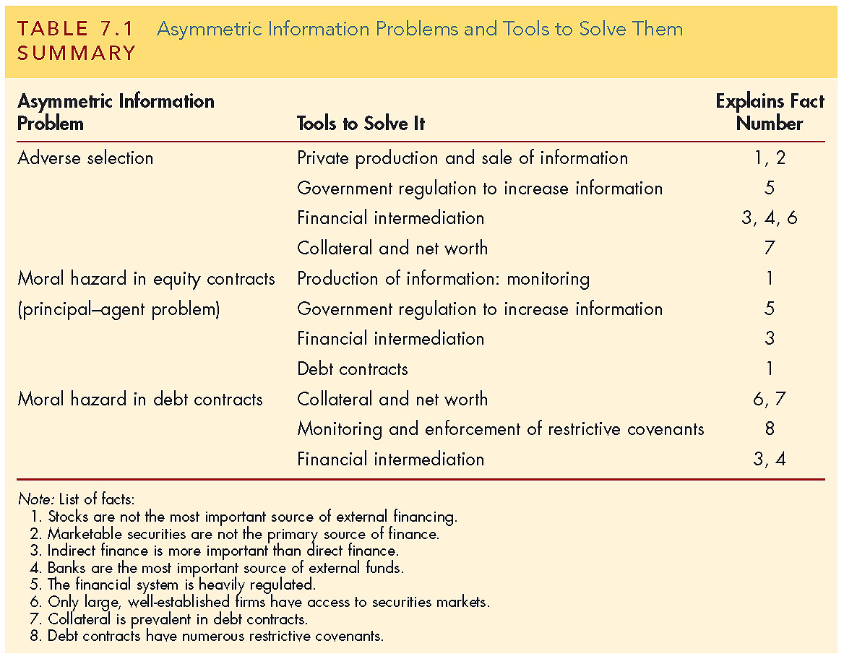
Asymmetric Information Problems and Tools to Solve Them

Slide 39
Conflicts of Interest
Conflicts of interest are a type of moral hazard that occurs when a person or institution has multiple interests, and serving one interest is detrimental to the other.
Three classic conflicts developed in financial institutions. Looking at these closely offers insight in avoiding these conflicts in the future.

Slide 40
Conflicts of Interest: Underwriting and Research in Investment Banking
Investment banks may both research companies with public securities, as well as underwrite securities for companies for sale to the public.
Research is expected to be unbiased and accurate, reflecting the facts about the firm. It is used by the public to form investment choices.
Underwriters will have an easier time if research is positive. Underwriters can better serve the firm going public if the firm’s outlook is optimistic.

Slide 41
Conflicts of Interest: Underwriting and Research in Investment Banking
Research is expected to be unbiased and accurate, reflecting facts about the firm. It is used by the public to form investment choices.
Underwriters can command a better price for securities issued by a firm if the firm’s outlook is optimistic.
An investment bank acting as both a researcher and underwriter of securities for companies clearly has a conflict—serve the interest of the issuing firm or the public?

Slide 42
Conflicts of Interest: Underwriting and Research in Investment Banking
During the tech boom, research reports were clearly distorted to please issuers. Firms with no hope of ever earning a profit received favorable research.
This also lead to spinning, where underpriced equity was allocated to executives who would promise future business to the investment bank.

Slide 43
Conflicts of Interest: Auditing and Consulting in Accounting Firms
Auditors check the assets and books of a firm for the quality and accuracy of the information. The objective in an unbiased opinion of the firm’s financial health.
Consultants, for a fee, help firms with variety of managerial, strategic, and operational projects.
An auditor acting as both an auditor and consultant for a firm clearly is not objective, especially if the consulting fees exceed the auditing fees.

Slide 44
Conflicts of Interest: Credit Assessment and Consulting in Rating Agencies
Rating agencies assign a credit rating to a security issuance of a firm based on projected cash flow, assets pledged, etc. The rating helps determine the riskiness of a security.
Consultants, for a fee, help firms with variety of managerial, strategic, and operational projects.
An rating agency acting as both an rater and consultant for a firm clearly is not objective, especially if the consulting fees exceed the rating fees.

Slide 45
Conflicts of Interest: Credit Assessment and Consulting in Rating Agencies
Rating agencies, such as Moody’s and Standard and Poor, were caught in this game during the housing bubble. Firms asked the rater to help structure debt offering to attain the highest rating possible. When the debt subsequently defaulted, it was difficult for the agency to justify the original high rating. Perhaps it was just error. But few believe that—most see the rating agencies as being blinded by high consulting fees.

