Slide 1
Chapter 7. Ver 10
RLL Design and Sequencing System
  7.1 Commonly used industrial machine sequence.
  7.2 Sequencing chart
  7.3 Design Relay Ladder Logic for Sequencing Problems using PLCs (CASCADE Method)
  7.3.1 Design RLL for Single-Path Machine Sequence Having Non-Sustain Control Signals
  7.3.2 Design RLL for Single-Path Machine Sequence Having Sustain Control Signals
  7.3.3 Design RLL for Multi-Path Sequencing Systems with Sustain Outputs
  7.3.4 RLL for machine sequence with two or more alternative parallel paths
  7.3.5 RLL for machine sequence with option of bypassing certain steps.
  7.3.6 RLL for machine sequence with the option of repeating certain steps.

Slide 2
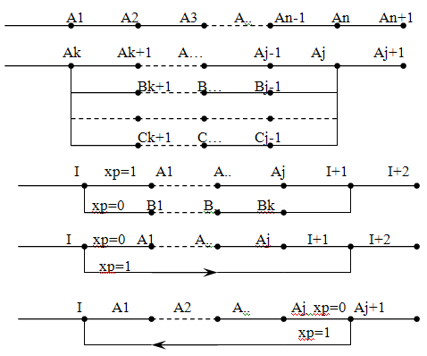
7.1 Commonly used industrial machine sequence
  Single-Path Machine Sequence.
  (b) Multi-Path (parallel) Machine Sequencing.
  (c) Two or more alternative parallel paths machine sequence.
  (d) Machine sequence with option of bypassing certain steps.
  (e) Machine sequence with the option of repeating certain steps.

Slide 3
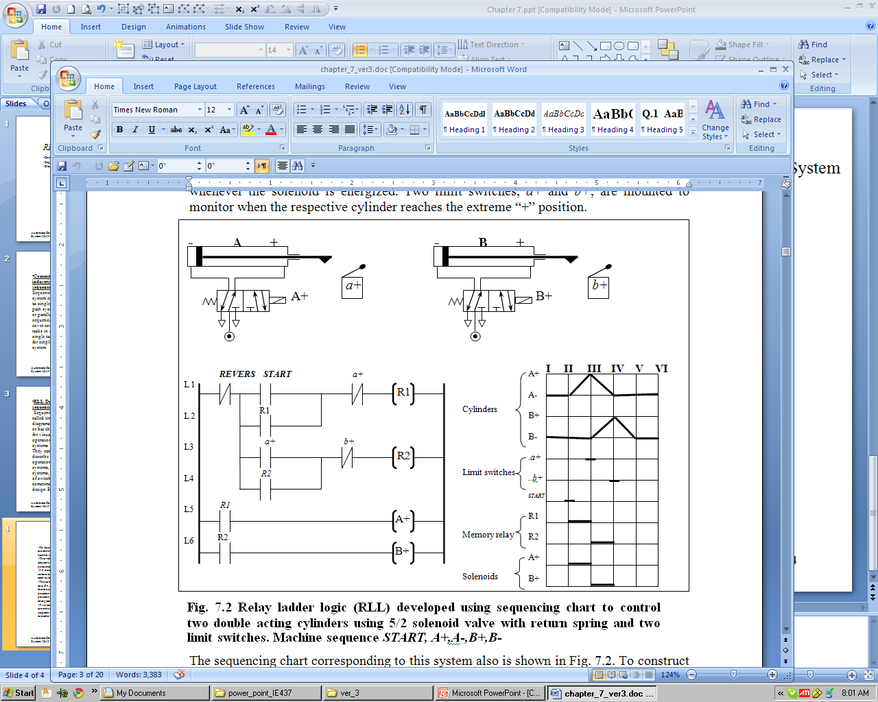
7.2 Design Using Sequencing Chart
  Sequence charts (also called time-motion diagrams, state diagram, or bar charts) are useful for visualizing the operation of switching systems.
  They can be used to describe the step-by-step operation of relay systems, pneumatic systems, or any other type of switching systems and sometime helpful in design RLL.
  Consider machine cycle:
  START, A+ B-
A-
B+
Where A, and B are double acting cylinders actuators,
Two solenoid 5x2 valve Outputs spring return type, and
Two limits switches inputs at cylinder forward position

Slide 4
7.2 Design Using Sequencing Chart
A-
B+
  START, A+ B-

Slide 5
7.2 Design Using Sequencing Chart
Work as Emergency switch
Sequencing chart
Flip flop module
Output module

Slide 6
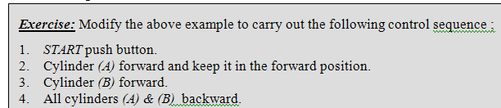
7.2 Design Using Sequencing Chart
  START, A+, B+
A-
B+
Machine Sequence > |  | A+ | B+ | A- B-
Actuators | A+
 | A-
 | B+
 | B-
Sensors | a+
 | b+
 | START
Outputs | Sol A+
 | Sol B+
Flip flops | R1
 | R2

Slide 7
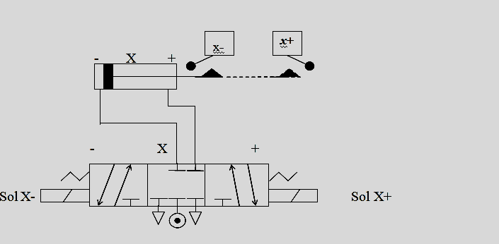
Type of Control Signals
  Control Signals either with and without mechanical memory and called :
  Non-sustain and Sustain Control Signals ?
a-
a+
Sustain control signal:
No mechanical memory.
Non-sustain control signal:
Have mechanical memory.

Slide 8
7.3 RLL Design for Sequencing System Using CASCADE Methods
  CASCADE method is systematic method help in design common industrial machine sequence [7.1] can be sued for non-sustain and sustain outputs. Summery of the method as follows:
  The RLL consist of two modules, flip flop and output modules.
  Dividing the machine sequence into groups, such that no opposing output command appears in the same group. (Why ?)
  In flip flop module, each group has flip-flop with set and reset signals, those signals will be used run the flip flop in sequence.
  The flip flop group set from previous flip flop group and reset using next flip flop group.
  First flip flop group set using START button switch, and end flip flop group will rest using last feedback input signal.
  The output module developed using flip flop group and associated input signal of the actuator.
G1 flip flop
G2 flip flop
G3 flip flop
START

Slide 9
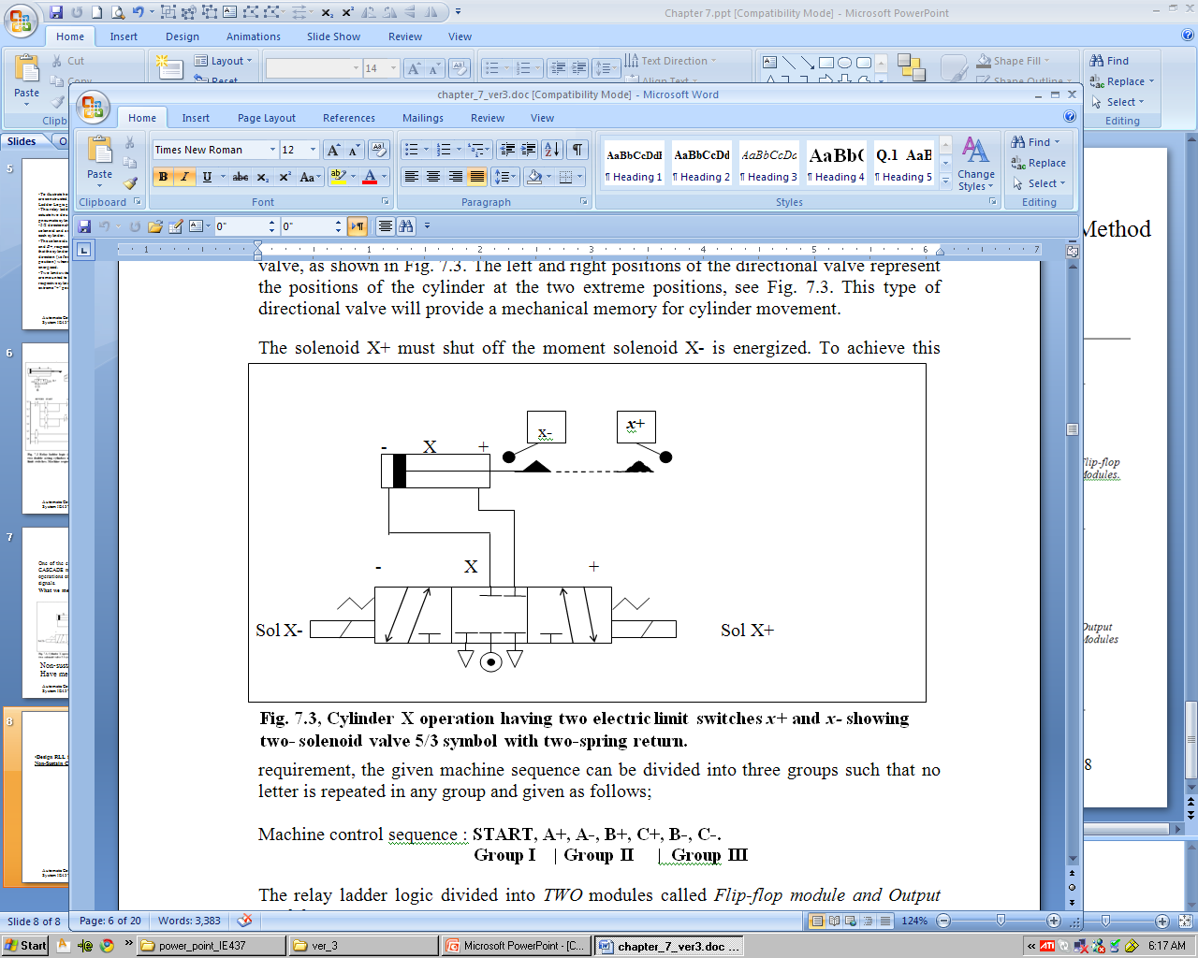
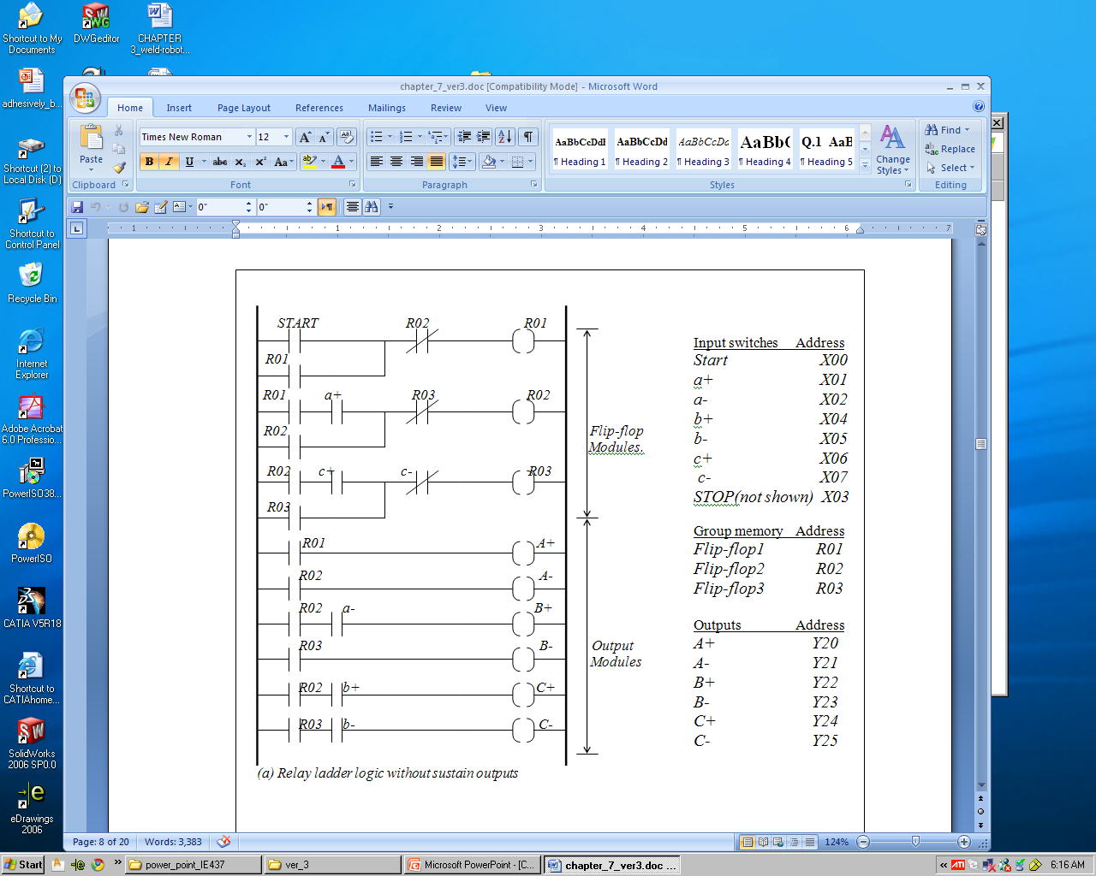
7.3 RLL Design for Sequencing System Using CASCADE Methods
Design RLL for Single-Path Machine Sequence using CASCADE method Non-Sustain Control Signals:
Illustrated Example 7.0a:

Slide 10
7.3 RLL Design for Sequencing System Using CASCADE Methods
Design RLL for Single-Path Machine Sequence Non-Sustain Control Signals:
Flip flop module Output Module

Slide 11
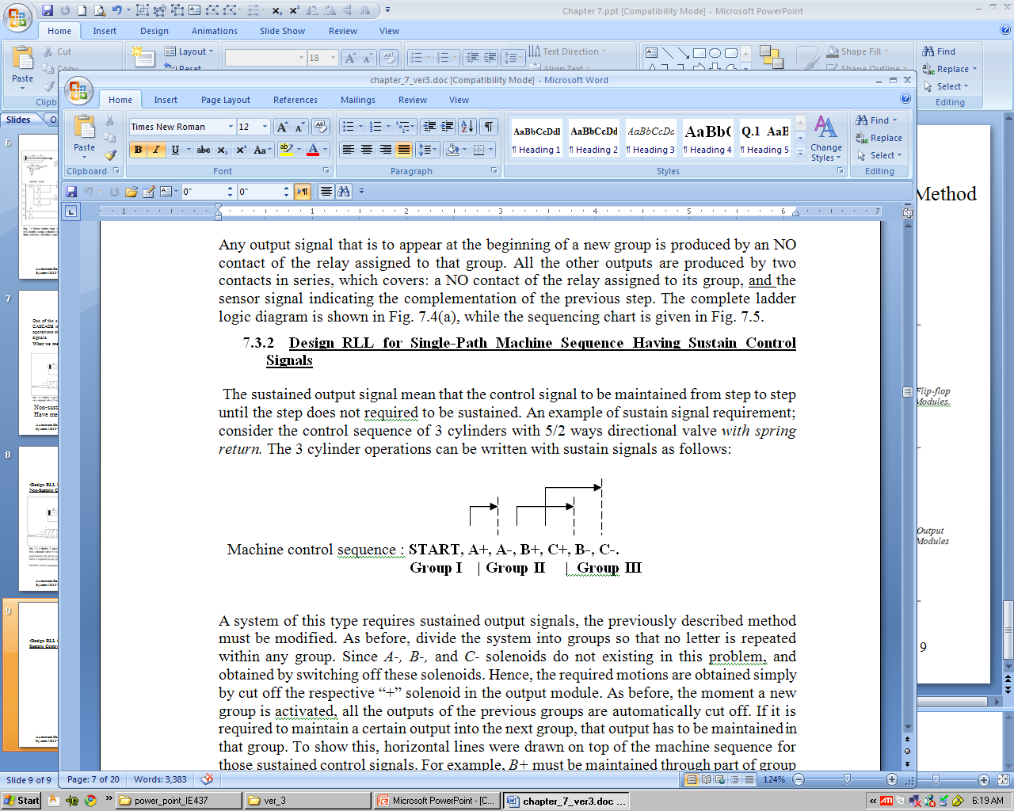
7.3 RLL Design for Sequencing System Using CASCADE Methods
Design RLL for Single-Path Machine Sequence Sustain Control Signals:
Example 7.0b

Slide 12
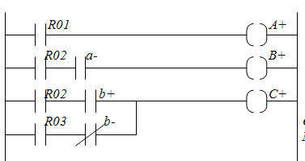
7.3 RLL Design for Sequencing System Using CASCADE Methods
Design RLL for Single-Path Machine Sequence Sustain Control Signals:
Example 7.0b

Slide 13
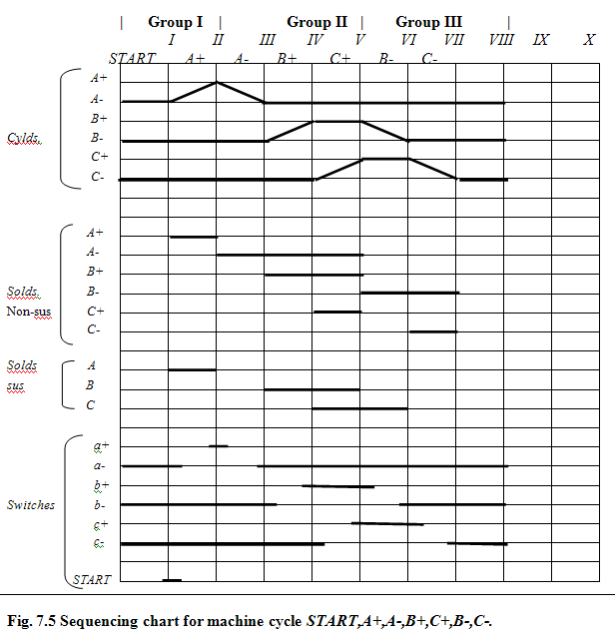
7.3 RLL Design for Sequencing System Using CASCADE Methods

Slide 14
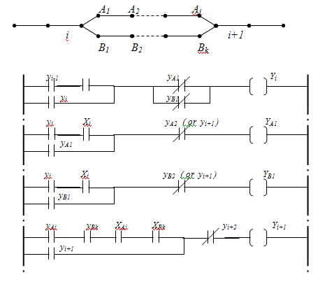
7.3 RLL Design for Sequencing System Using CASCADE Methods
Design RLL for Multi-Path Machine Sequence using CASCADE method (Sustain/Non-Sustain Outputs)
Multi-path machine control sequence.
Here program proceeds as regular single path up to the completion of step(i).
At this point, two parallel paths A and B are carried out simultaneously.
Path A has j steps, and path B has k steps; the j and k are not necessarily equal.
Only after both paths have been completed AND function, the program continue with the next single-path step(i+1).

Slide 15
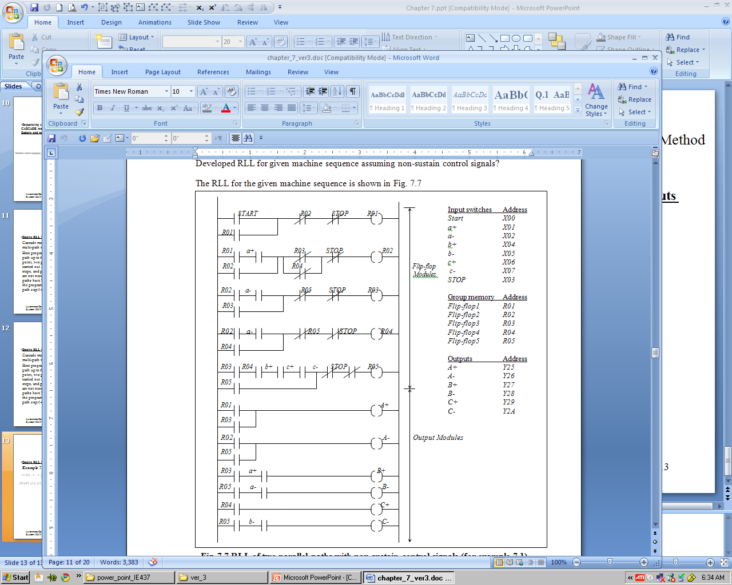
7.3 RLL Design for Sequencing System Using CASCADE Methods
Design RLL for Multi-Path Machine Sequence using CASCADE method (Sustain/Non-Sustain Outputs)
Example 7.1

Slide 16
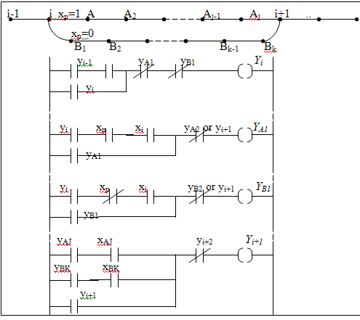
7.3 RLL Design for Sequencing System Using CASCADE Methods
Design RLL for Multi-Path Machine Sequence with two or more alternative parallel paths
Some of machine control sequence require two or more alternative parallel sequence.
This required to use multiple RLL sequence for each path.
Any parallel machine sequence can be enabled using selector switch/switches, or any other external logic.
After step i is completed and after switch x_{I} is set logic 1, either flip-flop Y_{A1} or Y_{B1} is set, depending on whether x_{p} = 1 or 0, respectively.
Compellation of either step A_{j} or B_{k} sets flip-flop Y_{i+1} .

Slide 17
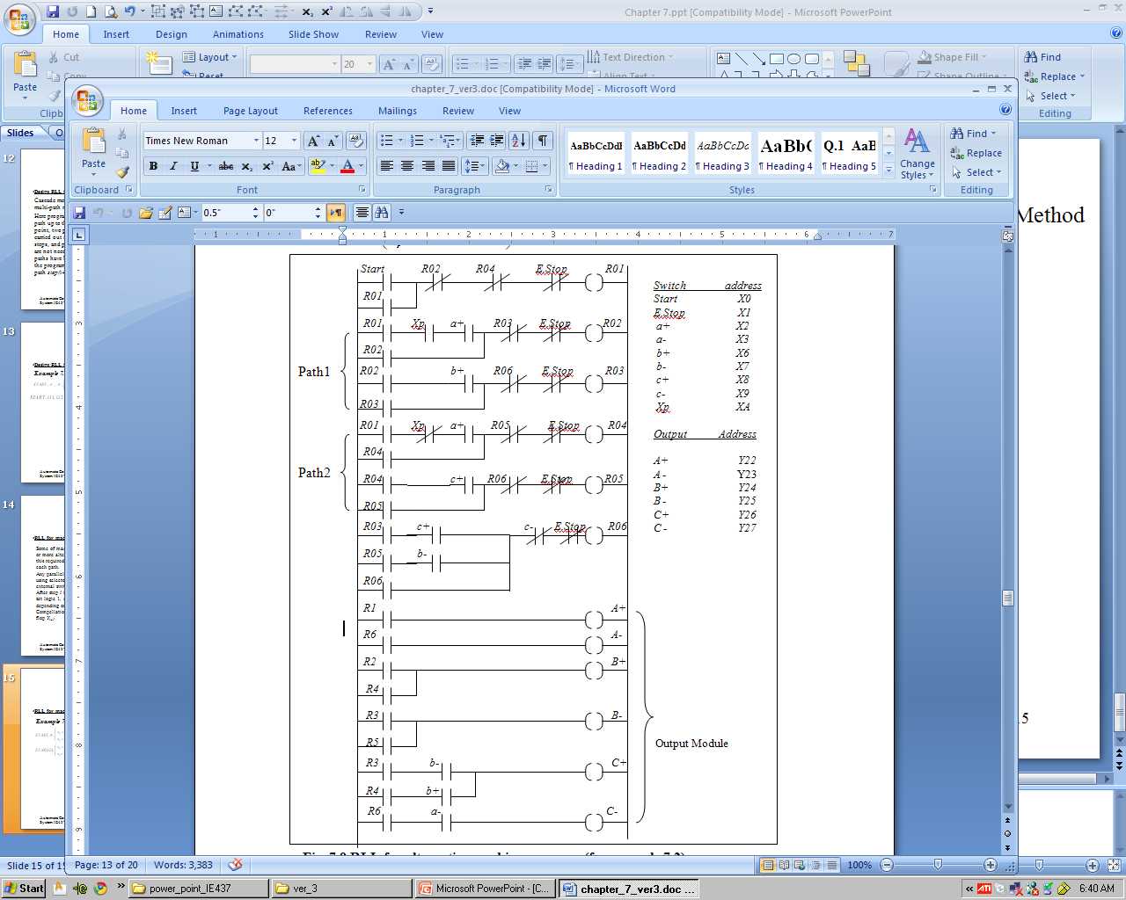
7.3 RLL Design for Sequencing System Using CASCADE Methods
Design RLL for Multi-Path Machine Sequence with two or more alternative parallel paths
Example 7-2

Slide 18
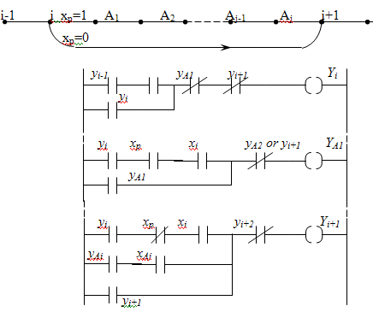
7.3 RLL Design for Sequencing System Using CASCADE Methods
Design RLL for Machine Sequence with option of bypassing certain steps
Here there are a machine sequence with the option of bypassing certain machine sequence steps.
At the completion of step i, if input control signal x_{p} =1, then the system goes through program steps from A₁ to A_{j} , and continue with step I+1.
If on the other hand, x_{p} = 0, then the system jumps directly from step I to I+1.

Slide 19
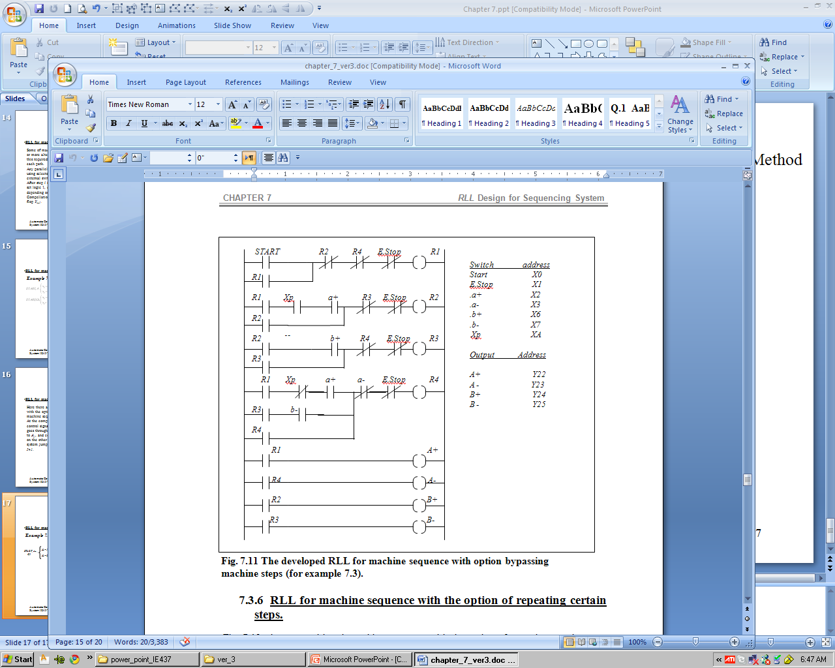
7.3 RLL Design for Sequencing System Using CASCADE Methods
Design RLL for Machine Sequence with option of bypassing certain steps
Example 7.3
START, A+ , , A- .
G1 G4
X_{p}=1; ( B+, B-)
G2 | G3
X_{p}=0; by pass

Slide 20
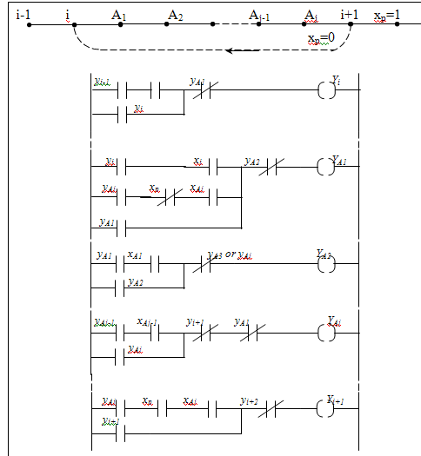
7.3 RLL Design for Sequencing System Using CASCADE Methods
Design RLL for Machine Sequence with option of repeating certain steps
Multi-path machine sequence with the option of repeating certain steps.
At the completion of step A_{j} , the system will continue with step i+1, provided x_{p} =1 . If, however, x_{p} = 0 , then steps A₁ to A_{J} are repeated indefinitely until x_{p} becomes 1.
This circuit is suitable for machine sequence to be repeated until the desired effect is achieved.
Note; at least three flip-flops must be allocated for repeated machine steps, sometime a third ‘dummy’ group must be added.

Slide 21
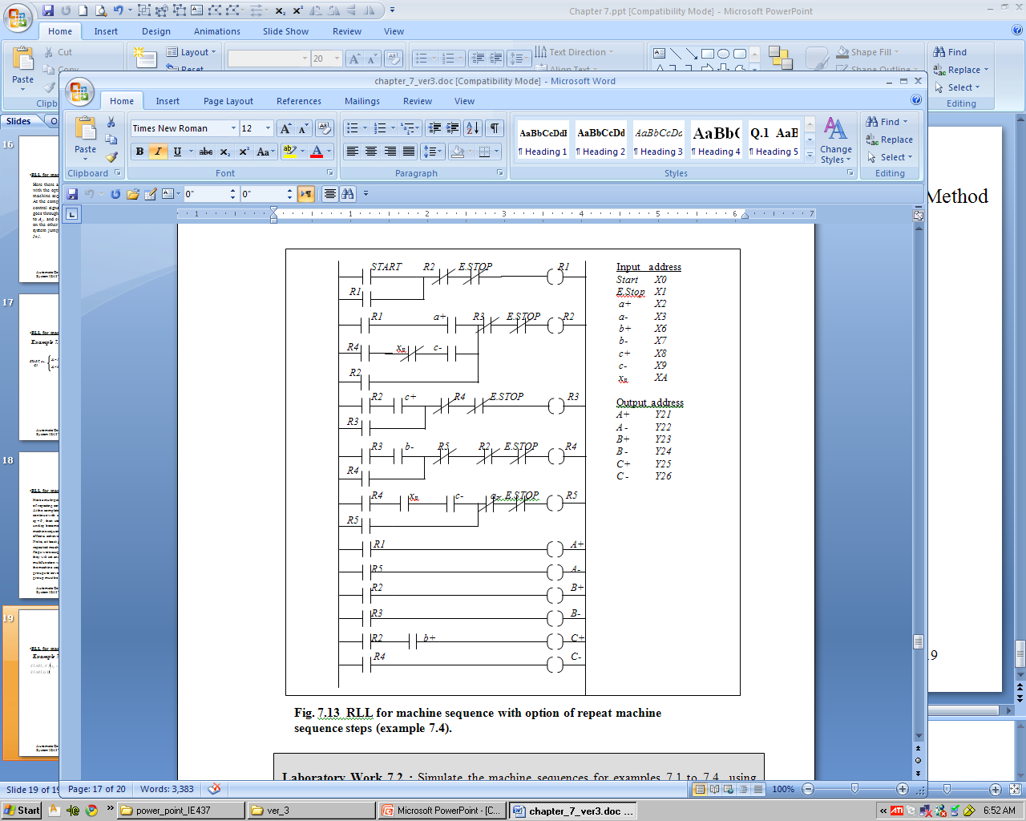
7.3 RLL Design for Sequencing System Using CASCADE Methods
Design RLL for Machine Sequence with option of repeating certain steps
Example 7.4

Slide 22
Problems
  Problem 7.1
  Develop the sequencing chart for the following machine cycles using double acting cylinder having two limit switches, at the two extreme positions. Solve the problem assuming non-sustain control signals (5/3 double solenoids and two spring for valve center);
  START, A+, A-, A+, A-, B+, B-.
  START, A-, B+, B-, B+, B-, A+. (assume initial position of cylinder A at forward position)
  START, A+, A-, B+, C+, B-, C-.
  START, A+, B+, A-, A+, B-, A-.
  START, A+, B+, A-, B-, A+, A-.
  Problem 7.2
  Group the machine cycles given in Prob. 7.1 using Cascade method then develop the RLL?
  Problem 7.3
  Resolve Problem 7.1 using sustain control signals (5/2 solenoid valve with return spring)?
  Problem 7.4 Resolve Problem 7.2 using sustain control signals (5/2 solenoid valve with return spring)?

Slide 23
  Problem 7.5
  Group the following parallel path machine cycles using Cascade method, develop the sequencing chart, and RLL using non-sustain control signals;
a)
b)

Slide 24
  Problem 7.6
  Group the following machine cycles using Cascade method and develop the RLL for three double acting cylinders . The machine sequence having three alternative paths and using two selector switches X_{p1} and X_{p2}. The machine sequence given as follows (assume non-sustain control signal for cylinders B,C and D, while sustain control signal for cylinder A ):

Slide 25
  Problem 7.7
  Group the following machine cycle using Cascade method and develop the RLL for three double acting cylinders. The machine sequence having two alternative paths and bypass machine cycle path.
  The selection of machine paths and bypass path is achieved using two selector switches X_{p1} and X_{p2}. The machine sequence given as follows(assuming non-sustain control signals for all cylinders):

Slide 26
  Problem 7.8
  Develop RLL for machine sequence with optional repeat machine steps of two double acting cylinders. Where the selection of repeated machine path is achieved using two selector switches x_{p1} and x_{p2} for the machine sequence given as follows (assuming non-sustain control signal for all cylinders):
  Problem 7.9
  Resolve Prob. 7.8 by adding alternative path of machine sequence as illustrated below:

