Slide 1
Aldehydes and ketones
340 Chem 1st 1439

Slide 2
Outline
Structure and Bonding
Nomenclature
Physical Properties
Preparation
Reactions
340 Chem 1st 1439

Slide 3
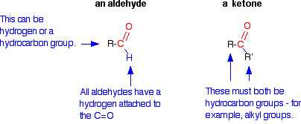
Structure and Bonding
The functional group of an aldehyde is a carbonyl group bonded to a hydrogen atom and a carbon atom
The functional group of a ketone is a carbonyl group bonded to two carbon atoms
Many compounds found in nature have aldehyde or ketone functional groups. Aldehydes have pungent odors, whereas ketones tend to smell sweet. Vanillin and cinnamaldehyde are examples of naturally occurring aldehydes. A whiff of vanilla extract will allow you to appreciate the pungent odor of vanillin. The ketones camphor and carvone are responsible for the characteristic sweet odors of the leaves of camphor trees, spearmint leaves, and caraway seeds.
340 Chem 1st 1439

Slide 4
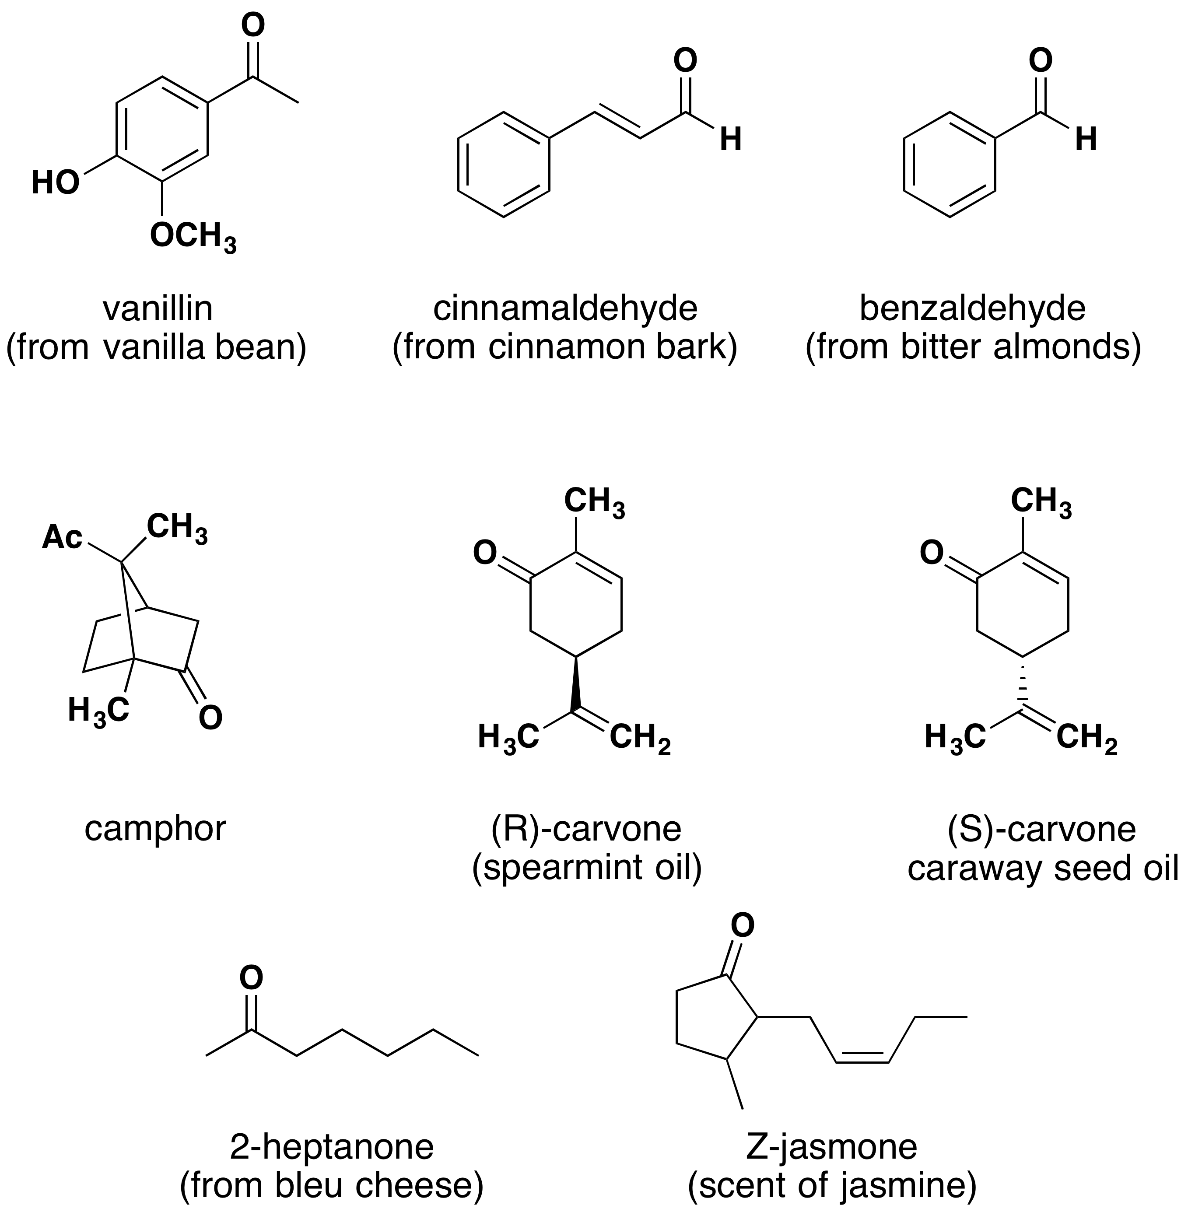
340 Chem 1st 1439

Slide 5
IUPAC Nomenclature of aldehyde
Select the longest chain of carbon atoms that contains the functional group.
changing the suffix -e of the parent alkane to –al.
Number must start with carbonyl group of an aldehyde as carbon-1.
For unsaturated aldehydes, the presence of a carbon-carbon double or triple bond is indicated by the infix -en- or -yn-. As with other molecules with both an infix and a suffix, the location of the group corresponding to the suffix determines the numbering pattern.
The functional group priority order in nomenclature system is as following:
Acid and derivatives > aldehyde > ketone > alcohol > amine > alkene > alkyne > ether
For cyclic molecules in which }CHO is bonded directly to the ring, the molecule is named by adding the suffix -carbaldehyde to the name of the ring. The atom of the ring to which the aldehyde group is bonded is numbered 1.
340 Chem 1st 1439

Slide 6
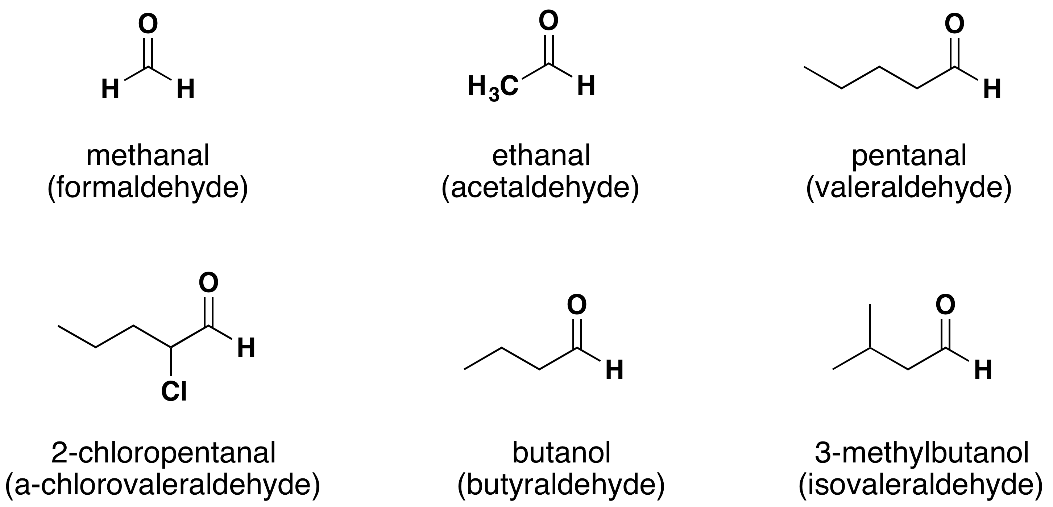


The common name for an aldehyde is derived from the common name of the corresponding carboxylic acid by dropping the word acid and changing the suffix -ic or –oic to -aldehyde.
In common names carbon atoms near the carbonyl group are often designated using Greek letters ($α$, ᵝ, ɣ , δ…..) beginning with carbon next the carbonyl group.
Butanal
3-Methylbutanal
a
a
$(α$-
340 Chem 1st 1439

Slide 7
340 Chem 1st 1439

Slide 8
β-Bromo- α-methyl butyraldehyde
β-Chloro- α -ethyl valeraldehyde
α
340 Chem 1st 1439

Slide 9
IUPAC Nomenclature of Ketone
ketones are named by selecting as the parent alkane the longest chain that contains the carbonyl group changing the suffix from -e to –one
The parent chain is numbered from the direction that gives the carbonyl carbon the smaller number.
If a ketone has a second functional group of higher naming priority, the ketone oxygen is indicated by the prefix “oxo.”
Common names for ketones are derived by naming the two alkyl or aryl groups bonded to the carbonyl group as separate words followed by the word ketone.
A ketone or aldehyde group can also be named as a substituent on a molecule with a higher priority functional group as its root. A ketone or aldehyde carbonyl is named by the prefix oxo- if it is included as part of the longest chain in the root name. When an aldehyde group is a substituent and not part of the longest chain, it is named by the prefix formyl. Carboxylic acids frequently contain ketone or aldehyde groups named as substituents.
340 Chem 1st 1439

Slide 10
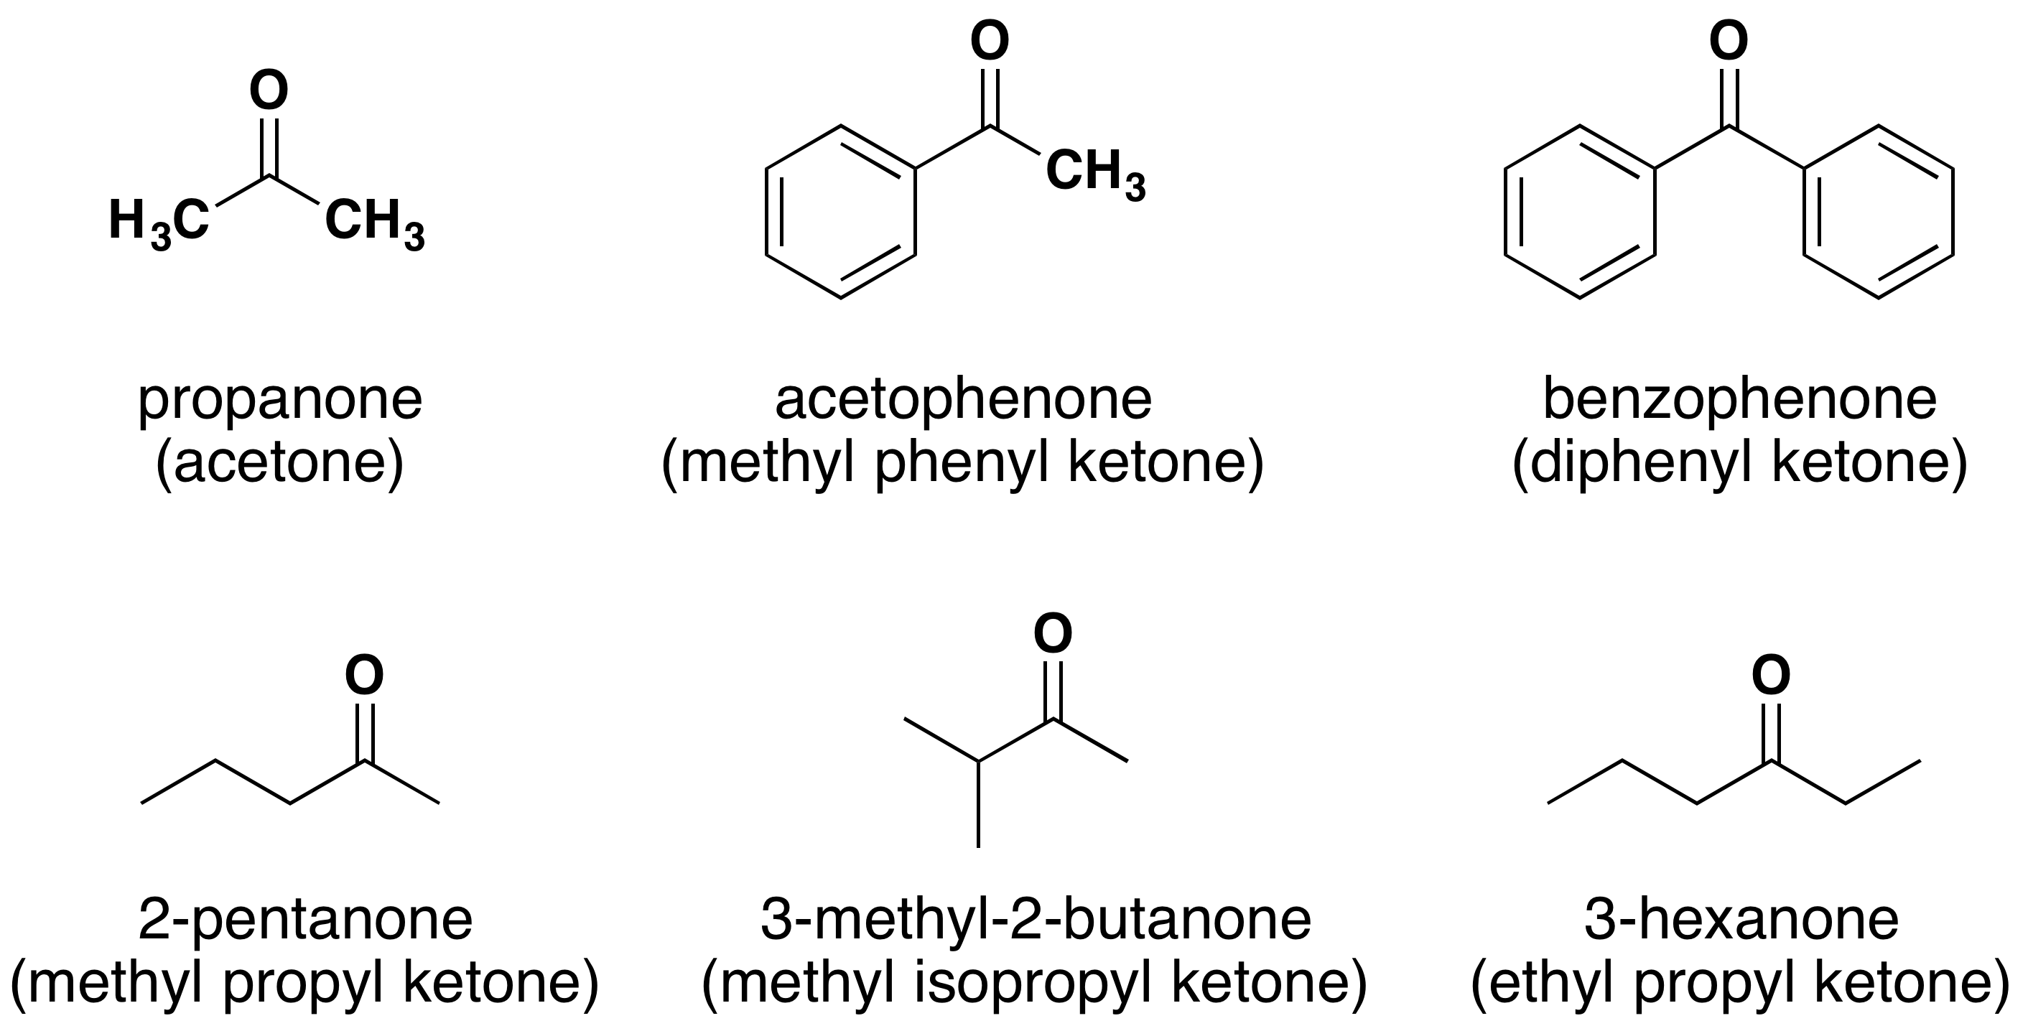
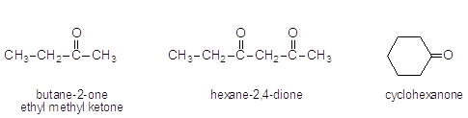
Phenyl ethanone
Diphenylmethanone
Dimethyl Ketone
340 Chem 1st 1439

Slide 11
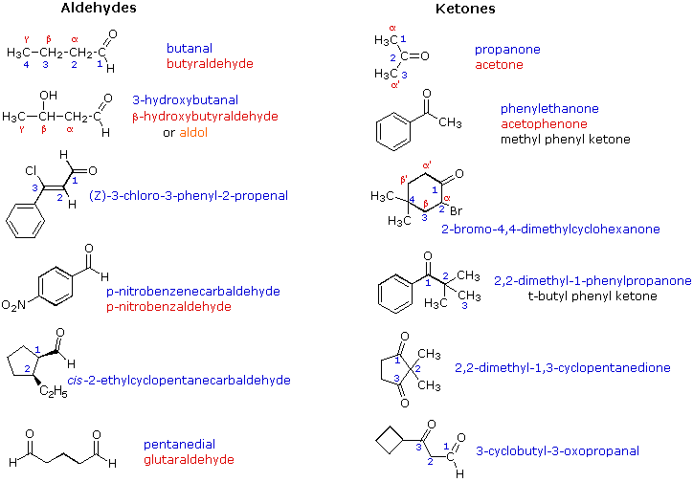
340 Chem 1st 1439

Slide 12
340 Chem 1st 1439

Slide 13
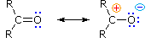
Physical Properties
Oxygen is more electronegative than carbon; therefore, a carbon-oxygen double bond is polar, with oxygen bearing a partial negative charge and carbon bearing a partial positive charge.
In general, aldehydes and ketones have higher boiling points than alkenes because they are more polar and the dipole–dipole attractive forces between molecules are stronger. But they have lower boiling points than alcohols because, unlike alcohols, two carbonyl groups can’t form hydrogen bonds to each other.
Aldehydes and ketones can form hydrogen bonds with the protons of OH groups. This makes them more soluble in water than alkenes, but less soluble than alcohols.
340 Chem 1st 1439

Slide 14
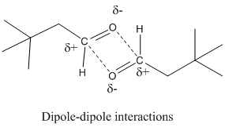
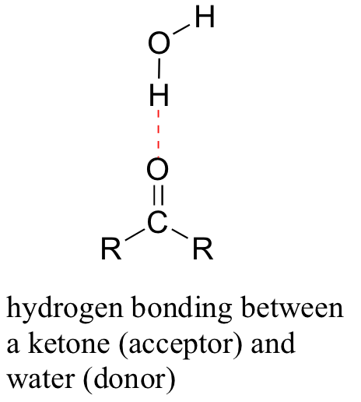
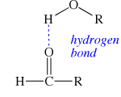
CH₃CH₂CH₂CH₃ CH₃OCH₂CH₃ CH₃CH₂CHO CH₃COCH₃ CH₃CH₂CH₂OH
Butane methoxyethane propanal acetone propan-1-ol
bp 0 °C bp 8 °C bp 49 °C bp 56 °C bp 97 °C
340 Chem 1st 1439

Slide 15
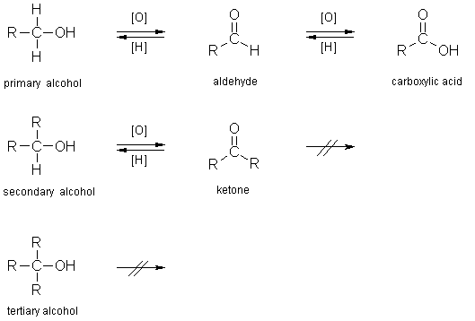
Syntheses of Ketones and Aldehydes
Oxidation of Alcohols
Sodium dichromate in sulfuric acid (“chromic acid,” H₂CrO₄) is the oxidizing reagent for secondary alcohols to ketones. Bleach (NaOCl sodium hypochlorite) is an inexpensive. Primary alcohols are usually oxidized by Pyridinium chlorochromate (PCC), a complex of chromium trioxide CrO₃ with pyridine and HCl, provides good yields of aldehydes
340 Chem 1st 1439

Slide 16
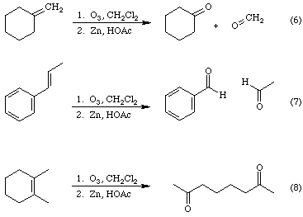
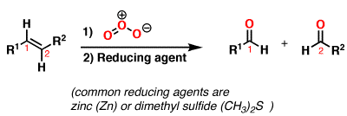
Ozonolysis of Alkenes
340 Chem 1st 1439

Slide 17
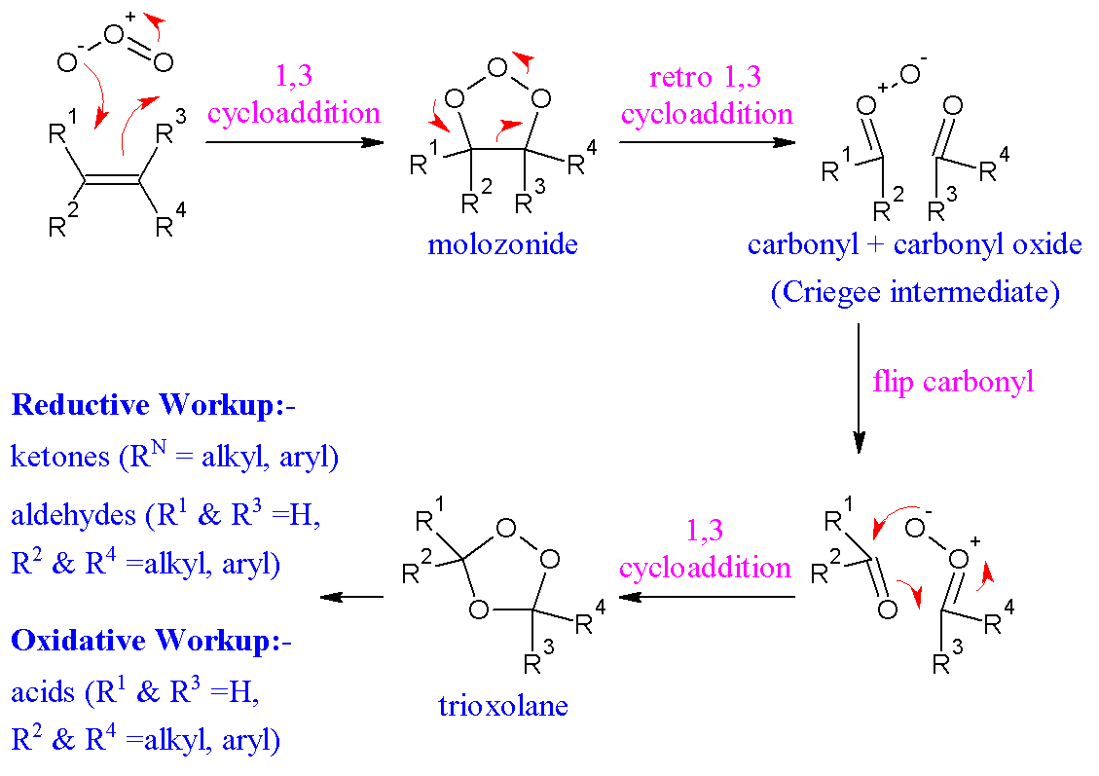
340 Chem 1st 1439

Slide 18
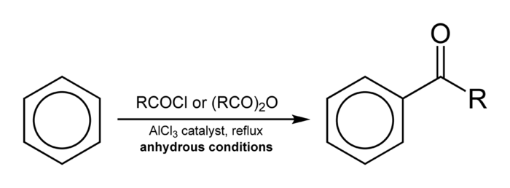
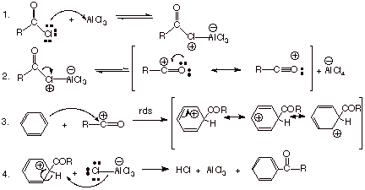
Friedel–Crafts Acylation
340 Chem 1st 1439

Slide 19
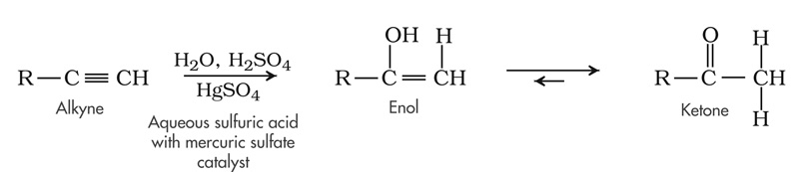
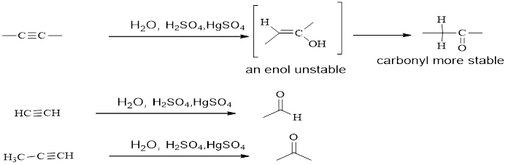
Hydration of Alkynes
340 Chem 1st 1439

Slide 20
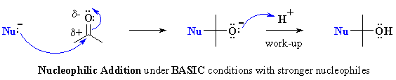
Reactions of aldehydes and Ketones
Nucleophilic Addition to the Carbon–Oxygen Double Bond
340 Chem 1st 1439

Slide 21
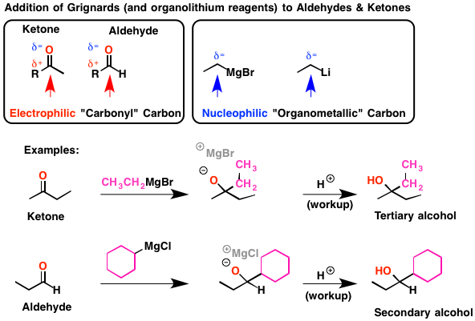
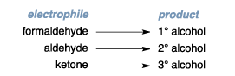
Addition of Grignard Reagents
340 Chem 1st 1439

Slide 22
Reduction of carbonyl group
Addition of metal hydrides( formation of alcohol)
340 Chem 1st 1439

Slide 23
The Addition of Alcohols: Hemiacetals and Acetals
340 Chem 1st 1439

Slide 24
Addition of Hydrogen Cyanide: Formation of cynohydrins
340 Chem 1st 1439

Slide 25
Addition of acetylide ions:
340 Chem 1st 1439

Slide 26
Addition of Ammonia and Ammonia Derivatives
340 Chem 1st 1439

Slide 27
Oxidation of Aldehydes
Iodoform reaction: The reaction occurs in any aldehyde or ketone containing CH₃CO.
340 Chem 1st 1439

Slide 28
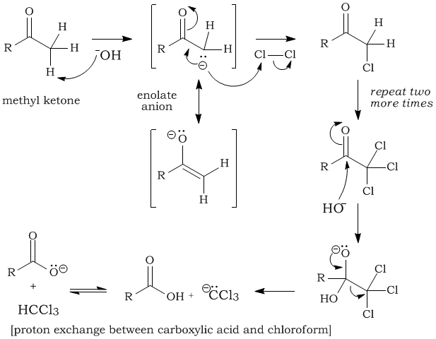
340 Chem 1st 1439

Slide 29
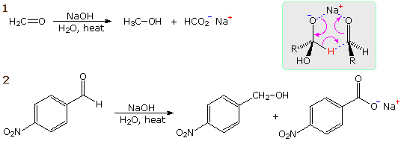
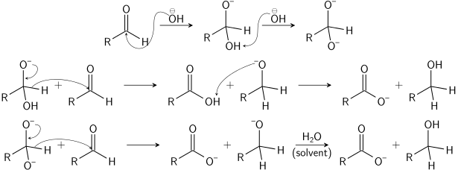
Cannizaro Reaction
B) Hydride shift: The tetrahedral intermediate I , expels a hydride ion as a leaving group and is thereby oxidized. A second aldehyde molecule accepts the hydride ion in another nucleophilic addition step and is thereby reduced.
A) Nucleophilic addition of an OH - ion to the 1st aldehyde molecule gives a tetrahedral intermediate.
A
B
340 Chem 1st 1439

Slide 30
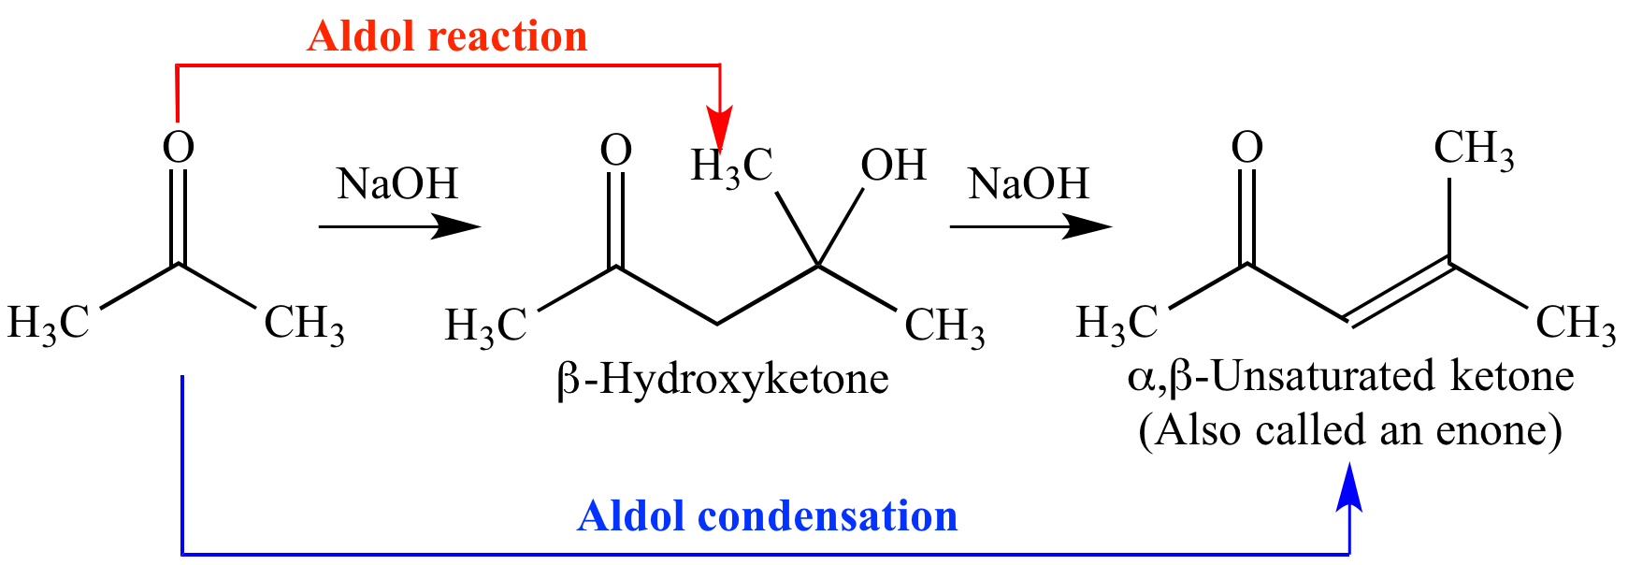
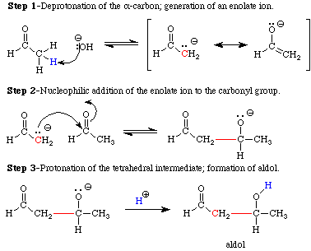
Aldol condensation:
340 Chem 1st 1439

Slide 31
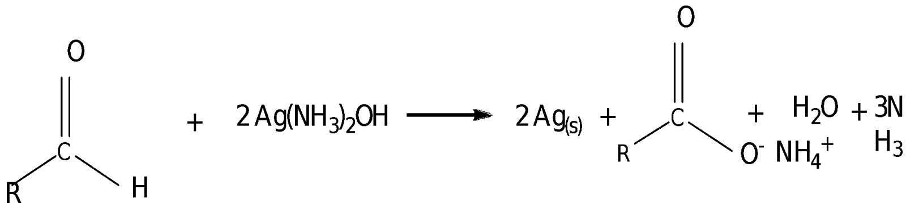
Tollens’ Test
Tollens’ reagent oxidizes an aldehyde into the corresponding carboxylic acid. The reaction is accompanied by the reduction of silver ions in Tollens’ reagent into metallic silver, which, if the test is carried out in a clean glass test tube, forms a mirror on the test tube.
Ketones are not oxidized by Tollens’ reagent, so the treatment of a ketone with Tollens’ reagent in a glass test tube does not result in a silver mirror.
340 Chem 1st 1439

