Slide 1
Chapter Five
Consumer Markets and Consumer Buyer Behavior

Slide 2
Consumer Markets and Consumer Buyer Behavior
Topic Outline
Model of Consumer Behavior
Characteristics Affecting Consumer Behavior
Types of Buying Decision Behavior
The Buyer Decision Process
The Buyer Decision Process for New Products

Slide 3
Model of Consumer Behavior
Consumer buyer behavior : the buying behavior of final consumers, individuals and households, who buy goods and services for personal consumption
Consumer market : all of the personal consumption of final consumers
Notes:
Note to Instructor
Discussion Question
What have you recently purchased that cost over $100? Write down all the reasons you purchased this particular item.
Because students are all consumers—it is interesting to start the class with a discussion of products they have recently purchased. When you ask them why they purchased a particular item or product, you can bring them through many topics in this chapter including the characteristics that affect consumer behavior (cultural, social, personal, and psychological). You can also try to determine the process they went through including how and where they searched for information and how they evaluated their alternatives. Finally, ask them how they feel about their purchase (postpurchase behavior). This discussion will lead nicely to the next slide which is the Model of Buyer Behavior.

Slide 4
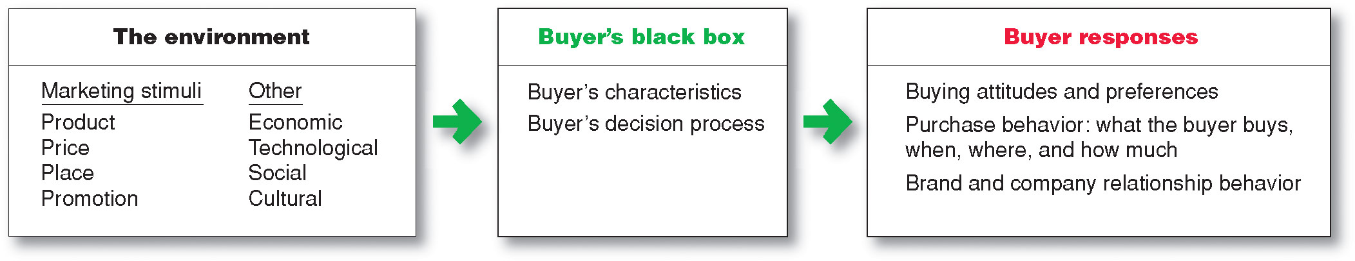

Model of Consumer Behavior
Notes:
Note to Instructor
Figure 5.1 Understanding the whys of buying behavior is very difficult. Says one expert, “The mind is a whirling, swirling, jumbled mass of neurons
bouncing around…”
It is interesting to talk about the buyer’s black box and one of the largest challenges in marketing is to understand what happens in this black box. Students will enjoy this video by Derren Brown. It is unclear how he obtains his results and how scientific this is, but it will certainly have students realize the mystery of the consumer’s brain.

Slide 5
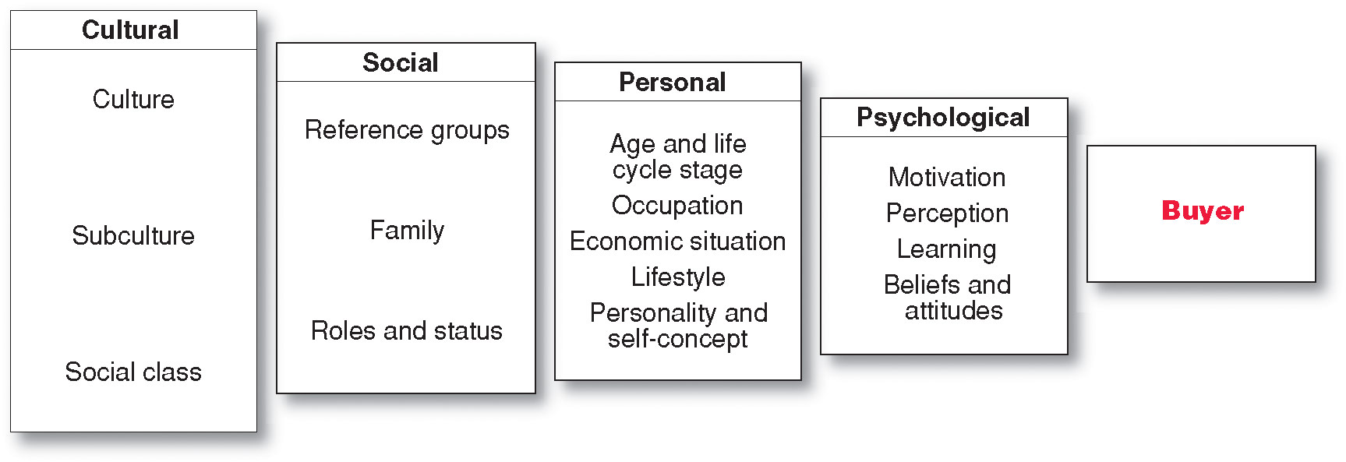
Characteristics Affecting Consumer Behavior
Factors Influencing Consumer Behavior
Notes:
Many levels of factors
affect our buying
behavior—from broad cultural and
social influences to motivations, beliefs,
and attitudes lying deep within us. For
example, why did you buy that specific
cell phone?

Slide 6
Characteristics Affecting Consumer Behavior
Culture is the learned values, perceptions, wants, and behavior from family and other important institutions
Notes:
Look for cultural shifts to discover new product opportunities. For instance, the shift toward a greater concern for fitness results in new foods, fitness centers, equipment, clothing.

Slide 7
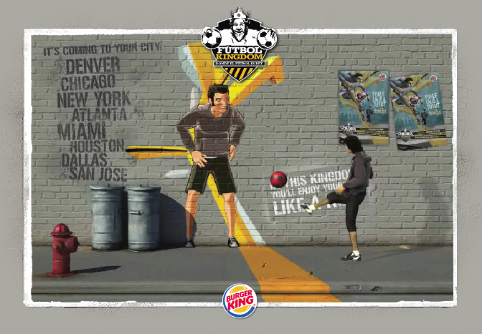
Characteristics Affecting Consumer Behavior
Subculture are groups of people within a culture with shared value systems based on common life experiences
and situations
Hispanic American
African American
Asian American
Mature consumers
Notes:
Note to Instructor
Many brands now target specific
subcultures—such as Hispanic
American, African American, and
Asian American consumers—with
marketing programs tailored to
their specific needs and preferences.
For example, P&G’s CoverGirl
Queen cosmetics line was inspired
by Queen Latifah to “celebrate the
beauty of women of color.”
Discussion Question
What subculture do you belong to? How does this influence you as a consumer?

Slide 8
Characteristics Affecting Consumer Behavior
Social classes are society’s relatively permanent and ordered divisions whose members share similar values, interests, and behaviors
Measured by a combination of occupation, income, education, wealth, and other variables

Slide 9
Characteristics Affecting Consumer Behavior
Groups and Social Networks
Membership Groups
Groups with direct influence and to which a person belongs
Aspirational Groups
Groups an individual wishes to belong to
Reference Groups
Groups that form a comparison or reference in forming attitudes or behavior
Notes:
Note to Instructor
Groups that have a direct influence and to which a person belongs are called
membership groups.
Reference groups serve as direct (face-to-face) or indirect points of comparison or reference in forming a person’s attitudes or behavior.
Aspirational: People often are influenced by reference groups to which they do not belong.
Discussion Question
What groups are you a member of and what are your aspirational groups. How does this influence you as a consumers?

Slide 10


Characteristics Affecting Consumer Behavior
Groups and Social Networks
Word-of-mouth influence and buzz marketing
  Opinion leaders are people within a reference group who exert social influence on others
  Also called influentials or leading adopters
  Marketers identify them to use as brand ambassadors
Notes:
Note to Instructor
It is a great idea to click through to the Tremor Web site. It is an excellent example of Buzz marketing. Ask students if they tend to have a “go to” person when they want to purchase. Would they consider themselves opinion leaders? A great group to ask about is middle school aged kids. Who are the opinion leaders here? What qualities do they possess?

Slide 11
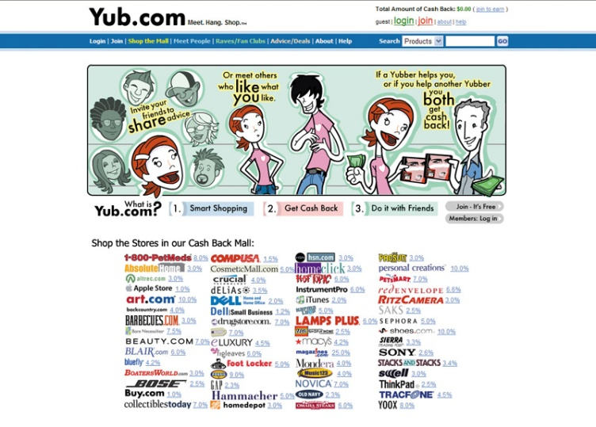
Characteristics Affecting Consumer Behavior
Groups and Social Networks
Online Social Networks are online communities where people socialize or exchange information and opinions
Include blogs, social networking sites (facebook), virtual worlds (second life)
Notes:
Note to Instructor:
Discussion Question
How can marketers use these networks?
This slide should provide a lively discussion for students because they all are users of social networks. Ask students for examples they have seen or experienced. Then be sure to ask if they think the marketing efforts were effective for the marketer and why? The text gives many examples .

Slide 12
Characteristics Affecting Consumer Behavior
Social Factors
Family is the most important consumer-buying organization in society
Social roles and status are the groups, family, clubs, and organizations that a person belongs to that can define role and social status
Notes:
Note to Instructor
Discussion Question
What brands do you purchase because it is what their parents used? Why do you think this occurs?

Slide 13
Characteristics Affecting Consumer Behavior
Personal Factors
Age and life-cycle stage
Occupation affects the goods and services bought by consumers
Economic situation includes trends in:
Personal income
Savings
Interest rates

Slide 14

Characteristics Affecting Consumer Behavior
Personal Factors
Lifestyle is a person’s pattern of living as expressed in his or her psychographics
Measures a consumer’s AIOs (activities, interests, opinions) to capture information about a person’s pattern of acting and interacting in the environment
Notes:
Note to Instructor
Discussion Question
What categories of products seem to be targeted to consumer’s lifestyles?
They will realize many products in addition to cars including food, cosmetics, shampoo also appeal to a consumer’s lifestyles.

Slide 15
Characteristics Affecting Consumer Behavior
Personal Factors
Personality and self-concept
  Personality refers to the unique psychological characteristics that lead to consistent and lasting responses to the consumer’s environment
Notes:
Note to Instructor
This PC ad from Fall of 2008 shows how PC’s are a fit for many personalities even though Mac has run ads which stereotype the user.

Slide 16
Characteristics Affecting Consumer Behavior
Personal Factors
Dominance
Autonomy
Defensiveness
Adaptability
Aggressiveness
Notes:
Note to Instructor
It is interesting to talk about brand personalities and ask students the personality of several brands:
A brand personality is the specific mix of human traits that may be attributed to a particular brand.
One researcher identified five brand personality traits
1. Sincerity (down-to-earth, honest, wholesome, and cheerful)
2. Excitement (daring, spirited, imaginative, and up-to-date)
3. Competence (reliable, intelligent, and successful)
4. Sophistication (upper class and charming)
5. Ruggedness (outdoorsy and tough)

Slide 17

Characteristics Affecting Consumer Behavior
Psychological Factors
Motivation
Perception
Learning
Beliefs and attitudes

Slide 18
Characteristics Affecting Consumer Behavior
Psychological Factors
Motivation
A motive is a need that is sufficiently pressing to direct the person to seek satisfaction
Motivation research refers to qualitative research designed to probe consumers’ hidden, subconscious motivations

Slide 19
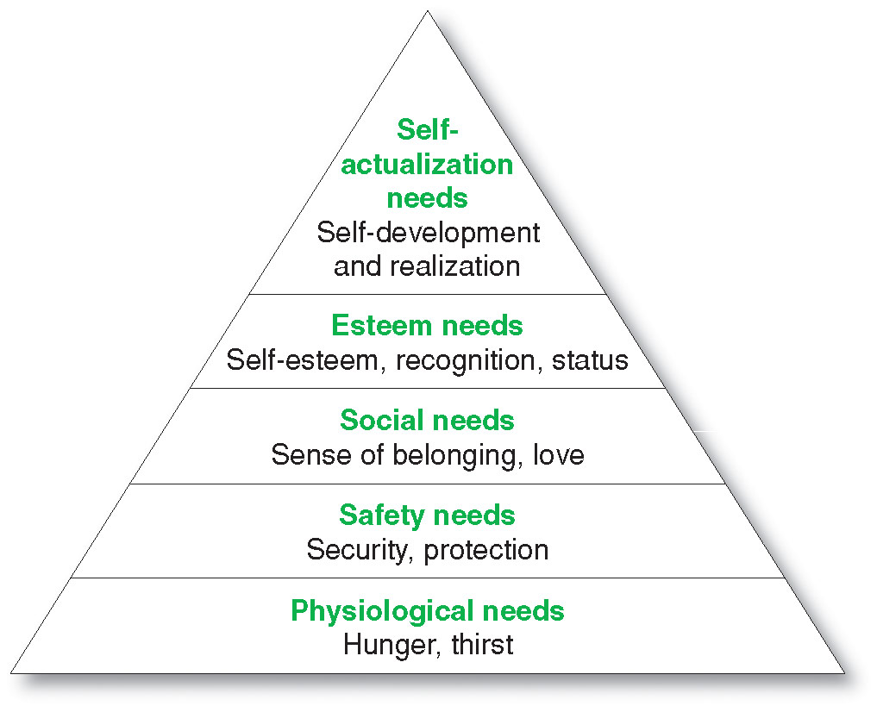
Characteristics Affecting Consumer Behavior
Maslow’s
Hierarchy of Needs

Slide 20

Characteristics Affecting Consumer Behavior
Psychological Factors
Perception is the process by which people select, organize, and interpret information to form a meaningful picture of the world from three perceptual processes
  Selective attention
  Selective distortion
  Selective retention
Notes:
Note to Instructor
Discussion Question
If you watched television last night, what ads do you remember seeing?
Probe to find out why they remember certain ads—was it that they broke through the clutter, that they saw them many times, or that they are in the market for that certain product?

Slide 21
Characteristics Affecting Consumer Behavior
Psychological Factors
Selective attention is the tendency for people to screen out most of the information to which they are exposed
Selective distortion is the tendency for people to interpret information in a way that will support what they already believe
Selective retention is the tendency to remember good points made about a brand they favor and forget good points about competing brands

Slide 22
Characteristics Affecting Consumer Behavior
Psychological Factors
Learning is the change in an individual’s behavior arising from experience and occurs through interplay of:
Drives
Stimuli
Cues
Responses
Reinforcement

Slide 23
Characteristics Affecting Consumer Behavior
Psychological Factors
Beliefs and Attitudes
Belief is a descriptive thought that a person has about something based on:
Knowledge
Opinion
Faith

Slide 24
Characteristics Affecting Consumer Behavior
Psychological Factors
Attitudes
describe a person’s relatively consistent evaluations, feelings, and tendencies toward an object or idea

Slide 25
Types of Buying Decision Behavior
Complex buying behavior
Dissonance-reducing buying behavior
Habitual buying behavior
Variety-seeking buying behavior
Notes:
Some purchases are
simple and routine, even
habitual. Others are far more
complex—involving extensive
information gathering and
evaluation—and are subject to
sometimes subtle influences. For
example, think of all that goes into a
new car buying decision.

Slide 26
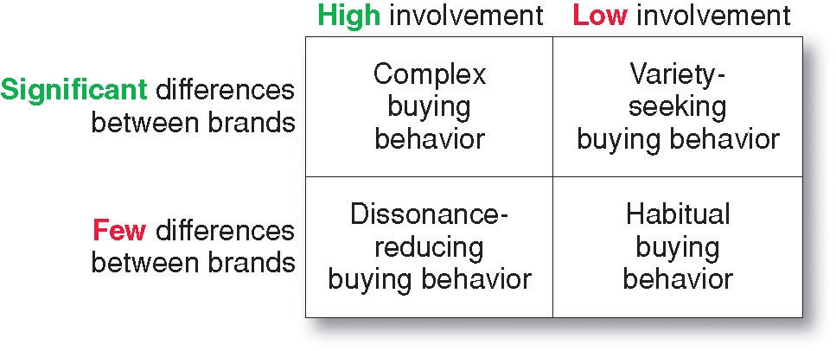
Types of Buying Decision Behavior
Four Types of Buying Behavior
Notes:
Buying behavior varies greatly for
different types of products. For example,
someone buying an expensive new PC
might undertake a full information gathering
and brand evaluation process.

Slide 27
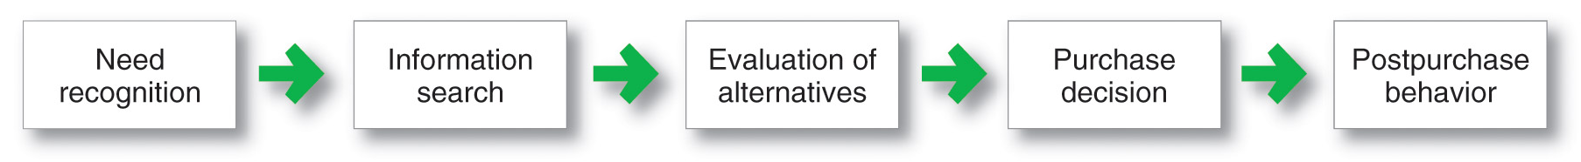
The Buyer Decision Process
Buyer Decision Making Process
Notes:
The actual purchase
decision is part of a much
larger buying process—starting with
need recognition through how you feel
after making the purchase. Marketers
want to be involved throughout the
entire buyer decision process.

Slide 28
The Buyer Decision Process
Need Recognition
Occurs when the buyer recognizes a problem or need triggered by:
  Internal stimuli
  External stimuli
Notes:
The buying process starts long
before the actual purchase and
continues long after. In fact, it
might result in a decision not to
buy. Therefore, marketers must
focus on the entire buying process,
not just the purchase decision.
Internal stimuli when one of the person’s normal needs—for example,
hunger or thirst—rises to a level high enough to become a drive
External stimuli. For example, an advertisement or a discussion with a friend
might get you thinking about buying a new car.

Slide 29

The Buyer Decision Process
Information Search
Sources of Information
Personal sources—family and friends
Commercial sources—advertising, Internet
Public sources—mass media, consumer organizations
Experiential sources—handling, examining, using the product

Slide 30


The Buyer Decision Process
Evaluation of Alternatives
How the consumer processes information to arrive at brand choices
Notes:
Note to Instructor
This Web link brings you to PriceGrabber—an online comparison shopping site. What is interesting on this site is on the left hand side, you can search by features. These features help a consumer know how to evaluate a product. For instance, this example is laptop computers and one can search by processing speed, processor type, screen size, etc.

Slide 31
The Buyer Decision Process
Purchase Decision
The act by the consumer to buy the most preferred brand
The purchase decision can be affected by:
  Attitudes of others
  Unexpected situational factors

Slide 32
The Buyer Decision Process
Post-Purchase Decision
The satisfaction or dissatisfaction that the consumer feels about the purchase
Relationship between:
  Consumer’s expectations
  Product’s perceived performance
The larger the gap between expectation and performance, the greater the consumer’s dissatisfaction
Cognitive dissonance is the discomfort caused by a post-purchase conflict

Slide 33
The Buyer Decision Process
Post-Purchase Decision
Customer satisfaction is a key to building profitable relationships with consumers—to keeping and growing consumers and reaping their customer lifetime value

Slide 34
The Buyer Decision Process for New Products
Adoption process is the mental process an individual goes through from first learning about an innovation to final regular use.
Stages in the process include:
Awareness
Interest
Evaluation
Trial
Adoption

Slide 35
What is Organizational Buying?
The business market versus the consumer market
  Organizational buying: the decision- making process by which formal organizations establish the need for purchased products and services and identify, evaluate, and choose among alternative brands and suppliers.

Slide 36
  The business market versus the consumer market
Fewer buyers
Larger buyers
Close supplier-customer relationship
Geographically concentrated buyers
Derived demand
Inelastic demand
Fluctuating demand
Professional purchasing
Several buying influences
Directed purchasing
Reciprocity
Leasing

