Slide 1
Chapter 4
Fundamental of Computer Logic n PLC

Slide 2
4.1 Introduction on Computer Logic
James Bool, an Irish mathematician, developed Boolean algebra in the 1800’s. It was found to be useful technique to design digital and logic circuits in logic control and computer logic circuits.
The engineer or technicians can used this method to model very complicated logic control problem using a single equation. Furthermore, this equation can be simplified using different techniques, e.g. Karnaugh Maps, to optimize the production of the circuit.
Relay ladder logic can be very easily developed for same Boolean equation. The simplification of the Boolian equation will save the PLC memory during the RLL development.

Slide 3
4.2 Computer Logic Gates

Slide 4
4.2 Computer Logic Gates

Slide 5
4.2 Computer Logic Gates
Truth table for NOT logic gate
A | NOT (Ā)
1 | 0
0 | 1

Slide 6
4.2 Computer Logic Gates
These three logic gates, AND, OR and NOT, can be combined to form other logic devices, e.g. NAND which is a combination of NOT and AND gates. Also, NOR, EOR (exclusive OR gate).

Slide 7
4.2 Computer Logic Gates
These three logic gates, AND, OR and NOT, can be combined to form other logic devices, e.g. NAND which is a combination of NOT and AND gates. Also, NOR, EOR (exclusive OR gate).

Slide 8
4.2 Computer Logic Gates

Slide 9
4.3 Basic theorems of Boolean Algebra

Slide 11
4.6 Implementation of Boolean equations using RLL and Electronic solid state logic gates

Slide 12
4.6 Implementation of Boolean equations using RLL and Electronic solid state logic gates

Slide 13
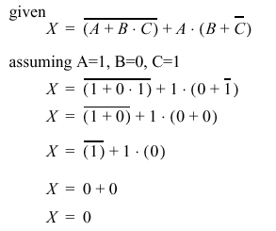
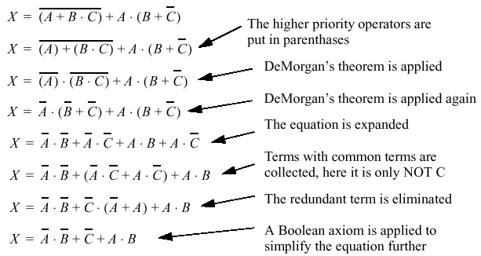
4.6 Implementation of Boolean equations using RLL and Electronic solid state logic gates
Example: Determine X ?
Example: Simplify;

Slide 14
4.6 Implementation of Boolean equations using RLL and Electronic solid state logic gates

Slide 15
4.6 Implementation of Boolean equations using RLL and Electronic solid state logic gates

Slide 16
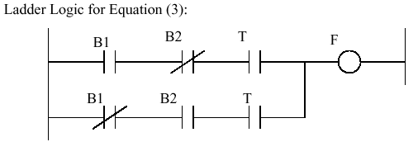
4.6 Implementation of Boolean equations using RLL and Electronic solid state logic gates

Slide 17
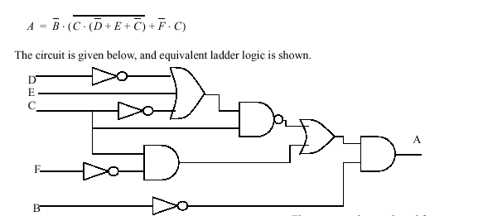
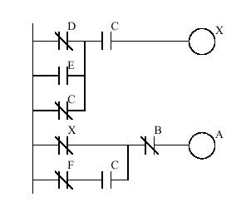
4.6 Implementation of Boolean equations using RLL and Electronic solid state logic gates
Example 6: given the following Boolean equation , sketch logic network and RLL

Slide 18
4.6 Logic network design
For a given logic control sequence or truth table, It is possible to produce the
Boolean Algebra expression using the following steps:
Construct a truth table for the design input/output relationship if not given.
For each true statement in an output, form the logic product (AND) of the inputs.
For each output have true statements, form the logic Sum (OR) of the logic product produced in step 2.

Slide 19
4.6 Logic network design

Slide 20
4.6 Combination and Sequential Networks

Slide 21
4.6 Combination and Sequential Networks
Input |  | Output
S | R | Q_{n+1} | Q_{n+1}
0 | 0 | Q_{n} | Q_{n}
0 | 1 | 0 | 1
1 | 0 | 1 | 0
1 | 1 | Not define | Not define

Slide 25
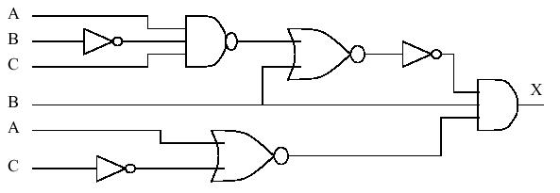
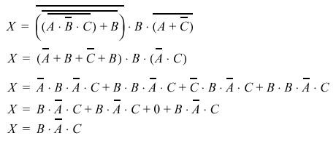
B A C
X

