Slide 1
Chapter 33 Problems
3,10,17,21,22,26,32,33,37

Slide 2
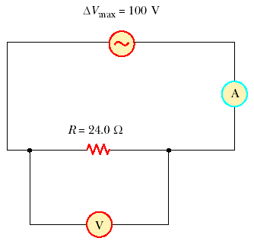
3. An AC power supply produces a maximum voltage ΔV_{max} = 100 V. This power supply is connected to a 24.0-Ω resistor, and the current and resistor voltage are measured with an ideal AC ammeter and voltmeter, as shown in Figure P33.3. What does each meter read? Note that an ideal ammeter has zero resistance and that an ideal voltmeter has infinite resistance.

Slide 4
10. An inductor has a 54.0-Ω reactance at 60.0 Hz. What is the maximum current if this inductor is connected to a 50.0-Hz source that produces a 100-V rms voltage?

Slide 5
17. What maximum current is delivered by an AC source with ΔV_{max} = 48.0 V and f = 90.0 Hz when connected across a 3.70-μF capacitor

Slide 6
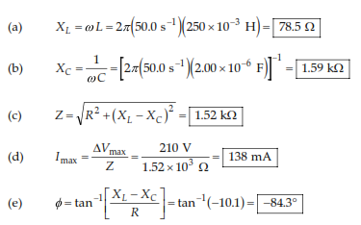
21. A series AC circuit contains the following components: R = 150 Ω, L = 250 mH, C = 2.00 μF and a source with ΔV_{max} = 210 V operating at 50.0 Hz. Calculate the (a) inductive reactance, (b) capacitive reactance, (c) impedance, (d) maximum current, and (e) phase angle between current and source voltage.

Slide 7
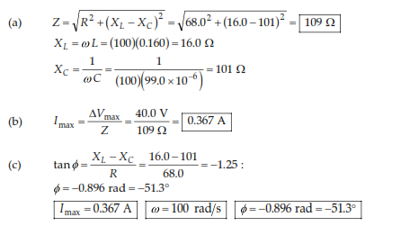
22. A sinusoidal voltage Δv(t) = (40.0 V) sin(100t) is applied to a series RLC circuit with L = 160 mH, C = 99.0 μF, and R = 68.0 Ω. (a) What is the impedance of the circuit? (b) What is the maximum current? (c) Determine the numerical values for I_{max}, ω, and φ in the equation i(t) = I_{max} sin(ωt – φ).

Slide 8
26. An AC source with ΔV_{max} = 150 V and f = 50.0 Hz is connected between points a and d in Figure P33.26. Calculate the maximum voltages between points (a) a and b, (b) b and c, (c) c and d, and (d) b and d.

Slide 9
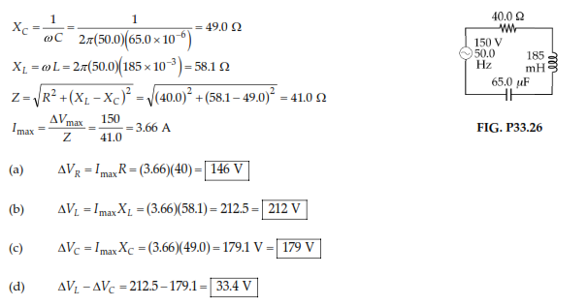

Slide 10
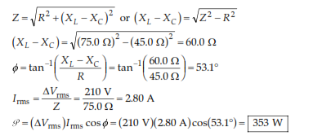
32. A series RLC circuit has a resistance of 45.0 Ω and an impedance of 75.0 Ω. What average power is delivered to this circuit when ΔV_{rms} = 210 V?

Slide 11
33. In a certain series RLC circuit, I_{rms} = 9.00 A, ΔV_{rms} = 180 V, and the current leads the voltage by 37.0°. (a) What is the total resistance of the circuit? (b) Calculate the reactance of the circuit (X_{L} – X_{C}).

Slide 12
37. An RLC circuit is used in a radio to tune into an FM station broadcasting at 99.7 MHz. The resistance in the circuit is 12.0 Ω, and the inductance is 1.40 μH. What capacitance should be used?

