Slide 1
Chapter 33 Examples
1,5,6,7

Slide 2
Example 33.1 What Is the r m s Current? The voltage output of an AC source is given by the expression Δv = (200 V) sin ꞷt. Find the r m s current in the circuit when this source is connected to a 100 Ω( resistor.

Slide 3
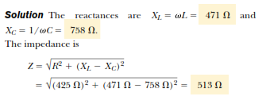
Example 33.5 Analyzing a Series RLC Circuit

Slide 4
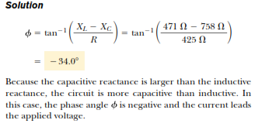

Slide 5
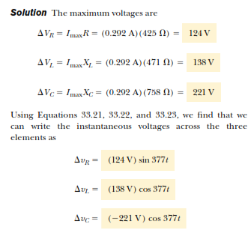

Slide 6
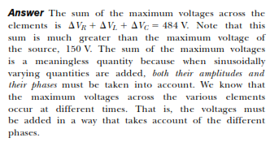

Slide 7
Example 33.6 Average Power in an RLC Series Circuit
Calculate the average power delivered to the series RLC circuit described in Example 33.5.

Slide 9
Example 33.7 A Resonating Series RLC Circuit

