Slide 1
Chapter 33 Alternating Current Circuits
33.1 AC Sources
33.2 Resistors in an AC Circuit
33.3 Inductors in an AC Circuit
33.4 Capacitors in an AC Circuit
33.5 The RLC Series Circuit
33.6 Power in an AC Circuit
33.7 Resonance in a Series RLC Circuit

Slide 2
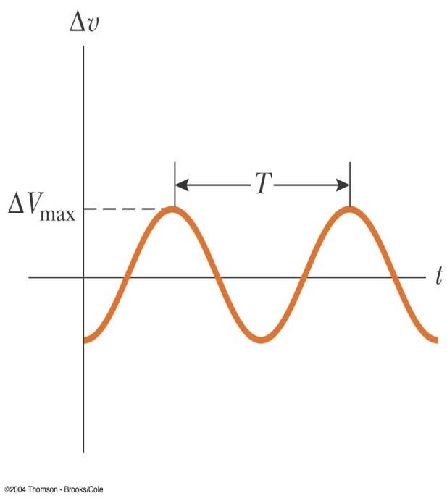
33.1 AC Sources
An AC circuit consists of a combination of circuit elements and a power source
The power source provides an alternative voltage, Δv
The output of an AC power source is sinusoidal and varies with time according to the following equation:
Δv = ΔV_{max} sin ωt
Δv is the instantaneous voltage
ΔV_{max} is the maximum output voltage of the source
Also called the voltage amplitude
ω is the angular frequency of the AC voltage
The angular frequency is
ƒ is the frequency of the source
T is the period of the source
The voltage is positive during one half of the cycle and negative during the other half

Slide 3
The current in any circuit driven by an AC source is an alternating current that varies sinusoidally with time
Sine waves are characterized by the amplitude and period. The amplitude is the maximum value of a voltage or current; the period is the time interval for one complete cycle.
The amplitude (A) of this sine wave is
A
20 V
50.0 μs
The period is
T
If the period is 50 μs, the frequency is
0.02 MHz = 20 kHz.

Slide 4
Sine waves
Sine waves are characterized by the amplitude and period. The amplitude is the maximum value of a voltage or current; the period is the time interval for one complete cycle.
The amplitude (A) of this sine wave is
A
20 V
The period is
50.0 μs
T

Slide 5
33.2 Resistors in an AC Circuit
Consider a circuit consisting of an AC source and a resistor
The AC source is symbolized by
Δv_{R} = Dv= V_{max} sin wt
Δv_{R} is the instantaneous voltage across the resistor
The instantaneous current in the resistor is
The instantaneous voltage across the resistor is also given as
Δv_{R} = I_{max} R sin ωt

Slide 6
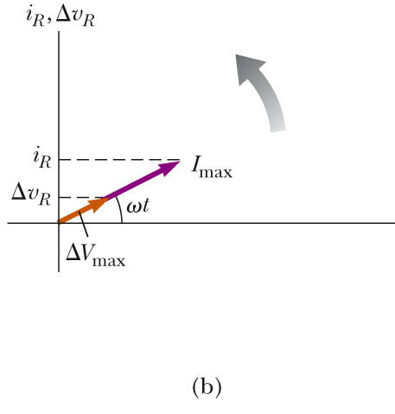
The graph shows the current through and the voltage across the resistor
The current and the voltage reach their maximum values at the same time
The current and the voltage are said to be in phase
For a sinusoidal applied voltage, the current in a resistor is always in phase with the voltage across the resistor
The direction of the current has no effect on the behavior of the resistor
Resistors behave essentially the same way in both DC and AC circuits
Phasor Diagram
To simplify the analysis of AC circuits, a graphical constructor called a phasor diagram can be used
A phasor is a vector whose length is proportional to the maximum value of the variable it represents

Slide 7
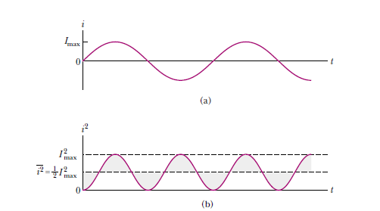
The vector rotates counterclockwise at an angular speed equal to the angular frequency associated with the variable
The projection of the phasor onto the vertical axis represents the instantaneous value of the quantity it represents
rms Current and Voltage
The average current in one cycle is zero
The rms current is the average of importance in an AC circuit
rms stands for root mean square
Alternating voltages can also be
discussed in terms of rms values

Slide 8
rms Current and Voltage
The average current in one cycle is zero
The rms current is the average of importance in an AC circuit
rms stands for root mean square
Alternating voltages can also be discussed in terms of rms values
rms values are used when discussing alternating currents and voltages because
AC ammeters and voltmeters are designed to read rms values

Slide 9
Example : For a particular device, the house ac voltage is 120-V and the ac current is 10 A. What are their maximum values?
I_{rms} = 0.707 i_{max}
V_{rms}= 0.707 V_{max}

Slide 10
Example
A 60 W light bulb operates on a peak voltage of 156 V. Find the V_{rms}, I_{rms}, and resistance of the light bulb.
V_{rms} = 110 V
I_{rms} = 0.55 A
R = 202 Ω
V_{rms} = 156 V / √2 = 110 V
I_{rms}: P = IV → 60 W = I (110V) → .55 A
P=V²/R → 60 W = (110 V)²/R → R = (110V)²/60W → 202 Ω
Notes:
V_{rms} = 156 V / √2 = 110 V
I_{rms}: P = IV → 60 W = I (110V) → .55 A
P=V²/R → 60 W = (110 V)²/R → R = (110V)²/60W → 202 ΩV_{rms} = 156 V / √2 = 110 V
I_{rms}: P = IV → 60 W = I (110V) → .55 A
P=V²/R → 60 W = (110 V)²/R → R = (110V)²/60W → 202 Ω

Slide 11
Power
The rate at which electrical energy is dissipated in the circuit is given by
P = i ² R
i is the instantaneous current
The heating effect produced by an AC current with a maximum value of I_{max} is not the same as that of a DC current of the same value
The maximum current occurs for a small amount of time
The average power delivered to a resistor that carries an alternating current is
Example:
Assume a sine wave with a peak value of 40 V is applied to a 100 Ω resistive load. What power is dissipated?
V_{rms} = 0.707 x V_{p} = 0.707 x 40 V = 28.3 V
8 W

Slide 12
Example 33.1 What Is the rms Current?

Slide 13
1- A heater takes 10 A rms from the 230 V rms mains. What is its power?
A) 1630 W
2300 W
3250 W
D) 4600 W
2- The voltage output of an AC source is given by the expression :
v = (200 V) sin wt. Find the rms current in the circuit when this source is connected to a 100-Ωresistor.

Slide 14
33-3 Inductors in an AC Circuit
Kirchhoff’s loop rule can be applied and gives:

Slide 15
Current in an Inductor
The equation obtained from Kirchhoff's loop rule can be solved for the current
This shows that the instantaneous current i_{L} in the inductor and the instantaneous voltage Δv_{L} across the inductor are out of phase by (π/2) rad = 90º

Slide 16
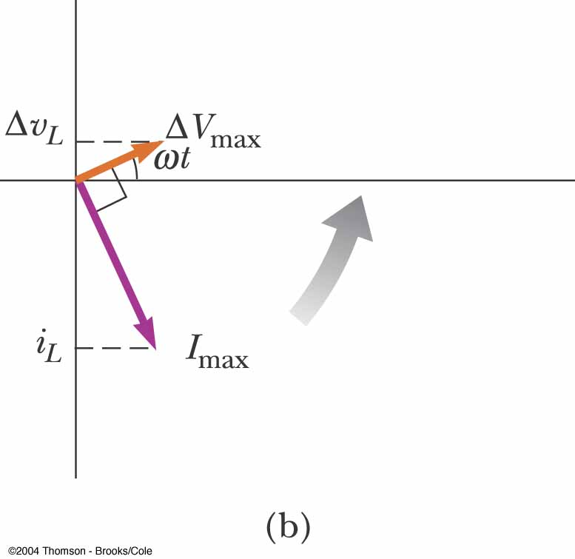
Phase Relationship of Inductors in an AC Circuit
The current is a maximum when the voltage across the inductor is zero
The current is momentarily not changing
For a sinusoidal applied voltage, the current in an inductor always lags behind the voltage across the inductor by 90° (π/2)
Phasor Diagram for an Inductor
The phasors are at 90º with respect to each other
This represents the phase difference between the current and voltage
Specifically, the current always lags behind the voltage by 90º

Slide 17
Inductive Reactance
The factor ωL has the same units as resistance and is related to current and voltage in the same way as resistance
Because ω depends on the frequency, it reacts differently, in terms of offering resistance to current, for different frequencies
The factor X_{L} is the inductive reactance and is given by:
X_{L} = ωL

Slide 18
Inductive Reactance, cont.
Current can be expressed in terms of the inductive reactance
As the frequency increases, the inductive reactance increases
This is consistent with Faraday’s Law:
The larger the rate of change of the current in the inductor, the larger the back emf, giving an increase in the reactance and a decrease in the current

Slide 19
Example 33.2 A Purely Inductive AC Circuit
In a purely inductive AC circuit, L = 25.0 mH and the rms voltage is 150 V. Calculate the inductive reactance and rms current in the circuit if the frequency is 60.0 Hz.
What if the frequency increases to 6.00 kHz? What happens to the rms current in the circuit?

Slide 20
Example : A coil having an inductance of 0.6 H is connected to a 120-V, 60 Hz ac source. Neglecting resistance, what is the effective current(I_{rms}) through the coil?
Reactance: X_{L} = 2πfL
L = 0.6 H
X_{L} = 2π(60 Hz)(0.6 H)
A
V
X_{L} = 226 Ω
120 V, 60 Hz
i_{eff} = 0.531 A
Show that the peak current is I_{max} = 0.750 A

Slide 21
33.4 Capacitors in an AC Circuit
The circuit contains a capacitor and an AC source
Kirchhoff’s loop rule gives:
Δv + Δv_{c} = 0 and so
Δv = Δv_{C} = ΔV_{max} sin ωt
Δv_{c} is the instantaneous voltage across the capacitor
q = C V [ V=Vmax sin(wt) ]
The charge is q = C ΔV_{max} sin ωt
The instantaneous current is given by
The current is π/2 rad = 90º out of phase with the voltage
Take derivative: i_{c} = dq/dt = C dV/dt

Slide 22
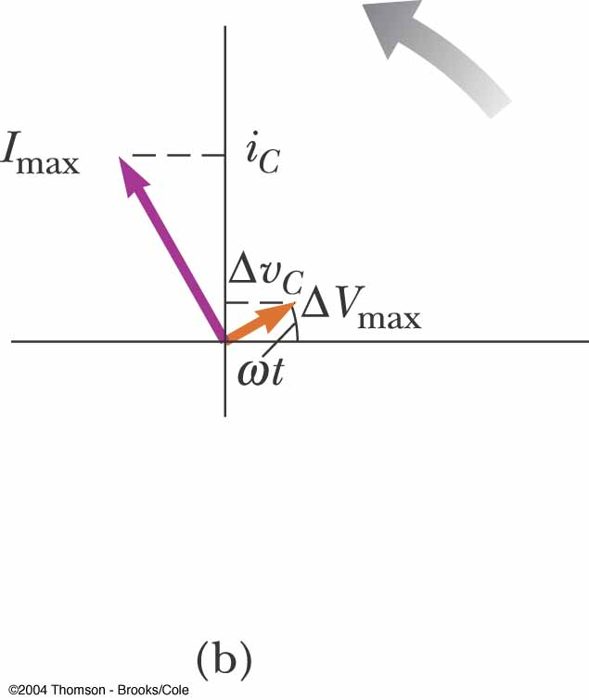
The current reaches its maximum value one quarter of a cycle sooner than the voltage reaches its maximum value
The current leads the voltage by 90º
Phasor Diagram for Capacitor
The phasor diagram shows that for a sinusoidally applied voltage, the current always leads the voltage across a capacitor by 90º

Slide 23
Capacitive Reactance
The maximum current in the circuit occurs at cos ωt = 1 which gives
The impeding effect of a capacitor on the current in an AC circuit is called the capacitive reactance and is given by

Slide 24
Voltage Across a Capacitor
The instantaneous voltage across the capacitor can be written as Δv_{C} = ΔV_{max} sin ωt = I_{max} X_{C} sin ωt
As the frequency of the voltage source increases, the capacitive reactance decreases and the maximum current increases
As the frequency approaches zero, X_{C} approaches infinity and the current approaches zero
This would act like a DC voltage and the capacitor would act as an open circuit

Slide 25
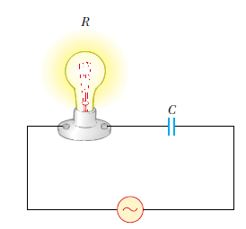
Quick Quiz
Consider the AC circuit in the Figure .The frequency of the AC source is adjusted while its voltage amplitude is held constant. The lightbulbwill glow the brightest at;
a)high frequencies
b)low frequencies
c)The brightness will be same at all frequencies.

Slide 26
Example :A 2-μF capacitor is connected to a 120-V, 60 Hz ac source. Neglecting resistance, what is the effective current through the Capacitor?
C = 2 μF
Reactance:
A
V
120 V, 60 Hz
X_{C} = 1330 Ω
i_{eff} = 90.5 mA
Show that the peak current is i_{max} = 128 mA

Slide 27
Example
What are the peak and rms currents of a circuit if
C = 1.0 μF and V_{rms} = 120 V. The frequency is 60.0 Hz.
X_{C} = 1 = 1
2 π fC 2π(60 Hz)(1.0 X 10⁻⁶F)
X_{C} = 2700 Ω
V_{rms} = V_{max} /√2
V_{max}= V_{rms}√2
V_{max} = (120 V)(√2) = 170 V
I_{max} = V_{max}/X_{C}
I_{max} = 170 V/2700 Ω
I_{max} = 63 mA
I_{rms} = V_{rms}/X_{C}
I_{rms} = 120 V/2700 Ω = 44 mA

Slide 28
Example A Purely Capacitive AC Circuit
An 8.00μF capacitor is connected to the terminals of a 60.0-Hz AC source whose rms voltage is 150 V. Find the capacitive reactance and the rms current in the circuit
What if the frequency is doubled? What happens to the rms current in the circuit?
If the frequency increases, the capacitive reactance decreases—just the opposite as in the case of an inductor. The decrease in capacitive reactance results in an increase in the current. Let us calculate the new capacitive reactance

Slide 29
The RLC Series Circuit
The resistor, inductor, and capacitor can be combined in a circuit
The current and the voltage in the circuit vary sinusoidally with time

Slide 30
The RLC Series Circuit, cont.
The instantaneous voltage would be given by Δv = ΔV_{max} sin ωt
The instantaneous current would be given by i = I_{max} sin (ωt - φ)
φ is the phase angle between the current and the applied voltage
Since the elements are in series, the current at all points in the circuit has the same amplitude and phase

Slide 31
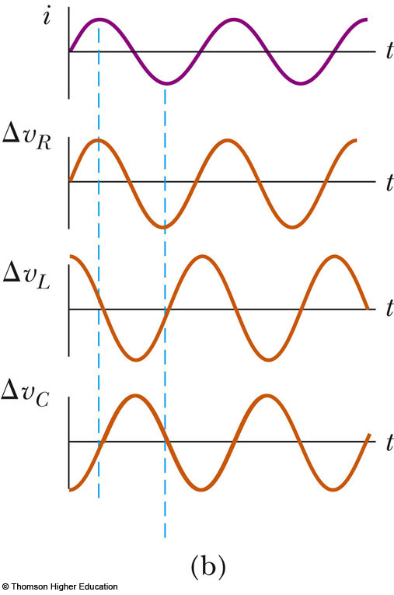
i and v Phase Relationships – Graphical View
The instantaneous voltage across the resistor is in phase with the current
The instantaneous voltage across the inductor leads the current by 90°
The instantaneous voltage across the capacitor lags the current by 90°

Slide 32
i and v Phase Relationships – Equations
The instantaneous voltage across each of the three circuit elements can be expressed as

Slide 33
More About Voltage in RLC Circuits
ΔV_{R} is the maximum voltage across the resistor and ΔV_{R} = I_{max}R
ΔV_{L} is the maximum voltage across the inductor and ΔV_{L} = I_{max}X_{L}
ΔV_{C} is the maximum voltage across the capacitor and ΔV_{C} = I_{max}X_{C}
The sum of these voltages must equal the voltage from the AC source
Because of the different phase relationships with the current, they cannot be added directly

Slide 34
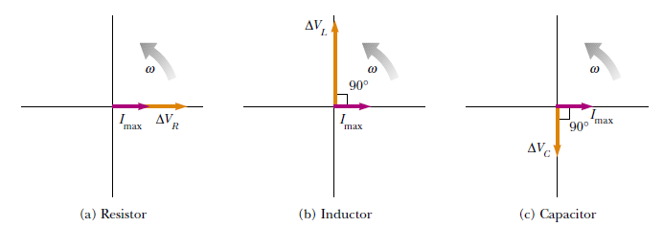
Phasor Diagrams
To account for the different phases of the voltage drops, vector techniques are used
Remember the phasors are rotating vectors
The phasors for the individual elements are shown

Slide 35
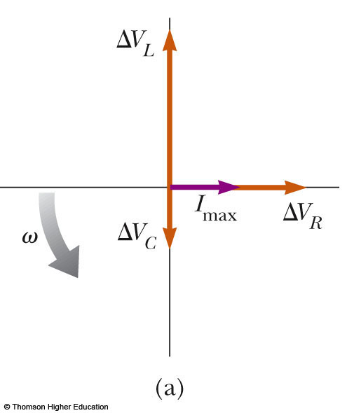
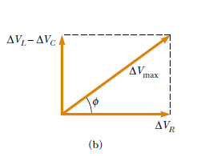
Resulting Phasor Diagram
The individual phasor diagrams can be combined
Here a single phasor I_{max} is used to represent the current in each element
In series, the current is the same in each element

Slide 36
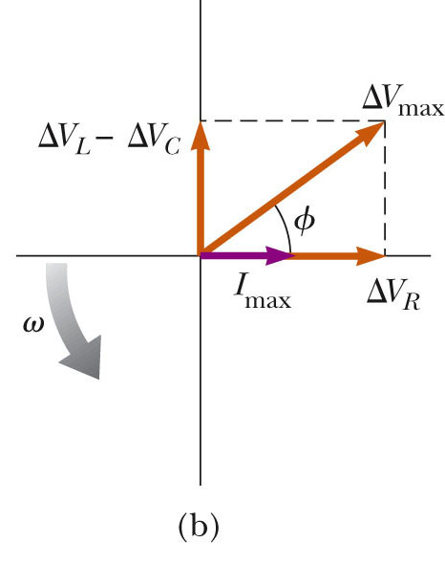
Vector Addition of the Phasor Diagram
Vector addition is used to combine the voltage phasors
ΔV_{L} and ΔV_{C} are in opposite directions, so they can be combined
Their resultant is perpendicular to ΔV_{R}

Slide 37
Total Voltage in RLC Circuits
From the vector diagram, ΔV_{max} can be calculated

Slide 38
Impedance
The current in an RLC circuit is
Z is called the impedance of the circuit and it plays the role of resistance in the circuit, where
Impedance has units of ohms
Phase Angle
The right triangle in the phasor diagram can be used to find the phase angle, φ
The phase angle can be positive or negative and determines the nature of the circuit

Slide 39
Determining the Nature of the Circuit
If φ is positive
X_{L}> X_{C} (which occurs at high frequencies)
The current lags the applied voltage
The circuit is more inductive than capacitive
If φ is negative
X_{L}< X_{C} (which occurs at low frequencies)
The current leads the applied voltage
The circuit is more capacitive than inductive
If φ is zero
X_{L}= X_{C}
The circuit is purely resistive

Slide 40
Power in an AC Circuit
The average power delivered by the AC source is converted to internal energy in the resistor
℘_{av} = ½ I_{max} ΔV_{max} cos φ = I_{rms}ΔV_{rms} cos φ
cos φ is called the power factor of the circuit
We can also find the average power in terms of R
℘_{av} = I²_{rms}R

Slide 41
Power in an AC Circuit, cont.
The average power delivered by the source is converted to internal energy in the resistor
No power losses are associated with pure capacitors and pure inductors in an AC circuit
In a capacitor, during one-half of a cycle, energy is stored and during the other half the energy is returned to the circuit and no power losses occur in the capacitor
In an inductor, the source does work against the back emf of the inductor and energy is stored in the inductor, but when the current begins to decrease in the circuit, the energy is returned to the circuit

Slide 42
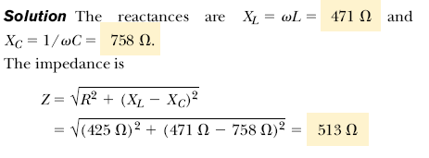
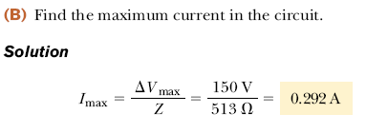

Slide 43
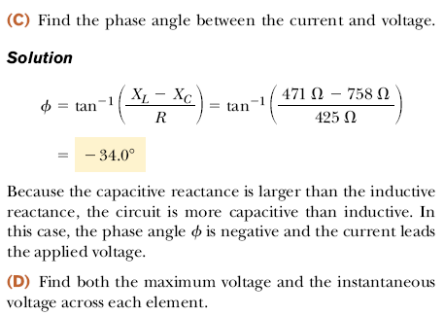
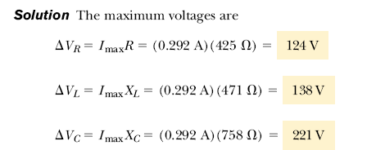

Slide 44
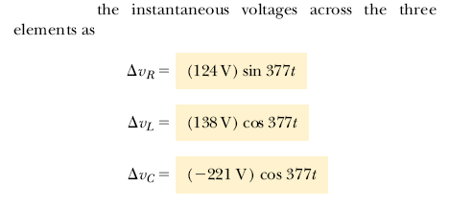

Slide 45
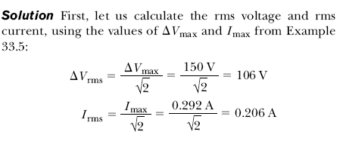
Calculate the average power delivered to the series RLC
circuit described in Example 33.5.

Slide 46
Example
A circuit has R=25.0 Ω, L = 30.0 mH, and C = 12.0 μF. Calculate the impedance of the circuit if they are connected to a 90.0 V ac(rms), 500 Hz source. Also calculate the phase angle.
X_{L} = 2πfL
X_{L} = 2π(500 Hz)(0.030 H) = 94.2 Ω
X_{C} = 1/2πfC
X_{C} = 1/2π(500 Hz)(12 X 10⁻⁶F) = 26.5 Ω

Slide 47
Z = √R² + (X_{L} – X_{C})²
Z = √(25.0Ω)² + (94.2 Ω – 26.5 Ω)²
Z = 72.2 Ω
tan φ = X_{L} – X_{C}
R
tan φ = 94.2 Ω – 26.5 Ω
25.0 Ω
φ = 69.7º

Slide 48
Calculate the rms current
V = IZ
I_{rms} = V_{rms}/Z = 90.0 V/ 72.2 Ω
I_{rms} = 1.25 A
Calculate the voltage drop across each element
(V_{R})_{rms} = I_{rms}R = (1.25 A)(25.0 Ω) = 31.2 V
(V_{L})_{rms} = I_{rms}X_{L} = (1.25 A)(94.2 Ω) = 118 V
(V_{C})_{rms} = I_{rms}X_{C} = (1.25 A)(26.5 Ω) = 33.1 V
Voltages do not add to 90.0 V (out of phase)
Calculate the power loss in the circuit
P_{ave} = I_{rms}V_{rms}cosφ
P_{ave} = (1.25 A)(90.0 V)cos(69.7º)
P_{ave} = 39.0 W

Slide 49
33.7 Resonance in a Series RLC Circuit
Resonance occurs at the angular frequency ω_{o} where the current has its maximum value
To achieve maximum current, the impedance must have a minimum value
This occurs when X_{L} = X_{C}
The Resonance frequency
Solving for the angular frequency gives

Slide 50
Calculating Total Source Voltage
Source voltage
Treating as vectors, we find:
V_{T}
V_{L} - V_{C}
θ
V_{R}
Now recall that:
V_{R} = iR; V_{L} = iX_{L}; and V_{C} = iV_{C}
Substitution into the above voltage equation gives:

Slide 51
Impedance in an AC Circuit
Impedance
Z
X_{L} - X_{C}
φ
Impedance Z is defined:
R
Ohm’s law for ac current and impedance:
The impedance is the combined opposition to ac current consisting of both resistance and reactance.

Slide 52
Example : A 60-Ω resistor, a 0.5 H inductor, and an 8-μF capacitor are connected in series with a 120-V, 60 Hz ac source. Calculate the impedance for this circuit.
0.5 H
A
8 μF
120 V
60 Hz
60 Ω
Thus, the impedance is:
Z = 122 Ω

Slide 53
Example : Find the effective current (I_{rms}) and the phase angle for the previous example.
X_{L} = 226 Ω; X_{C} = 332 Ω;
R = 60 Ω; Z = 122 Ω
0.5 H
A
8 μF
I_{rms} = 0.985 A
120 V
Next we find the phase angle:
60 Hz
60 Ω
Impedance
X_{L} – X_{C} = 226 – 332 = -106 Ω
Z
X_{L} - X_{C}
φ
R = 60 Ω
R

Slide 54
Example :Find the phase angle φ for the previous example.
60 Ω
X_{L} – X_{C} = 226 – 332 = -106 Ω
φ
-106 Ω
Z
R = 60 Ω
φ = -60.5⁰
The negative phase angle means that the ac voltage lags the current by 60.5⁰. This is known as a capacitive circuit.

Slide 55
Example : Find the resonant frequency for the previous circuit example: L = .5 H, C = 8 μF
Resonance X_{L} = X_{C}
0.5 H
A
8 μF
120 V
Resonant f_{r} = 79.6 Hz
? Hz
60 Ω
At resonant frequency, there is zero reactance (only resistance) and the circuit has a phase angle of zero.

Slide 56
Power in an AC Circuit
No power is consumed by inductance or capacitance. Thus power is a function of the component of the impedance along resistance:
Impedance
In terms of ac voltage:
Z
X_{L} - X_{C}
P =I_{rms}V_{rms}cos φ
φ
In terms of the resistance R:
R
P lost in R only
P = i_{rms}²R
The fraction Cos φ is known as the power factor.

Slide 57
Example : What is the average power loss for the previous example: V = 120 V, φ = -60.5⁰, I_{rms} = 90.5 A, and R = 60Ω .
P = i²R = (0.0905 A)²(60 Ω)
Resonance X_{L} = X_{C}
0.5 H
Average P = 0.491 W
A
8 μF
The power factor is: Cos 60.5⁰
120 V
Cos φ = 0.492 or 49.2%
? Hz
60 Ω
The higher the power factor, the more efficient is the circuit in its use of ac power.

Slide 58
Example:
A radio tunes in a station at 980 kHz at a capacitance of 3 μF. What is the inductance of the circuit?
X_{c=⅟ 2π f c}
X _{C} =1/2x3.14x980x10³x3x10⁻⁶
ANS: 8.8 X 10 ⁻⁹ H or 8.8 pH

