Slide 1
Chapter 32 Examples
1,2

Slide 2
Example 32.1 Find the inductance of a uniformly wound solenoid having N turns and length ℓ. Assume that ℓ is much longer than the
radius of the windings and that the core of the solenoid is air.

Slide 3
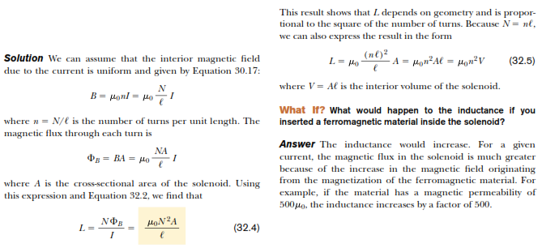

Slide 4
Example 2
(A) Calculate the inductance of an air-core solenoid containing 300 turns if the length of the solenoid is 25.0 cm and its cross-sectional area is 4.00 cm
(B) Calculate the self-induced emf in the solenoid if the current it carries is decreasing at the rate of 50.0 A/s.

Slide 5
