Slide 1
Chapter 31 Problems
2,5,13,20

Slide 2
2. A flat loop of wire consisting of a single turn of cross-sectional area 8.00 cm² is perpendicular to a magnetic field that increases uniformly in magnitude from 0.500 T to 2.50 T in 1.00 s. What is the resulting induced current if the loop has a resistance of 2.00 Ω?

Slide 3
5. A strong electromagnet produces a uniform magnetic field of 1.60 T over a cross-sectional area of 0.200 m². We place a coil having 200 turns and a total resistance of 20.0 Ω around the electromagnet. We then smoothly reduce the current in the electromagnet until it reaches zero in 20.0 ms. What is the current induced in the coil?

Slide 4
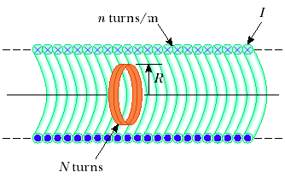
13. A long solenoid has 400 turns per meter and carries a current given by
I = (30.0 A)(1 – e ^{– 1.60 t} ). Inside the solenoid and coaxial with it is a coil that has a radius of 6.00 cm and consists of a total of 250 turns of fine wire (Fig. P31.13). What emf is induced in the coil by the changing current?

Slide 5
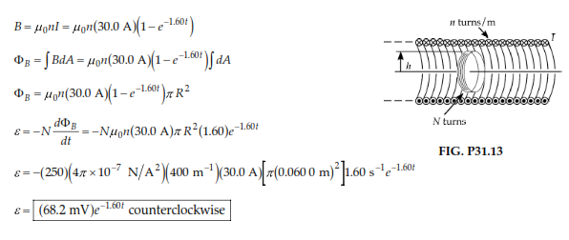

Slide 6
20. Consider the arrangement shown in Figure P31.20. Assume that R = 6.00 Ω, ℓ = 1.20 m, and a uniform 2.50-T magnetic field is directed into the page. At what speed should the bar be moved to produce a current of 0.500 A in the resistor?

