Slide 1
Chapter 31 Examples
1,5

Slide 2
Example 31.1 A coil consists of 200 turns of wire. Each turn is a square of side 18 cm, and a uniform magnetic field directed perpendicular to the plane of the coil is turned on. If the field changes linearly from 0 to 0.50 T in 0.80 s, what is the magnitude of the induced emf in the coil while the field is changing?

Slide 3
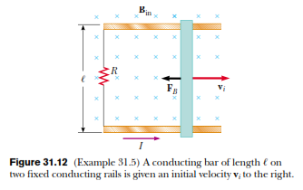
Example 31.5 The conducting bar illustrated in Figure 31.12 moves on two frictionless parallel rails in the presence of a uniform magnetic ﬁeld directed into the page. The bar has mass m and its length is !. The bar is given an initial velocity v to the right and is released at t " 0.
(A) Using Newton’s laws, ﬁnd the velocity of the bar as a function of time.
(B) Show that the same result is reached by using an energy approach.

Slide 4
Solution (A) Conceptualize this situation as follows. As the bar slides to the right in Figure 31.12, a counterclockwise current is established in the circuit consisting of the bar, the rails, and the resistor. The upward current in the bar results in a magnetic force to the left on the bar as shown in the ﬁgure. As a result, the bar will slow down, so our mathematical solution should demonstrate this. The text of part (A) already categorizes this as a problem in using Newton’s laws. To analyze the problem, we determine from Equation 29.3 that the magnetic force is F _{B} = -I ℓ B, where the negative sign indicates that the retarding force is to the left. Because this is the only horizontal force acting on the bar, Newton’s second law applied to motion in the horizontal direction F_{x} = ma = m dv/dt = - I ℓ B

Slide 5
