Slide 1
Chapter 30 Examples
4,8

Slide 2
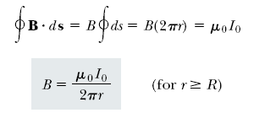
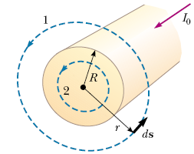
Let us choose for our path of integration circle 1 in Figure …From symmetry, B must be constant in magnitude and parallel to ds at every point on this circle. Because the total current passing through the plane of the circle is I₀, Ampère’s law gives
Now consider the interior of the wire, where r <R. Here the current I passing through the plane of circle 2 is less than the total current I ₀ . Because the current is uniform over the cross-section of the wire, the fraction of the current enclosed by circle 2 must equal the ratio of the area r ² enclosed by circle 2 to the cross-sectional area R² of the wire:
Notes:
Figure 30.12 (Example 30.4) A long, straight wire of radius R carrying a steady current I uniformly distributed across the cross section of the wire. The magnetic field at any point can be calculated from Ampère’s law using a circular path of radius r, concentric with the wire.

Slide 3
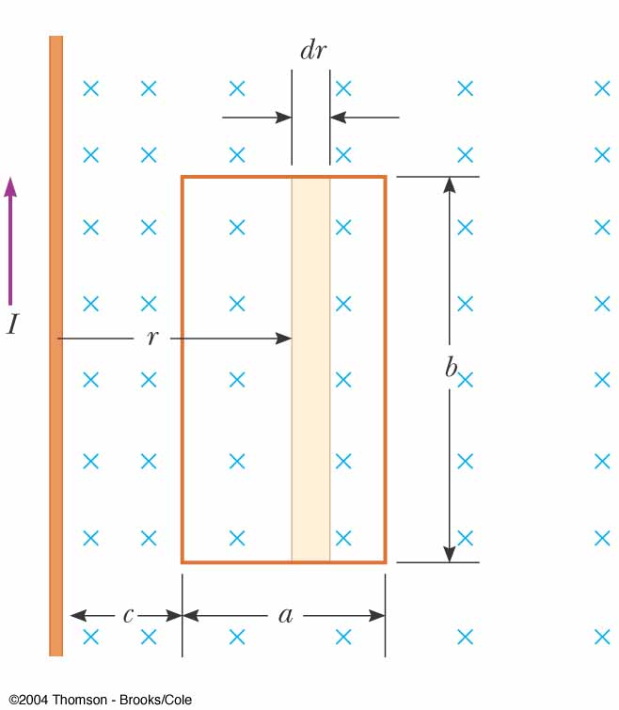
A rectangular loop of width a and length b is located near a long wire carrying a current I (Fig. 30.21). The distance between the wire and the closest side of the loop is c . The wire is parallel to the long side of the loop. Find the total magnetic flux through the loop due to the current in the wire.
Because B is parallel to dA at any point within the loop, the magnetic flux through an area element dA is
Fig 30-22, p.941
Notes:
Figure 30.22 (Example 30.8) The magnetic field due to the wire carrying a current I is not uniform over the rectangular loop.

