Slide 1
Chapter 30 Sources of the Magnetic Field
30.1 The Biot–Savart Law
30.2 The Magnetic Force Between Two Parallel Conductors
30.3 Ampere's Law
30.4 The Magnetic Field of a Solenoid
30.5 Magnetic Flux
30.6 Gauss’s Law in Magnetism

Slide 2
30.1 The Biot–Savart Law
Jean-Baptiste Biot (1774–1862) and Félix Savart (1791–1841) performed quantitative experiments on the force exerted by an electric current on a nearby magnet.
• The vector dB is perpendicular both to ds (which points in the direction of the current) and to the unit vector directed from ds to P.
• The magnitude of dB is inversely proportional to r², where r is the distance from ds to P.
• The magnitude of dB is proportional to the current and to the magnitude ds of the length element ds.
• The magnitude of dB is proportional to sin θ , where θ is the angle between the vectors ds and ˆr.
The magnetic field dB at a point due to the current I through a length element ds is given by the Biot–Savart law. The direction of the field is out of the page at P and into the page at P /
Notes:
Figure 30.1 The magnetic field dB at a point due to the current I through a length element ds is given by the Biot–Savart law. The direction of the field is out of the page at P and into the page at P.

Slide 3
To find the total magnetic field B created at some point by a current of finite size, we must sum up contributions from all current elements Ids that make up the current. That is, we must evaluate B by integrating Equation 30.1

Slide 4
Consider a thin, straight wire carrying a constant current I
and placed along the x axis as shown in Figure …. Determine the magnitude and direction of the magnetic field at point P due to this current
Notes:
Figure 30.3 (Example 30.1) (a) A thin, straight wire carrying a current I. The magnetic field at point P due to the current in each element ds of the wire is out of the page, so the net field at point P is also out of the page. (b) The angles 1 and 2 used for determining the net field. When the wire is infinitely long, 1 0 and 2 180°.

Slide 5
The right-hand rule for determining the direction of the magnetic field surrounding a long, straight wire carrying a current. Note that the magnetic field lines form circles around the wire.
Notes:
Figure 30.4 The right-hand rule for determining the direction of the magnetic field surrounding a long, straight wire carrying a current. Note that the magnetic field lines form circles around the wire.

Slide 6
(a) Magnetic field lines surrounding a current loop. (b) Magnetic field lines surrounding a current loop, displayed with iron filings. (c) Magnetic field lines surrounding a bar magnet. Note the similarity between this line pattern and that of a current loop
Notes:
Figure 30.7 (Example 30.3) (a) Magnetic field lines surrounding a current loop. (b) Magnetic field lines surrounding a current loop, displayed with iron filings. (c) Magnetic field lines surrounding a bar magnet. Note the similarity between this line pattern and that of a current loop. © Richard Megna, Fundamental Photographs

Slide 7
Example A vertical electric wire in the wall of a building carries a current of 25 A upward. What is the magnetic field at a point 10 cm due north of this wire?
up
Let’s make north be to the left in this picture, and up be up.
I=25 A
N
According to the right hand rule, the magnetic field is to the west, coming out of the plane of the “paper.”
d=0.1 m
B
To calculate the magnitude, B:

Slide 8
example
Two infinitely long wires form the x and y axis of a 2D coordinate system. They each carry current as shown. What is the magnetic field at a point P (2.0 m, 2.0 m)?
7×10⁻⁷ T into the page
7×10⁻⁷ T out of the page
1×10⁻⁷ T into the page
1×10⁻⁷ T out of the page
0
I₁ = 3.0 A
• P
I₂ = 4.0 A

Slide 9
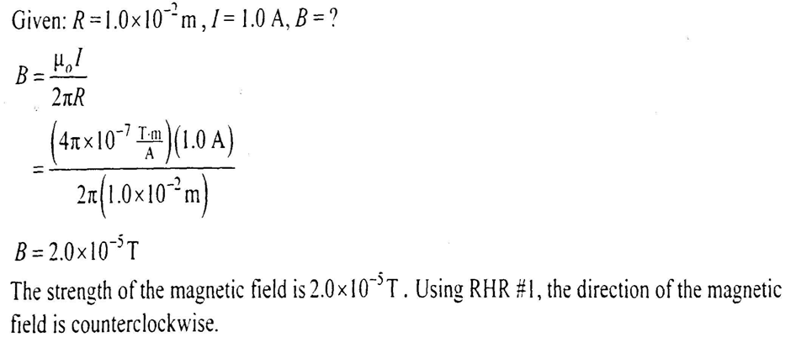

Slide 10
30.2 The Magnetic Force Between Two Parallel Conductors
Consider two long, straight, parallel wires separated by a distance a and carrying currents I₁ and I₂ in the same direction
We can determine the force exerted on one wire due to the magnetic field set up by the other wire.
RHR-
Fingers along B
Thumb along v
Palm shows F
parallel conductors carrying currents in the same direction attract each other, and parallel conductors carrying currents in opposite directions repel each other.
Notes:
Active Figure 30.8 Two parallel wires that each carry a steady current exert a force on each other. The field B2 due to the current in wire 2 exerts a force of magnitude F1 I1B2 on wire 1. The force is attractive if the currents are parallel (as shown) and repulsive if the currents are antiparallel.

Slide 11
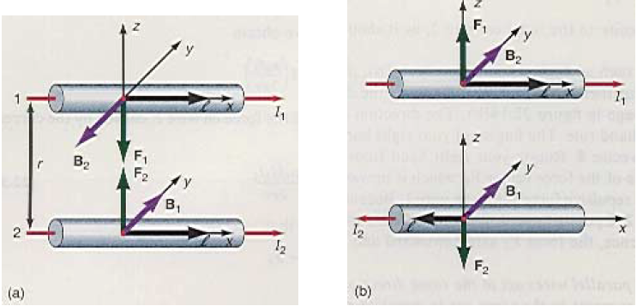

Slide 12
Because the magnitudes of the forces are the same on both wires, we denote the magnitude of the magnetic force between the wires as simply F_{B} .
Force per unit length:
Definition of the Ampere
When the magnitude of the force per unit length between two long parallel wires that carry identical currents and are separated by 1 m is 2 x 10⁻⁷ N/m, the current in each wire is defined to be 1 A
Definition of the Coulomb
The SI unit of charge, the coulomb, is defined in terms of the ampere
When a conductor carries a steady current of 1 A, the quantity of charge that flows through a cross section of the conductor in 1 s is 1 C
Notes:
Andre-Marie Ampère French Physicist (1775–1836) Ampère is credited with the discovery of electromagnetism— the relationship between electric currents and magnetic fields. Ampère’s genius, particularly in mathematics, became evident by the time he was 12 years old; his personal life, however, was filled with tragedy. His father, a wealthy city official, was guillotined during the French Revolution, and his wife died young, in 1803. Ampère died at the age of 61 of pneumonia. His judgment of his life is clear from the epitaph he chose for his gravestone: Tandem Felix (Happy at Last).

Slide 13
example
Two very long straight, parallel wires have currents I running through them as shown in the figure. The force on wire 2 due to wire 1 is:
Down
Up
Into the page
Out of the page
I₁
d
F
I₂
B₁
Magnetic field by 1 at location of wire 2 is out of the page.
Force on I₂ by B₁ is up.
Parallel currents: attraction
Antiparallel currents: repulsion

Slide 14
30.3 Ampere's Law
Because the compass needles point in the direction of B, we conclude that the lines of B form circles around the wire,
the magnitude of B is the same everywhere on a circular path centered on the wire and lying in a plane perpendicular to the wire.
By varying the current and distance a from the wire, we find that B is proportional to the current and inversely proportional to the distance from the wire,
Notes:
Active Figure 30.9 (a) When no current is present in the wire, all compass needles point in the same direction (toward the Earth’s north pole). (b) When the wire carries a strong current, the compass needles deflect in a direction tangent to the circle, which is the direction of the magnetic field created by the current. (c) Circular magnetic field lines surrounding a current-carrying conductor, displayed with iron filings.

Slide 15
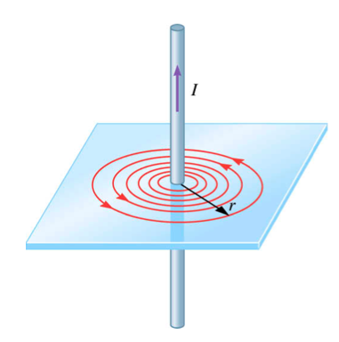
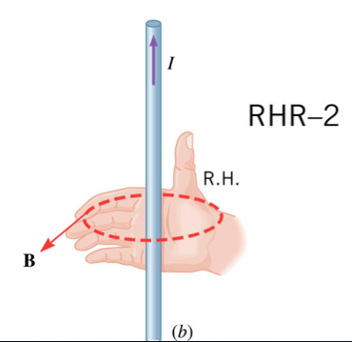

Slide 16
Ampere's law describes the creation of magnetic fields by all continuous current configurations, but at our mathematical level it is useful only for calculating the magnetic field of current configurations having a high degree of symmetry. Its use is similar to that of Gauss’s law in calculating electric fields for highly symmetric charge distributions.
I₁
If your path includes more than one source of current, add all the currents (with correct sign).
I₂
ds

Slide 17
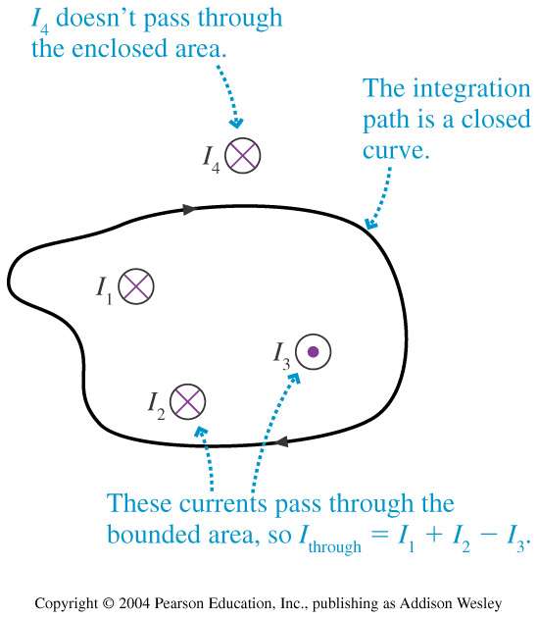
I
B
I
I
B
I

Slide 18
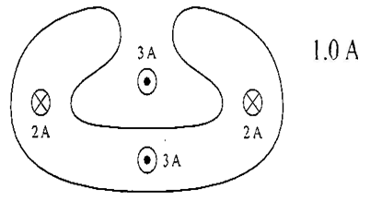
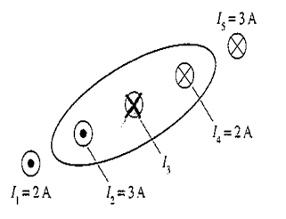
Example:
1A into the page
Example:
I₃ = 3A into the page

Slide 19
Example:
Use Ampere’s Law to find B near a very long, straight wire. B is independent of position along the wire and only depends on the distance from the wire (symmetry).
i
r
i
By symmetry
Suppose
i = 10 A
r = 10 cm

Slide 20
Draw the magnetic field vector at each dot. Show relative size with arrow length if possible:
Example:

Slide 21
Example
Interaction between current-carrying wires
2 parallel wires A & B, carry the same size of current.
(a) Draw a few magnetic field lines due to the current through wire A.
•
•
A
B

Slide 22
Example
Interaction between current-carrying wires
2 parallel wires A & B, carry the same size of current.
field at B due to current through A
•
•
A
B
(b) Mark the direction of this magnetic field at wire B with an arrow.

Slide 23
Example
Interaction between current-carrying wires
2 parallel wires A & B, carry the same size of current.
magnetic force
field at B due to current through A
•
•
A
B
(c) Mark the direction of magnetic force acting on B due to magnetic field of the current through A.

Slide 24
Example
Interaction between current-carrying wires
2 parallel wires A & B, carry the same size of current.
magnetic force
field at B due to current through A
•
•
field at A due to current through B
A
B
(d) Deduce the direction of magnetic force acting on A due to magnetic field of the current through B.

Slide 25
Example
Interaction between current-carrying wires
2 parallel wires A & B, carry same size of current.
magnetic force
field at B due to current through A
•
•
field at A due to current through B
A
B
(e) Do A & B attract or repel each other?
They attract each other.

Slide 26
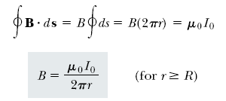
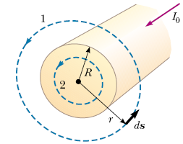
Let us choose for our path of integration circle 1 in Figure …From symmetry, B must be constant in magnitude and parallel to ds at every point on this circle. Because the total current passing through the plane of the circle is I₀, Ampère’s law gives
Now consider the interior of the wire, where r <R. Here the current I passing through the plane of circle 2 is less than the total current I ₀ . Because the current is uniform over the cross-section of the wire, the fraction of the current enclosed by circle 2 must equal the ratio of the area r ² enclosed by circle 2 to the cross-sectional area R² of the wire:
Notes:
Figure 30.12 (Example 30.4) A long, straight wire of radius R carrying a steady current I uniformly distributed across the cross section of the wire. The magnetic field at any point can be calculated from Ampère’s law using a circular path of radius r, concentric with the wire.

Slide 27
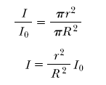
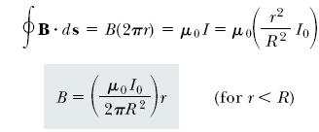
Fig 30-13, p.936
Notes:
Figure 30.13 (Example 30.4) Magnitude of the magnetic field versus r for the wire shown in Figure 30.12. The field is proportional to r inside the wire and varies as 1/r outside the wire.

Slide 28
30.4 The Magnetic Field of a Solenoid
A solenoid is a long wire wound in the form of a helix. With this configuration, a reasonably uniform magnetic field can be produced in the space surrounded by the turns of wire—which we shall call the interior of the solenoid—when the solenoid carries a current.
* The magnetic field lines for a loosely wound solenoid.
the field lines in the interior are nearly parallel to one another, are uniformly distributed, and are close together, indicating that the field in this space is uniform and strong.
The field lines between current elements on two adjacent turns tend to cancel each other because the field vectors from the two elements are in opposite directions.
The field at exterior points such as P is weak because the field due to current elements on the right-hand portion of a turn tends to cancel the field due to current elements on the left-hand portion.
Notes:
Figure 30.17 The magnetic field lines for a loosely wound solenoid.

Slide 29
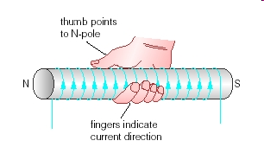
Magnetic field lines for a tightly wound solenoid of finite length, carrying a steady current
The field at exterior points such as P is weak because the field due to current elements on the right-hand portion of a turn tends to cancel the field due to current elements on the left-hand portion.
The magnetic field pattern of a bar magnet, displayed with small iron filings on a sheet of paper.
Notes:
Figure 30.18 (a) Magnetic field lines for a tightly wound solenoid of finite length, carrying a steady current. Magnetic field lines for a tightly wound solenoid of finite length, carrying a steady current

Slide 30
An ideal solenoid is approached when the turns are closely spaced and the length is much greater than the radius of the turns. In this case, the external field is zero, and the interior field is uniform over a great volume.

Slide 31
Because the solenoid is ideal, B in the interior space is uniform and parallel to the axis, and B in the exterior space is zero.
Consider the rectangular path of length and width w shown in Figure…. We can apply Ampere's law to this path by evaluating the integral of B.ds over each side of the rectangle.
N is the number of turns enclosed by our surface
n= N/L is the number of turns per unit length
Notes:
Figure 30.19 Cross-sectional view of an ideal solenoid, where the interior magnetic field is uniform and the exterior field is close to zero. Ampère’s law applied to the circular path near the bottom whose plane is perpendicular to the page can be used to show that there is a weak field outside the solenoid. Ampère’s law applied to the rectangular dashed path in the plane of the page can be used to calculate the magnitude of the interior field.

Slide 32
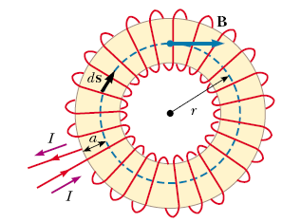
valid only for points near the center (that is, far from the ends) of a very long solenoid.
If the radius r of the torus in Figure 30.13 containing N turns is much greater than the toroid’s cross-sectional radius a, a short section of the toroid approximates a solenoid for which

Slide 33
Example:
a thin 10-cm long solenoid has a total of 400 turns of wire and carries a current of 2 A. Calculate the magnetic field inside near the center.

Slide 34
Example
A 10 cm long solenoid has a total of 400 turns of wire and carries a current of 2.0 A. Calculate the magnetic field inside the solenoid
n = 400 turns/0.10 m = 4000 m⁻¹
B = m_{o}nI
B = (4p X 10⁻⁷ T m/A)(4000m-1)(2.0 A)
B = 0.01 T

Slide 35
Example:
A solenoid 20 cm long and 4 cm in diameter is wounded with a total of 200 turns of wire. The solenoid is aligned with its axis parallel to the earth’s magnetic field which is 3x10⁻⁵ T in magnitude. What should the current in the solenoid be in order for its field to exactly cancel the earth’s field inside the solenoid?
Solution: Since l=0.2 m and N=200 turns, B=Nμ_{o}I/l
I=Bl/μ_{o}N=(3x10⁻⁵T)(0.2)/(4πx10⁻⁷Tm/A)(200)=0.024 A=24 mA
The solenoid diameter has no significance except as a check that the solenoid is long relative to its diameter.

Slide 36
Example
A 0.100 T magnetic field is required. A student makes a solenoid of length 10.0 cm. Calculate how many turns are required if the wire is to carry 10.0 A.

Slide 37
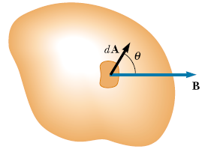
Magnetic Flux, Φ: The number of magnetic (flux) field lines which pass through a given cross-sectional area A
30.5 Magnetic Flux
Consider the special case of a plane of area A in a uniform field B that makes an angle θ with dA. The magnetic flux through the plane in this case is
Units:
Φ webers B Tesla
A area m²
angle formed between B and the normal to the loop (area vector A)
The area vector A is perpendicular to the surface A and has a magnitude equal to the area A.
Notes:
Active Figure 30.21 Magnetic flux through a plane lying in a magnetic field. (a) The flux through the plane is zero when the magnetic field is parallel to the plane surface. (b) The flux through the plane is a maximum when the magnetic field is perpendicular to the plane.

Slide 38
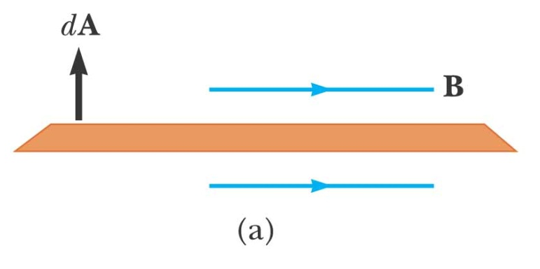
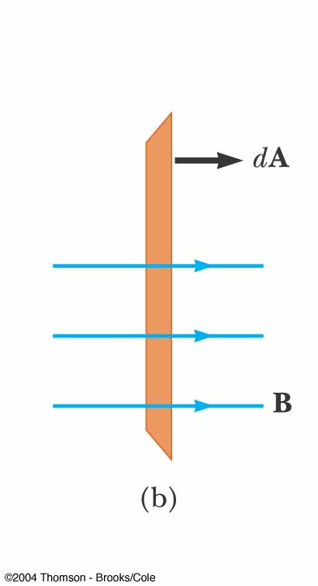
When B is perpendicular to the loop?
Hint: θ is the angle formed between B and the normal to the loop.
When B is along the plane of the loop?
Φ= B A cos θ
Θ = 90⁰
Φ= 0
Φ= B A cos θ
Θ = 0⁰
Φ= B A

Slide 39
Which has the largest magnetic flux?
Example:
Answer: A

Slide 40
A rectangular loop of width a and length b is located near a long wire carrying a current I (Fig. 30.21). The distance between the wire and the closest side of the loop is c . The wire is parallel to the long side of the loop. Find the total magnetic flux through the loop due to the current in the wire.
Because B is parallel to dA at any point within the loop, the magnetic flux through an area element dA is
Fig 30-22, p.941
Notes:
Figure 30.22 (Example 30.8) The magnetic field due to the wire carrying a current I is not uniform over the rectangular loop.

Slide 42
In Chapter 24 we found that the electric flux through a closed surface surrounding a net charge is proportional to that charge (Gauss’s law). In other words, the number of electric field lines leaving the surface depends only on the net charge within it. This property is based on the fact that electric field lines originate and terminate on electric charges.
The situation is quite different for magnetic fields, which are continuous and form closed loops
Fig 30-23, p.942
Notes:
Figure 30.23 The magnetic field lines of a bar magnet form closed loops. Note that the net magnetic flux through a closed surface surrounding one of the poles (or any other closed surface) is zero. (The dashed line represents the intersection of the surface with the page.)

Slide 43
Fig 30-24, p.942
Notes:
Figure 30.24 The electric field lines surrounding an electric dipole begin on the positive charge and terminate on the negative charge. The electric flux through a closed surface surrounding one of the charges is not zero.

Slide 47
long straight wire
use Ampere’s law (or note the lack of N)
center of N loops of radius a
probably not a starting equation
solenoid, length l, N turns
field inside a solenoid is constant
solenoid, n turns per unit length
field inside a solenoid is constant
toroid, N loops
field inside a toroid depends on position (r)

