Slide 1
Chapter 16: Equity Portfolio Management Strategies

Slide 2
Passive versus Active Management
Total Portfolio Return
The total actual return on any equity portfolio can be decomposed into:
Expected return
Alpha
The Equation
Total Actual Return
=[Expected Return] + [“Alpha”]
=[Risk-Free Rate + Risk Premium]+[“Alpha”]

Slide 3
Passive versus Active Management
Passive equity portfolio management
Long-term buy-and-hold strategy
Usually tracks an index over time
Designed to match market performance
Manager is judged on how well they track the target index
Active equity portfolio management
Attempts to outperform a passive benchmark portfolio on a risk-adjusted basis by seeking the “alpha” value
See Exhibit 16.1

Slide 4
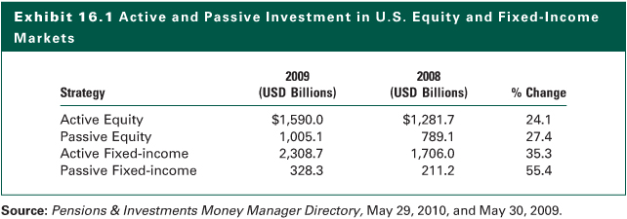
Exhibit 16.1

Slide 5
An Overview of Passive Strategies
Attempt to replicate the performance of an index
May slightly underperform the target index due to fees and commissions
Strong rationale for this approach
Costs of active management (1 to 2 percent) are hard to overcome in risk-adjusted performance
Many different market indexes are used for tracking portfolios
S&P 500 Index
NASDAQ Composite Index

Slide 6
Index Portfolio Construction Techniques
Full Replication
All securities in the index are purchased in proportion to weights in the index
This helps ensure close tracking
Increases transaction costs, particularly with dividend reinvestment

Slide 7
Index Portfolio Construction Techniques
Sampling
Buys a representative sample of stocks in the benchmark index according to their weights in the index
Fewer stocks means lower commissions
Reinvestment of dividends is less difficult
Will not track the index as closely, so there will be some tracking error

Slide 8
Index Portfolio Construction Techniques
Quadratic Optimization (or programming techniques)
Historical information on price changes and correlations between securities are input into a computer program that determines the composition of a portfolio that will minimize tracking error with the benchmark
This relies on historical correlations, which may change over time, leading to failure to track the index

Slide 9
Tracking Error and Index Portfolio Construction
The goal of the passive manager should be to minimize the portfolio’s return volatility relative to the index, i.e., to minimize tracking error
Tracking Error Measure
Return differential in time period t
Δ_{t} =R_{pt} – R_{bt}
where R_{pt}= return to the managed portfolio in Period t
R_{bt}= return to the benchmark portfolio in Period t
Tracking error is measured as the standard deviation of Δ_{t} , normally annualized (TE)
See Exhibit 16.2

Slide 10
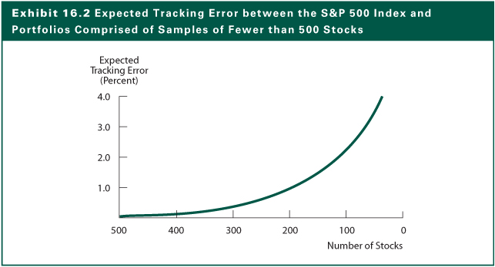
Exhibit 16.2

Slide 11
Methods of Index Portfolio Investing
Index Funds
In an indexed portfolio, the fund manager will typically attempt to replicate the composition of the particular index exactly
The fund manager will buy the exact securities comprising the index in their exact weights
Change those positions anytime the composition of the index itself is changed
Low trading and management expense ratios
The advantage of index mutual funds is that they provide an inexpensive way for investors to acquire a diversified portfolio

Slide 12
Methods of Index Portfolio Investing
Exchange-Traded Funds (ETF)
EFTs are depository receipts that give investors a pro rata claim on the capital gains and cash flows of the securities that are held in deposit by a financial institution that issued the certificates
A significant advantage of ETFs over index mutual funds is that they can be bought and sold (and short sold) like common stock
The notable example of ETFs
Standard & Poor’s 500 Depository Receipts (SPDRs)
iShares
Sector ETFs

Slide 13
An Overview of Active Strategies
Goal is to earn a portfolio return that exceeds the return of a passive benchmark portfolio, net of transaction costs, on a risk-adjusted basis
Need to select an appropriate benchmark
Practical difficulties of active manager
Transactions costs must be offset by superior performance vis-à-vis the benchmark
Higher risk-taking can also increase needed performance to beat the benchmark
See Exhibits 16.5 and 16.6

Slide 14
Fundamental Strategies
Top-Down versus Bottom-Up Approaches
Top-Down
Broad country and asset class allocations
Sector allocation decisions
Individual securities selection
Bottom-Up
Emphasizes the selection of securities without any initial market or sector analysis
Form a portfolio of equities that can be purchased at a substantial discount to what his or her valuation model indicates they are worth

Slide 15
Fundamental Strategies
Three Generic Themes
Time the equity market by shifting funds into and out of stocks, bonds, and T-bills depending on broad market forecasts
Shift funds among different equity sectors and industries (e.g., financial stocks, technology stocks) or among investment styles (e.g., value, growth large capitalization, small capitalization). This is basically the sector rotation strategy
Do stock picking and look at individual issues in an attempt to find undervalued stocks

Slide 16
Fundamental Strategies
The 130/30 Strategy
Long positions up to 130 percent of the portfolio’s original capital and short positions up to 30 percent
The use of the short positions creates the leverage needed, increasing both risk and expected returns compared to the fund’s benchmark
Enable managers to make full use of their fundamental research to buy stocks they identify as undervalued as well as short those that are overvalued

Slide 17
Technical Strategies
Contrarian Investment Strategy
The belief that the best time to buy (sell) a stock is when the majority of other investors are the most bearish (bullish) about it
The concept of mean reverting
The overreaction hypothesis (Exhibit 16.9)
Price Momentum Strategy
Focus on the trend of past prices alone and makes purchase and sale decisions accordingly
Assume that recent trends in past prices will continue

Slide 18
Anomalies and Attributes
Earnings Momentum Strategy
Momentum is measured by the difference of actual EPS to the expected EPS
Purchases stocks that have accelerating earnings and sells (or short sells) stocks with disappointing earnings
Calendar-Related Anomalies
The Weekend Effect
The January Effect
Firm-Specific Attributes
Firm Size
P/E and P/BV ratios (Exhibit 16.12)

Slide 19
Tax Efficiency and Active Equity Management
Active portfolio managers especially need to consider taxes when deciding whether to sell or hold a stock whose value has increased
If a security is sold at a profit, capital gains are paid and less in left in the portfolio to reinvest
A new security (the reinvestment security) needs to have a superior return sufficient to make up for these taxes
The size of the expected return depends on the expected holding period and the cost basis (and amount of the capital gain) of the original security

Slide 20
Tax Efficiency and Active Equity Management
Measures of Tax Efficiency
Portfolio Turnover
Measured as the total dollar value of the securities sold from the portfolio in a year divided by the average dollar value of the assets
Tax Cost Ratio (%)
The Formula
Tax Cost Ratio = [1 – (1 + TAR)/(1 + PTR)] x 100
where
PTR = pretax return
TAR = tax-adjusted return
See Exhibit 16.14

Slide 21
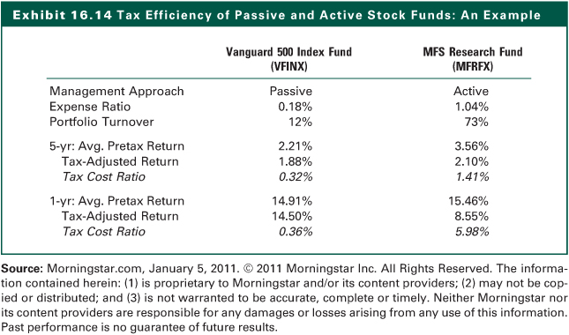
Exhibit 16.14

Slide 22
Value versus Growth
A growth investor focuses on the current and future economic “story” of a company, with less regard to share valuation
A value investor focuses on share price in anticipation of a market correction and, possibly, improving company fundamentals.
Value stocks generally have offered somewhat higher returns than growth stocks, but this does not occur with much consistency from one investment period to another

Slide 23
Value versus Growth
Growth-oriented investor will:
Focus on EPS and its economic determinants
Look for companies expected to have rapid EPS growth
Assumes constant P/E ratio
Value-oriented investor will:
Focus on the price component
Not care much about current earnings
Assume the P/E ratio is below its natural level

Slide 24
Style Analysis
Construct a portfolio to capture one or more of the characteristics of equity securities
Small-cap stocks, low-P/E stocks, etc…
Value stocks (those that appear to be under-priced according to various measures)
Low Price/Book value or Price/Earnings ratios
Growth stocks (above-average earnings per share increases)
High P/E, possibly a price momentum strategy
See Exhibit 16.20

Slide 25
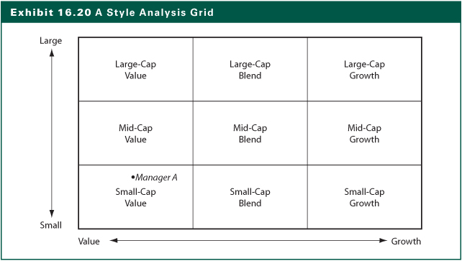
Exhibit 16.20

Slide 26
Does Style Matter?
Choice to align with investment style communicates information to clients
Determining style is useful in measuring performance relative to a benchmark
Style identification allows an investor to diversify by portfolio
Style investing allows control of the total portfolio to be shared between the investment managers and a sponsor
Intentional and unintentional style drift

Slide 27
Asset Allocation Strategies
Integrated asset allocation
Capital market conditions
Investor’s objectives and constraints
Strategic asset allocation
Constant-mix
Tactical asset allocation
Mean reversion
Inherently contrarian
Insured asset allocation
Constant proportion

Slide 28
Asset Allocation Strategies
Selecting an Active Allocation Method
Perceptions of variability in the client’s objectives and constraints
Perceived relationship between the past and future capital market conditions
The investor’s needs and capital market conditions are can be considered constant and can be considered variable

Slide 29
The Internet Investments Online
http://www.russell.com
http://www.firstquadrant.com
http://www.panagora.com
http://www.wilshire.com

