Slide 1
Phys 110
Chapter 2
Motion in One Dimension

Slide 2
LECTURE OUTLINE
2.3 Acceleration
2.5 One-Dimensional Motion with Constant Acceleration
2.6 Freely Falling Objects

Slide 3
Introduction
When the velocity of a particle changes with time, the particle is said to be accelerating.

Slide 4

2.3 Acceleration
Average Acceleration
The average acceleration $\overline{a_{x}}$ of the particle is defined as the change in velocity $∆v_{x}$divided by the time interval $∆t$during which that change occurs:
$$\overline{a_{x}}=\frac{∆v_{x}}{∆t}=\frac{v_{xf}−v_{xi}}{t_{f}−t_{i}}$$
Because the dimensions of velocity are L/T and the dimension of time is T, acceleration has dimensions of length divided by time squared, or L/T². The SI unit of acceleration is meters per second squared (m/s²).
In one dimension, positive and negative can be used to indicate direction.

Slide 5

2.3 Acceleration
Instantaneous acceleration
Instantaneous acceleration define as the limit of the average acceleration as $∆t$ approaches zero.
$a_{x}=\lim_{∆t→0}{\frac{∆v_{x}}{∆t}=\frac{dv_{x}}{dt}}=\frac{d}{dt}\left(\frac{dx}{dt}\right)=\frac{d^{2}x}{dt^{2}}$
That is, the instantaneous acceleration equals the derivative of the velocity with respect to time, which by definition is the slope of the velocity–time graph.
The term acceleration will mean instantaneous acceleration. If average acceleration is wanted, the word average will be included.

Slide 6
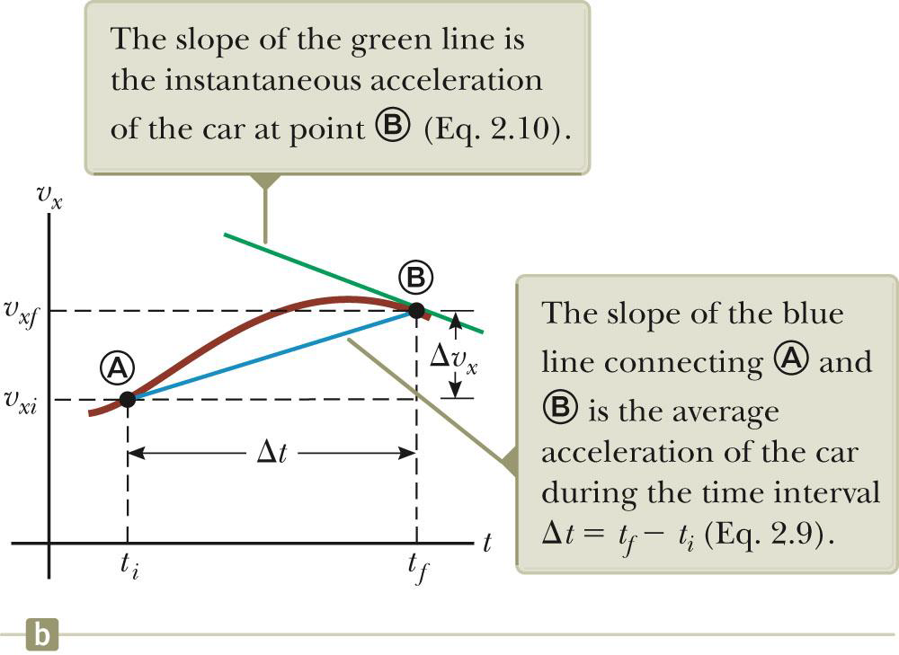
2.3 Acceleration
Instantaneous acceleration
The slope of the velocity-time graph is the acceleration. The green line represents the instantaneous acceleration. The blue line is the average acceleration.

Slide 7
2.3 Acceleration
Acceleration and Velocity, Directions
When an object’s velocity and acceleration are in the same direction, the object is speeding up. When an object’s velocity and acceleration are in the opposite direction, the object is slowing down.

Slide 8
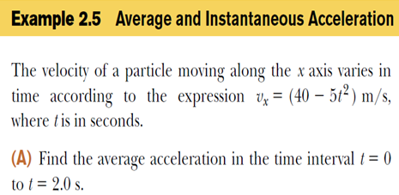

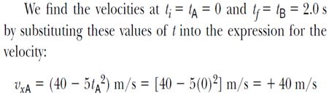

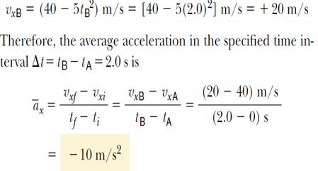

2.3 Acceleration

Slide 9

2.5 One-Dimensional Motion with Constant Acceleration
If the acceleration of a particle varies in time, its motion can be complex and difficult to analyze.
Simple type of 1-D motion is that in which the acceleration is constant. When this is the case, the average acceleration over any time interval is numerically equal to the instantaneous acceleration $a_{x}$ at any instant within the interval, and the velocity changes at the same rate throughout the motion.

Slide 10

2.5 One-Dimensional Motion with Constant Acceleration
average acceleration
$$\overline{a_{x}}=\frac{∆v_{x}}{∆t}=\frac{v_{xf}−v_{xi}}{t_{f}−t_{i}}$$
average velocity
$$\overline{v_{x}}=\frac{∆x}{∆t}=\frac{x_{f}−x_{i}}{∆t}$$
or
$$x_{f}−x_{i}=\overline{v_{x}} ∆t$$
$${∆x=x}_{f}−x_{i}$$
$$∆t=t_{f}−t_{i}$$

Slide 11

2.5 1-D Motion with Constant Acceleration
for situations $a_{x}{=\frac{dv_{x}}{dt}}=\frac{d^{2}x}{dt^{2}}=Cons$ and $∆t=t_{f}−t_{i}=t−0=t$
$$a_{x}=\frac{v_{xf}−v_{xi}}{t_{f}−0} or v_{xf}=v_{xi}+a_{x}t$$
$$\overline{v_{x}}=\frac{v_{xi}+v_{xf}}{2}$$
$$While x_{f}−x_{i}=\overline{v_{x}} ∆t=1/2\left(v_{xf}+v_{xi}\right)t$$
$$x_{f}=x_{i}+\frac{1}{2}\left(v_{xi}+v_{xf}\right)t$$
$$x_{f}=x_{i}+\frac{1}{2}\left(v_{xi}+v_{xi}+a_{x}t \right)t=x_{i}+\frac{1}{2}\left(2v_{xi}+a_{x}t \right)t$$
$$x_{f}=x_{i}+v_{xi}t+\frac{1}{2}a_{x}t^{2}$$
$$x_{f}=x_{i}+\frac{1}{2}\left(v_{xi}+v_{xf}\right)\left(\frac{v_{xf}−v_{xi}}{a_{x}}\right)=x_{i}+\left(\frac{{v_{xf}}^{2}−{v_{xi}}^{2}}{2a_{x}}\right)$$
$${v_{xf}}^{2}={v_{xi}}^{2}+2a_{x}(x_{f}−x_{i})$$

Slide 12

2.5 One-Dimensional Motion with Constant Acceleration
For constant acceleration
$a_{x}=Cons$ and $∆t=t$
$$\overline{v_{x}}=\frac{v_{xi}+v_{xf}}{2}$$
This applies only in situations where the acceleration is constant.
$$x_{f}=x_{i}+\frac{1}{2}\left(v_{xi}+v_{xf}\right)t$$
This gives you the position of the particle in terms of time and velocities. Doesn’t give you the acceleration
$$x_{f}=x_{i}+v_{xi}t+\frac{1}{2}a_{x}t^{2}$$
Gives final position in terms of velocity and acceleration Doesn’t tell you about final velocity
$${v_{xf}}^{2}={v_{xi}}^{2}+2a_{x}(x_{f}−x_{i})$$
Gives final velocity in terms of acceleration and displacement Does not give any information about the time

Slide 13

2.5 One-Dimensional Motion with Constant Acceleration
For motion at zero acceleration
$a_{x}=0$ and$v_{x}=C$
$$v_{xf}=v_{xi}=v_{x}$$
$$x_{f}=x_{i}+\frac{1}{2}\left(v_{x}+v_{x}\right)t$$
$$x_{f}=x_{i}+v_{x}t$$
That is, when the acceleration of a particle is zero, its velocity is constant and its position changes linearly with time.
The constant acceleration model reduces to the constant velocity model.

Slide 14
Homework
A particle moves along the x axis. Its position is given by the equation
x = 2 + 3t − 4t² with x in meters and t in seconds. Determine (a) its position when it changes direction and (b) its velocity when it returns to the position it had at t = 0.

Slide 15
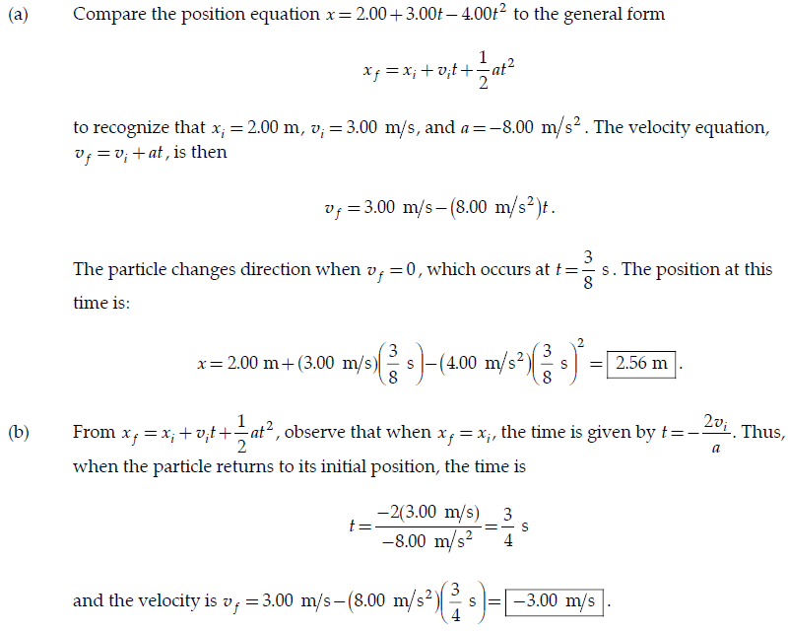

Slide 16

2.6 Freely Falling Objects
A freely falling object is any object moving freely under the influence of gravity alone, regardless of its initial motion. Objects thrown upward or downward and those released from rest are all falling freely once they are released. Any freely falling object experiences an acceleration directed downward, regardless of its initial motion.
At the Earth’s surface, the value of g is approximately 9.80 m/s².
we always choose $a_{y}$=-g=-9.80 m/s²

Slide 17
Quick Quiz: A ball is thrown upward. While the ball is in free fall, does its acceleration (a) increase (b) decrease (c) increase and then decrease (d) decrease and then increase (e) remain constant?
e). For the entire time interval that the ball is in free fall, the acceleration is that due to gravity.

Slide 18
Quick Quiz: After a ball is thrown upward and is in the air, its speed (a) increases (b) decreases (c) increases and then decreases (d) decreases and then increases (e) remains the same.
d) While the ball is rising, it is slowing down. After reaching the highest point, the ball begins to fall and its speed increases.

Slide 19
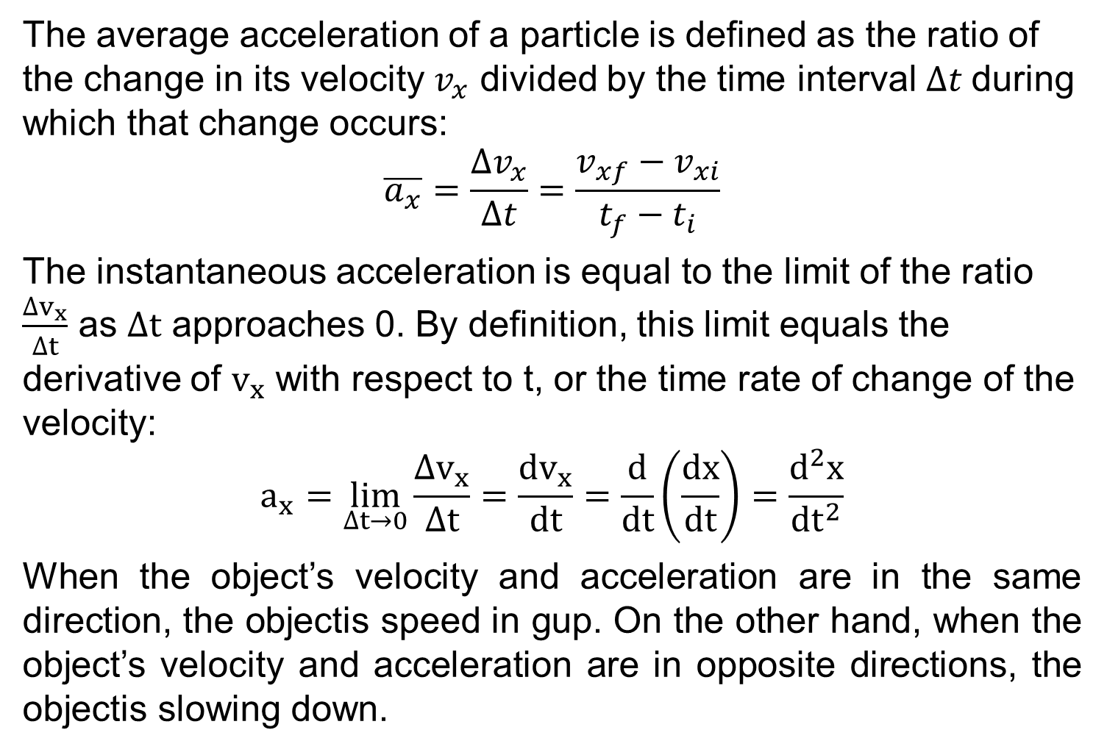
Lecture Summary
The average acceleration of a particle is defined as the ratio of the change in its velocity $v_{x}$ divided by the time interval $∆t$during which that change occurs:
$$\overline{a_{x}}=\frac{∆v_{x}}{∆t}=\frac{v_{xf}−v_{xi}}{t_{f}−t_{i}}$$
The instantaneous acceleration is equal to the limit of the ratio $\frac{∆v_{x}}{∆t}$ as $∆t$ approaches 0. By definition, this limit equals the derivative of $v_{x}$ with respect to t, or the time rate of change of the velocity:
$$a_{x}=\lim_{∆t→0}{\frac{∆v_{x}}{∆t}=\frac{dv_{x}}{dt}}=\frac{d}{dt}\left(\frac{dx}{dt}\right)=\frac{d^{2}x}{dt^{2}}$$
When the object’s velocity and acceleration are in the same direction, the objectis speed in gup. On the other hand, when the object’s velocity and acceleration are in opposite directions, the objectis slowing down.

Slide 20
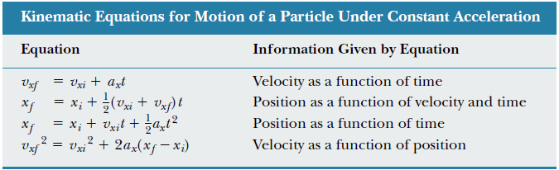
Lecture Summary
The equations of kinematics for a particle moving along the x axis with uniform acceleration a_{x} are:

Slide 21
Homework
A ball is thrown directly downward, with an initial speed of 8.00 m/s, from a height of 30.0 m. After what time interval does the ball strike the ground?
A freely falling object requires 1.50 s to travel the last 30.0 m before it hits the ground. From what height above the ground did it fall?

Slide 22
