Slide 1
Chapter Two
Company and Marketing Strategy
Partnering to Build Customer Relationships

Slide 2
Company and Marketing Strategy
Topic Outline
Companywide Strategic Planning: Defining Marketing’s Role
Designing the Business Portfolio
Planning Marketing: Partnering to Build Customer Relationships
Marketing Strategy and the Marketing Mix
Managing the Marketing Effort
Measuring and Managing Return on Marketing Investment

Slide 3
Companywide Strategic Planning
Strategic Planning
Strategic planning is the process of developing and maintaining a strategic fit between the organization’s goals and capabilities and its changing marketing opportunities
Notes:
Note to Instructor
Strategic planning sets the stage for the rest of the planning in the firm.
Discussion Question
How might the strategic plan of the college or university influence decisions in the schools programs and offerings. How might it influence decisions in food services, dormitories, executive education, and undergraduate versus graduate programs?

Slide 4
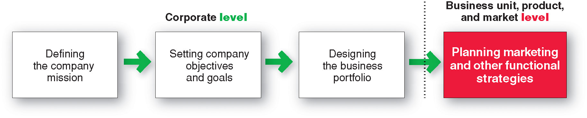
Companywide Strategic Planning
Steps in Strategic Planning

Slide 5

Companywide Strategic Planning
Defining a Market-Oriented Mission
The mission statement is the organization’s purpose, what it wants to accomplish in the larger environment
Market-oriented mission statement defines the business in terms of satisfying basic customer needs
We help you organize the world’s information and make it universally accessible and useful.
Notes:
Note to Instructor
A mission statement should:
Not be myopic in product terms
Meaningful and specific
Motivating
Emphasize the company’s strengths
Contain specific workable guidelines
Not be stated as making sales or profits

Slide 6
Companywide Strategic Planning
Setting Company Objectives and Goals
Business objectives
Build profitable customer relationships
Invest in research
Improve profits
Marketing objectives
Increase market share
Create local partnerships
Increase promotion

Slide 7
Companywide Strategic Planning
Designing the Business Portfolio
The business portfolio is the collection of businesses and products that make up the company
Portfolio analysis is a major activity in strategic planning whereby management evaluates the products and businesses that make up the company

Slide 8

Companywide Strategic Planning
Analyzing the Current Business Portfolio
Strategic business units can be
Company division
Product line within a division
Single product or brand
Notes:
Note to Instructor
This Web link is to Procter & Gamble is an interesting site to explore with the students. Click on the Family of products.
Discussion Question
Which product categories might be growing markets, slower markets, and emerging markets. This site can be explored again when viewing Figure 2.2—the BCG grid.

Slide 9
Companywide Strategic Planning
Analyzing the Current Business Portfolio
Identify key businesses (strategic business units, or SBUs) that make up the company
Assess the attractiveness of its various SBUs
Decide how much support each SBU deserves

Slide 10
Companywide Strategic Planning
Developing Strategies for Growth and Downsizing
Product/market expansion grid is a tool for identifying company growth opportunities through market penetration, market development, product development, or diversification

Slide 11
Companywide Strategic Planning
Developing Strategies for Growth and Downsizing Product/Market Expansion Grid Strategies
Market penetration
Market development
Product development
Diversification

Slide 12
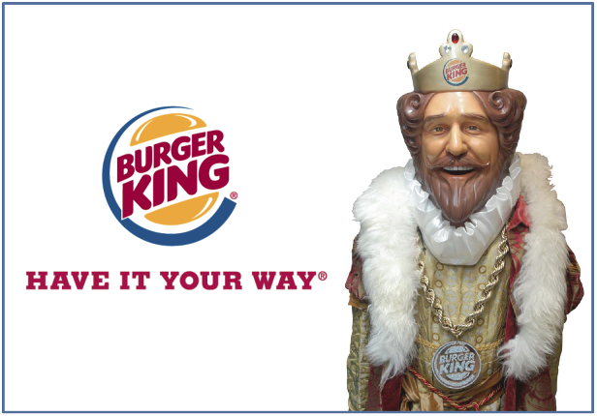
Companywide Strategic Planning
Developing Strategies
for Growth and Downsizing
Market penetration is a growth strategy increasing sales to current market segments without changing the product
Market development is a growth strategy that identifies and develops new market segments for current products

Slide 13
Companywide Strategic Planning
Developing Strategies
for Growth and Downsizing
Product development is a growth strategy that offers new or modified products to existing market segments
Diversification is a growth strategy through starting up or acquiring businesses outside the company’s current products and markets
Notes:
Note to Instructor
This Web link leads to the hompage for Virgin. This is a great company to discuss as they provide examples of market development, product development and diversification. Their homepage lists all their industries and products including tourism, leisure, shopping, media, finance, and healthcare.

Slide 14
Companywide Strategic Planning
Developing Strategies
for Growth and Downsizing
Downsizing is the reduction of the business portfolio by eliminating products or business units that are not profitable or that no longer fit the company’s overall strategy
Notes:
Downsizing is the reduction of the business portfolio by eliminating products or business units that are not profitable or that no longer fit the company’s overall strategy

Slide 15

Planning Marketing
Partnering to Build Customer Relationships
Value chain is a series of departments that carry out value-creating activities to design, produce, market, deliver, and support a firm’s products
Notes:
Marketing alone can’t
create superior customer
value. Under the company-wide
strategic plan, marketers must work
closely with other departments to form
an effective internal company value
chain and with other companies in the
marketing system to create an overall
external value delivery network that
jointly serves customers.

Slide 16

Planning Marketing
Partnering to Build Customer Relationships
Value delivery network is made up of the company, suppliers, distributors, and ultimately customers who partner with each other to improve performance of the entire system

Slide 17
Marketing Strategy and the Marketing Mix
Customer-Driven Marketing Strategy
Market segmentation is the division of a market into distinct groups of buyers who have different needs, characteristics, or behavior and who might require separate products or marketing mixes
Market segment is a group of consumers who respond in a similar way to a given set of marketing efforts

Slide 18
Marketing Strategy and the Marketing Mix
Customer-Centered Marketing Strategy
Market targeting is the process of evaluating each market segment’s attractiveness and selecting one or more segments to enter
Notes:
Note to Instructor
This link goes to the nike.com site. Explore with the students the different segments including gender Nike Women, psychographics (sports centric including football), and age.
Discussion Questions (can include the topic of positioning which is on the following slide).
Specific questions for the students:
How does Nike segment their market?
What appears to be their most important segments?
How does Nike position their products in the marketplace?

Slide 19
Marketing Strategy and the Marketing Mix
Customer-Centered Marketing Strategy
Market positioning is the arranging for a product to occupy a clear, distinctive, and desirable place relative to competing products in the minds of the target consumer

Slide 20
Marketing Strategy and the Marketing Mix
Developing an Integrated Marketing Mix
Marketing mix is the set of controllable tactical marketing tools—product, price, place, and promotion—that the firm blends to produce the response it wants in the target market

Slide 21
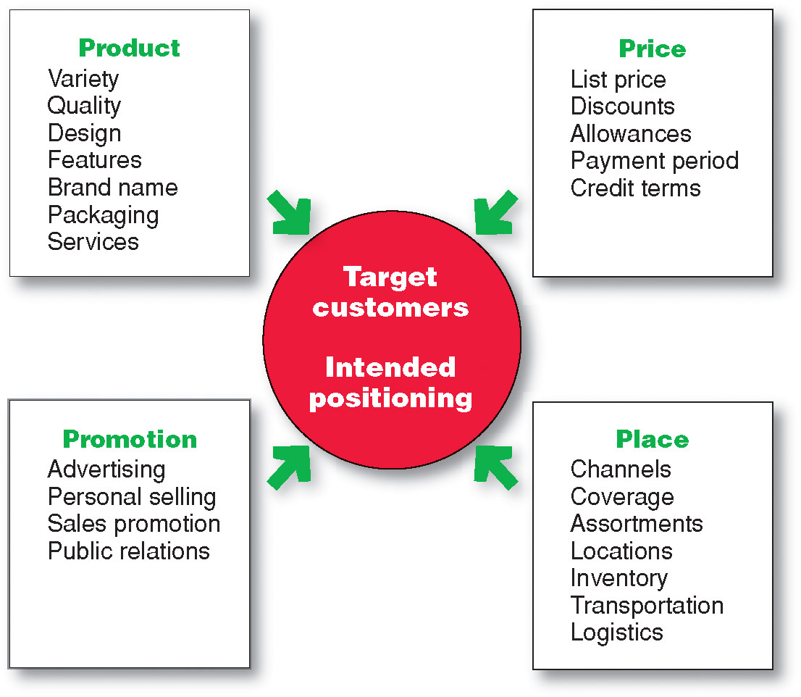
Marketing Strategy and the Marketing Mix
Developing an Integrated Marketing Mix
Notes:
Note to Instructor
It is interesting to ask how to make the 4Ps more customer centric. This leads to a redefining of the 4Ps to the 4Cs as follows:
Product—Customer solution
Price—Customer cost
Place—Convenience
Promotion—Communication

Slide 22
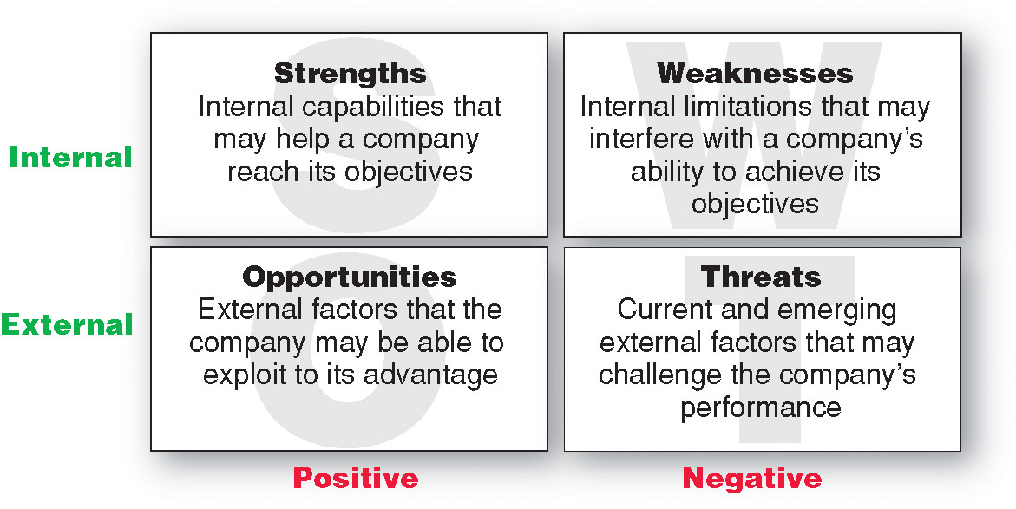
Managing the Marketing Effort
Marketing Analysis – SWOT Analysis

Slide 23
Managing the Marketing Effort
Marketing Department Organization
Functional organization
Geographic organization
Product management organization
Market or customer management
Notes:
Note to Instructor
Functional organization: This is the most common form of marketing organization with different marketing functions headed by a functional specialist.
Geographic organization: Useful for companies that sell across the country or internationally. Managers are responsible for developing strategies and plans for a specific region.
Product management: Useful for companies with different products or brands. Managers are responsible for developing strategies and plans for a specific product or brand.
Market or customer management organization: Useful for companies with one product line sold to many different markets and customers. Managers are responsible for developing strategies and plans for their specific markets or customers.
Customer management involves a customer focus and not a product focus for managing customer profitability and customer equity.

Slide 24

Measuring and Managing
Return on Marketing Investment
Return on Marketing Investment (Marketing ROI)
Return on marketing investment (Marketing ROI) is the net return from a marketing investment divided by the costs of the marketing investment. Marketing ROI provides a measurement of the profits generated by investments in marketing activities.
Notes:
Measuring return on
marketing investment has
become a major marketing emphasis.
But it can be difficult. For example, a
Super Bowl ad reaches more than 100
million consumers but may cost as
much as $3 million for 30 seconds of
airtime. How do you measure the
specific return on such an investment
in terms of sales, profits, and building
customer relationships? We’ll look at
this question again in Chapter 15.

