Slide 1
King Saud University College of Engineering IE – 462: “Industrial Information Systems” Fall – 2018 (1st Sem. 1439-40H)
Chapter 2
Information System Development – p2
Prepared by: Ahmed M. El-Sherbeeny, PhD

Slide 2
Lesson Overview
Source of Software
Comparing Sources of Software Components
Criteria for Selecting Software

Slide 3
Sources of Software
There are various sources of software for organizations
First administrative information system: US, General Electric’s (GE) payroll system (1954) as in-house development
There are various criteria used to evaluate software

Slide 4
Sources of Software
Information technology services firm (outsourcing)
Packaged software producers
Enterprise-wide solutions (ERP)
Cloud computing
Open source software
In-house development

Slide 5
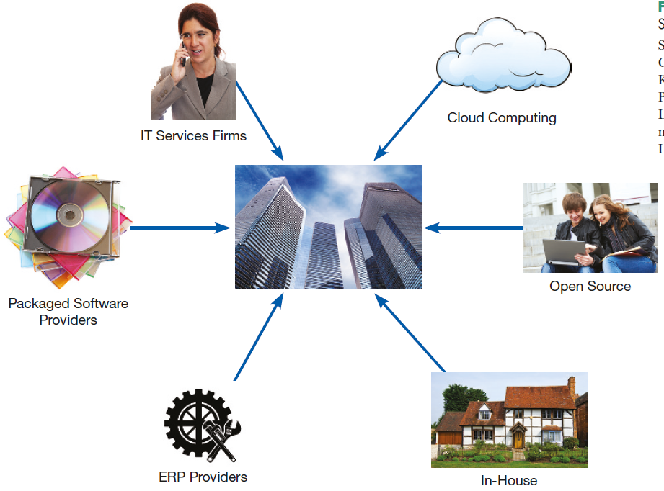
Sources of Software

Slide 6
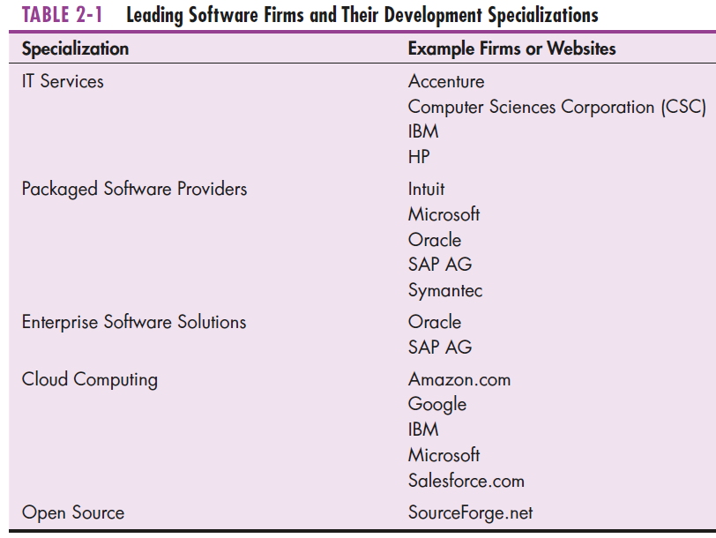
Sources of Software

Slide 7
1. Information Technology (IT) Services Firms
Outsourcing: Turning over responsibility of some or all of an organization's information systems applications and operations to an outside firm
Reasons to outsource:
Cost-effective
Take advantage of economies of scale
Free up internal resources
Reduce time to market
Increase process efficiencies
When system development is a non-core activity for the organization
Help companies develop custom information systems for internal use
IT service firms develop, host, and run applications for customers
Notes:
Outsourcing: تفويض خارجي

Slide 8
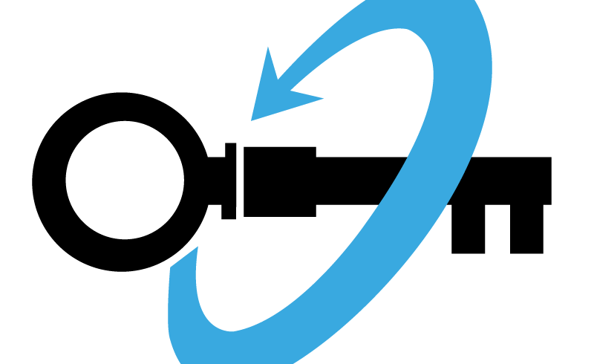
2. Packaged / Off-The-Shelf Software Producers
Serve many market segments
Provide variety of software:
broad-based packages (e.g. productivity tools)
specialized packages (e.g. software to manage small store)
Software runs on all size computers, from microcomputers to large mainframes
Prepackaged software (e.g. MS. Project) is off-the-shelf and is turnkey software* (i.e. not customizable)
Notes:
* Note, producer of a turnkey system will make changes to the software only when a substantial number of users ask for a specific change

Slide 9
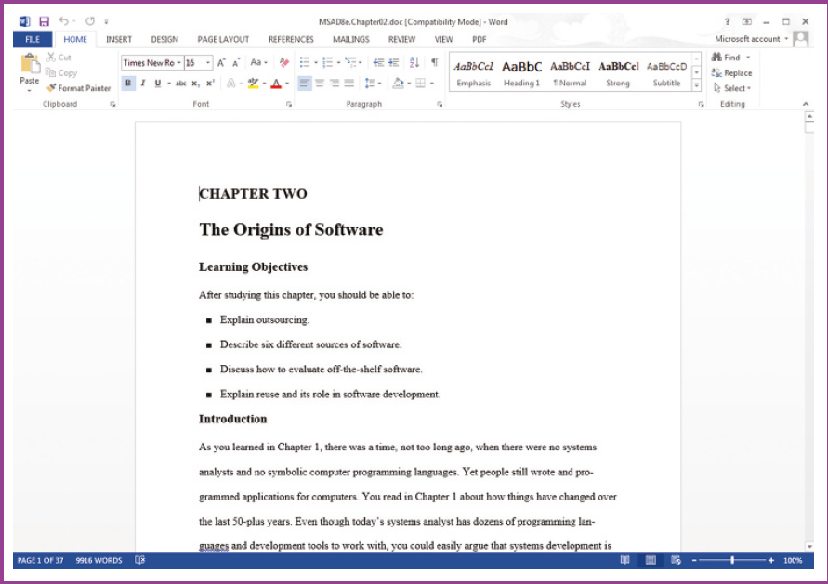
2. Packaged / Off-The-Shelf Software Producers

Slide 10
3. Enterprise Solutions Software
Enterprise Resource Planning (ERP) systems integrate individual traditional business functions into modules enabling a single seamless transaction to cut across functional boundaries
e.g. series of modules will support entire order entry process, from receiving order, to adjusting inventory, to shipping to billing, to after-the-sale service*
SAP AG (German company; since 1972) is the leading vendor of ERP systems; also Oracle (US company; famous for database software); both control 36% of ERP market
Notes:
Seamless: continuous; note, traditional approach would use different systems in different functional areas of the business, such as a billing system in accounting and an inventory system in the warehouse

Slide 11
3. Enterprise Solutions Software
Advantages of ERP system:
single repository of data for all aspects of a business process
flexibility of the modules (easy to integrate new modules)
consistent and accurate data
less maintenance
Disadvantages of ERP system:
systems are very complex
implementation can take a long time to complete
usually very expensive to hire consultants to install system
“migration” to new system involves changing how organizations do business

Slide 12
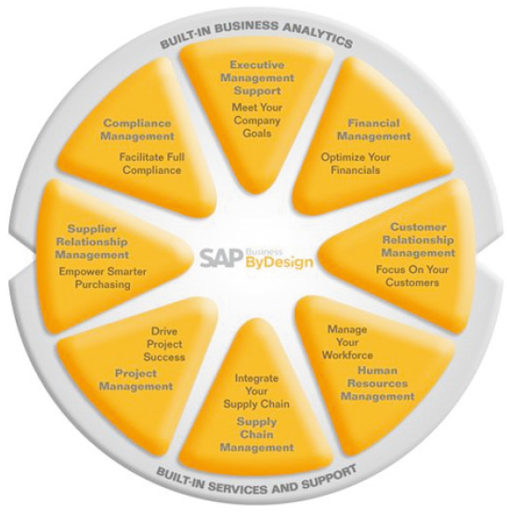
3. Enterprise Solutions Software
SAP’s Business ByDesign, product designed for medium-sized companies

Slide 13
4. Cloud Computing
The provision of computing resources, including applications, over the Internet, so customers do not have to invest in the computing infrastructure needed to run and maintain the resources
Third-party providers run applications at remote sites
Users have access to applications through the Internet or through virtual private networks
The application provider buys, installs, maintains, and upgrades the applications
Notes:
Note, users pay on a per-use basis or they license the software, typically month to month

Slide 14
4. Cloud Computing
Advantages of cloud computing:
freeing internal IT staff
gaining access to applications faster than via internal development
achieving low-cost access to corporate-quality applications
no expensive, time-consuming system implementation
cost effectiveness, speed to market, and better performance
Disadvantages of cloud computing :
security concern: storing company data (e.g. customer information) on machines one does not own and that others can access
reliability: vulnerable to unexpected risks due to its complexity
compliance with government regulations

Slide 15
4. Cloud Computing
A presentation edited in Google Apps

Slide 16
5. Open Source Software
Freely available, including source code
Developed by a large community* of interested people (making money through maintenance, support, and selling fully-featured versions)
Performs the same functions as commercial software (e.g. operating systems, e-mail, database systems, web browsers)
e.g. Linux, mySQL (database system), Firefox
Notes:
* As of January 2105, SourceForge. net hosted 430,000 projects and had over 3.7 million registered users!

Slide 17
6. In-House Development
If sufficient system development expertise with the chosen platform exists in-house, then some or all of the system can be developed by the organization’s own staff
Becoming a progressively smaller piece of all systems development work that takes place in and for organizations (large maintenance burden)*
Hybrid solutions involving some purchased and some in-house components are common
Notes:
* As opposed to packaged applications

Slide 18
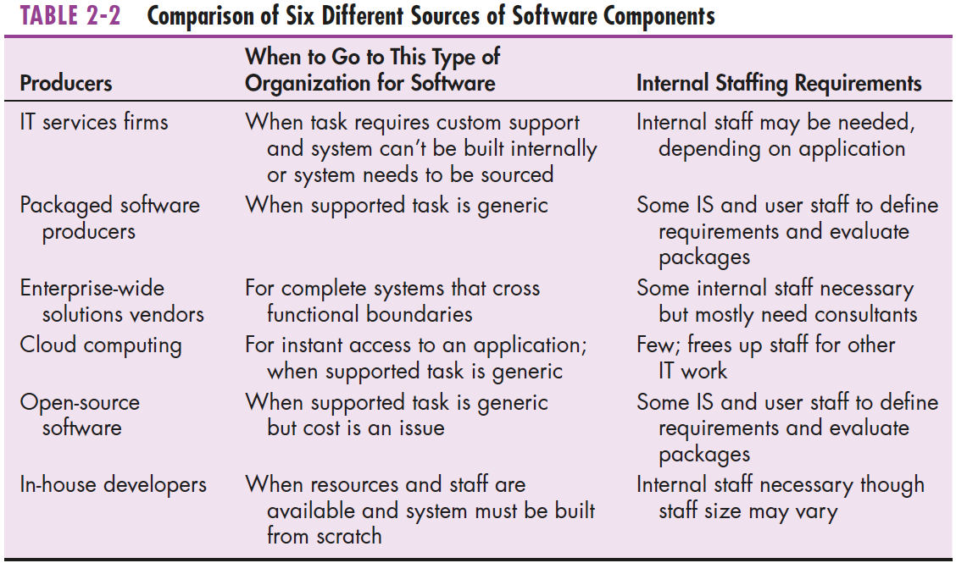
Comparing Sources of Software Components

Slide 19
Criteria for Selecting Software
Cost: comparing the cost of developing in-house with the cost of purchasing or licensing the software pack
Functionality: tasks that the software can perform
Vendor support: how much support the vendor provides and at what cost
Viability of vendor: can the software adapt to changes in systems software and hardware
Flexibility: how easy it is to customize the software
Documentation: is the user’s manual and technical documentation understandable and up-to-date?
Response time: how long it takes the software package to respond to the user’s requests in an interactive session
Ease of installation: a measure of the difficulty of loading the software and making it operational
Notes:
Vendor: بائع/مورد

Slide 20
Sources
Modern Systems Analysis and Design. Joseph S. Valacich and Joey F. George. Pearson. Eighth Ed. 2017. Chapter 2.
Youtube: Types of Software by Michelle TPY https://youtu.be/RV9kqndSn4Q

