Slide 1
King Saud University College of Engineering IE – 462: “Industrial Information Systems” Fall – 2018 (1st Sem. 1439-40H)
Chapter 2
Information System Development – p1
Prepared by: Ahmed M. El-Sherbeeny, PhD

Slide 2
Lesson Overview
Introduction to IS Development
System Development Life Cycle (SDLC)
Programming Languages

Slide 3
Introduction to IS Development
Systems development methodology is a standard process followed in an organization to analyze, design, implement and maintain information systems
System analyst is responsible for analyzing and designing an information system

Slide 4
System Development Life Cycle (SDLC)
A traditional methodology used to plan, analyze, design, implement and maintain information systems

Slide 5
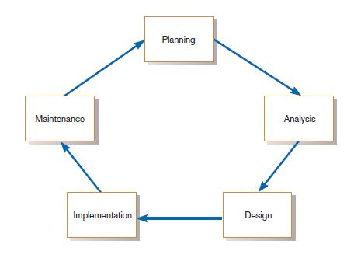
SDLC- Cont.
Phases in SDLC:
Planning
Analysis
Design
Implementation
Maintenance

Slide 6
SDLC- Cont.
Planning – an organization’s total information system objectives or purposes are identified, analyzed, prioritized, and arranged
Analysis – system requirements are studied and structured (this’s called system analysis) Includes feasibility analysis:
technical feasibility
economic feasibility
legal feasibility

Slide 7
SDLC- Cont.
Design – a description of the recommended solution is converted into logical and then physical system specifications
Logical design: all functional features of the system chosen for development in analysis are described independently of any computer platform
Physical design: transforming the logical specifications of the system into the technology-specific details

Slide 8
SDLC- Cont.
Design – cont.
See below: difference between physical and logical design
Skateboard ramp blueprint (logical design)
A skateboard ramp (physical design)

Slide 9
SDLC- Cont.
Implementation – information system is
coded (i.e. programmed)
tested (includes unit test, system test, user-acceptance test)
installed (training users, providing documentation, and conversion from previous system to new system)
Maintenance – information system is systematically repaired and improved
structured support process: reported bugs are fixed, requests for new features are evaluated and implemented
system updates/backups are performed on a regular basis

Slide 10
Types of SDLCs
SDLC can be performed in different ways:
Traditional Waterfall SDLC
Iterative SDLC
Rapid Application Development (RAD)
Agile Methodologies
Lean Methodology

Slide 11
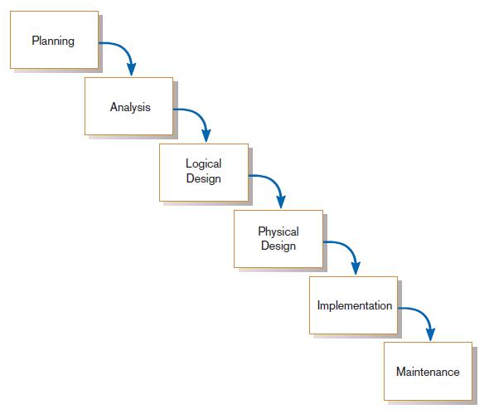
SDLC Types: Traditional Waterfall SDLC
One phase begins when another completes, with little backtracking and looping
Notes:
Can you guess why it’s called “Waterfall” SDLC?

Slide 12
Problems with Waterfall Approach
Quite rigid: system requirements can't change after being determined
No software is available until after the programming phase
Limited user cooperation (only in requirements phase)
Projects can sometimes take months/years to complete

Slide 13
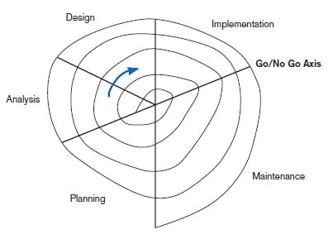
SDLC Types: Iterative SDLC
Development phases are repeated as required until an acceptable system is found
User participates
Spiral development (evolutionary) SDLC in which we constantly cycle through phases at different levels of details

Slide 14
Rapid Application Development (RAD)
Systems-development methodology that focuses on quickly
building working model of software
getting feedback from users,
then using that feedback to update the working model
making several iterations of development, and developing/implementing a final version
This greatly decreases design / implementation time ⇒ shortened development (compressed process)
Uses extensive user cooperation, prototyping, integrated CASE tools, and code generators

Slide 15
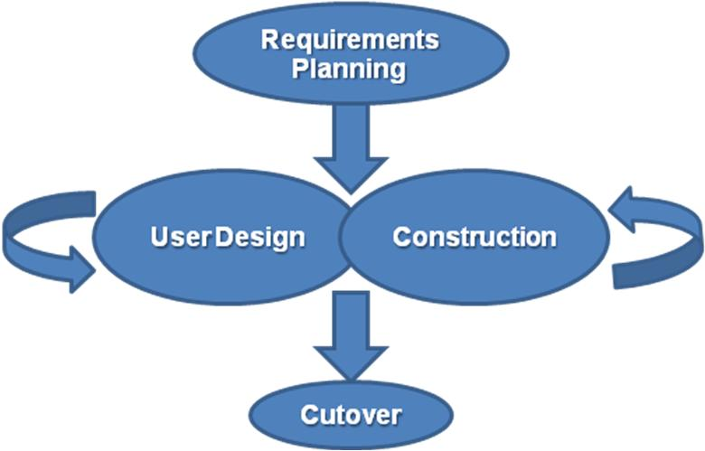
Rapid Application Development (RAD)

Slide 16
Rapid Application Development (RAD)
Requirements planning: overall requirements for system are defined; team is identified; and feasibility is determined (similar to analysis/design phases in Waterfall Approach)
User design: prototyping the system with user using CASE in creating interfaces/report; e.g. JAD (joint application development) session: all stakeholders have a structured discussion about design of system
Construction: coding the system using CASE; interactive, iterative process, and changes can be made as developers are working on program
Cutover: delivery of developed system (implementation)

Slide 17
SDLC Types: Agile Methodologies
Group of methodologies that utilize incremental changes with a focus on quality, details (started: 2001)
Each increment is released in a specified time (called a “time box”) ⇒ regular release schedule with very specific objectives
Share some RAD principles: iterative development, user, interaction, ability to change
Goal: provide flexibility of iterative approach, while ensuring a quality product

Slide 18
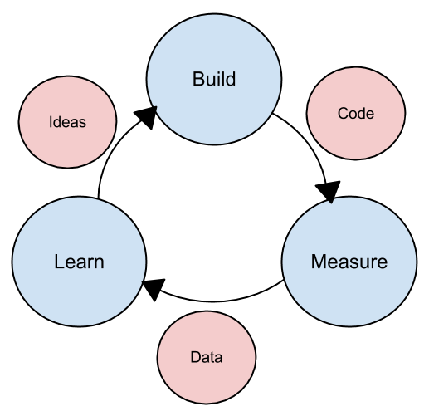
SDLC Types: Lean Methodology
New concept; focus is on taking initial idea and developing minimum viable product (MVP): working software application with just enough functionality to demonstrate the idea behind the project
MVP: given to potential users for review, team determines whether to continue in same direction or rethink idea behind project ⇒ new MVP
Iterative process: until final product is completed
Notes:
The lean methodology works best in an entrepreneurial environment where a company is interested in determining if their idea for a software application is worth developing

Slide 19
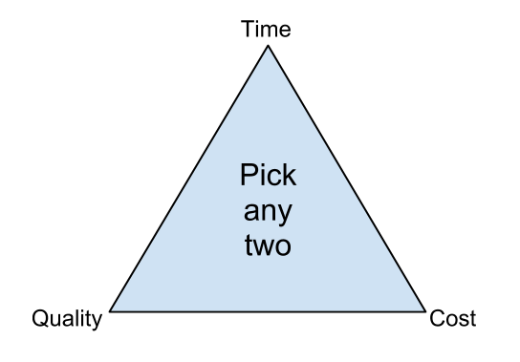
Note: Quality Triangle
Quality triangle: simple concept: For any product/service being developed, you can only address 2 of the following:
Time
Cost
Quality
e.g. you cannot complete a low-cost, high-quality project in a small amount of time
Also, if you can spend a lot of money ⇒ project can be completed quickly with high-quality results
If completion date is not a priority, then it can be completed at a lower cost with higher-quality results

Slide 20
Programming Languages
One way to characterize programming languages is by their “generation”
First-generation languages
Second-generation languages
Third-generation languages
Fourth-generation languages

Slide 21
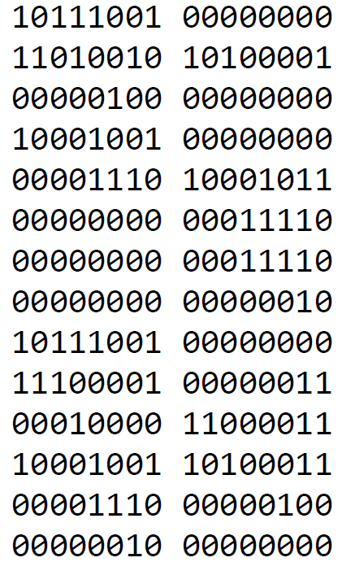
Programming Languages (cont.)
First-generation languages
called machine code: specific to the type of hardware to be programmed
each type of computer hardware had a different low-level programming language
uses actual ones and zeroes (bits) in the program using binary code
example here: adds 1234 and 4321 using machine language

Slide 22
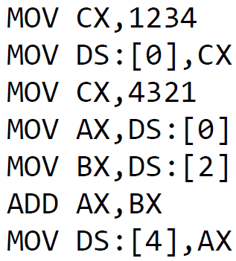
Programming Languages (cont.)
Second-generation languages
Called Assembly language (also low-level language)
Gives English-like phrases to machine-code instructions, making it easier to program
Run through an assembler, which converts it into machine code
See here program that adds 1234 and 4321 using assembly language

Slide 23
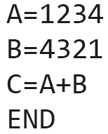
Programming Languages (cont.)
Third-generation languages
Not specific to type of hardware on which they run
Much more like spoken languages
Most third-generation languages must be compiled, a process that converts them into machine code
Well-known third-generation languages: BASIC, C, Pascal, and Java
Program (in BASIC) that adds 1234 and 4321

Slide 24
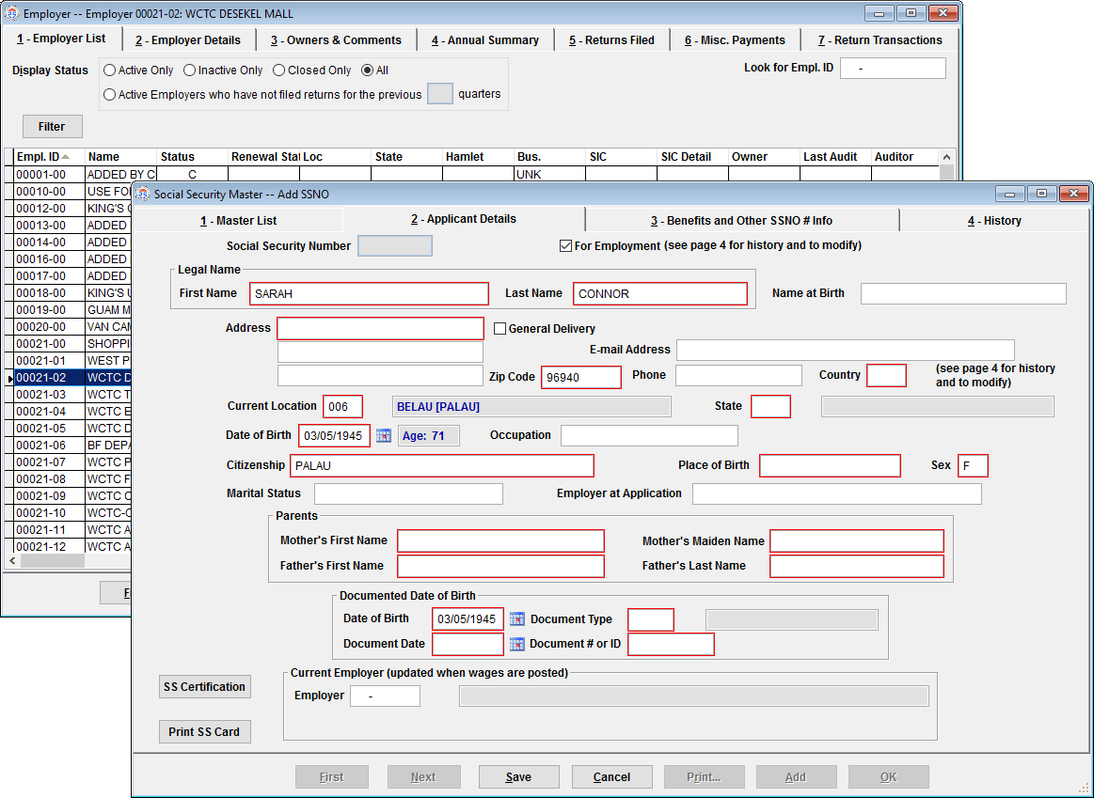
Programming Languages (cont.)
Fourth-generation languages
Class of programming tools that enable fast application development using intuitive interfaces and environments
Have very specific purpose, such as database interaction or report-writing
Can be used by those with very little training in programming; allow for quick development of applications and/or functionality
Examples: Clipper, FOCUS, FoxPro, SQL, and SPSS
Notes:
Example of FoxPro is shown here (employee record in company database)

Slide 25
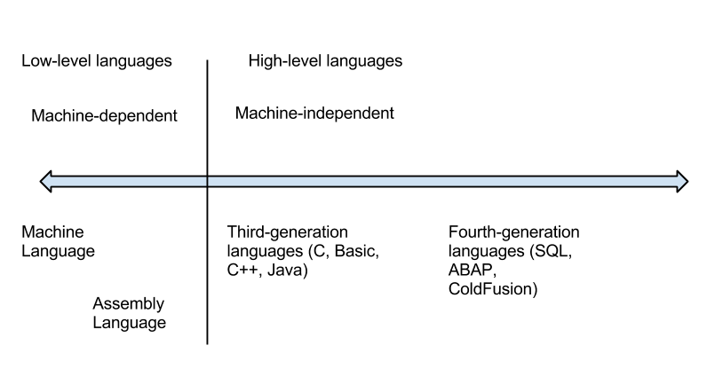
Programming Languages (cont.)
Higher vs. Lower Level Languages
Lower-level languages (e.g. assembly language): much more efficient and execute much more quickly; you have finer control over the hardware as well
Sometimes, combination of higher- and lower-level languages are mixed ⇒ “best of both worlds”: overall structure and interface using a higher-level language, but use lower-level languages for parts of program that are used many times or require more precision

Slide 26
Programming Languages (cont.)
Compiled vs. Interpreted
Another way to classify programming languages
Compiled language: code is translated into a machine-readable form called an executable that can be run on the hardware (e.g. C, C++, and COBOL)
Interpreted language: requires a “runtime program” to be installed in order to execute; this program then interprets the program code line by line and runs it; generally easier to work with but slower (e.g. BASIC, PHP, PERL, and Python)
Web languages (HTML and Javascript) also considered interpreted because they require a browser in order to run
Note, Java programming language: interesting exception to this classification (hybrid of the two)
Notes:
Note, COBOL is hardly used anymore

Slide 27
Programming Languages (cont.)
Procedural vs. Object-Oriented
Procedural programming language: designed to allow a programmer to define a specific starting point for the program and then execute sequentially (include all early programming languages)
Object-oriented programming language: uses interactive and graphical user interfaces to allow the user to define the flow of the program
programmer defines “objects” that can take certain actions based on input from the user
Procedural program focuses on sequence of activities to be performed, while object-oriented program focuses on the different items being manipulated

Slide 28
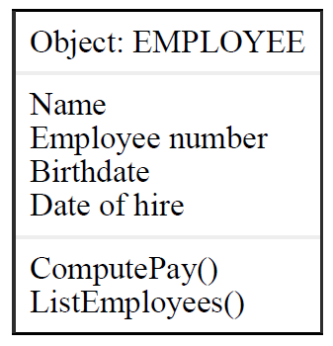
Programming Languages (cont.)
Procedural vs. Object-Oriented (cont.)
Example of object-oriented code (human resource system)
object (“EMPLOYEE”) is created in program to retrieve or set data regarding an employee:
Every object has properties: descriptive fields associated with the object (“Name”, “Employee number”, “Birthdate” and “Date of hire”)
Object also has methods which can take actions related to the object: “ComputePay()”: money owed to person “ListEmployees()”: who works under that employee

Slide 29
Programming Languages (cont.)
Programming Tools
Traditional Tools: text editor, checking syntax, code compiler
Additional tools:
Integrated Development Environment (IDE)
Computer-Aided Software-Engineering (CASE) tools

Slide 30
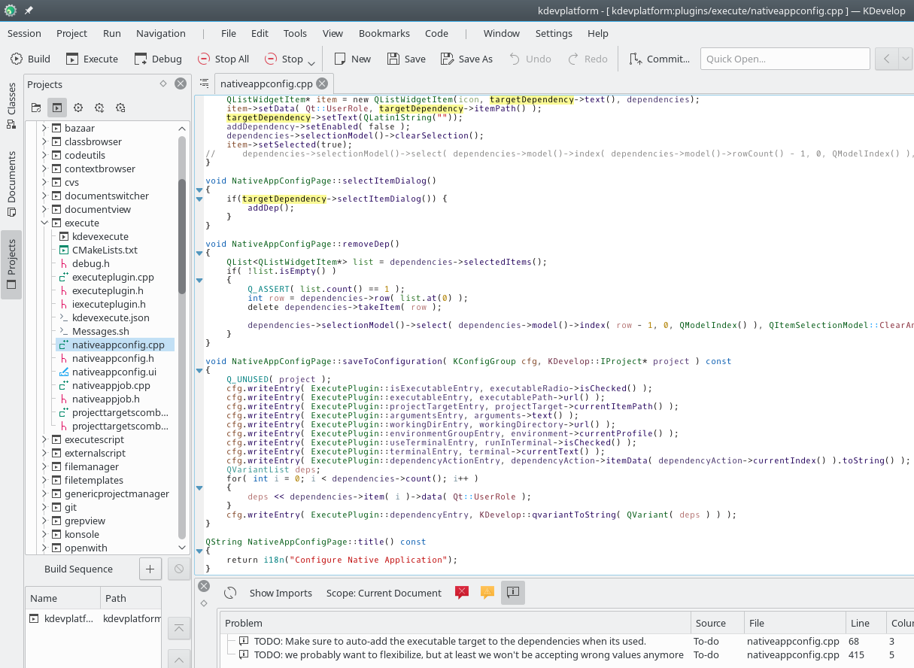
Programming Languages (cont.)
Programming Tools (cont.)
Integrated Development Environment (IDE) provides:
an editor for writing the program that will color-code or highlight keywords from the programming language
help system
compiler/interpreter
debugging tool (to resolve problems)
check-in/check-out mechanism (so that more than one programmer can work on code)
Microsoft Visual Studio: IDE for Visual C++, Visual BASIC

Slide 31
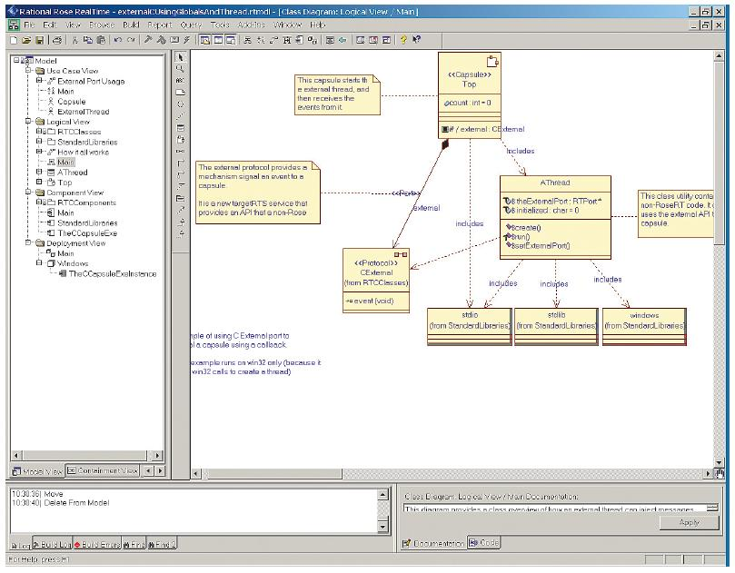
Programming Languages (cont.)
Programming Tools (cont.)
Computer-aided software-engineering (CASE) Tools:
Allows a designer to develop software with little or no programming
Writes the code for the designer
Goal is to generate quality code based on input created by the designer
Notes:
Rational Rose is an object-oriented Unified Modeling Language (UML) software design tool intended for visual modeling and component construction of enterprise-level software applications

Slide 32
Programming Languages (cont.)
Programming Tools (cont.)
Computer-aided software-engineering (CASE) Tools (cont.):
Diagramming tools enable graphical representation
Computer displays and report generators help prototype how systems “look and feel”
Documentation generators standardize technical and user documentation
Code generators enable automatic generation of programs and database code directly from design documents, diagrams, forms, and reports

