Slide 1
Chapter 29 Problems
Problems 7, 9, 12, 30, 37, 41

Slide 2
7. A proton moving at 4.00 × 10⁶ m/s through a magnetic field of 1.70 T experiences a magnetic force of magnitude 8.20 × 10^{–13} N. What is the angle between the proton’s velocity and the field?

Slide 3
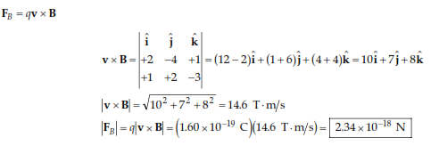
9. A proton moves with a velocity of v = (2 i – 4 j + k ) m/s in a region in which the magnetic field is B = ( i + 2 j – 3 k ) T. What is the magnitude of the magnetic force this charge experiences?

Slide 4
12. A wire carries a steady current of 2.40 A. A straight section of the wire is 0.750 m long and lies along the x axis within a uniform magnetic field, B = 1.60 T. If the current is in the +x direction, what is the magnetic force on the section of wire?

Slide 5
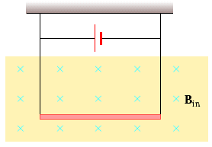
14. A conductor suspended by two flexible wires as shown in Figure P29.14 has a mass per unit length of 0.040 0 kg/m. What current must exist in the conductor in order for the tension in the supporting wires to be zero when the magnetic field is 3.60 T into the page? What is the required direction for the current?

Slide 7
30. A singly charged positive ion has a mass of 3.20 × 10–26 kg. After being accelerated from rest through a potential difference of 833 V, the ion enters a magnetic field of 0.920 T along a direction perpendicular to the direction of the field. Calculate the radius of the path of the ion in the field.

Slide 8
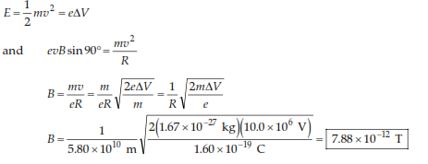
37. A cosmic-ray proton in interstellar space has an energy of 10.0 MeV and executes a circular orbit having a radius equal to that of Mercury’s orbit around the Sun (5.80 × 10¹⁰ m). What is the magnetic field in that region of space?

Slide 9
41. Singly charged uranium-238 ions are accelerated through a potential difference of 2.00 kV and enter a uniform magnetic field of 1.20 T directed perpendicular to their velocities. (a) Determine the radius of their circular path. (b) Repeat for uranium-235 ions. What If? How does the ratio of these path radii depend on the accelerating voltage and on the magnitude of the magnetic field?

Slide 10
