Slide 1
Chapter 29 Examples
Examples 1, 6, 7

Slide 2
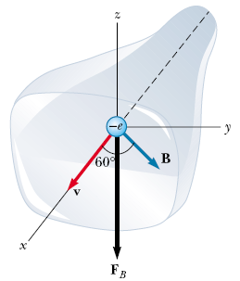
An electron in a television picture tube moves toward the front of the tube with a speed of 8.0 x 10⁶ m/s along the x axis. Surrounding the neck of the tube are coils of wire that create a magnetic field of magnitude 0.025 T, directed at an angle of 60° to the x axis and lying in the xy plane. Calculate the magnetic force on and acceleration of the electron.

Slide 3
A proton is moving in a circular orbit of radius 14 cm in a uniform 0.35-T magnetic field perpendicular to the velocity of the proton. Find the linear speed of the proton.

Slide 4
Example 29.7 In an experiment designed to measure the magnitude of a uniform magnetic ﬁeld, electrons are accelerated from rest through a potential difference of 350 V. The electrons travel along a curved path because of the magnetic force exerted on them, and the radius of the path is measured to be 7.5 cm. (Fig. 29.20 shows such a curved beam of electrons.) If the magnetic ﬁeld is perpendicular to the beam, (A) what is the magnitude of the ﬁeld? (B) What is the angular speed of the electrons?
Figure 29.20 (Example 29.7) The bending of an electron
beam in a magnetic ﬁeld.

Slide 5
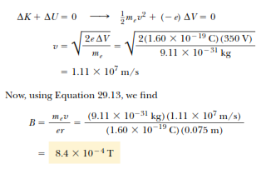
To begin analyzing the problem, we ﬁnd the electron speed. For the isolated electron–electric ﬁeld system, the loss of potential energy as the electron moves through the 350-V potential difference appears as an increase in the kinetic energy of the electron. Because K _{I} = 0 and , we have K_{f} =1/2m_{e} v ² we have

Slide 6
