Slide 1
Chapter 28 Problems
2,6,8,9,15,20,21,36,40

Slide 2
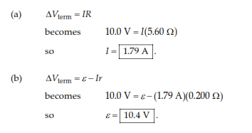
2.(a) What is the current in a 5.60-Ω resistor connected to a battery that has a 0.200-Ω internal resistance if the terminal voltage of the battery is 10.0 V? (b) What is the emf of the battery?

Slide 3
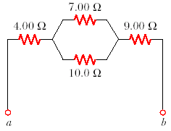
6. (a) Find the equivalent resistance between points a and b in Figure P28.6. (b) A potential difference of 34.0 V is applied between points a and b. Calculate the current in each resistor.

Slide 4
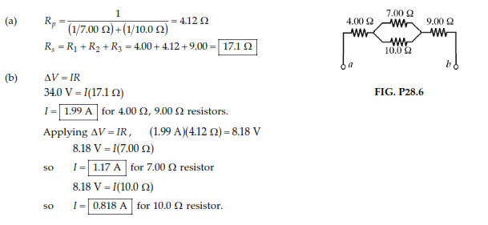

Slide 5
8. Four copper wires of equal length are connected in series. Their cross-sectional areas are 1.00 cm², 2.00 cm², 3.00 cm², and 5.00 cm². A potential difference of 120 V is applied across the combination. Determine the voltage across the 2.00-cm² wire.

Slide 6
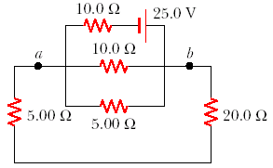
9. Consider the circuit shown in Figure P28.9. Find (a) the current in the 20.0-Ω resistor and (b) the potential difference between points a and b.

Slide 7
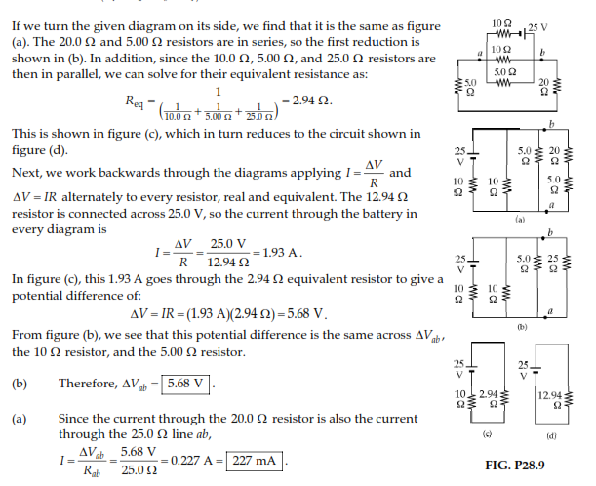

Slide 8
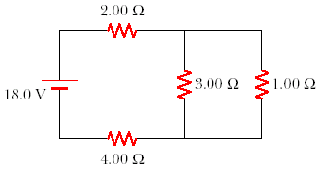
15. Calculate the power delivered to each resistor in the circuit shown in Figure P28.15.

Slide 9
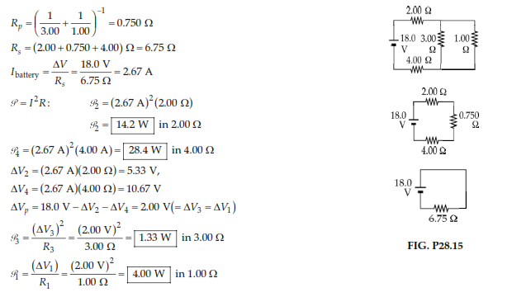

Slide 10
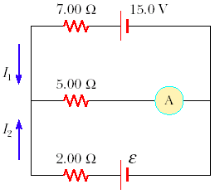
20. The ammeter shown in Figure P28.20 reads 2.00 A. Find I₁, I₂, and ε.

Slide 12
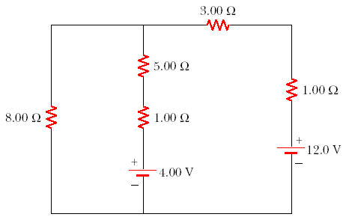
21. Determine the current in each branch of the circuit shown in Figure P28.21.

Slide 13
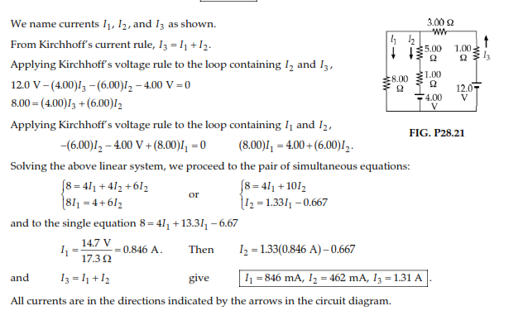

Slide 14
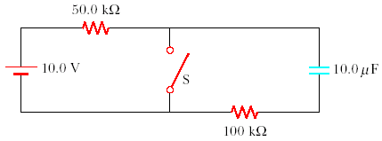
36. In the circuit of Figure P28.36, the switch S has been open for a long time. It is then suddenly closed. Determine the time constant (a) before the switch is closed and (b) after the switch is closed. (c) Let the switch be closed at t = 0. Determine the current in the switch as a function of time.

Slide 15
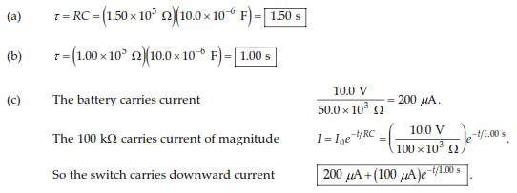

Slide 16
40. Dielectric materials used in the manufacture of capacitors are characterized by conductivities that are small but not zero. Therefore, a charged capacitor slowly loses its charge by “leaking” across the dielectric. If a capacitor having capacitance C leaks charge such that the potential difference has decreased to half its initial (t = 0) value at a time t, what is the equivalent resistance of the dielectric?

Slide 17
