Slide 1
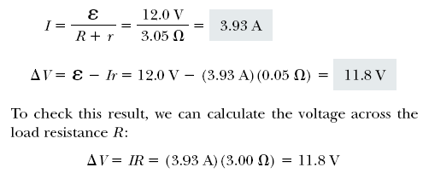
Example 28.1 Terminal Voltage of a Battery
A battery has an emf of 12V and an internal resistance of 0.05Ω. Its terminals are connected to a load resistance of 3Ω. Find:
The current in the circuit and the terminal voltage
The power dissipated in the load, the internal resistance, and the total power delivered by the battery

Slide 2
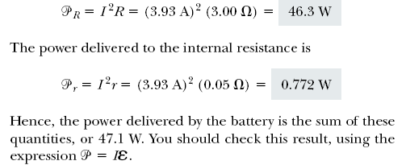

Slide 3
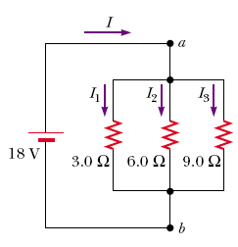
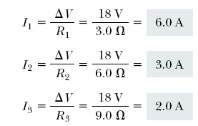
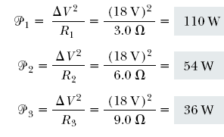
Three resistors are connected in parallel as shown in Figure 28.7. A potential difference of 18 V is maintained between points a and b.
(a) Find the current in each resistor.
(b) Calculate the power delivered to each resistor and the total power delivered to the combination of resistors.
Notes:
Active Figure 28.4 (c) The resistors replaced with a single resistor having an equivalent resistance Req = R1+R2.

Slide 4
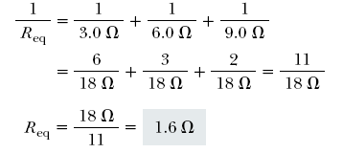
(c) Calculate the equivalent resistance of the circuit.
Notes:
Figure 28.5 (Quick Quiz 28.4) What happens when the switch is opened?

Slide 5
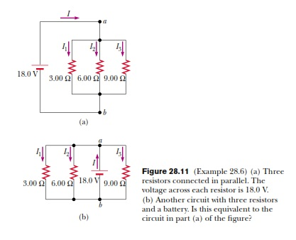
EX 6. Three resistors are connected in parallel as shown in Figure 28.11a. A potential difference of 18.0 V is maintained between points a and b.
(A) Find the current in each resistor.

Slide 6
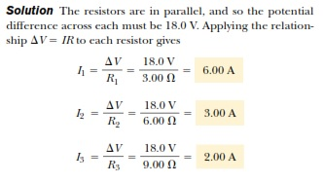

Slide 7
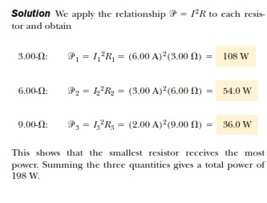
(B) Calculate the power delivered to each resistor and the total power delivered to the combination of resistors.

Slide 8
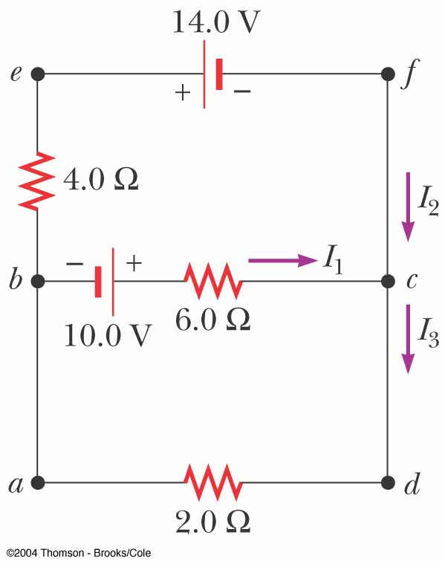
Find the currents I₁ , I₂ , and I₃ in the circuit
We arbitrarily choose the directions of the currents as labeled in Figure
Substituting Equation (1) into Equation (2) gives
Dividing each term in Equation (3) by 2 and rearranging gives
Subtracting Equation (5) from Equation (4) eliminates I ₂ , giving
The fact that I ₂ and I ₃ are both negative indicates only that the currents are opposite the direction we chose for them. However, the numerical values are correct.
Notes:
Figure 28.17 (Example 28.9) A circuit containing different branches.

Slide 9
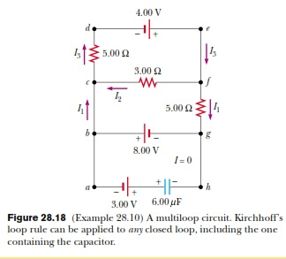
EX 10

Slide 10
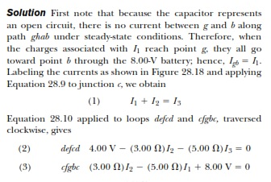

Slide 11
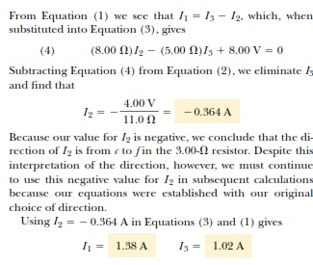

Slide 12
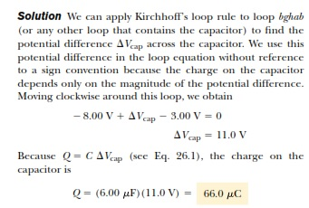
EX 10

