Slide 1
Chapter 28
Direct Current Circuits
28.1 Electromotive Force
28.2 Resistors in Series and Parallel
28.3 Kirchhoff’s Rules

Slide 2
28.1 Electromotive Force
A constant current can be maintained in a closed circuit through the use of a source of emf, (such as a battery or generator) that produces an electric field and thus may cause charges to move around a circuit.
One can think of a source of emf as a “charge pump.” When an electric potential difference exists between two points, the source moves charges “uphill” from the lower potential to the higher.
The emf describes the work done per unit charge, and hence the SI unit of emf is the volt.
The emf of a battery 𝜺 is the maximum possible voltage that the battery can provide between its terminals.
Notes:
Figure 28.1

Slide 3
assume that the connecting wires have no resistance.
The positive terminal of the battery is at a higher potential than the negative terminal. If we neglect the internal resistance of the battery, the potential difference across it (called the terminal voltage) equals its emf.
However, because a real battery always has some internal resistance r, the terminal voltage is not equal to the emf for a battery in a circuit in which there is a current.
A circuit consisting of a resistor connected to the terminals of a battery.

Slide 4
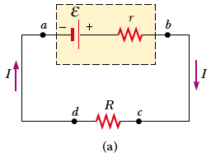
As we pass from the negative terminal to the positive terminal, the potential increases by an amount ε.
As we move through the resistance r, the potential decreases by an amount Ir, where I is the current in the circuit.
Figure 28.2 (a) Circuit diagram of a source of emf (in this case, a battery), of internal resistance r, connected to an external resistor of resistance R.
ε : is equivalent to the open-circuit voltage—that is, the terminal voltage when the current is zero. The emf is the voltage labeled on a battery,….
the terminal voltage V must equal the potential difference across the external resistance R, often called the load resistance.
Notes:
Active Figure 28.2 (a) Circuit diagram of a source of emf (in this case, a battery), of internal resistance r, connected to an external resistor of resistance R. (b) Graphical representation showing how the electric potential changes as the circuit in part (a) is traversed clockwise.

Slide 5
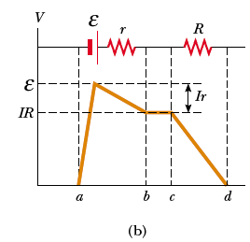
the changes in electric potential as the circuit is traversed in the clockwise direction
The resistor represents a load on the battery because the battery must supply energy to operate the device. The potential difference across the load resistance is
ΔV = IR
Figure 28.2 (b) Graphical representation showing how the electric potential changes as the circuit in part (a) is traversed clockwise.
the total power output Iε of the battery is delivered to the external load resistance in the amount I ²R and to the internal resistance in the amount I ²r.

Slide 6
Real Batteries
I
A
r = “internal resistance” of the battery
r
I
R_{L} (external resistance, “load”)
I
B
V_{B} + - Ir = V_{A}
V_{A} – V_{B} = V = “terminal voltage” ➔ measured
ε - Ir = V
“Terminal voltage”

Slide 7
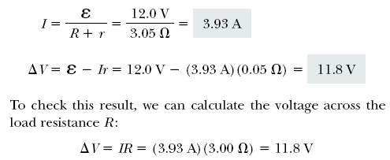
Example 28.1 Terminal Voltage of a Battery
A battery has an emf of 12V and an internal resistance of 0.05Ω. Its terminals are connected to a load resistance of 3Ω. Find:
The current in the circuit and the terminal voltage
The power dissipated in the load, the internal resistance, and the total power delivered by the battery

Slide 8
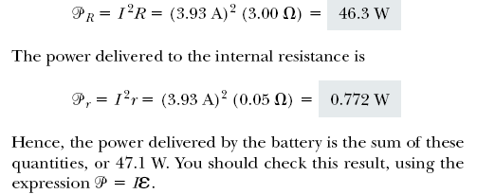

Slide 9
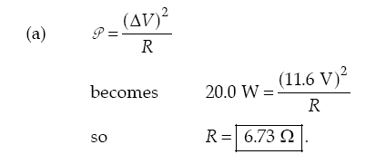
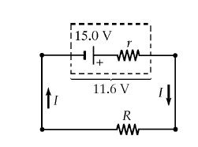
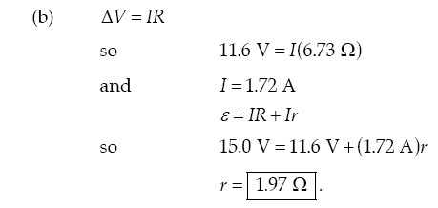
Example
* A battery has an emf of 15.0 V. The terminal voltage of the battery is 11.6 V when it is delivering 20.0 W of power to an external load resistor R. (a) What is the value of R? (b) What is the internal resistance of the battery?

Slide 10
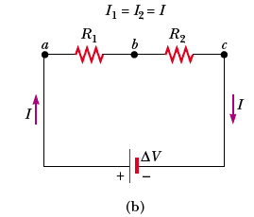
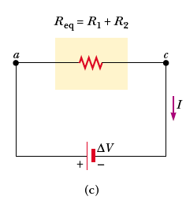
28.2 Resistors in Series and Parallel
series connection
When two or more resistors are connected together as are the light- bulbs, they are said to be in series.
In a series connection, all the charges moving through one resistor must also pass through the second resistor.
for a series combination of two resistors, the currents are the same in both resistors because the amount of charge that passes through R₁ must also pass through R₂
This relationship indicates that the equivalent resistance of a series connection of resistors is always greater than any individual resistance.
Notes:
Figure 28.4 (a) A series connection of two lightbulbs with resistances R1 and R2. (b) Circuit diagram for the two-resistor circuit. The current in R1 is the same as that in R2. (c) The resistors replaced with a single resistor having an equivalent resistance Req = R1+R2.

Slide 11
Find the equivalent resistance R_{e}. What is the current I in the circuit?
Example :
R_{eq} = R₁ + R₂ + R₃
2 Ω
Equivalent R_{eq} = 3 Ω + 2 Ω + 1 Ω = 6 Ω
3 Ω
1 Ω
The current is found from Ohm’s law: V = IR_{e}
12 V
I = 2 A
Current I = 2 A same in each R.
V₁ = IR₁ ; V₂ = IR_{2 ;} V₃ = IR₃
V₁ = (2 A)(1 Ω) = 2 V
V₁ + V₂ + V₃ = V_{Total}
V₁ = (2 A)(2 Ω) = 4 V
2 V + 4 V + 6 V = 12 V
V₁ = (2 A)(3 Ω) = 6 V

Slide 12
Exmple
1. Find Req
2. Find Itotal
3. Find the V drops across each resistor.
1. Since the resistors are in series, simply add the three resistances to find R_{eq}:
R_{eq} = 4 Ω + 2 Ω + 6 Ω = 12 Ω
4 Ω
2. To find I_{total} (the current through the battery), use V = I R: 6 = 12 I. So, I = 6/12 = 0.5 A
2 Ω
6 V
6 Ω
Since the current throughout a series circuit is constant, use V = I R with each resistor individually to find the V drop across each. Listed clockwise from top:
V1 = (0.5)(4) = 2 V
V2 = (0.5)(2) = 1 V
V3 = (0.5)(6) = 3 V
Note the voltage drops sum to 6 V.

Slide 13
Now consider two resistors connected in parallel,
When the current I reaches point a in Figure 28.5b, called a junction, it splits into two parts, with I1 going through R₁ and I 2 going through R₂ . A junction is any point in a circuit where a current can split
when resistors are connected in parallel, the potential differences across the resistors is the same.
Notes:
Figure 28.6 (a) A parallel connection of two lightbulbs with resistances R1 and R2.

Slide 14
Calculate the total resistance in the circuit below
3 Ω
2 Ω
R_{eq} = 3 Ω + 2 Ω = 5 Ω
6 Ω
4 Ω
R_{eq} = 6 Ω + 4 Ω = 10 Ω
R_{eq} = 3 .33 Ω
+
-
1/Req = 2/10 Ω+ 1/10 Ω = 3/10 Ω

Slide 15
Parallel Example
1. Find Req
2. Find Itotal
15 V
6 Ω
4 Ω
3. Find the current through, and voltage drop across, each resistor.
1. 1/R_{eq}= 1/R1 + 1/R2 = 1/4 + 1/6
= 6/24 + 4/24 = 5/12
R_{eq} = 12/5 = 2.4 Ω
I_{total}
I₂
2. Itotal = V / R_{eq}
= 15 / (12/5)
= 75/12 = 6.25 A
I₁
6 Ω
15 V
4 Ω
3. The voltage drop across each resistor is the same in parallel. Each drop is 15 V. The current through the 4 Ω resistor is (15 V)/(4 Ω) = 3.75 A. The current through the 6 Ω resistor is (15 V)/(6 Ω) = 2.5 A. Check:

Slide 16
Assume a 12-V emf is connected to the circuit as shown. Find the equivalent resistance R_{e} for the three resistors below. What is the total current leaving the source of emf?
Example
V_{T}
R₁
R₂
R₃
2 Ω
4 Ω
6 Ω
12 V
R_{eq} = 1.09 𝜴
V_{total} = 12 V;
V₁ = V₂ = V₃ = 12 V
I_{T} = I₁ + I₂ + I₃
Total current: I_{T} = 11.0 A
Ohm’s Law:

Slide 17
Find the equivalent resistance for the circuit drawn below (assume V_{T} = 12 V). Find the total current I_{T}.
Example
4 Ω
V_{T}
3 Ω
6 Ω
R_{eq} = 4 Ω + 2 Ω = 6 Ω
4 Ω
12 V
6 Ω
12 V
2 Ω
I_{T} = 2.00 A

Slide 18
Find the currents and the voltages across each resistor.
I₄ = I_{T} = 2 A
4 Ω
V_{T}
3 Ω
6 Ω
V₄ = (2 A)(4 Ω) = 8 V
The remainder of the voltage: (12 V – 8 V = 4 V) drops across EACH of the parallel resistors.
This can also be found from V_{3,6} = I_{3,6}R_{3,6} = (2 A)(2 Ω)
V₃ = V₆ = 4 V

Slide 19
Find the currents and voltages across each resistor.
V₄ = 8 V
V₆ = V₃ = 4 V
4 Ω
V_{T}
3 Ω
6 Ω
I₃ = 1.33 A
I₆ = 0.667 A
I₄ = 2 A

Slide 20
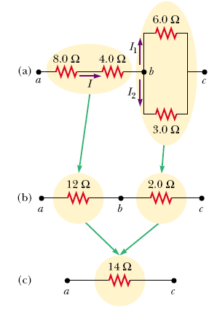
(a) Find the equivalent resistance between points a and c.
(b) What is the current in each resistor if a potential difference of 42V is maintained between a and c ?
Notes:
Active Figure 28.4 (b) Circuit diagram for the two-resistor circuit. The current in R1 is the same as that in R2.

Slide 21
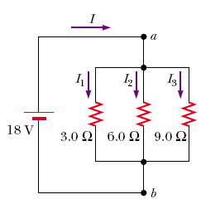
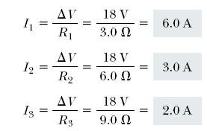
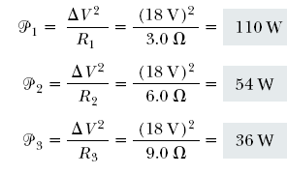
Three resistors are connected in parallel as shown in Figure 28.7. A potential difference of 18 V is maintained between points a and b.
(a) Find the current in each resistor.
(b) Calculate the power delivered to each resistor and the total power delivered to the combination of resistors.
Notes:
Active Figure 28.4 (c) The resistors replaced with a single resistor having an equivalent resistance Req = R1+R2.

Slide 22
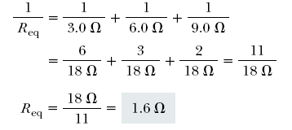
(c) Calculate the equivalent resistance of the circuit.
Exercise :Use R_{eq} to calculate the total power delivered by the battery.
Answer :200 W.
Notes:
Figure 28.5 (Quick Quiz 28.4) What happens when the switch is opened?

Slide 23
If three equal resistors are in parallel, the total resistance is
a. one third the value of one resistor
b. the same as one resistor
c. three times the value of one resistor
d. there is not enough information to say

Slide 24
- we can analyze simple circuits using the expression V IR and the rules for series and parallel combinations of resistors. Very often, however, it is not possible to reduce a circuit to a single loop.
- The procedure for analyzing more complex circuits is greatly simplified if we use two principles called Kirchhoff’s rules:
Notes:
Active Figure 28.6 (b) Circuit diagram for the two-resistor circuit. The potential difference across R1 is the same as that across R2.

Slide 25
Kirchhoff’s first rule is a statement of conservation of electric charge.
the charge passes through some circuit elements must equal the sum of the
decreases in energy as it passes through other elements. The potential energy
decreases whenever the charge moves through a potential drop IR across a resis-tor or whenever it moves in the reverse direction through a source of emf. The
potential energy increases whenever the charge passes through a battery from the
negative terminal to the positive terminal.
Fig 28-14, p.870
Notes:
the charge passes through some circuit elements must equal the sum of the
decreases in energy as it passes through other elements. The potential energy
decreases whenever the charge moves through a potential drop IR across a resis-tor
or whenever it moves in the reverse direction through a source of emf. The
potential energy increases whenever the charge passes through a battery from the
negative terminal to the positive terminal.
Figure 28.14 (a) Kirchhoff’s junction rule. Conservation of charge requires that all charges entering a junction must leave that junction. Therefore, I1= I2+ I3. (b) A mechanical analog of the junction rule: the amount of water flowing out of the branches on the right must equal the amount flowing into the single branch on the left.

Slide 26
Kirchhoff’s second rule follows from the law of conservation of energy.
Let us imagine moving a charge around the loop. When the charge returns to the starting point, the charge–circuit system must have the same energy as when the charge started from it.
The sum of the increases in energy in some circuit elements must equal the sum of the decreases in energy in other elements.
The potential energy decreases whenever the charge moves through a potential drop IR across a resistor or whenever it moves in the reverse direction through a source of emf. The potential energy increases when-ever the charge passes through a battery from the negative terminal to the positive terminal.

Slide 27
Traveling around the loop from a to b
In a, the resistor is transversed in the direction of the current, the potential across the resistor is –IR
In b, the resistor is transversed in the direction opposite of the current, the potential across the resistor is +IR
In c, the source of emf is transversed in the direction of the emf (from – to +), the change in the electric potential is +ε
In d, the source of emf is transversed in the direction opposite of the emf (from + to -), the change in the electric potential is -ε

Slide 28
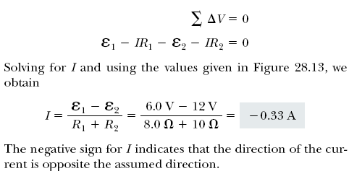
(a) Find the current in the circuit. (Neglect the internal resistances of the batteries.)
Traversing the circuit in the clockwise direction, starting at a, we see that a →b represents a potential change of +ε₁ , b → c represents a potential change of - IR₁ , c → d represents a potential change of -ε₂ , and d → a represents a potential change of -IR₂ . Applying Kirchhoff’s loop rule gives
Notes:
Figure 28.16 (Example 28.8) A series circuit containing two batteries and two resistors, where the polarities of the batteries are in opposition.

Slide 29
(b) What power is delivered to each resistor? What power is delivered by the 12-V battery?
The 12-V battery delivers power Iε₂. Half of this power is delivered to the two resistors, as we just calculated. The other half is delivered to the 6-V battery, which is being charged by the 12-V battery.

Slide 30
Find the currents I₁ , I₂ , and I₃ in the circuit
We arbitrarily choose the directions of the currents as labeled in Figure
Substituting Equation (1) into Equation (2) gives
Dividing each term in Equation (3) by 2 and rearranging gives
Subtracting Equation (5) from Equation (4) eliminates I ₂ , giving
The fact that I ₂ and I ₃ are both negative indicates only that the currents are opposite the direction we chose for them. However, the numerical values are correct.
Notes:
Figure 28.17 (Example 28.9) A circuit containing different branches.

Slide 31
Exercise Find the potential difference between points b and c .
Answer 2 V.

Slide 32
30 Ω
h
I₁
40 Ω
I₃
1 Ω
ε₂ = 45 V
a
a
d
d
b
c
20 Ω
I₂
ε₁ = 85 V
1 Ω
g
f
e
Back to our circuit: we have 3 unknowns (I₁, I₂, and I₃), so we will need 3 equations. We begin with the junctions.
Junction a: I₃ – I₁ – I₂ = 0 --eq. 1
Junction d: -I₃ + I₁ + I₂ = 0
Junction d gave no new information, so we still need two more equations.

Slide 33
30 Ω
h
I₁
40 Ω
I₃
1 Ω
ε₂ = 45 V
a
d
b
c
20 Ω
I₂
ε₁ = 85 V
1 Ω
g
f
e
There are three loops.
Loop 1.
Loop 2.
Loop 3.
Any two loops will produce independent equations. Using the third loop will provide no new information.

Slide 34
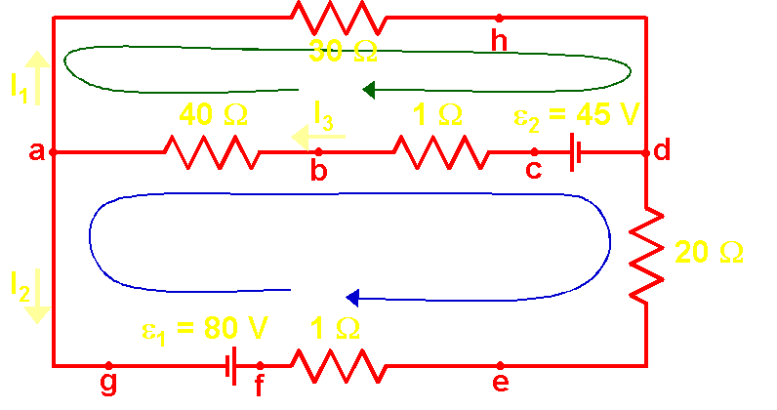
Reminders:
I
+
V is -
-
V is +
loop
loop
5
The “green” loop (a-h-d-c-b-a):
(- 30 I₁) + (+45) + (-1 I₃) + (- 40 I₃) = 0
- 30 I₁ + 45 - 41 I₃ = 0 --eq. 2
The “blue” loop (a-b-c-d-e-f-g):
(+ 40 I₃) + ( +1 I₃) + (-45) + (+20 I₂) + (+1 I₂) + (-85) = 0
41 I₃ -130 + 21 I₂ = 0 --eq. 3
skip algebra
Three equations, three unknowns; the rest is “algebra.”
Make sure to use voltages in V and resistances in Ω. Then currents will be in A.

Slide 35
Collect our three equations:
I₃ – I₁ – I₂ = 0
- 30 I₁ + 45 - 41 I₃ = 0
41 I₃ -130 + 21 I₂ = 0
Rearrange to get variables in “right” order:
– I₁ – I₂ + I₃ = 0
- 30 I₁ - 41 I₃ + 45 = 0
21 I₂ + 41 I₃ -130 = 0
Use the middle equation to eliminate I₁:
I₁ = (41 I₃ – 45)/(-30)
There are many valid sets of steps to solving a system of equations. Any that works is acceptable.

Slide 36
Two equations left to solve:
– (41 I₃ – 45)/(-30) – I₂ + I₃ = 0
21 I₂ + 41 I₃ -130 = 0
Might as well work out the numbers:
1.37 I₃ – 1.5 – I₂ + I₃ = 0
21 I₂ + 41 I₃ -130 = 0
– I₂ + 2.37 I₃ – 1.5 = 0
21 I₂ + 41 I₃ -130 = 0
Multiply the top equation by 21:
– 21 I₂ + 49.8 I₃ – 31.5 = 0
21 I₂ + 41 I₃ -130 = 0

Slide 37
Add the two equations to eliminate I₂:
– 21 I₂ + 49.8 I₃ – 31.5 = 0
+ ( 21 I₂ + 41 I₃ -130 = 0 )
90.8 I₃ – 161.5 = 0
Solve for I₃:
I₃ = 161.5 / 90.8
I₃ = 1.78
Go back to the “middle equation” two slides ago for I₁:
I₁ = (41 I₃ – 45)/(-30)
I₁ = - 1.37 I₃ + 1.5
I₁ = - (1.37) (1.78) + 1.5
I₁ = - 0.94

Slide 38
Go back two slides to get an equation that gives I₂:
– I₂ + 2.37 I₃ – 1.5 = 0
I₂ = 2.37 I₃ – 1.5
I₂ = (2.37) (1.78) – 1.5
I₂ = 2.72
Summarize answers so your lazy prof doesn’t have to go searching for them and get irritated (don’t forget to show units in your answer):
I₁ = - 0.94 A
I₂ = 2.72 A
I₃ = 1.78 A
Are these currents correct? How could you tell? We’d better check our results.

Slide 39
I₃ – I₁ – I₂ = 0
- 30 I₁ + 45 - 41 I₃ = 0
41 I₃ -130 + 21 I₂ = 0
I₁ = - 0.94 A
I₂ = 2.72 A
I₃ = 1.78 A
1.78 – (-0.94) – 2.72 = 0 ☑
- 30 (-0.94) + 45 - 41 (1.78) = 0.22 ☑?
41 (1.78) -130 + 21 (2.72) = 0.10 ☑?
Are the last two indication of a mistake or just roundoff error? Recalculating while retaining 2 more digits gives I₁=0.933, I₂=2.714, I₃=1.7806, and the last two results are 0.01 or less ⇒ roundoff was the culprit.

Slide 40
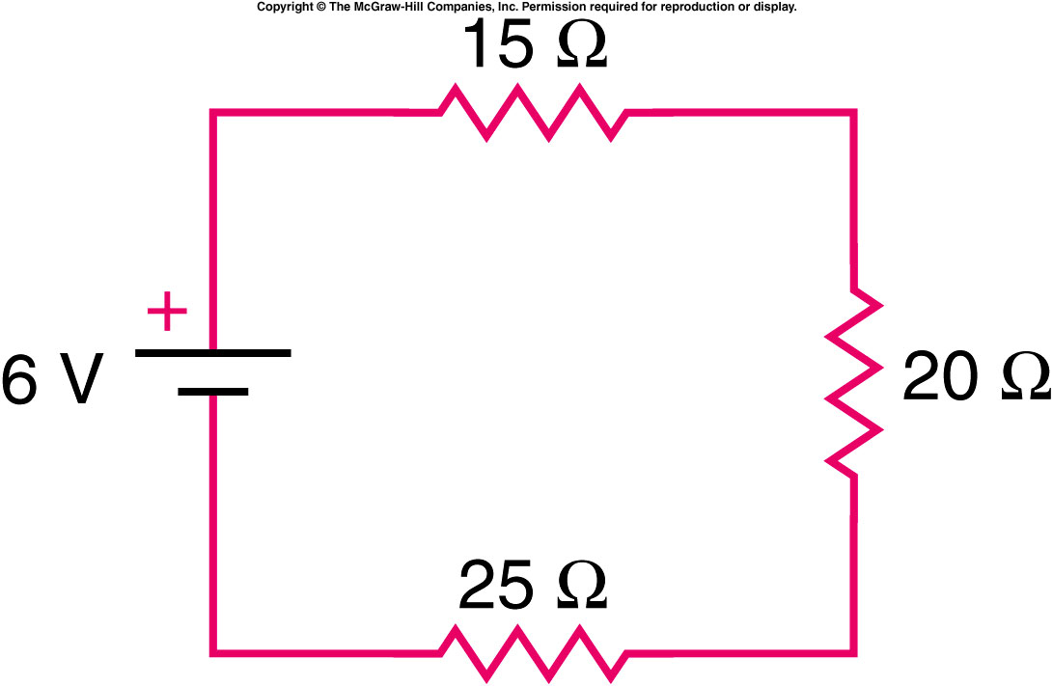
What is the total resistance of this circuit?
1.) 66 ohms
2.) 60 ohms
3.) 54 ohms
4.) 25 ohms
5.) 15 ohms
Notes:
Fig. 13.p274a

Slide 41
What is the current that flows in this circuit?
1.)10 amps
2.) 1 amp
3.) 0.1 amp
4.) 0.3 amp
5.) 0.03 amps
Notes:
Fig. 13.p274a

Slide 42
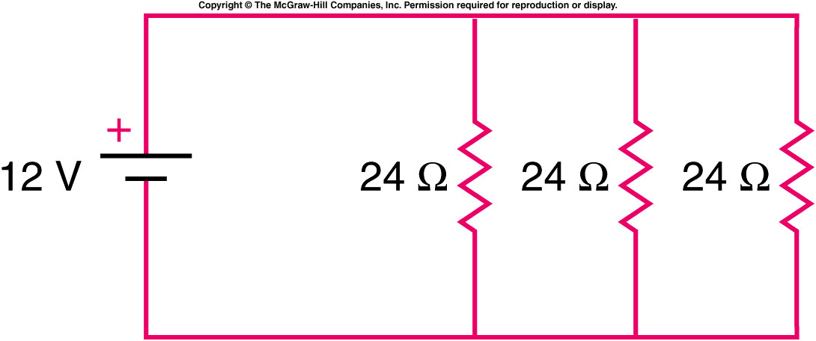
B.
.
A
What is the current that flows in this circuit at point A?
1.)288 amps
2.) 1.5 amp
3.) 0.1 amp
4.) 0.5 amp
5.) 0.03 amps
What is the current that flows in this circuit at point B?
1.)288 amps
2.) 1.5 amp
3.) 0.1 amp
4.) 0.5 amp
5.) 0.03 amps
Notes:
Fig. 13.p274b

Slide 43
For three resistors in parallel, choose the correct statement:
A. The current and the voltage across all three are the same.
B. The voltage drop and the power dissipated across all three are the same.
C. Power delivered = sum of the power dissipated across all three resistors.
D. The current through one resistor is the same as the current through the battery.
EMF
volts
1
2
3

Slide 44
How much current I runs through this circuit:
A. 0.25 Amps
B. 0.375 A
C. 0.67 A
D. 1.50 A
E. 2.25 A
3 V
4 Ω
4 Ω

Slide 45
10. The total power dissipated in a parallel circuit is equal to the
a. power in the largest resistor
b. power in the smallest resistor
c. average of the power in all resistors
d. sum of the power in all resistors

Slide 46
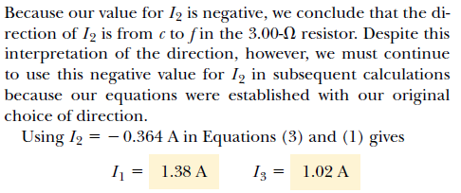
Figure 28.18 (Example 28.10) A multiloop circuit. Kirchhoff’s loop rule can be applied to any closed loop, including the one containing the capacitor.

Slide 47
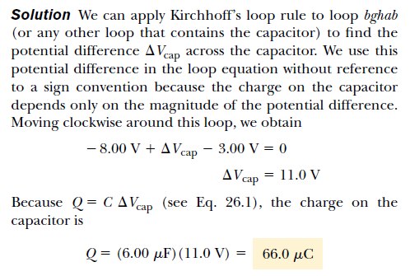

Slide 48
