Slide 1
Chapter 27
Problems
1,11,12,15,16,22,32,33,36,49,56

Slide 2
1. In a particular cathode ray tube, the measured beam current is 30.0 μA. How many electrons strike the tube screen every 40.0 s?

Slide 3
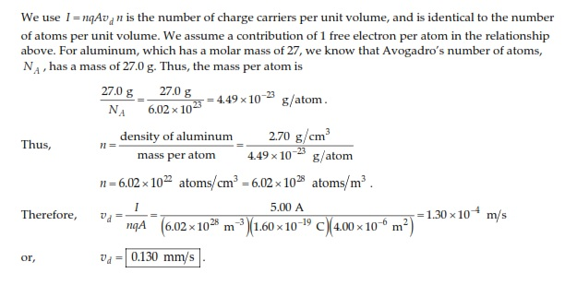
11. An aluminum wire having a cross-sectional area of 4.00 × 10^{–6} m² carries a current of 5.00 A. Find the drift speed of the electrons in the wire. The density of aluminum is 2.70 g/cm³. Assume that one conduction electron is supplied by each atom.

Slide 4
12. Calculate the current density in a gold wire at 20°C, if an electric field of 0.740 V/m exists in the wire.

Slide 5
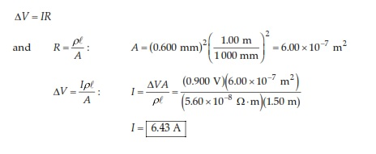
15. A 0.900-V potential difference is maintained across a 1.50-m length of tungsten wire that has a cross-sectional area of 0.600 mm². What is the current in the wire?

Slide 6
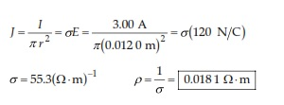
16. A conductor of uniform radius 1.20 cm carries a current of 3.00 A produced by an electric field of 120 V/m. What is the resistivity of the material?

Slide 7
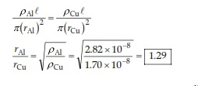
22. Aluminum and copper wires of equal length are found to have the same resistance. What is the ratio of their radii?

Slide 8
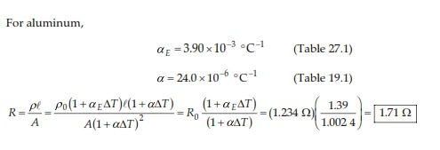
32. Review problem. An aluminum rod has a resistance of 1.234 Ω at 20.0°C. Calculate the resistance of the rod at 120°C by accounting for the changes in both the resistivity and the dimensions of the rod.

Slide 9
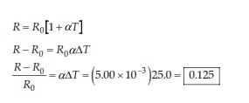
33. What is the fractional change in the resistance of an iron filament when its temperature changes from 25.0°C to 50.0°C?

Slide 10
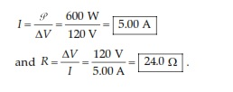
36. A toaster is rated at 600 W when connected to a 120-V source. What current does the toaster carry, and what is its resistance?

Slide 11
49. Compute the cost per day of operating a lamp that draws a current of 1.70 A from a 110-V line. Assume the cost of energy from the power company is $0.060 0/kWh.

Slide 12
56. A high-voltage transmission line with a diameter of 2.00 cm and a length of 200 km carries a steady current of 1 000 A. If the conductor is copper wire with a free charge density of 8.00 × 10²⁸ electrons/m³, how long does it take one electron to travel the full length of the line?

