Slide 1
Chapter 27
Examples

Slide 2
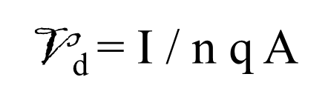
Ex. 1. A copper wire in a typical residential building has a cross-sectional area of 3.31x 10⁶ m². If it carries a current of 10.0 A, what is the drift speed of the electrons? Assume that each copper atom contributes one free electron to the current. The density of copper is 8.95 g/cm³. (Atomic mass of cupper is 63.5 g/mol.
# Recall that 1 mol of any substance contains Avogadro’s number of atoms (6.02x 10²³). Knowing the density of copper 8.95 g/cm³, we can calculate the volume occupied by 63.5 g (≡ 1mol) of copper:

Slide 3
V_{d} = I / n q A
10 / (8.49 x 10 ²⁸ m⁻³ )(1.6 x 10 ⁻¹⁹ C)(3.31 x 10 ⁻⁶ m⁻²)
= 2.22 x 10 ⁻⁴ m/s

Slide 4
Ex. 2 Calculate the resistance of an aluminum cylinder that is 10.0 cm long and has a cross-sectional area of 2.0x 10⁻⁴ m². Repeat the calculation for a cylinder of the same dimensions and made of glass having a resistivity of 3x10¹⁰ Ω

Slide 5
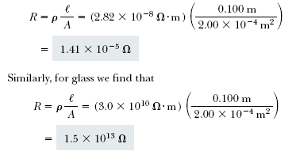

Slide 6
(Ex 3.a) Calculate the resistance per unit length of a 22-gauge Nickle Chrome wire, which has a radius of 0.321 mm.
(Ex 3.b) If a potential difference of 10 V is maintained across a 1.0-m length of the Nickle Chrome wire, what is the current in the wire?

Slide 7
I = ΔV/ R = 10 V / 4.6 Ω = 2.2 A

Slide 8
Ex. 6. A resistance thermometer, which measures temperature by measuring the change in resistance of a conductor, is made from platinum and has a resistance of 50.0 Ω at 20.0°C. When immersed in a vessel containing melting indium, its resistance increases to 76.8 . Calculate the melting point of the indium.
R = R_{o}[1 + α(T - T_{o})]
α = 3.92 x 10⁻³ C⁻¹

Slide 9
Ex. 7 An electric heater is constructed by applying a potential difference of 120 V to a Ni-chrome wire that has a total resistance of 8.0 Ω . Find the current carried by the wire and the power rating of the heater.

Slide 10
If we doubled the applied potential difference, the current would double but the power would quadruple because

Slide 11
Ex. 8 Estimate the cost of cooking a turkey for 4 h in an oven that operates continuously at 20.0 A and 240 V.

Slide 12
