Slide 1
Chapter 26 Problems Solving

Slide 2
1. (a) How much charge is on each plate of a 4.00-μF capacitor when it is connected to a 12.0-V battery? (b) If this same capacitor is connected to a 1.50-V battery, what charge is stored?

Slide 3
4. (a) If a drop of liquid has capacitance 1.00 pF, what is its radius? (b) If another drop has radius 2.00 mm, what is its capacitance? (c) What is the charge on the smaller drop if its potential is 100 V?

Slide 4
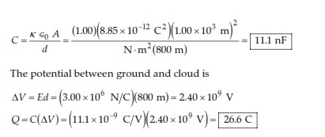
6. Regarding the Earth and a cloud layer 800 m above the Earth as the “plates’’ of a capacitor, calculate the capacitance. Assume the cloud layer has an area of 1.00 km² and that the air between the cloud and the ground is pure and dry. Assume charge builds up on the cloud and on the ground until a uniform electric field of 3.00 × 10⁶ N/C throughout the space between them makes the air break down and conduct electricity as a lightning bolt. What is the maximum charge the cloud can hold?

Slide 5
7. An air-filled capacitor consists of two parallel plates, each with an area of 7.60 cm², separated by a distance of 1.80 mm. A 20.0-V potential difference is applied to these plates. Calculate (a) the electric field between the plates, (b) the surface charge density, (c) the capacitance, and (d) the charge on each plate.

Slide 7
9. When a potential difference of 150 V is applied to the plates of a parallel-plate capacitor, the plates carry a surface charge density of 30.0 n C/cm². What is the spacing between the plates?

Slide 8
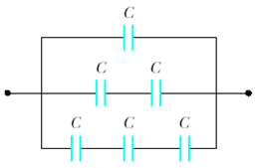
18. Evaluate the equivalent capacitance of the configuration shown in Figure. All the capacitors are identical, and each has capacitance C.

Slide 9
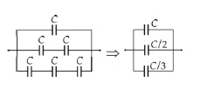

Slide 10
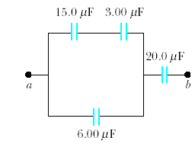
21.Four capacitors are connected as shown in Figure P26.21. (a) Find the equivalent capacitance between points a and b. (b) Calculate the charge on each capacitor if ΔV_{ab} = 15.0 V.

Slide 11
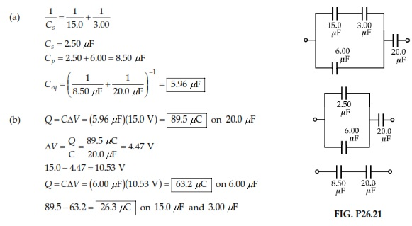

Slide 12
31. (a) A 3.00-μF capacitor is connected to a 12.0-V battery. How much energy is stored in the capacitor? (b) If the capacitor had been connected to a 6.00-V battery, how much energy would have been stored?

Slide 13
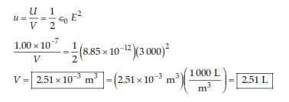
36. A uniform electric field E = 3 000 V/m exists within a certain region. What volume of space contains an energy equal to 1.00 × 10^{–7} J? Express your answer in cubic meters and in liters.

Slide 14
47. A parallel-plate capacitor in air has a plate separation of 1.50 cm and a plate area of 25.0 cm². The plates are charged to a potential difference of 250 V and disconnected from the source. The capacitor is then immersed in distilled water. Determine (a) the charge on the plates before and after immersion, (b) the capacitance and potential difference after immersion, and (c) the change in energy of the capacitor. Assume the liquid is an insulator.

Slide 15
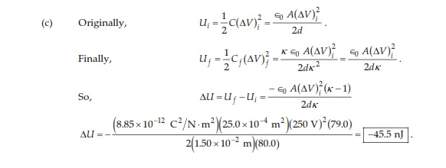

Slide 16
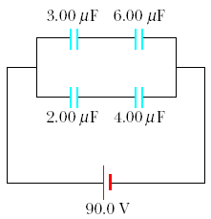
54. For the system of capacitors shown in Figure P26.54, find (a) the equivalent capacitance of the system, (b) the potential across each capacitor, (c) the charge on each capacitor, and (d) the total energy stored by the group.

Slide 17
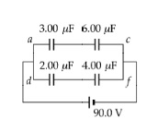

Slide 18
