Slide 1
Chapter 26 Examples
26.1 parallel-plate capacitor with air between the plates has an area A = 2.00 x 10 ⁻⁴ m ² and a plate separation d = 1.00 mm. Find its capacitance?.

Slide 2
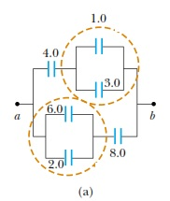
4. Find the equivalent capacitance between a and b for the combination of capacitors shown in Figure. All capacitances are in microfarads.

Slide 3
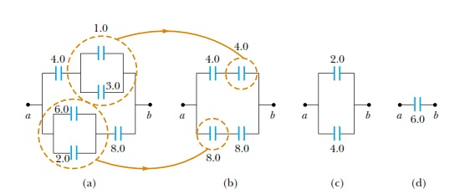

Slide 4
We reduce the combination step by step as indicated in the ﬁgure. The 1.0- m F
and 3.0- mF capacitors are in parallel and combine according to the expression
C eq = C 1 + C 2 = 4.0 mF.
The 2.0-mF and 6.0-mF capacitors also are in parallel and have an equivalent capacitance of 8.0 mF. Thus, the upper branch in Figure
consists of two 4.0-mF capacitors in series, which combine as follows:
The lower branch in Figure consists of two 8.0-μF capacitors in series, which combine to yield an equivalent capacitance of 4.0 μF. Finally, the 2.0-μF and 4.0-μF capacitors in Figure are in parallel and thus have an equivalent capacitance of 6.0 μF.

Slide 6
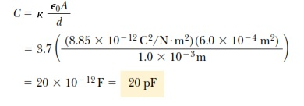
6. A parallel-plate capacitor has plates of dimensions 2.0 cm by 3.0 cm separated by a 1.0-mm thickness of paper. (A) Find its capacitance.

Slide 7
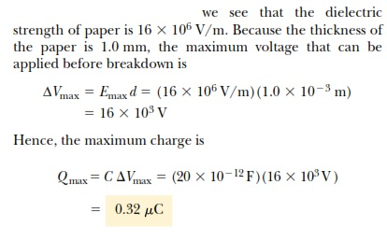
(B) What is the maximum charge that can be placed on the capacitor?

Slide 8
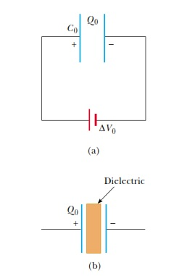
7. A parallel-plate capacitor is charged with a battery to a charge Q₀ , as shown in Figure a. The battery is then removed, and a slab of material that has a dielectric constant 1 is inserted between the plates, as shown in Figure b. Find the energy stored in the capacitor before and after the dielectric is inserted.

Slide 9
