Slide 1
3. A 40.0-cm-diameter loop is rotated in a uniform electric field until the position of maximum electric flux is found. The flux in this position is measured to be 5.20 × 10⁵ N · m²/C. What is the magnitude of the electric field?
ΦE = EA cos θ
The flux is a maximum when the surface is perpendicular to the field
The flux is a minimum (zero) when the surface is (parallel) to the field

Slide 2
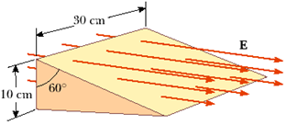
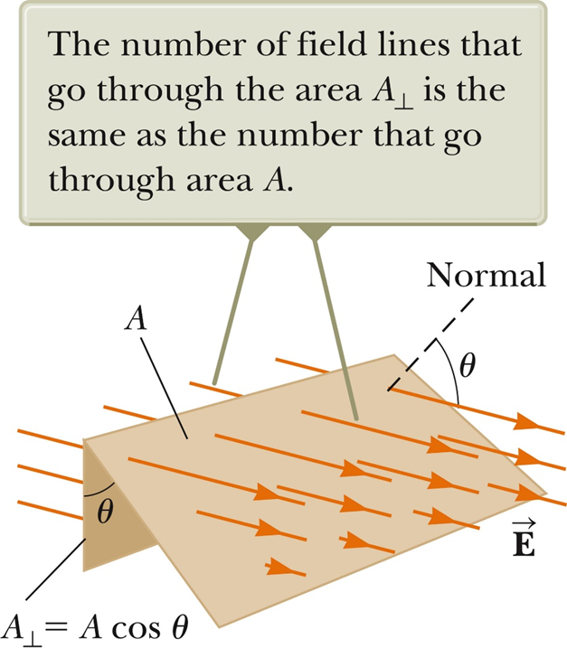
4. Consider a closed triangular box resting within a horizontal electric field of magnitude E = 7.80 × 104 N/C as shown in Figure P24.4. Calculate the electric flux through (a) the vertical rectangular surface.
(b) the slanted surface, and (c) the entire surface of the box.

Slide 3
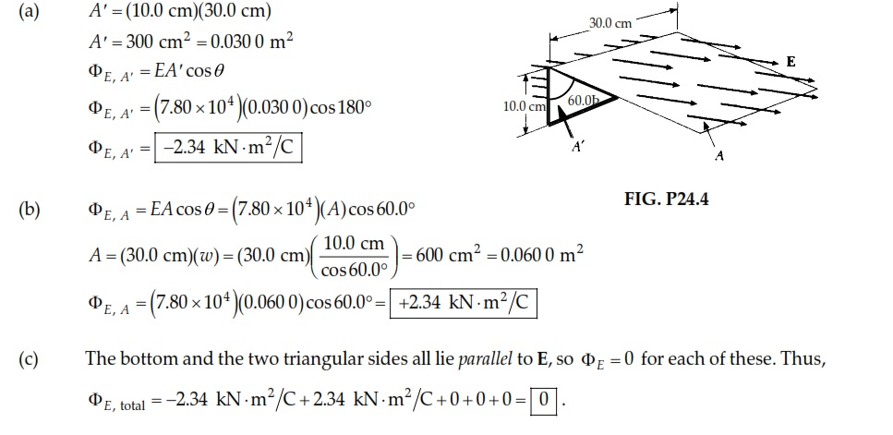

Slide 4
9. The following charges are located inside a submarine: 5.00 μC, –9.00 μC, 27.0 μC, and –84.0 μC. (a) Calculate the net electric flux through the hull of the submarine. (b) Is the number of electric field lines leaving the submarine greater than, equal to, or less than the number entering it?

Slide 5
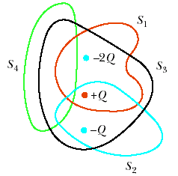
11. Four closed surfaces, S1 through S4, together with the charges –2Q, Q, and –Q are sketched in Figure P24.11. (The colored lines are the intersections of the surfaces with the page.) Find the electric flux through each surface.

Slide 6
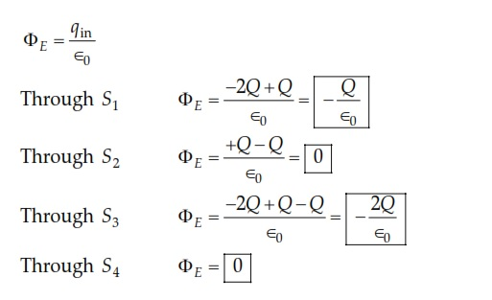

Slide 7
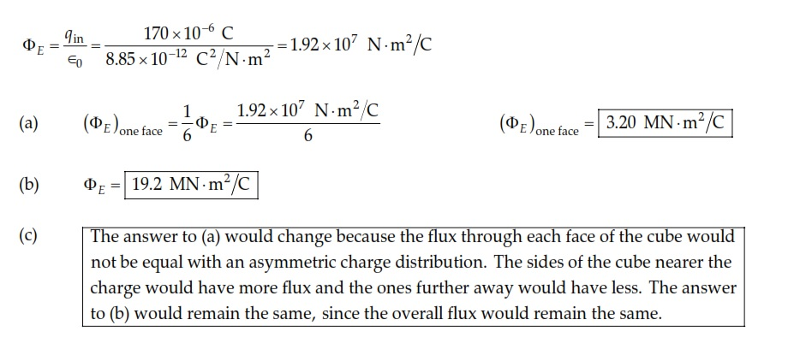
21. A charge of 170 μC is at the center of a cube of edge 80.0 cm. (a) Find the total flux through each face of the cube. (b) Find the flux through the whole surface of the cube. (c) What If? Would your answers to parts (a) or (b) change if the charge were not at the center? Explain.

Slide 8
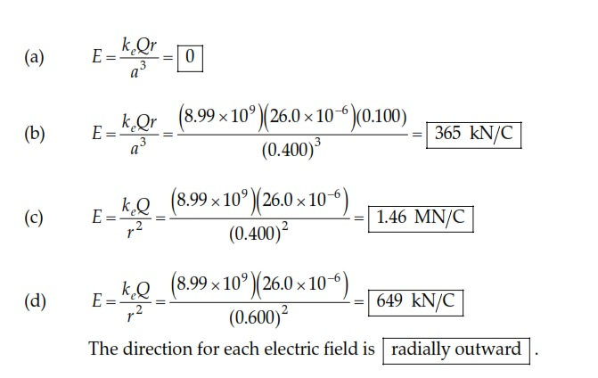
24.A solid sphere of radius 40.0 cm has a total positive charge of 26.0 μC uniformly distributed throughout its volume. Calculate the magnitude of the electric field (a) 0 cm, (b) 10.0 cm, (c) 40.0 cm, and (d) 60.0 cm from the center of the sphere.

Slide 9
31.Consider a thin spherical shell of radius 14.0 cm with a total charge of 32.0 μC distributed uniformly on its surface. Find the electric field (a) 10.0 cm and (b) 20.0 cm from the center of the charge distribution.

Slide 10
35.A uniformly charged, straight filament 7.00 m in length has a total positive charge of 2.00 μC. An uncharged cardboard cylinder 2.00 cm in length and 10.0 cm in radius surrounds the filament at its center, with the filament as the axis of the cylinder. Using reasonable approximations, find (a) the electric field at the surface of the cylinder and (b) the total electric flux through the cylinder.

Slide 11
37.A large flat horizontal sheet of charge has a charge per unit area of 9.00 μC/m2. Find the electric field just above the middle of the sheet.

Slide 12
40. On a clear, sunny day, a vertical electric field of about 130 N/C points down over flat ground. What is the surface charge density on the ground for these conditions?

Slide 13
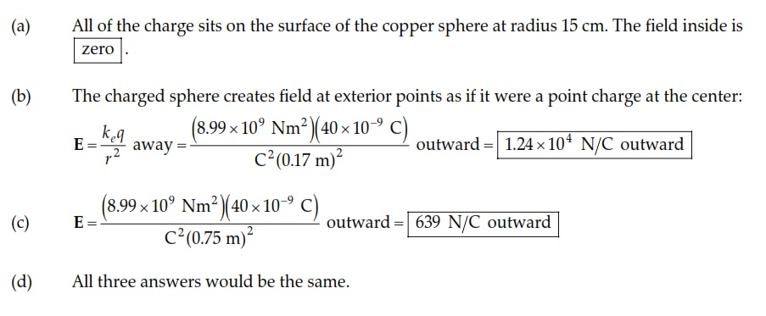
42. A solid copper sphere of radius 15.0 cm carries a charge of 40.0 nC. Find the electric field (a) 12.0 cm, (b) 17.0 cm, and (c) 75.0 cm from the center of the sphere. (d) What If? How would your answers change if the sphere were hollow?

