Slide 1
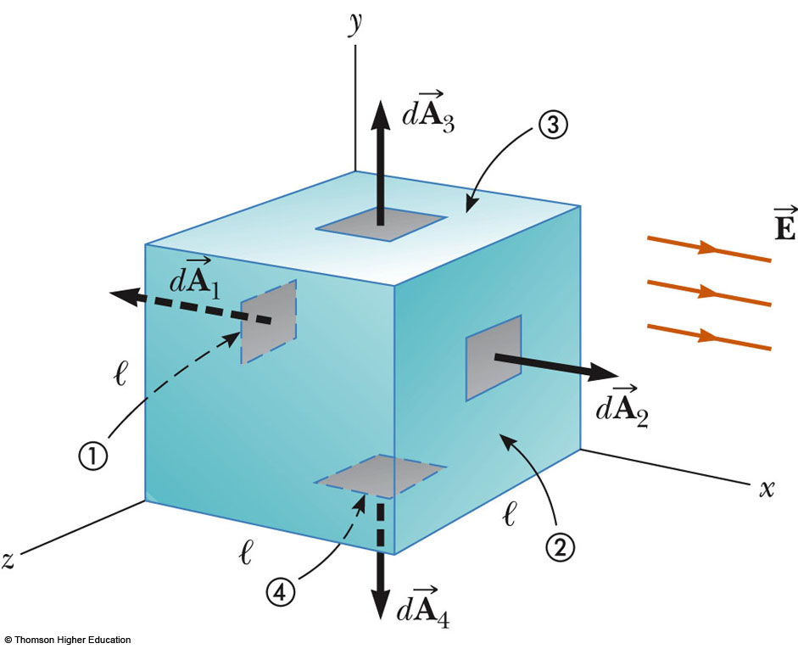
Example 24-2: flux through a cube of a uniform electric field
The field lines pass through l h two surfaces perpendicularly and are parallel to the other four surfaces
For side 1, Φ_{E} = -El ²
For side 2, Φ_{E} = El ²
For the other sides,
Φ_{E} = 0
Therefore, Φ_{total} = 0

Slide 2
Example 24-3: flux Due to a Point Charge
A spherical Gaussian surface surrounds a point charge q. Describe what happens to the total Flux through the surface if: (A) the charge is tripled. (B) the radius of sphere is doubled. (C) the surface is changed to a cube, and (D) the charge is moved to another location inside the surface.
Solution:
(A) Φ is tripled because Φ is proportional to the amount of charge.
(B) Φ does not change because All E lines from a charge pass through the sphere regardless of its radius.
(C) Φ does not change because All E lines from a charge pass through the surface regardless of its shape .
(D) Φ does not change because Gauss’s law refers to the total charge enclosed regardless of where the charge is located inside the surface.

Slide 3
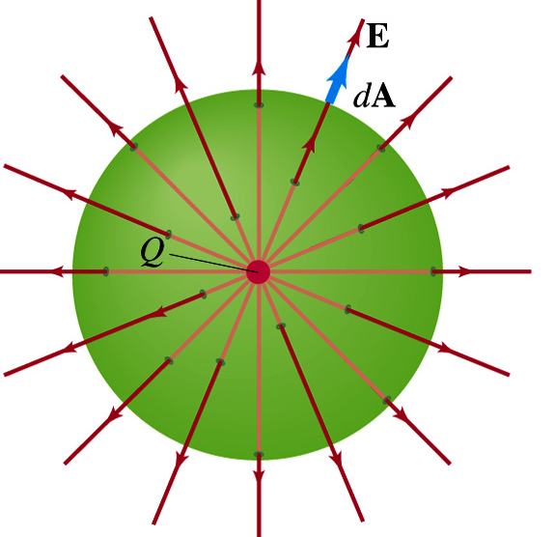
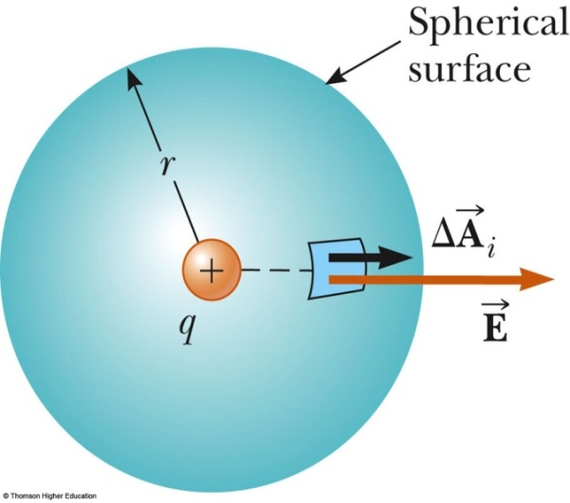
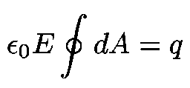
Example 24.4 The Electric Field Due to a Point Charge
Starting with Gauss’s law, calculate the electric field due to an isolated point charge q.
The field lines are directed radially outwards and are perpendicular to the surface at every point, so
The angle θ between E and dA is zero at any point on the surface, we can re-write Gauss’ Law as
E has the has same value at all points on the surface
E is can be moved out
Integral is the sum of surface area
A spherical Gaussian surface centered on a point charge q
Coulomb’s Law

Slide 4
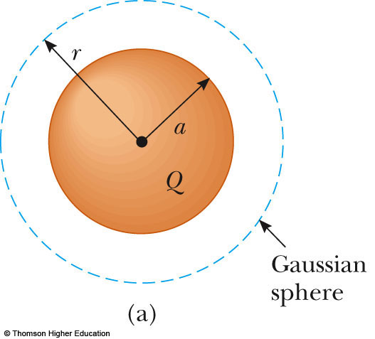
Example 24.5 A Spherically Symmetric Charge Distribution
An insulating solid sphere of radius a has a uniform volume charge density ρ and carries total charge Q.
Find the magnitude of the E-field at a point outside the sphere
Find the magnitude of the E-field at a point inside the sphere
For r > a

Slide 5
Now we select a spherical Gaussian surface with radius r < a. Again the symmetry of the charge distribution allows us to simply evaluate the left side of Gauss’s law just as before.
r
a
◆
The charge inside the Gaussian sphere is no longer Q. If we call the Gaussian sphere volume V’ then
Q
Volume charge density“: ρ = charge / unit volume is used to characterize the charge distribution
❖
⬥


Slide 6
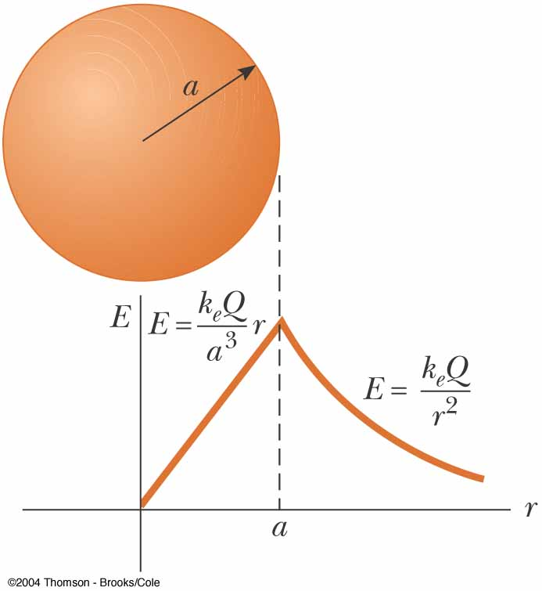

E = lim (K_{e} Q/r²) = K_{e} Q/a²
^{r a}
E = lim (K_{e} Q/a³)r ) = K_{e} Q/a³)a
^{r a}
Inside the sphere, E varies linearly with r (E → 0 as r → 0)
The value of the field is the same as we approach the surface from both directions.

Slide 7
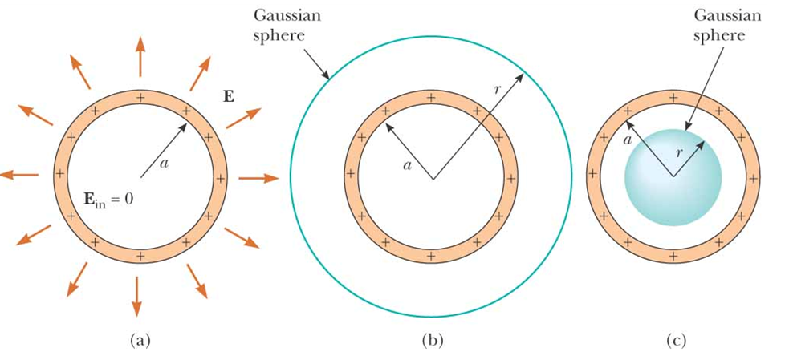
Example 24.6 The Electric Field Due to a Thin Spherical Shell
A thin spherical shell of radius a has a total charge Q distributed uniformly over its surface Find the electric field at points (A) outside and (B) inside the shell.

Slide 8
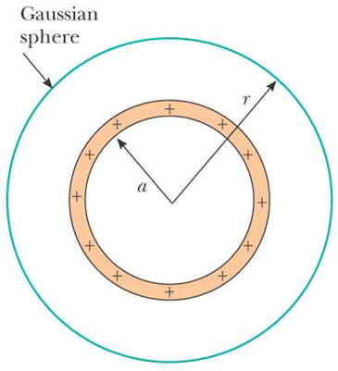
Let’s start with the Gaussian surface outside the sphere of charge, r > a
We know from symmetry arguments that the electric field will be radial outside the charged sphere
If we rotate the sphere, the electric field cannot change
Spherical symmetry
Thus we can apply Gauss’ Law and get
… so the electric field is

Slide 9
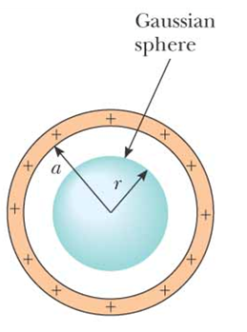
Let’s take the Gaussian surface inside the sphere of charge, r < a
We know that the enclosed charge is zero so
We find that the electric field is zero everywhere inside spherical shell of charge
Thus we obtain two results
The electric field outside a spherical shell of charge is the same as that of a point charge.
The electric field inside a spherical shell of charge is zero.

Slide 10
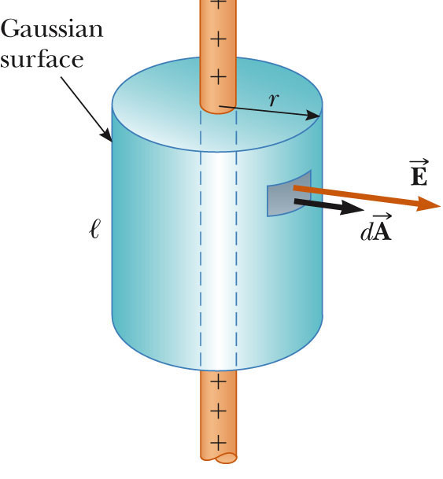
24-7 A Cylindrically Symmetric Charge Distribution
Find the E-field a distance r from a line of positive charge of infinite length and constant charge per unit length λ.
Symmetry ⇒ E field must be ⊥ to line and directed outward
Select a cylinder as Gaussian surface. The cylinder has a radius of r and a length of ℓ
is constant in magnitude and parallel to the surface (the direction of a surface is its normal!) at every point on the curved part of the surface (the body of the cylinder.

Slide 11
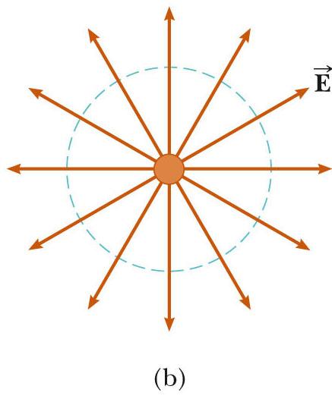
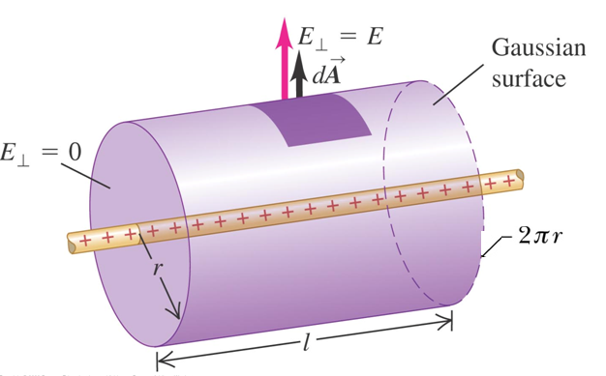
Line of Charge

Slide 12
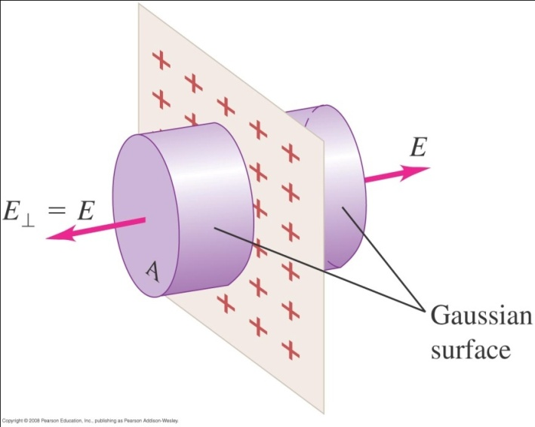
Example 24.8 A Plane of Charge
Find the electric field due to an infinite plane of positive charge with uniform surface charge density σ.
Assume that we have a thin, infinite non-conducting sheet of positive charge
The charge density in this case is the charge per unit area,σ
From symmetry, we can see that the electric field will be perpendicular to the surface of the sheet

Slide 13
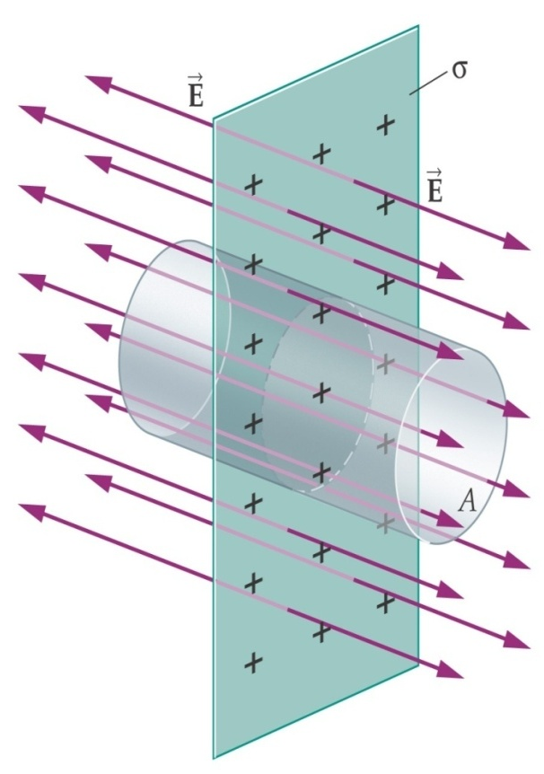
To calculate the electric field using Gauss’ Law, we assume a Gaussian surface in the form of a right cylinder with cross sectional area A and height 2r, chosen to cut through the plane perpendicularly.
Because the electric field is perpendicular to the plane everywhere, the electric field will be parallel to the walls of the cylinder and perpendicular to the ends of the cylinder.
Using Gauss’ Law we get
The distance from each flat end does not appear we conclude that at any distance
From the plane. The electric field is uniform everywhere

