Slide 1
4. Two protons in an atomic nucleus are typically separated by a distance of 2 × 10^{–15} m. The electric repulsion force between the protons is huge, but the attractive nuclear force is even stronger and keeps the nucleus from bursting apart. What is the magnitude of the electric force between two protons separated by 2.00 × 10^{–15} m?

Slide 3
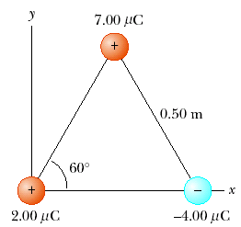
7.Three point charges are located at the corners of an equilateral triangle as shown in Figure. Calculate the resultant electric force on the 7.00-μC charge.

Slide 4
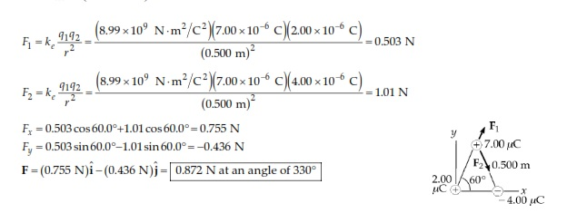

Slide 5
14. An object having a net charge of 24.0 μC is placed in a uniform electric field of 610 N/C directed vertically. What is the mass of this object if it “floats’’ in the field?

Slide 7
20. Two 2.00-μC point charges are located on the x axis. One is at x = 1.00 m, and the other is at x = –1.00 m. (a) Determine the electric field on the y axis at y = 0.500 m. (b) Calculate the electric force on a –3.00-μC charge placed on the y axis at y = 0.500 m.

Slide 9
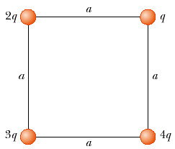
21. Four point charges are at the corners of a square of side a as shown in Figure P23.21. (a) Determine the magnitude and direction of the electric field at the location of charge q. (b) What is the resultant force on q?

Slide 11
42. An electron and a proton are each placed at rest in an electric field of 520 N/C. Calculate the speed of each particle 48.0 ns after being released.

Slide 12
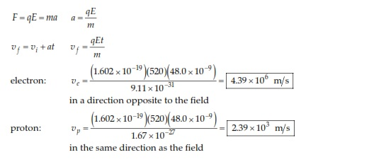

Slide 13
The electrons in a particle beam each have a kinetic energy K. What are the magnitude and direction of the electric field that will stop these electrons in a distance d?

Slide 14
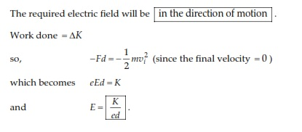

Slide 15
46. A positively charged bead having a mass of 1.00 g falls from rest in a vacuum from a height of 5.00 m in a uniform vertical electric field with a magnitude of 1.00 × 10⁴ N/C. The bead hits the ground at a speed of 21.0 m/s. Determine (a) the direction of the electric field (up or down), and (b) the charge on the bead.

